Slide 1
Project: IEEE P802.15 Working Group for Wireless Personal Area Networks (WPANs)
Submission Title: [Further Considerations of Advanced Channel Coding on 15.4ab]
Date Submitted: [10th March 2022]
Source: [Jiaqi Gu, Wei Lin, Xun Yang] Company [Huawei]
Address [Huawei base, Shenzhen, CHINA]
E-Mail:[lin.linwei@huawei.com]
Re: [Study Group 4ab: UWB Next Generation]
Abstract: [Further Considerations of Advanced Channel Coding on 15.4ab]
Purpose: []
Notice: This document has been prepared to assist the IEEE P802.15. It is offered as a basis for discussion and is not binding on the contributing individual(s) or organization(s). The material in this document is subject to change in form and content after further study. The contributor(s) reserve(s) the right to add, amend or withdraw material contained herein.
Release: The contributor acknowledges and accepts that this contribution becomes the property of IEEE and may be made publicly available by P802.15.

Slide 2
Technical Guidance
PAR Objective | Proposed Solution (how addressed)
Safeguards so that the high throughput data use cases will not cause significant disruption to low duty-cycle ranging use cases.
Interference mitigation techniques to support higher density and higher traffic use cases
Other coexistence improvement
Backward compatibility with enhanced ranging capable devices (ERDEVs).
Improved link budget and/or reduced air-time | New Channel Coding Schemes can provide improved link budgets and reduced air time
Additional channels and operating frequencies
Improvements to accuracy / precision / reliability and interoperability for high-integrity ranging;
Reduce complexity and power consumption;
Hybrid operation with narrowband signaling to assist UWB;
Enhanced native discovery and connection setup mechanisms;
Sensing capabilities to support presence detection and environment mapping;
Low-power low-latency streaming
higher data-rate streaming allowing at least 50 Mbit/s of throughput. | New Channel Coding Schemes with higher rates can support high data rate
Support for peer-to-peer, peer-to-multi-peer, and station-to-infrastructure protocols;
Infrastructure synchronization mechanisms.

Slide 3
Related Submissions
[1] 15-21-0506-02-04ab-Advanced Coding for Data Communications in 802.15.4ab, Aldana
[2] 15-21-0592-00-04ab-high-data-rates, Murray, et al
[3] 15-22-0050-00-04ab- Channel Coding Considerations for 802.15.4ab, Wei Lin, et al

Slide 4
Channel Coding Considerations – Overview [3]
As of today, IEEE 802.15.4z standard allows for data communication of small amounts of data with speed of a few tens of mbps.
  No Capacity-Approaching FEC codes (LDPC, Turbo, Polar, etc.) have been adopted yet
IEEE 802.15.4a employed a rate-1/2 convolutional code of K=3 (4 states) as well as an (63, 55) GF(2⁶) Reed-Solomon Code.
To further enhance the performance, 802.15.4z optionally introduced an standard rate-1/2 convolutional code of K=7 (64 states).
For 802.15.4ab, the needs for higher throughput as well as higher reliability have been discussed.
  Introduction of advanced coding has been discussed in [1], [2]，[3]

Slide 5
Channel Coding in 15.4ab
In [1], LDPC codes have been analyzed and suggested as an option for 802.15.4ab
The consideration of introducing new advanced coding schemes were discussed in [1][2][3]
  [1] proposed to include LDPC codes as an optional solution after an extensive comparison of Turbo, Polar, NR LDPC, and 802.11n LDPC codes
  [2] proposed to identify suitable candidate advanced codes for high-speed data, e.g., NR LDPC, 802.11n LDPC, candidates for Turbo and Polar codes, and possibly additional LDPC codes
  Power consumption at a given performance should be a central selection metric [2]
In this contribution, we further analyze Polar, LDPC, Turbo and CC codes in terms of computational complexity, error correcting capability (BLER performance) and power consumption.

Slide 6
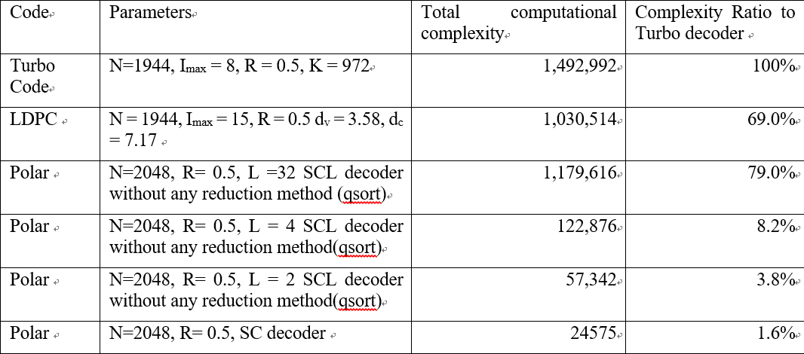
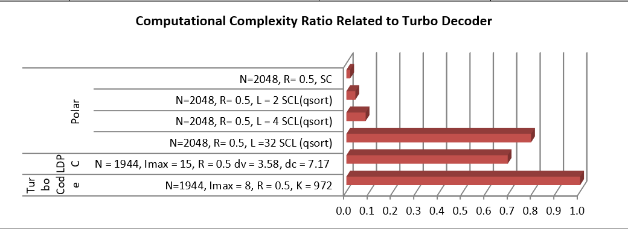
Channel Coding Consideration in 15.4ab
Complexity[1]
Code | Polar | LDPC | Turbo | TBCC
Complexity | SC: O(N*log2(N)) +O(N-1) SCL: O(L*N*log2(N))+O(N-1)+K* O(2*L*log2(2*L)) | Additions:Imax*O(2*N*dv + M*(2*dc-1)) Look up table operation: Imax*O(M*dc) | Addition:Imax*O(16*K*2m) Max operation: Imax*O(8*K*2m) | List Viterbi: 3*K*O(3*S+16) + K*O(2*S*L+16) + K*S*L
Note: SC: Successive Cancellation; SCL: Successive Cancellation with List
An example of computational complexity comparison between Turbo(N=1944), LDPC(N=1944) and Polar (N=2048).
Reference: 3GPP R1-164040 “On latency and complexity”
Notes:
Polar: LDPC Turbo TBCC
L is the list size M: number of parity bits m: memory length S: number of states
dv: average variable degree of LDPC parity check matrix Imax: iteration number m: memory length
dc: average check degree of LDPC parity check matrix L: list size
Imax: maximum iteration number

Slide 7
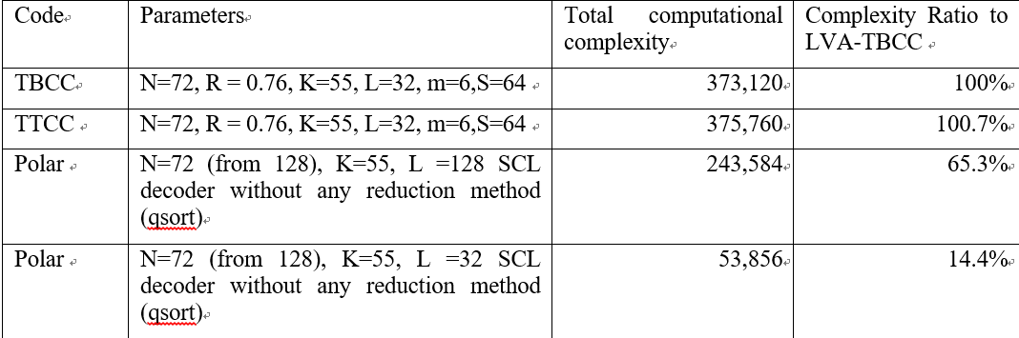
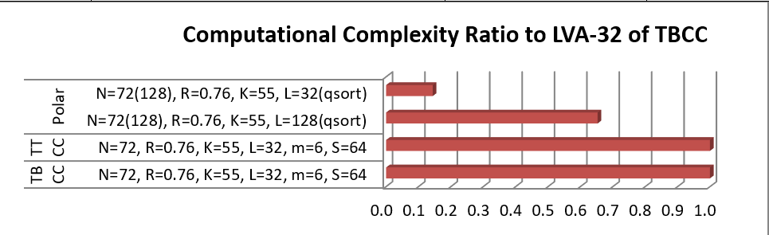
Channel Coding Consideration in 15.4ab
Complexity[1]
Another example of a short block length code between CC(N=72,R=0.76) and Polar(N=72 with mother code length 128).
Observations
Polar with SC decoder has a very low complexity，which makes it energy and area efficient for large block length
The complexities of both Polar & LDPC decoders are less than 80% of a Turbo decoder with 8 iterations
Reference: 3GPP R1-164040 “On latency and complexity”
Notes:
Polar: LDPC Turbo TBCC
L is the list size M: number of parity bits m: memory length S: number of states
dv: average variable degree of LDPC parity check matrix Imax: iteration number m: memory length
dc: average check degree of LDPC parity check matrix L: list size
Imax: maximum iteration number

Slide 8
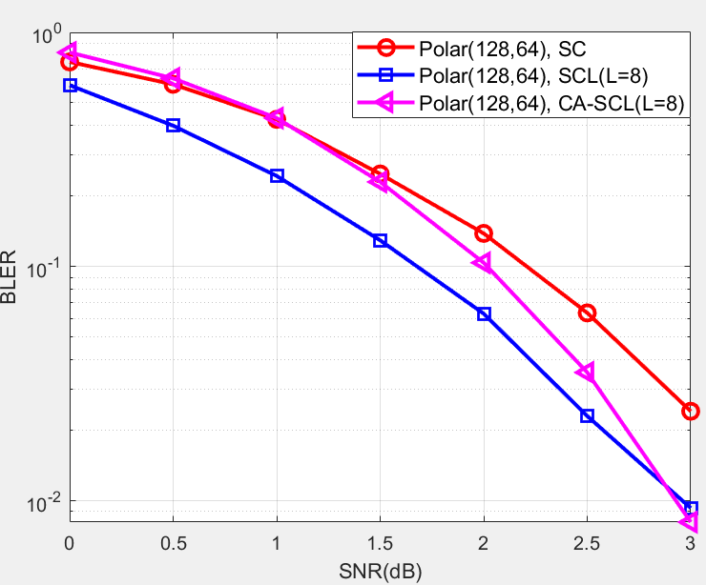
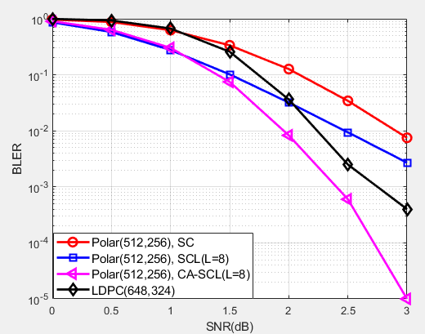
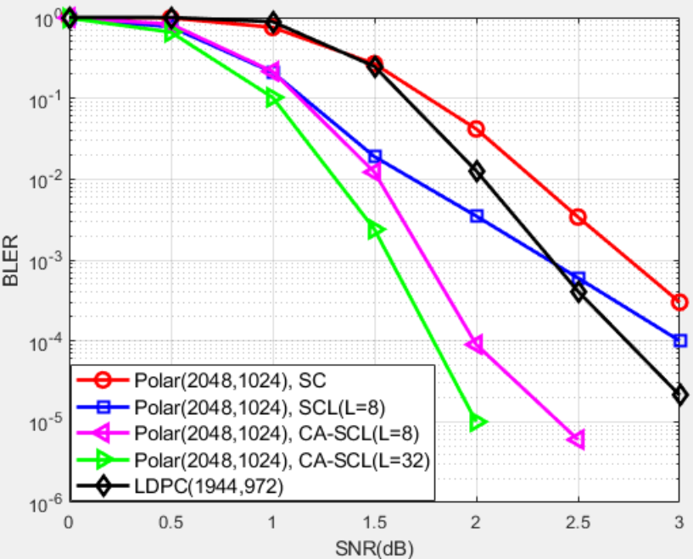
Channel Coding Consideration in 15.4ab
Error correcting capacity
Polar code performs very well at short codeword lengths, e.g., N = 128 bits
There are performance gaps between 11n LDPC and Polar codes, thus the performance of 802.11n LDPC codes need to be further enhanced, i.e., new LDPC codes

Slide 9
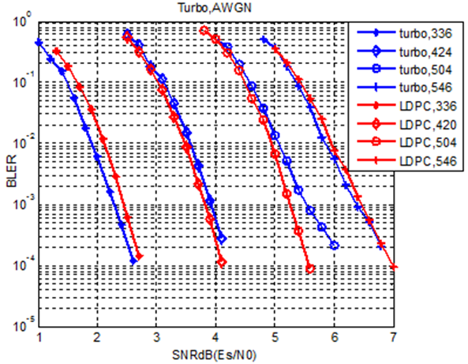
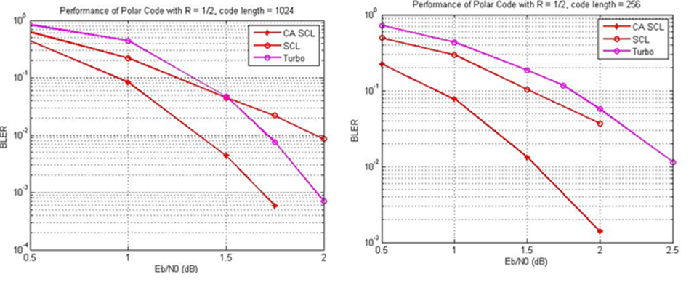
Channel Coding Consideration in 15.4ab
Error correcting capacity
Performance comparison between Polar, LDPC, and Turbo codes in AWGN, with several codeword lengths
Note: CA SCL means CRC-aided SCL
Polar codes with CA-SCL decoding outperforms turbo code up to around 1 dB, especially in the case of small packet sizes
LDPC codes can also outperform Turbo codes at short/medium lengths and medium/high rates
Reference: 3GPP R1-162230 “Discussion on channel coding for new radio interface”

Slide 10
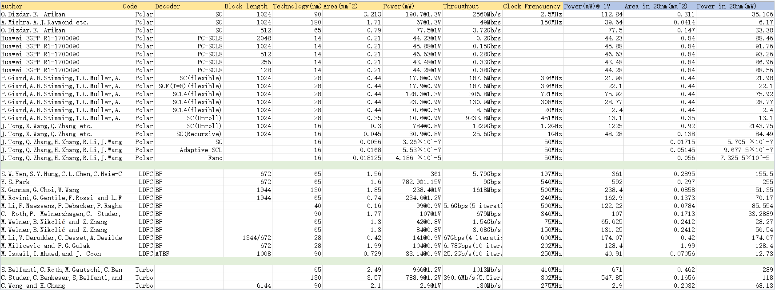
Channel Coding Consideration in 15.4ab
Power consumption
95.54mW
158.38mW
Suitable for scenario when high-throughput or low-latency is required
Assume power scales as s, where s is the technology feature size
Suitable for scenario when smaller chip size or lower energy consumption is required
Power consumption varies with architectures/design targets/criteria, but the power consumption of most polar & LDPC decoders are less than 100mW, while Turbo decoder requires relative higher power consumption

Slide 11
Channel Coding Consideration in 15.4ab
Candidate coding scheme comparison:
 | Polar | LDPC | Turbo | CC
Large Block(e.g. >8k) | Small-list decoder or SC decoder for good power and area efficiency | Good power/area efficiency Good performance only when code rate is higher than 1/2 | Low power/area efficiency | When the block length is large and code rate is smaller than 1/3, CC performance is poor
1k~8k blocks | Medium-List decoder for good performance for all rates, support various rates and lengths | Good performance Support a relative fine granularity of rates and lengths | Relative good performance Support a relative fine granularity of code rates and code lengths | When the block length is large and code rate is smaller than 1/3, CC performance is poor
Small block, ultra reliability | Large-List decoder for very good performance Support very low code rate | Not very good performance with small block and low code rates New LDPC needed | Poor performance with small block Error Floor HARQ required for high reliability | VA decoder has poorer performance than SCL Polar LVA decoder has much higher complexity than Polar List decoder.
Very Small block, low power consumption | Small-list decoder or SC decoder for low-power realization | Not very good performance with very small block New LDPC needed | Poor Performance with very small block | Viterbi Decoder for low-power realization; Performance is worse than SCL decoder
Reference: 3GPP R1-164039 “Polar codes - encoding and decoding”

Slide 12
Channel Coding Consideration in 15.4ab
Candidate coding considerations in 15.4ab
Both Polar and LDPC codes can achieve a decoding power consumption of <100mW
No error floor exists for polar code, as list size increases, non-saturated performance is maintained, which is affordable by the ever-developing ASIC technology
LDPC codes are widely adopted by various standards, and perform well at long code lengths, so they also should be considered
The performance of 802.11n LDPC Codes need to be further enhanced, i.e., new LDPC codes
When the block length is small, the LTE-Turbo code performance degrades

Slide 13
Summary
Both Polar and LDPC codes should be considered for 802.15.4ab
The performance of 802.11n LDPC Codes need to be further enhanced, i.e., new LDPC codes

Slide 14
Thank You

