Slide 1
Project: IEEE P802.15 Working Group for Wireless Speciality Networks (WSN)
Submission Title: Proposal of channel plans of terahertz radio for the 3ma after WRC19
Date Submitted: 1st March 2022
Source: Iwao Hosako, Akifumi Kasamatsu, Norihiko Sekine, and Hiroyo Ogawa, NICT, JAPAN
Address 4-2-1 Nukui-kitamachi, Koganei, Tokyo, 184-8795, Japan
Voice:+81423276508, FAX: +81423276941, E-Mail: hosako@nict.go.jp
Re: n/a
Abstract: Draft channel plan for 3ma: Review of channel plan for 3d in response to WRC19 results
Purpose: Proposal of channel plans of terahertz radio for discussion in 3ma
Notice: This document has been prepared to assist the IEEE P802.15. It is offered as a basis for discussion and is not binding on the contributing individual(s) or organization(s). The material in this document is subject to change in form and content after further study. The contributor(s) reserve(s) the right to add, amend or withdraw material contained herein.
Release: The contributor acknowledges and accepts that this contribution becomes the property of IEEE and may be made publicly available by P802.15.

Slide 2
Proposal of channel plans of terahertz radio after WRC19
Iwao Hosako (NICT), et.al.

Slide 3
Agenda
Background: Frequency Band Extension
Basic ideas and Exceptions
Re-numbering of Channel IDs

Slide 4
Background: Frequency Band Extension
Frequency Bands:
IEEE Std. 802.15.3d-2017 covers the frequency band from 252 to 321 GHz
At WRC 2019 additional frequency bands beyond 275 GHz (275-296 GHz, 306-313 GHz, 318-333 GHz, 356-450 GHz) have been identified for the use by Land Mobile Service (LMS) and Fixed Service (FS)
Of specific interest are 94 GHz contigous spectrum between 356 and 450 GHz, which may be used especially for short-range applications
→ The frequency bands 356 to 450 GHz should be included in 15.3

Slide 5
Basic ideas and exceptions
[Basic Ideas]
A simple extension of the 3d channel plan. That is, eight bandwidth channels(2.16 GHz, 4.32 GHz, 8.64 GHz, 12.96 GHz, 17.28 GHz, 25.92 GHz, 51.84 GHz, 69.12 GHz ) will be arranged starting from 321.84 GHz.
Below 450 GHz also includes bands not identified in WRC19 for LMS and FS (296 - 306 GHz, 313 - 318 GHz, 333 - 356 GHz), but they are not considered when considering the 3ma-channel plans because those bands may change in the future.
The channel ID in the 3d channel plan will not change. Newly added channels are assigned a new ID in order of narrowest bandwidth and lowest center frequency.

Slide 6
Basic ideas and Exceptions
[Exception-1]
Add a 34.56 GHz-bandwidth channel starting at 252.72 GHz
Therefore, we propose to assign the following five 34.56 GHz-bandwidth channels.
The five channels are 252.72 - 287.28 GHz, 287.28 - 321.84 GHz, 321.84 - 356.40 GHz, 356.40 - 390.96 GHz, and 390.96 - 425.52 GHz.
Reasons for the exception-1
The 3d standard have not assigned channels having 34.56 GHz bandwidth, which is twice as wide as 17.28 GHz.
Furthermore, a bandwidth of 34.56 GHz is suitable for realizing a 50 Gbps transmission rate by QPSK.
A 50 Gbps transmission rate is required for one of the specifications for 8K video transmission (8K60P).

Slide 7
Basic ideas and Exceptions
[Exception-2]
Remove a 69.12 GHz-bandwidth channel starting at 321.84 GHz
Add a 69.12 GHz-bandwidth channel starting at 356.40 GHz
Reasons for the exception-2
The 69.12 GHz-bandwidth channels starting at 321.84 GHz overlap with the bands not identified for LMS and FS in WRC19.
In WRC19, 94 GHz width from 356-450 GHz was identified for LSM and FS. Therefore, a 69.12 GHz-bandwidth channel can be configured in it.
At 356.40 GHz, the channel ends are all aligned except for the 69.12 GHz-bandwidth channel.

Slide 8
Re-numbering of Channel IDs
[Same content as shown in Basic Ideas]
The channel ID in the 3d channel plan will not change.
Newly added channels are assigned a new ID in order of narrowest bandwidth and lowest center frequency.

Slide 9
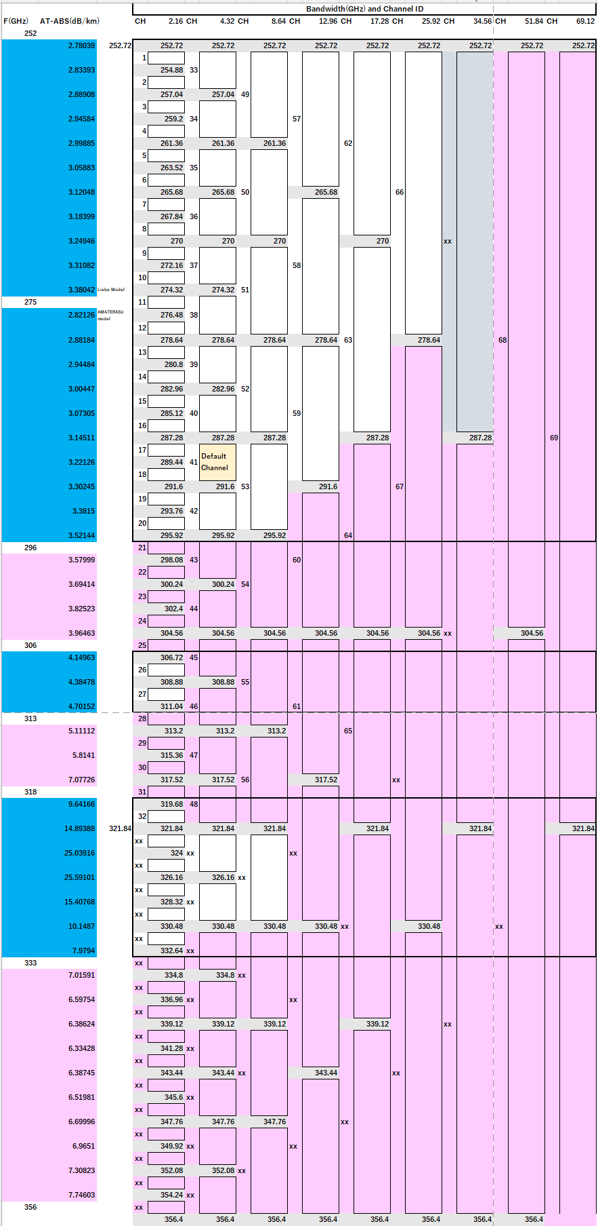
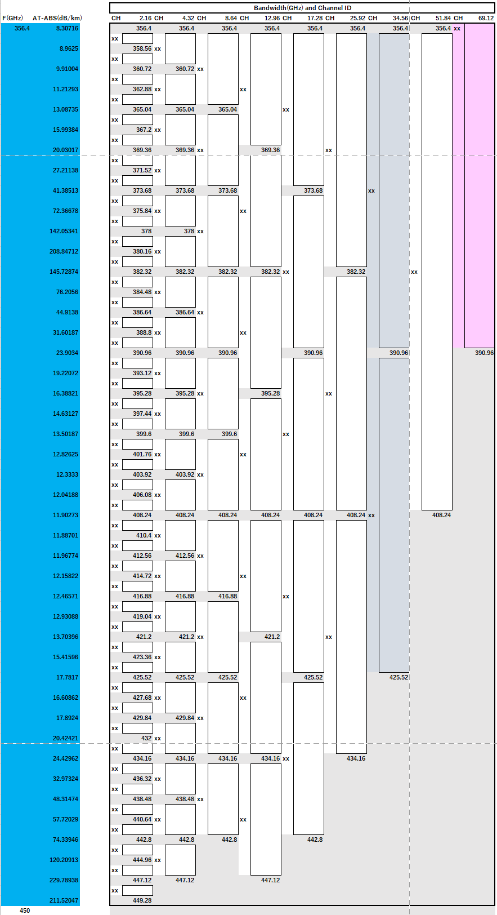
[Proposed channel plan (excluding 69.12GHz width)]
Blue color indicates areas identified as LSM and FS in WRC19.
Pink indicates areas not identified in WRC19 for LSM and FS and the associated affected channels.
Blue-gray indicates the newly proposed 34.56 GHz channels.

