Slide 1
Project: IEEE P802.15 Working Group for Wireless Specialty Networks (WSN)
Submission Title: Wireless Next Generation Closing Report
Date Submitted: 26 January 2022
Source: Benjamin A. Rolfe (Blind Creek Associates)
Contact:
Voice: +1 408 395 7207, E-Mail: ben.rolfe @ ieee.org
Re: Wireless Next Generation Standing Committee
Abstract: Closing Report for the January 2022 WNG meeting
Purpose: Report on the WNG meeting and for other purposes
Notice: This document has been prepared to assist the IEEE P802.15. It is offered as a basis for discussion and is not binding on the contributing individual(s) or organization(s). The material in this document is subject to change in form and content after further study. The contributor(s) reserve(s) the right to add, amend or withdraw material contained herein.
Release: The contributor acknowledges and accepts that this contribution becomes the property of IEEE and may be made publicly available by P802.15.
Notes:
Jul 12, 2010
Page 1

Slide 2
January 2022 Wireless Interim
Virtual Session
Closing Report

Slide 3
Summary
TG 12 concepts and future (Kinney)
Collaboration with 802.1 report (Rolfe)
Future planning

Slide 4
Links
Meeting Slides: https://mentor.ieee.org/802.15/dcn/22/15-22-0054-01-wng0-january-wng-meeting-slides.pptx

Slide 5
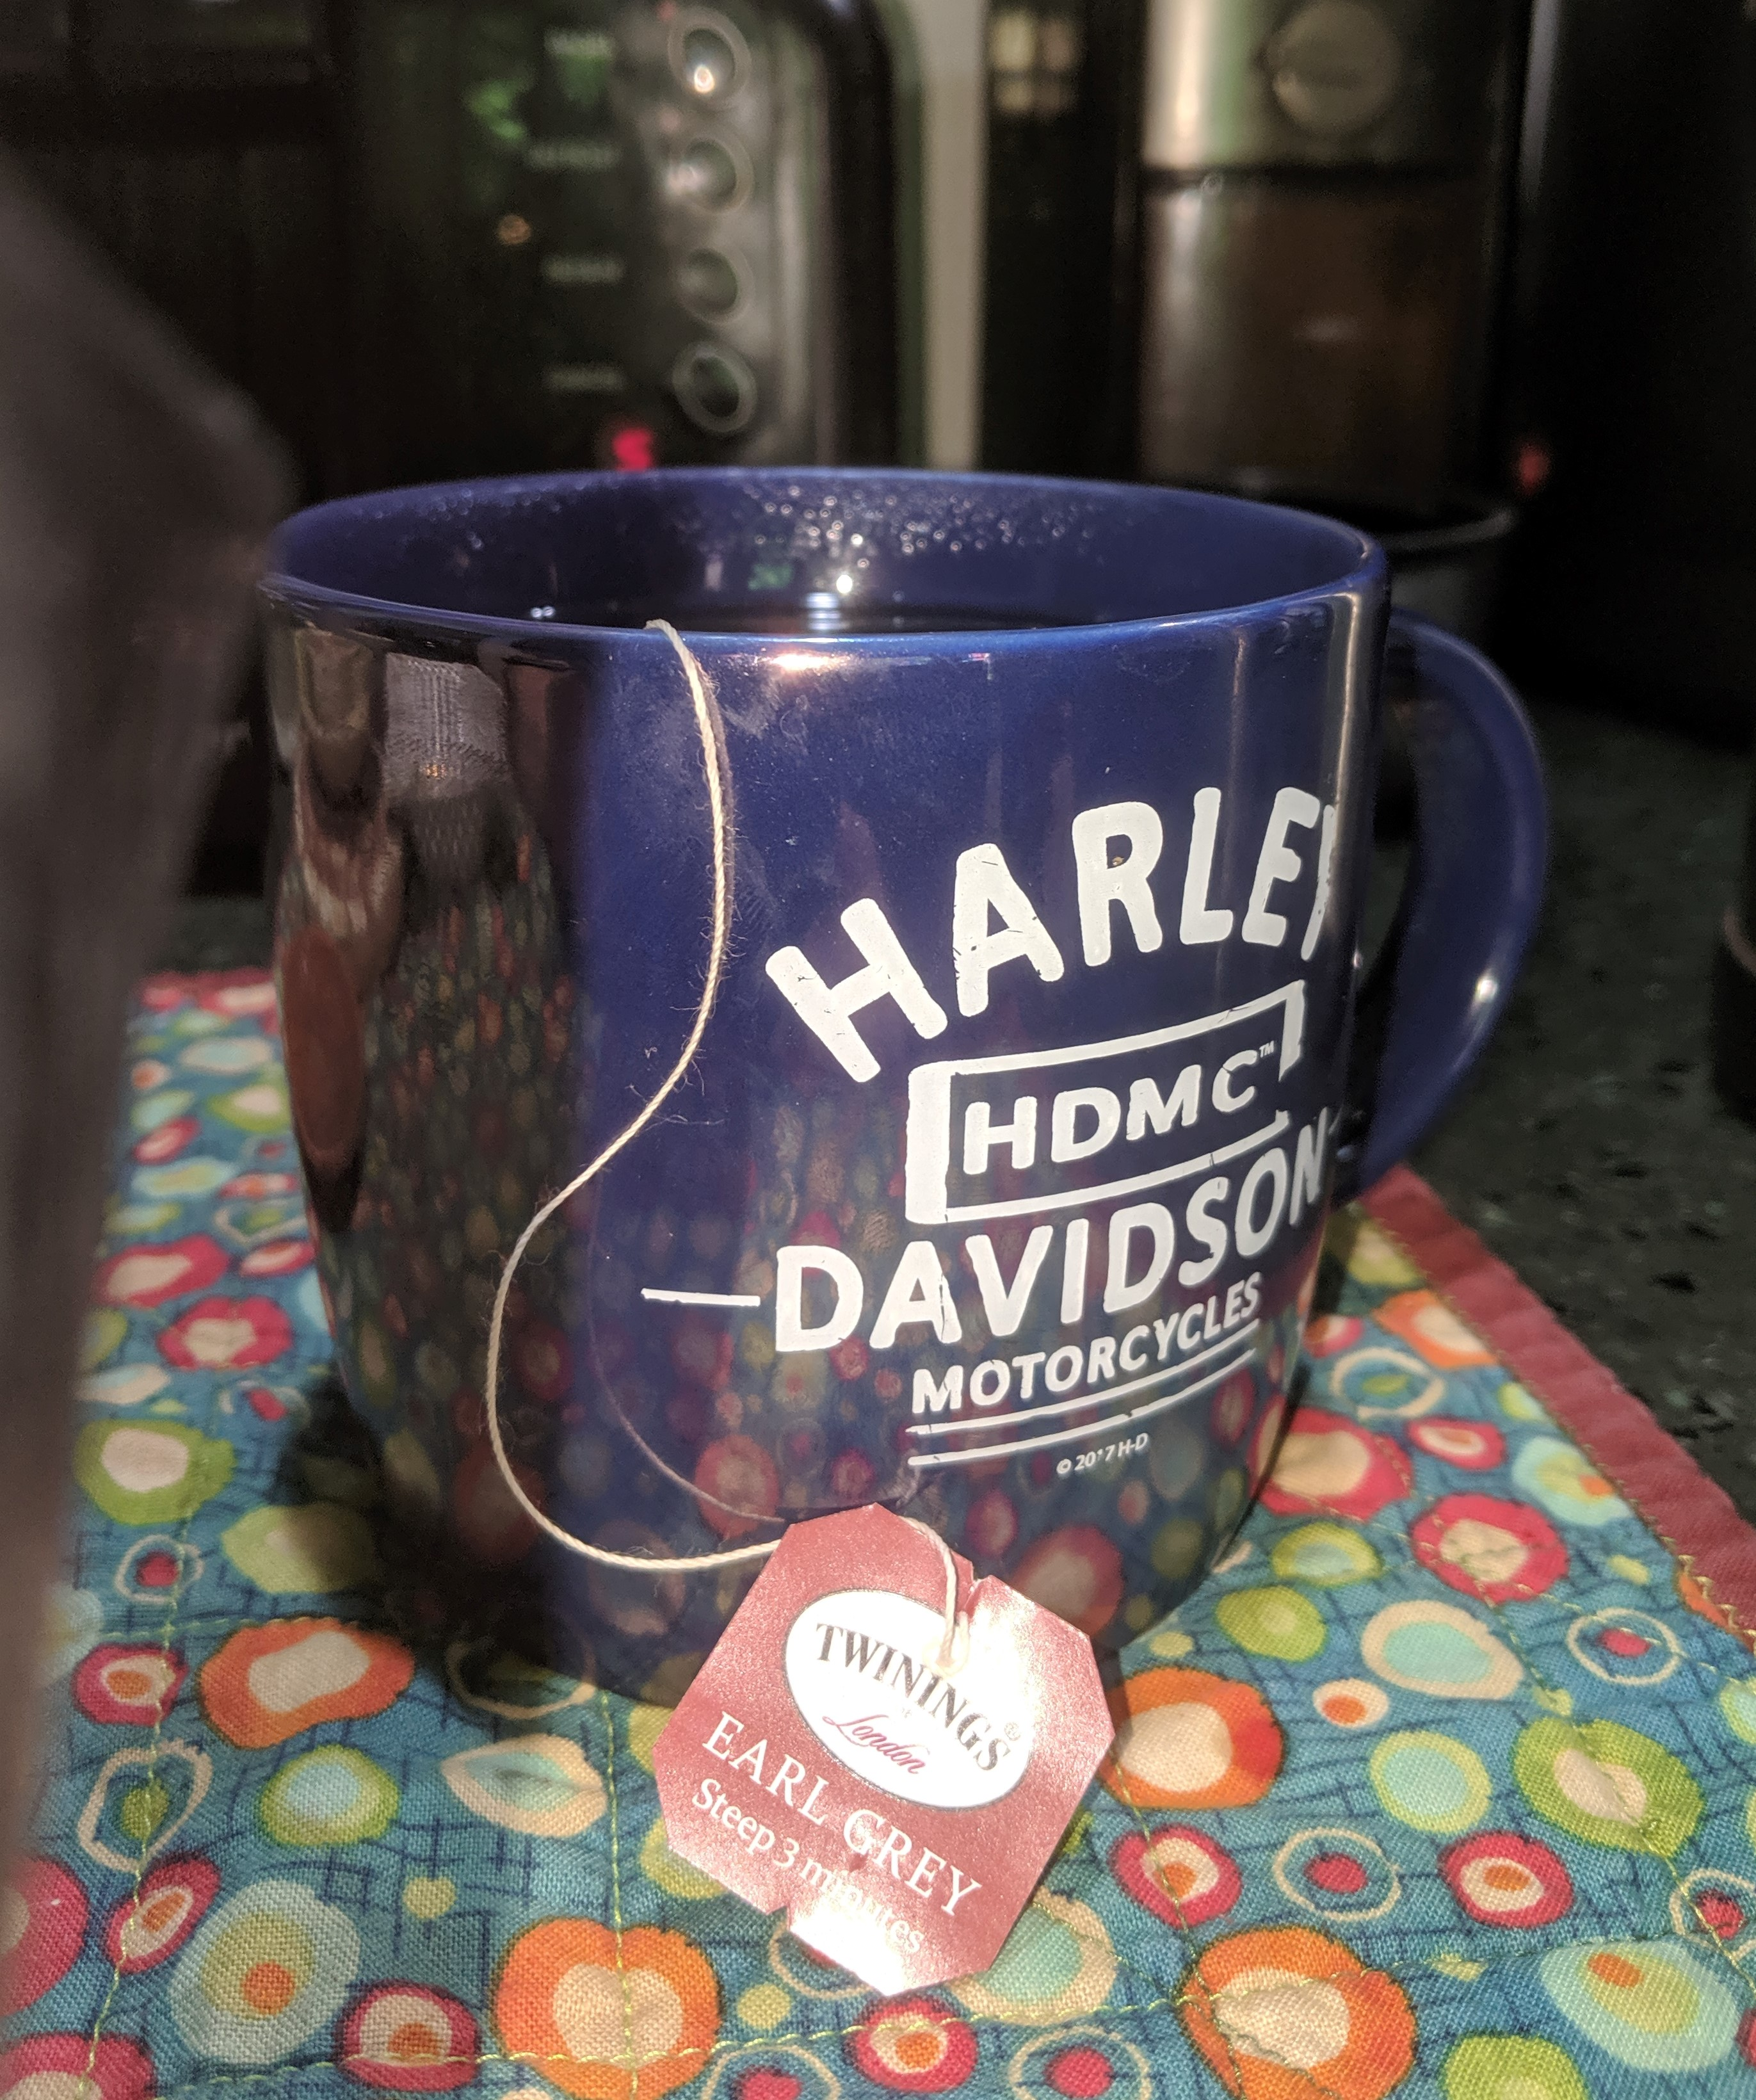
The usual question
What do you propose the Working Group do next?

Slide 6
Concepts from TG12
Consider the work done and apply the parts that are relevant today
Consider as part of the collaboration with 802.1

Slide 7
Summary Questions
What should WG15 members do with this information?
Consider the following questions and bring your thoughts to the joint 802.15/802.1 Effort
We have the experts on 802.15 standards and how they are used in the real world
The key questions:
What features make sense for 802.15 family of wireless media?
What are the barriers to using 802.1 features?
What are considered “essential to be called 802.1 compliant”?

Slide 8
Future Planning
IEEE 802 Tech Talks
Consider topics for future tech talks to showcase specific work
Bring ideas to WNG

Slide 9
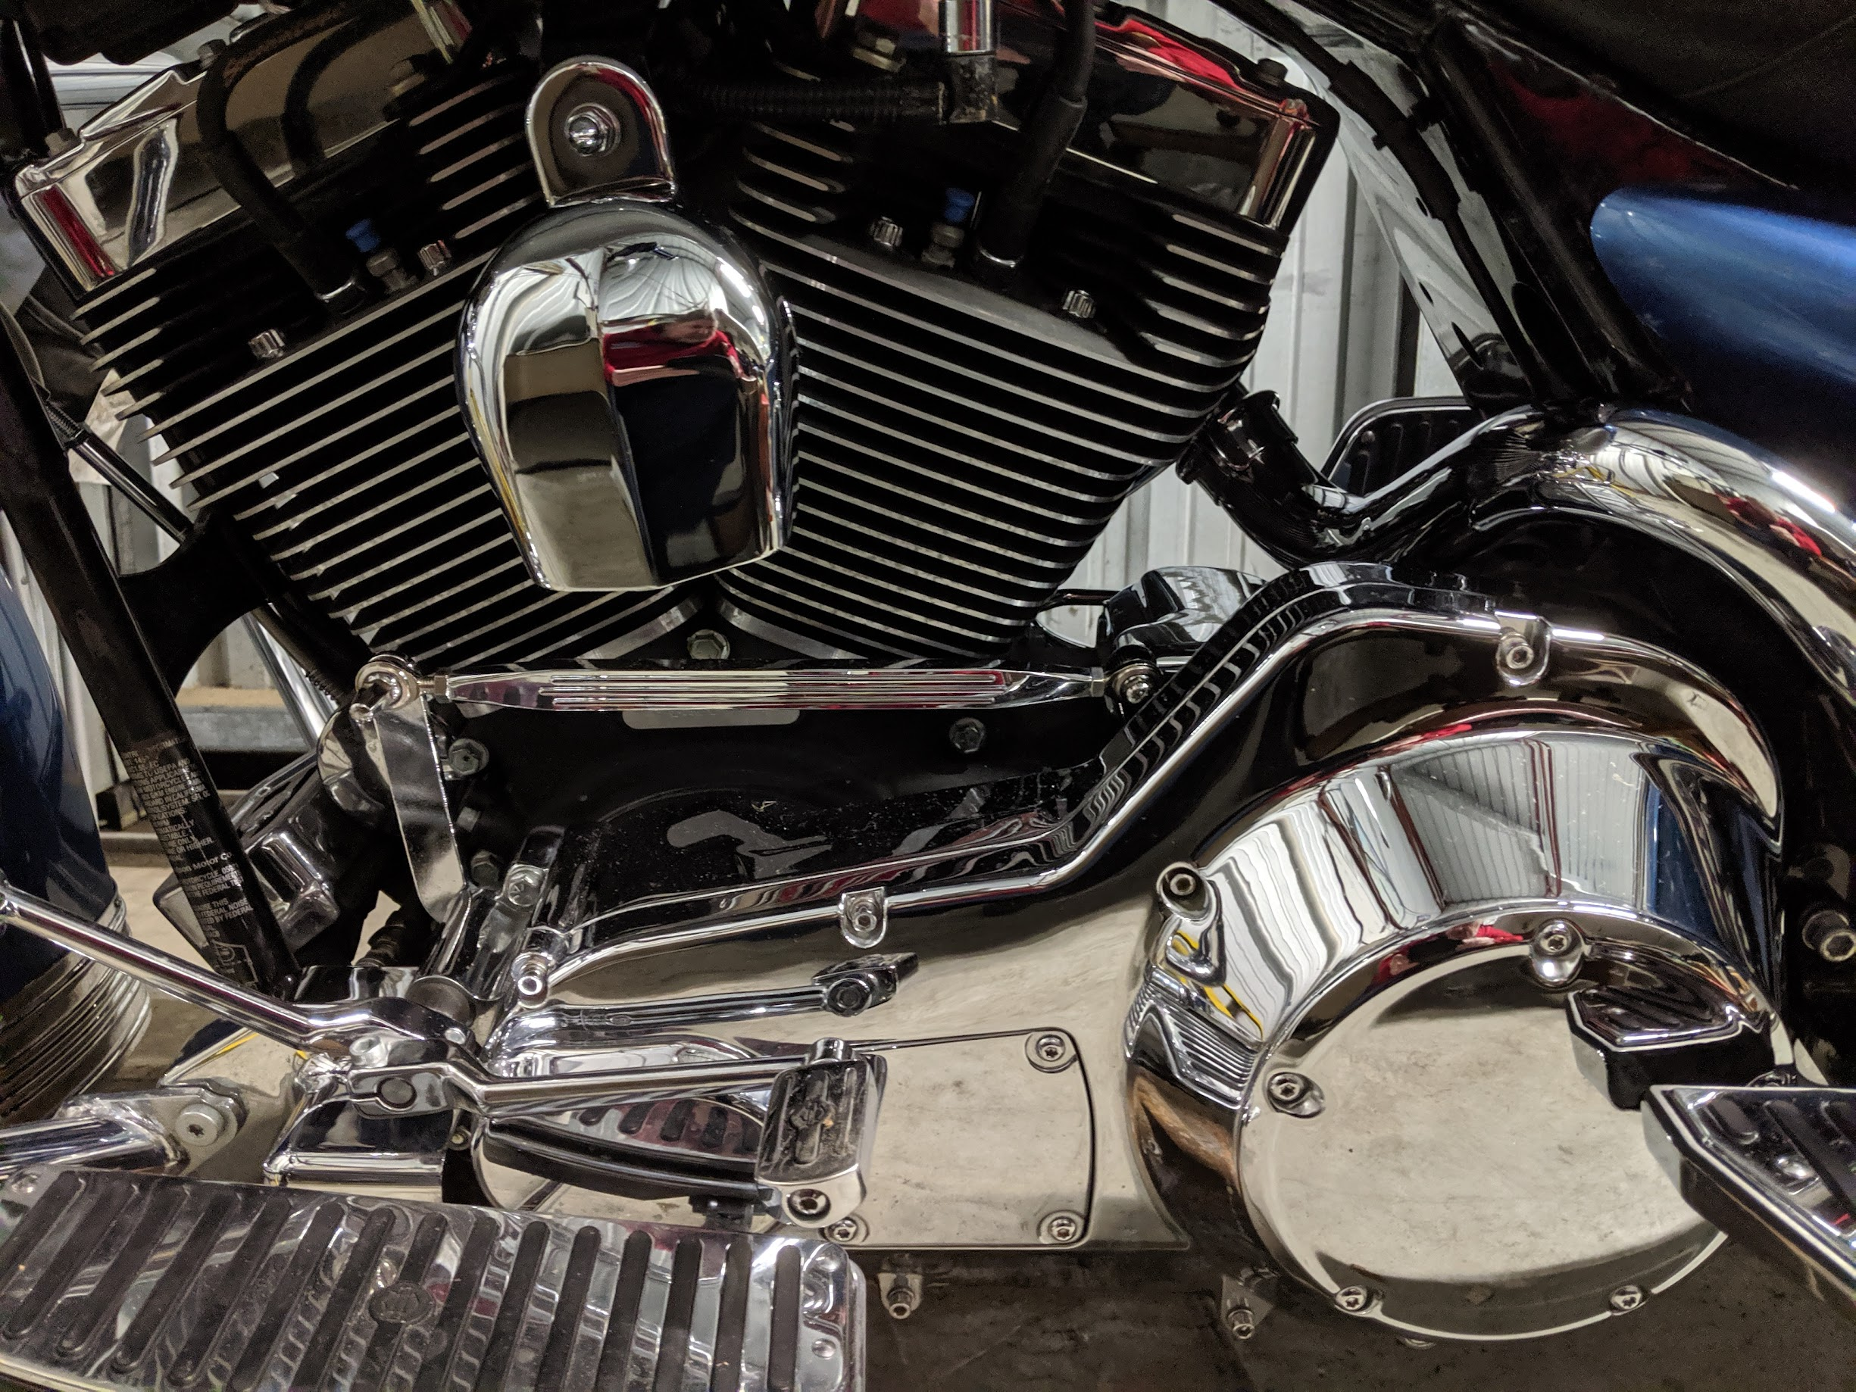
Thanks!
Something Shiny to look at while mingling

