Slide 1
Project: IEEE P802.15 Working Group for Wireless Personal Area Networks (WPANs)
Submission Title: Link budget analysis UWB vs NB
Date Submitted: 25 January 2022
Source: Michael McLaughlin (Qorvo Inc.)
Address: Adelaide Chambers, Peter St., Dublin 8, Ireland
E-Mail: michael.mclaughlin at qorvo.com
Abstract: Link budget analysis of both UWB and Narrowband.
Purpose: To compare link budgets.
Notice: This document has been prepared to assist the IEEE P802.15. It is offered as a basis for discussion and is not binding on the authoring individual(s) or organization(s). The material in this document is subject to change in form and content after further study. The authors(s) reserve(s) the right to add, amend or withdraw material contained herein.
Michael McLaughlin (Qorvo Inc.)

Slide 2
PAR Objective | Proposed Solution (how addressed)
Safeguards so that the high throughput data use cases will not cause significant disruption to low duty-cycle ranging use cases
Interference mitigation techniques to support higher density and higher traffic use cases
Other coexistence improvement
Backward compatibility with enhanced ranging capable devices (ERDEVs)
Improved link budget and/or reduced air-time | Proposes using a short, low bit rate, high PRF, UWB packet instead of a NB packet
Additional channels and operating frequencies
Improvements to accuracy / precision / reliability and interoperability for high-integrity ranging
Reduced complexity and power consumption
Hybrid operation with narrowband signaling to assist UWB
Enhanced native discovery and connection setup mechanisms
Sensing capabilities to support presence detection and environment mapping
Low-power low-latency streaming
Higher data-rate streaming allowing at least 50 Mbit/s of throughput
Support for peer-to-peer, peer-to-multi-peer, and station-to-infrastructure protocols
Infrastructure synchronization mechanisms
Michael McLaughlin (Qorvo Inc.)

Slide 4
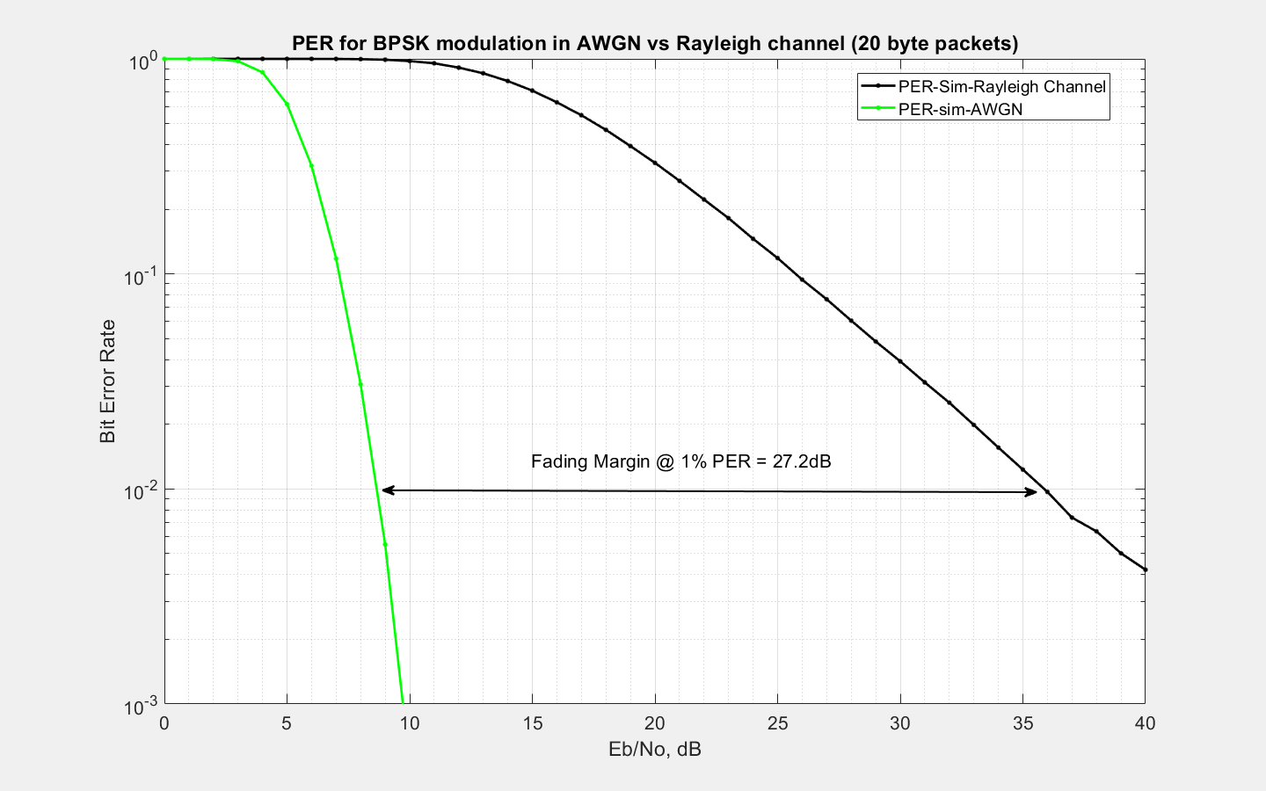
Flat Fading loss (Rayleigh fading)

Slide 5
Discussion
Throughput/Bandwidth/Fading:
  250kbps in 2MHz channel has redundancy so fading is better than for BT LE (27dB). I have used the 17dB figure from Apple’s simulations
  UWB with 3.4Mbps in 500MHz BW has massive redundancy so highly resistant to fading
Tx power: Although regulations permit +14dBm, most NB transmitters use +3dBm or less in order to limit power consumption. I have used +5dBm here for the NB radios.
Michael McLaughlin (Qorvo Inc.)

Slide 6
Discussion cont.
PRF: Previous submissions have used 64MHz BPRF for UWB link margin calculations. For short packets, using 256MHz, gives 4 times as many pulses per bit giving a Link Margin gain of 6dB
  In order to meet the 37nJ per 1ms regulations limit, the UWB power needs to be backed off by 2.4dB giving -1.7dBm transmit power
  Compare this to Doc 15-22-0074 which uses -7.8dBm
Michael McLaughlin (Qorvo Inc.)

Slide 7
Conclusion
We can see from slide 3 that UWB at 3.4Mbps with 256MHz PRF has a 4dB link margin advantage over a narrow band radio.
For very long range, rather than use a NB radio to assist the UWB packets, it would be better to initiate the link with a short, low bit rate, high PRF, UWB packet
Maybe we only need one radio?
Michael McLaughlin (Qorvo Inc.)

