Slide 1
Project: IEEE P802.15 Working Group for Wireless Specialty Networks
Submission Title: Summary of Channel and Environmental Modeling Activities for BANs on TG15.6ma
Date Submitted: July 13th, 2022
Source: Takumi Kobayashi, Minsoo Kim, Marco Hernandez, Ryuji Kohno
Company: (1)Yokohama National University (2) YRP International Alliance Institute
Address: (1)79-5 Tokiwadai, Hodogaya-ku, Yokohama, 240-8501 Japan,
(2) YRP1 Blg., 3-4 HikarinoOka, Yokosuka-City, Kanagawa, 239-0847 Japan
Voice:[+81-90-5408-0611] E-Mail:[minsoo@minsookim.com, kobayashi-takumi-ch@ynu.ac.jp, marco.hernandez@ieee.org, kohno@ynu.ac.jp, Kohno@yrp-iai.jp]
Re: In response to call for technical contributions
Abstract: This provides draft of channel and environmental model and its classification for vehicle body area network(VBAN) of amendment of IEEE802.15.6-2012 for wireless body area network(BAN) with enhanced dependability.
Purpose: Material for discussion in P802.15.6ma TG corresponding to comments in EC Meeting
Notice: This document has been prepared to assist the IEEE P802.15. It is offered as a basis for discussion and is not binding on the contributing individual(s) or organization(s). The material in this document is subject to change in form and content after further study. The contributor(s) reserve(s) the right to add, amend or withdraw material contained herein.
Release: The contributor acknowledges and accepts that this contribution becomes the property of IEEE and may be made publicly available by P802.15.

Slide 2
Summary of Channel and Environmental Modeling Activities for BANs on TG15.6ma
Takumi Kobayashi ^{(1,2)}, Marco Hernandez ⁽²⁾, Minsoo Kim ⁽²⁾, Ryuji Kohno^{(1,2)}
⁽¹⁾Yokohama National University,
⁽²⁾YRP-International Ariane Institute

Slide 3
This presentation is a summary of 3 documents below.
Channel and Environmental Models of Human and Vehicle Body Area Network,
doc.# 15-21-0244-06-006ma
Channel and Environmental Models Classification for Vehicle Body Area Network on TG15.6ma,
Doc.# 15-21-0560-01-006ma
Dynamic Channel and Environmental Modeling Scheme for BANs on TG15.6ma,
Doc.# 15-22-0023-00-006ma

Slide 4
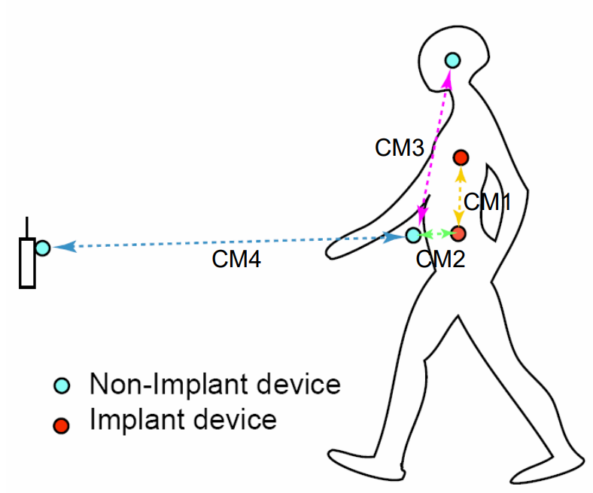
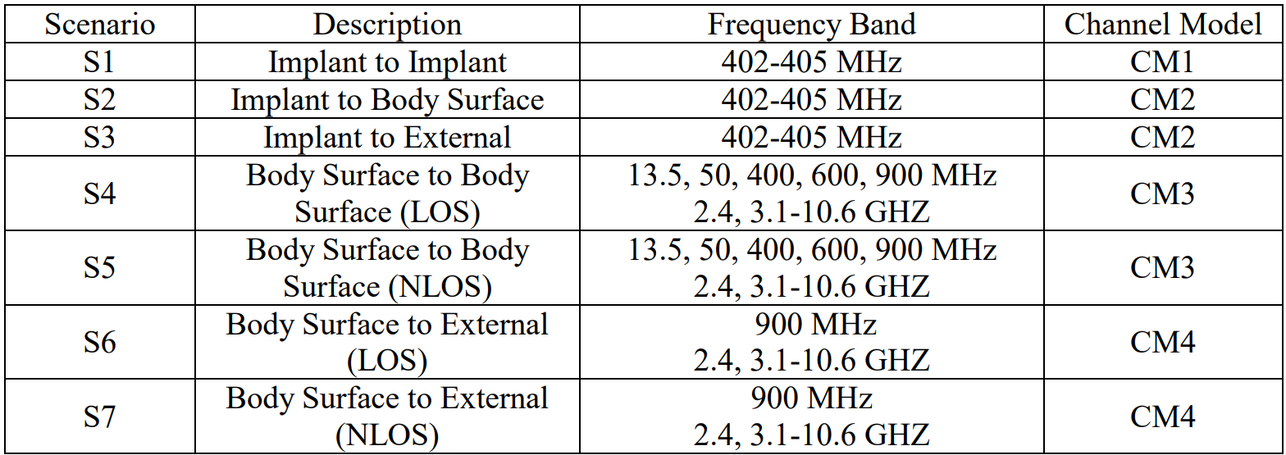
Channel models and scenarios in IEEE802.15.6-2012
IEEE P802.15-08-0780-12-0006-TG6
IEEE 802.15.6-2012 channel models considered
Fading ( Small scale/ large scale)
Path loss
Shadowing
Power delay profile
In-body (implant)
On-body (body surface)
CM1, 2, 3, 4
Scenario 1, to Scenario 7. (S1 – S7)

Slide 5
Channel models and scenarios in IEEE802.15.6ma
Scenario | Description | Frequency Band | Channel Model
S1 | Implant to Implant | 402-405 MHz, 3.1-10.6 GHz UWB | CM1
S2 | Implant to Body Surface | 402-405 MHz, 3.1-10.6 GHz UWB | CM2
S3 | Implant to External | 402-405 MHz, 3.1-10.6 GHz UWB | CM2
S4 | Body Surface to Body Surface (LOS) | 400, 600, 900 MHz 2.4, 3.1-10.6 GHz | CM3
S5 | Body Surface to Body Surface (NLOS) | 400, 600, 900 MHz 2.4, 3.1-10.6 GHz | CM3
S6 | Body Surface to External (LOS) | 900 MHz 2.4, 3.1-10.6 GHz | CM4
S7 | Body Surface to External (NLOS) | 900 MHz 2.4, 3.1-10.6 GHz | CM4
Specific use cases
Implant to Body Surface for BCI | Implant to Body Surface for BCI
Implant to External for BCI | Implant to External for BCI
Body Surface to External for BCI | Body Surface to Body Surface for BCI
Implant to body surface for capsule endoscopy | Implant to External capsule endoscopy
Need to discuss standard antenna issues.
Fading ( Small scale/ large scale)
Path loss
Shadowing
Power delay profile
In-body (implant)
On-body (body surface)
In-body (BCI)
On-body (BCI)
capsule endoscopy

Slide 6

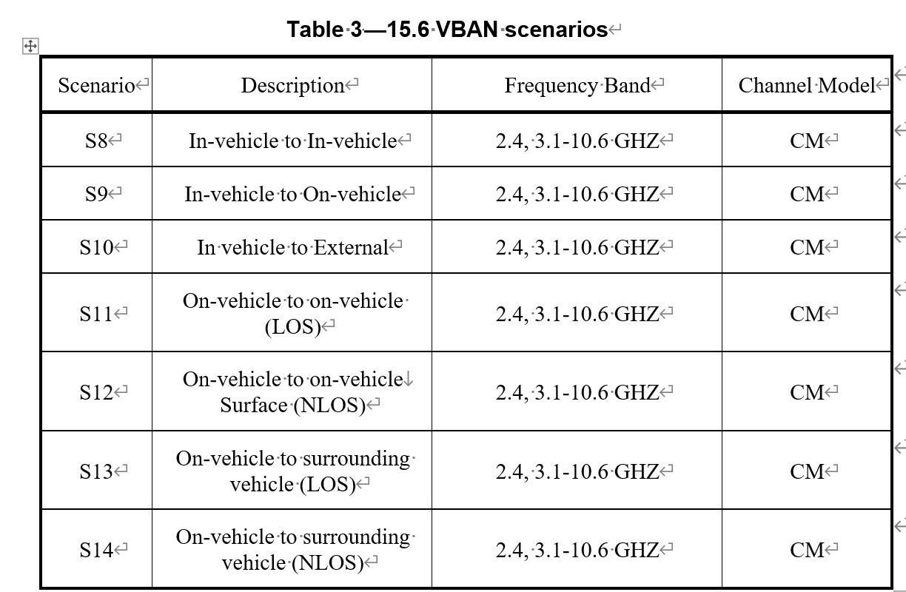
Channel models and scenarios in IEEE802.15.6ma
S11: On-vehicle to on-vehicle (LOS)
S13: On-vehicle to surrounding vehicle (LOS)
S12: On-vehicle to on-vehicle (NLOS)
S9: On-vehicle to in- vehicle
S10: In-vehicle to external
S8: In-vehicle to In-vehicle
S14: On-vehicle to surrounding vehicle (NLOS)

Slide 7
Classification of Channel and Environment Models for Human and Vehicle Body Area Networks (HBAN&VBAN)
Channel model
※Covered by
IEEE 802.15.6-2012
HBAN model
In-body (Implant)
※
On-body
※
Channel model
With environment
Around body
Outdoor
※Around means;
Desk, WiFi AP in the room etc.
Indoor
※
Home
Implanted BCI model
Office
※
On skull BCI model
Medical (e.g. Hospital)
※
capsule endoscopy
※not covered in 2012
VBAN model
In-vehicle
Engine compartment
Note:
HBAN-model:
-Environment with co-existing systems is not considered.
VBAN model:
Key-less entry system
Localization in-body, on-body
Most dominant model should be defined and separatory defined as Mandatory and Optional.
Cabin
Through Engine compartment and cabin
On-vehicle
Roof
Around vehicle
Side Right/Left/Front/back
Bottom
Static vehicle
Moving vehicle

Slide 8
From 15.6-2012
From 15.4a
From 15.4ab
Channel model
Marco san provided
15.8
Large scale fading
Small scale fading
Path loss
UWB Channel model
15.4 Indoor residential
Shadowing
15.4a Indoor residential
Simulation methodology
HBAN
Channel model
VBAN
Channel model
HBAN
Channel model
VBAN
Channel model
In-body
In-vehicle
On-body
On-vehicle
Surrounding body
Surrounding vehicle
In-body
In-vehicle
On-body
On-vehicle
15.4 outdoor
Surrounding body
Surrounding vehicle
15.4 outdoor

Slide 9
Channel and Environmental Models
Environment model
※will be defined in this amendment
Channel model
Environment model
Channel model
Path loss
Reflection
Multipath
Fading
LOS / NLOS model
White Gaussian noise
Interference from co-existing wireless systems
e.g. Bluetooth, IEEE 802.11, IEEE 802.15.4 etc.
Interference from the other BANs.
Interference from the other electric systems, devices and components (Electro-magnetic interference; EMI from electric motors, spark plugs in vehicles, etc.
Electro-magnetic compatibility; EMC. Possibility to affect to the other systems and human body.
VBAN ⬄ HBAN interference
VBAN and HBAN ⬄ Vehicle control and human body impacts.
Colored noise (Impulse noise, spike noise, ignition noise etc.)
Time-varying channel and interference modeling (Statistic, non-static, pseudo static model)
※IEEE802.15.6-2012
Other wireless systems
EMI EMC
Colored noise
Time-varying modeling
※mandatory
※optional
※mandatory
※mandatory
※Comments in May 2021.
※optional
or
?
※mandatory
or
?
※optional
※mandatory
※mandatory
※optional

Slide 10
Environmental model
EMI from vehicle system
Colored noise
EV Switching noise
Ignition noise
etc…
Standard antenna
Standard antenna
Channel model
Propagation Model （based on S-V Model）
RF
ANT
+
ANT
RF
Distance dependent function
Interference from the other Wireless systems
Interference from the other BAN
Interference from the other UWB (not BAN)
Distance dependent function
We propose to define environmental models including antenna effect. Parameter measurements will be performed by using standard antennas which will be defined separately.

Slide 11
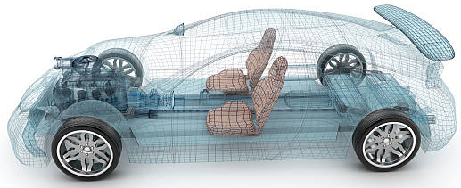
Environment Model in Vehicle
Engine/Motor room environment model
Engine/motor diagnostic sensor and controller
Air pressure sensor, wheel health sensor and controller
Transmission monitoring sensor and controller
Cabin environment sensor (temperature, brightness, humidity etc.)
Sheet sensor, health care sensors for driver
Sheet sensor, health care sensors for passenger
Cabin room environment model
Note:
Various type of car/vehicles
Bus, Bulldozer, Heavy construction equipment needed each different sensors.
4
2
5
1
3
6
https://media.istockphoto.com/photos/transparent-car-design-wire-model3d-illustration-my-own-car-design-picture-id594040008?k=6&m=594040008&s=612x612&w=0&h=XE8LiBjpM51aB4pH2CFt6-MT6IvALRPnlxPcac0RXhg=

Slide 12

Channel and Environmental models between VBAN and HBAN
On-vehicle to On vehicle(LOS)
On-vehicle to On Body
On-body to On-body
In-Vehicle to On-body

Slide 13
HBAN coordinator to HBAN coordinator
Body surface to ANOTHER body surface
Cannot be considered similar
Need to consider SAR issues
Body surface to body surface
Body surface to body surface

Slide 14
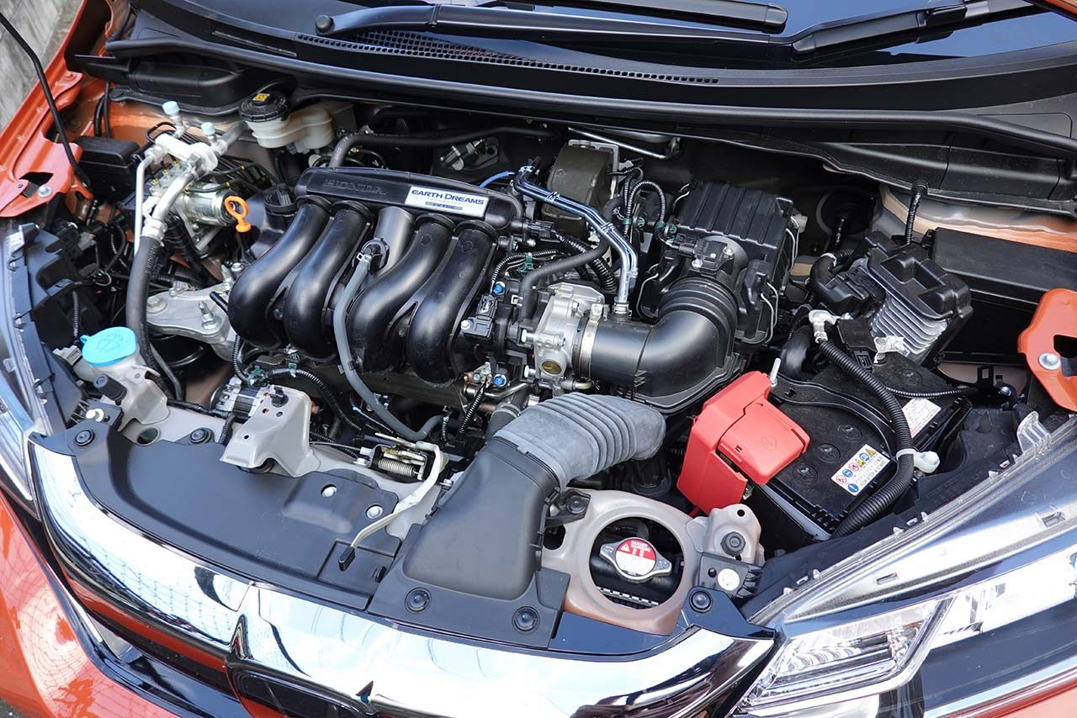
Engine/Motor Room Environment
Many metallic components
Components existing in densely
Ignition noise, motor noise
Larger path-loss than free propagation
A lot of reflection of RF signal
Electro-magnetic interference, EMI issues
Especially EV
https://www.as-web.jp/car/575374/attachment/03a_sub_dsc01273
Ignition coil
Spark plug
Electric generator
Electric motor
High current battery and cable

Slide 15
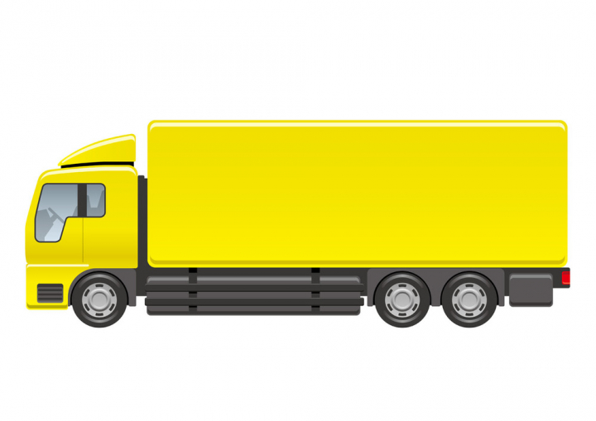
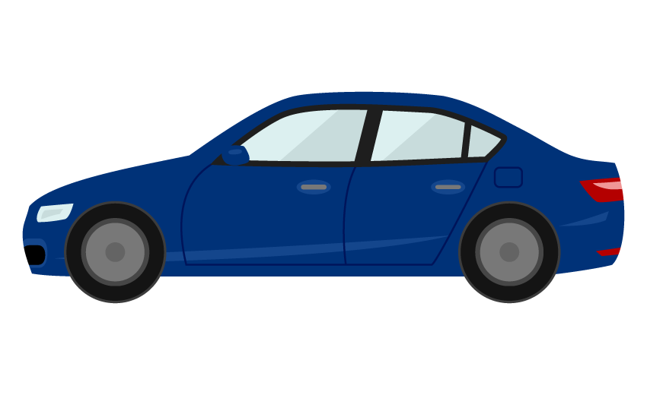
Environment models that can be applicable against different type of vehicles
Cabin
Engine
Cabin
Engine
Different
Size;
Structure;...etc.
https://nohat.cc/f/heavy-truck-illustration-isolated-on-a-white-background/comvecteezy328938-201908251309.html
Categories:
Categorize several type of vehicle like “for passengers”, “bus”, “small cargo”, “middle cargo”, “Large cargo” and “special purpose vehicles” such as a construction machines and build models for various categories.
Policy:
IEEE 802.15.6ma defines several common environment models against most dominant use cases as mandatory models.

Slide 16
Symmetric scenario
In channel model (without EMC/EMI and Interference issues), two direction of propagation should be considered as equal:
Channel reciprocity.
Coordinator
Node
Coordinator
Node
Channel models of “Coordinator to node” and “Node to coordinator” without noise source should be the same.
Asymmetric scenario
Noise and/or interference source
In case of environmental model including EMC/EMI . colored noise and interference issues, two direction between source and sink is not same meaning.
Coordinator
Node
Environmental model of two different direction should be defined separately.
Coordinator
Node
Environmental models of “Coordinator to node” and “Node to coordinator” should be different.

Slide 17
Use cases
Failure and/or deterioration detection of vehicle components.
  - Nodes are in engine compartment / coordinator is in engine compartment
Sensing for safety driving support / Collision avoidance
  - Nodes are on outside surface of vehicle / coordinator is in engine compartment
Entertainment for passengers
  - Nodes are in cabin / coordinator is in cabin.
Key-less entry system
- Node is around user outside of vehicle / coordinator is in engine compartment
Communication between user on pedestrian and vehicle
  - Node is around user outside of vehicle / coordinator is on outside surface of vehicle (vehicle moves at walking speed (<5km/h))
Vehicle controlling / Wireless herness
  - Coordinator and nodes are in between cabin and chassis of vehicle.
Driver’s health problem detection
  - Coordinator in engine compartment / nodes are on human (driver) body.
Driver’s and passenger’s healthcare application
  - Nodes and coordinator are on human body.

Slide 18



Use cases
 | Use case | Sedan/RV / SUV with combustion internal engine | Sedan/RV / SUV EV | Bus | Cargo / pickup | Special purpose
1 | Failure and/or deterioration detection of vehicle components | Case 1.1 | Case 1.2 | Case 1.3 |  | Case 1.5
2 | Sensing for safety driving support / Collision avoidance | Case 2.1 C-N | Case 2.2 C-N | Case 2.3 C-N |  | Case 2.5 C-N
 |  | Case 2.1 N-C | Case 2.2 N-C | Case 2.3 N-C |  | Case 2.5 N-C
3 | Entertainment for passengers | Case 3.1 |  | Case 3.3 | Same as 3.1 | ---
4 | Key-less entry system | Case 4.1 C-N | Case 4.2 C-N | Case 4.3 C-N |  | ---
 |  | Case 4.1 N-C | Case 4.2 N-C | Case 4.3 N-C |  | ---
5 | Communication between user on pedestrian and vehicle | Case 5.1 C-N |  | Case 5.3 C-N |  | ---
 |  | Case 5.1 N-C |  | Case 5.3 N-C |  | ---
6 | Vehicle controlling / Wireless herness | Case 6.1 C-N |  | Case 6.3 C-N |  | Case 6.5 C-N
 |  | Case 6.1 N-C |  | Case 6.3 N-C |  | Case 6.5 N-C
7 | Driver’s health problem detection | Case 7.1 C-N |  | Case 7.3 C-N |  | Case 7.5 C-N
 |  | Case 7.1 N-C |  | Case 7.3 N-C |  | Case 7.5 N-C
8 | Driver’s and passenger’s healthcare application | IEEE 802.15.6 – 2012 Channel models can be applied

Slide 19
Models between VBAN and HBAN
Channel and Environmental models between VBAN coordinator and VBAN coordinators.
VBAN
node
VBAN
coordinator
VBAN
coordinator
Channel and Environmental models for VBAN.
Channel and Environmental models between VBAN coordinator and HBAN coordinators.
VBAN
node
HBAN
coordinator
HBAN
coordinator
HBAN
coordinator
HBAN
coordinator
Channel and Environmental models for HBAN.
HBAN
node
HBAN
node
HBAN
node
HBAN
node
HBAN
node

Slide 20
Channel and Environmental models of VBAN
S11: On-vehicle to on-vehicle (LOS)
S13: On-vehicle to surrounding vehicle (LOS)
S12: On-vehicle to on-vehicle (NLOS)
S9: On-vehicle to in- vehicle
S10: In-vehicle to external
S8: In-vehicle to In-vehicle
S14: On-vehicle to surrounding vehicle (NLOS)

Slide 21
Scenario 8
Geometrical configuration
Nodes and coordinator are in cabin room
Coordinator and node
Noise source
Use case
Entertainment for passengers
  Nodes are in cabin room / coordinator is in cabin room.
  Symmetric environmental model
  EMI from engine and electric system are negligible. => channel model
 | Use case | Sedan/RV / SUV with engine | Sedan/RV / SUV without engine | Bus | Cargo / pickup | Special purpose
3 | Entertainment for passengers | Case 3.1 |  | Case 3.3 | Same as 3.1 | ---

Slide 22
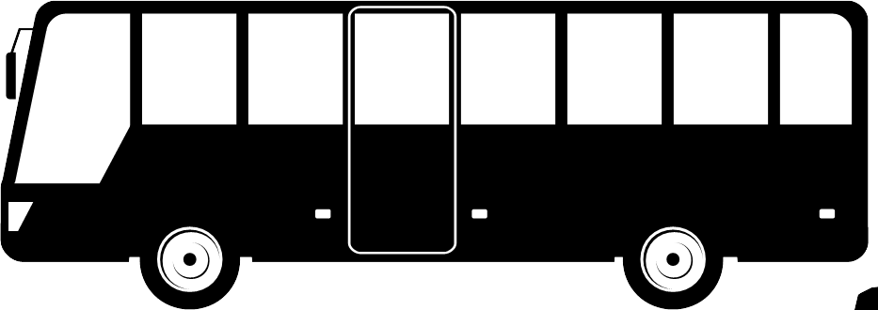
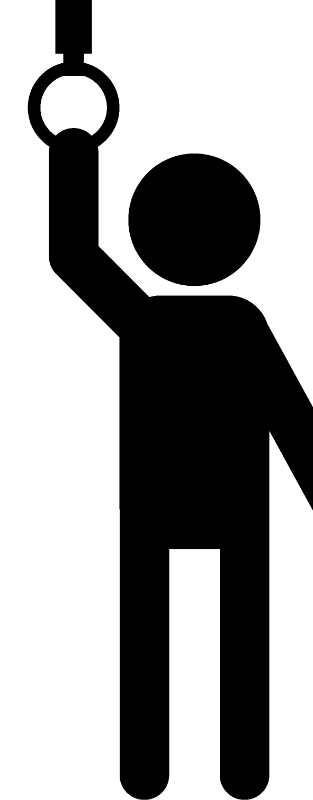
Scenario 8’ for BUS
Geometrical configuration
Nodes and coordinator are in cabin room
VBAN Coordinator
HBAN Coordinator
Noise source
coordinator
Use case
Entertainment for passengers
  Nodes are in cabin room / coordinator is in cabin room.
 |  | Sedan/RV / SUV with engine | Sedan/RV / SUV without engine | Bus | Cargo / pickup | Special purpose
8’VV | VBAN coordinator and VBAN coordinator | Case 3.1a |  | Case 3.3 | Same as 3.1 | ---
8’VH | VBAN coordinator and HBAN coordinator | Case 3.1b |  |  |  | ---

Slide 23
Scenario 10
Geometrical configuration
Engine compartment / body surface (outside)
VBAN Coordinator
HBAN Coordinator
Noise source
Use case
Key-less entry system
  Node is around user outside of vehicle / coordinator is in Engine compartment
  Asymmetric environment. Two direction model should be defined separatory.
 | Use case | Sedan/RV / SUV with engine | Sedan/RV / SUV without engine | Bus | Cargo / pickup | Special purpose
10 | Key-less entry system | Case 4.1 V-H | Case 4.2 V-H | Case 4.3 V-H |  | ---
 |  | Case 4.1 H-V | Case 4.2 H-V | Case 4.3 H-V |  | ---

Slide 24
Scenario 13
Geometrical configuration
Outside surface of vehicle / coordinator is in Engine compartment
VBAN Coordinator
HBAN Coordinator
Moving at walking speed (<5km/h)
Noise source
Use case
Communication between user on pedestrian and vehicle
  Node is around user outside of vehicle / coordinator is on outside surface of vehicle (vehicle moves in walking speed (<5km/h))
  Asymmetric environmental model
 | Use case | Sedan/RV / SUV with engine | Sedan/RV / SUV without engine | Bus | Cargo / pickup | Special purpose
13 | Communication between user on pedestrian and vehicle | Case 5.1 V-H |  | Case 5.3 V-H |  | ---
 |  | Case 5.1 H-V |  | Case 5.3 H-V |  | ---

Slide 25

Dynamic Channel Models Situations
Channel between a user on pedestrian and a vehicle.
Users in a vehicle are slightly moving due to vibration and acceleration.
Walking and/or standing users on a bus and train.
Between a tractor and trailer tail.
VBAN Coordinator
HBAN Coordinator
Moving at walking speed (<5km/h)
Noise source
LOS
LOS
NLOS

Slide 26
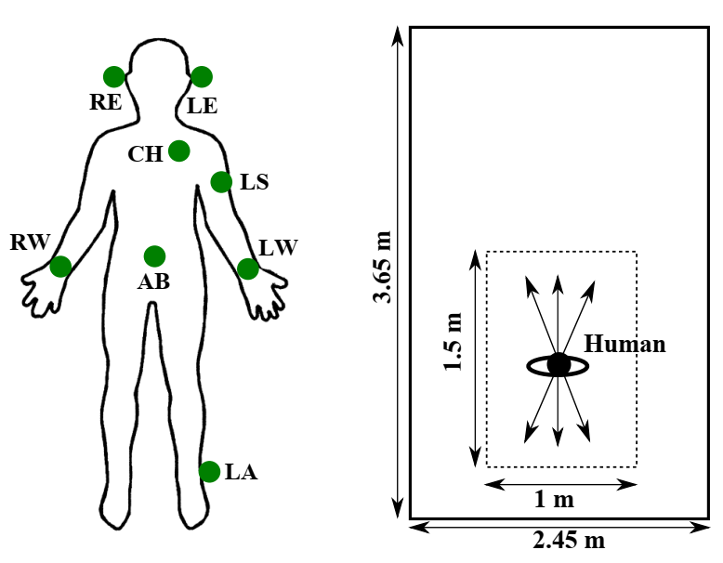
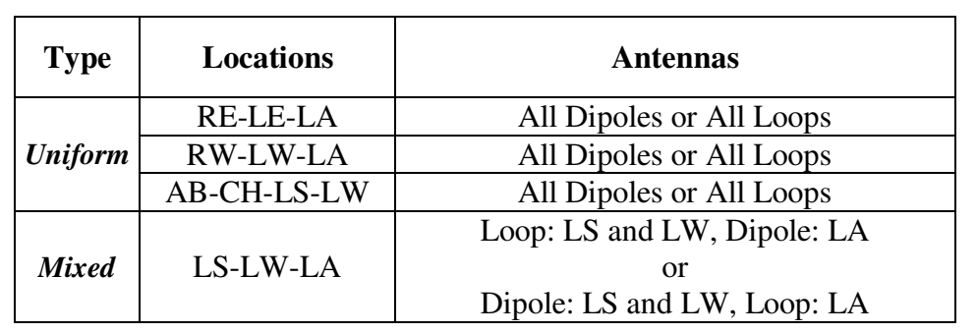
Dynamic on-body channel modeling
Timo Kumpuniemi, Matti Hämäläinen, Kamya Yekeh Yazdandoost, Jari Iinatti, “Dynamic On-Body UWB Radio Channel Modeling”, ISMICT2015, (2015)
Dynamic channel characteristics and parameters were derived categorizing the links into three classes: high, medium or low dynamics channels. (T. Kumpuniemi et al. 2015) The work is based on frequency domain measurements with a vector network analyzer in an anechoic chamber at a 2-8 GHz frequency band.
[ref] Timo Kumpuniemi, Matti Hämäläinen, Kamya Yekeh Yazdandoost, Jari Iinatti, “Dynamic On-Body UWB Radio Channel Modeling”, ISMICT2015, (2015)

Slide 27
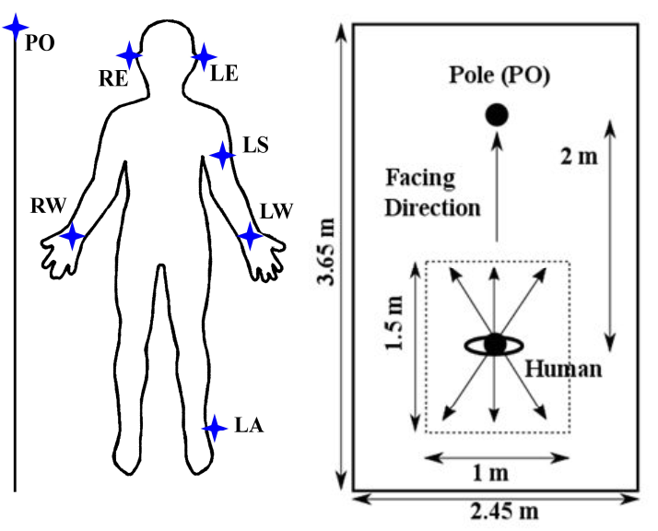
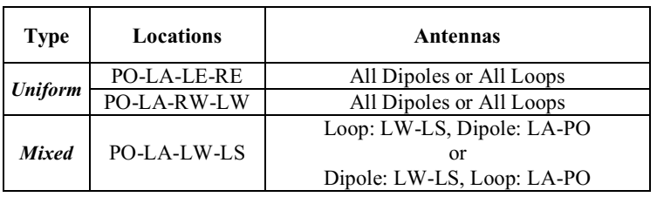
Dynamic off-body channel modeling
Timo Kumpuniemi, Juha-Pekka Mäkelä, Matti Hämäläinen, Kamya Yekeh Yazdandoost, Jari Iinatti, “Measurements and Analysis on Dynamic Off-Body Radio Channels at UWB Frequencies”, ISMICT2019. (2019)
Dynamic offbody radio channels in an UWB frequency range for wireless BAN was presented (T. Kumpuniemi et al. 2019) . Ten frequencies were examined at two links, and the path loss values and standard
deviations were determined. Then, all the links were considered at three discrete frequencies.
Timo Kumpuniemi, Juha-Pekka Mäkelä, Matti Hämäläinen, Kamya Yekeh Yazdandoost, Jari Iinatti, “Measurements and Analysis on Dynamic Off-Body Radio Channels at UWB Frequencies”, ISMICT2019. (2019)

Slide 28
Summary
Environment model which has wider meaning than channel model has been proposed.
Environment model including not only channel characteristics but also including interference, colored noise, EMC and human impact issues.
Channel and Environmental models discussed in TG6ma were described.
Importance to discuss dynamic and time-varying channel and environment modeling against person (user) and vehicle mobility was explained.

Slide 29
Dynamic on-body measurement method can be applied to the measurement of channel modeling of on-vehicle VBAN.
Dynamic off-body measurement method can be applied to the measurement of channel modeling of surrounding vehicle VBAN.
IEEE802.15.4a, 4z, 4ab, 4f, and 8 channel model activities can be referred for our vehicle channel modeling.
TG6ma (TG6) is forcusing on UWB channel model. 15.4a (4f, 4z, 4ab, 15.8 using the same model) can be used as common channels for UWB.

Slide 30
Thank you for your attention

