Slide 1
Project: IEEE P802.15 Working Group for Wireless Personal Area Networks (WPANs)
Submission Title: [UWB sensing concepts]
Date Submitted: [24 Jan, 2022]
Source: [Dag T. Wisland, Kristian Granhaug, Dries Neirynck] Company [Novelda AS]
E-mail: [dag.wisland@novelda.com]
Re: [Working Group input]
Abstract: [Presents sensing use-case scenario and related sensing concepts]
Purpose: []
Notice: This document has been prepared to assist the IEEE P802.15. It is offered as a basis for discussion and is not binding on the contributing individual(s) or organization(s). The material in this document is subject to change in form and content after further study. The contributor(s) reserve(s) the right to add, amend or withdraw material contained herein.
Release: The contributor acknowledges and accepts that this contribution becomes the property of IEEE and may be made publicly available by P802.15.

Slide 2
PAR Objective | Proposed Solution (how addressed)
Safeguards so that the high throughput data use cases will not cause significant disruption to low duty-cycle ranging use cases
Interference mitigation techniques to support higher density and higher traffic use cases
Other coexistence improvement
Backward compatibility with enhanced ranging capable devices (ERDEVs)
Improved link budget and/or reduced air-time
Additional channels and operating frequencies
Improvements to accuracy / precision / reliability and interoperability for high-integrity ranging
Reduced complexity and power consumption
Hybrid operation with narrowband signaling to assist UWB
Enhanced native discovery and connection setup mechanisms
Sensing capabilities to support presence detection and environment mapping | Efficient collaboration over multiple sensing-capable nodes
Low-power low-latency streaming
Higher data-rate streaming allowing at least 50 Mbit/s of throughput
Support for peer-to-peer, peer-to-multi-peer, and station-to-infrastructure protocols
Infrastructure synchronization mechanisms

Slide 3
UWB Sensing Concepts

Slide 4
Introduction / Content
Content is viewed from a radar / sensor point-of-view including terminology
Several good contributions in TG4ab showing alignment on direction [1-5]
Discuss collaborative sensing use-case and opportunities within scope of TG4ab
Address dynamic range requirements and link budget implications
Monostatic MIMO / Digital RX beamforming
Discussion and suggestions for further studies in TG4ab

Slide 5
Terminology (IEEE Std. 686TM-2017)
Monostatic radar: A radar system that transmits and receives through either a common antenna or through collocated antennas
Multistatic radar: A radar system having two or more transmitting or receiving antennas with all antennas separated by large distances when compared to the antenna sizes
Multiple-input multiple-output (MIMO) radar: A radar-equipped with multiple transmitters and multiple receivers
Multilateration: The location of an object by means of two or more range measurements from different reference points
Micro-Doppler radar: Radar which exploits the frequency modulation induced on the returned radar signal due to micro-motion
Pulse-Doppler radar: A Doppler radar that uses pulsed transmissions. The radar transmits N coherent pulses within a coherent processing interval (CPI) and usually forms N Doppler filters using an FFT

Slide 6
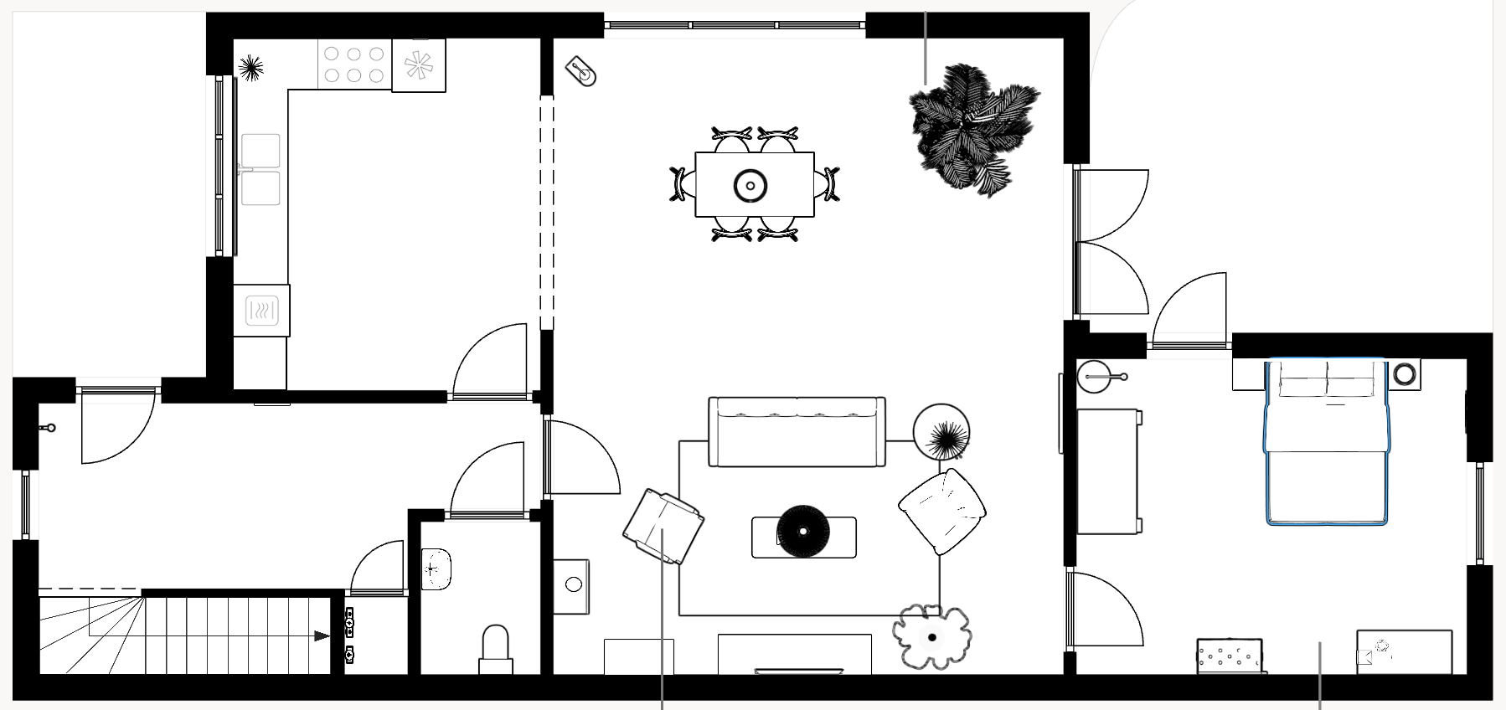



Use-case scenario: Collaborative sensing
Sensing / Ranging anchors distributed in living space
Persons may have 802.15.4(z/ab) tag / phone / watch
Context-based user experience
May localize and authenticate persons
Utilize micro-Doppler to sense vital signs given sufficient SNR and also link to unique individual
Robot vacuums
Luminaires
Appliances
Smart speakers
TVs, STBs
Smart mirrors

Slide 7
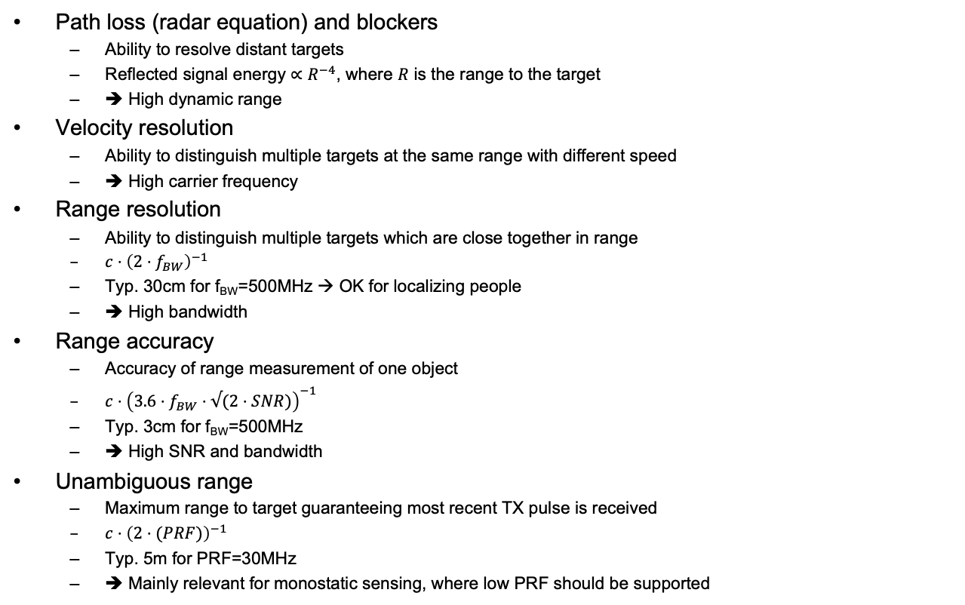
Radar system parameters / considerations
Path loss (radar equation) and blockers
  Ability to resolve distant targets
  Reflected signal energy $∝R^{−4}$, where $R$ is the range to the target
  ➔ High dynamic range
Velocity resolution
  Ability to distinguish multiple targets at the same range with different speed
  ➔ High carrier frequency
Range resolution
  Ability to distinguish multiple targets which are close together in range
  $c⋅{\left(2⋅f_{BW}\right)}^{−1}$
  Typ. 30cm for f_{BW}=500MHz → OK for localizing people
  ➔ High bandwidth
Range accuracy
  Accuracy of range measurement of one object
  $c⋅{\left(3.6⋅f_{BW}⋅√(2⋅SNR)\right)}^{−1}$
  Typ. 3cm for f_{BW}=500MHz
  ➔ High SNR and bandwidth
Unambiguous range
  Maximum range to target guaranteeing most recent TX pulse is received
  $c⋅{\left(2⋅(PRF)\right)}^{−1}$
  Typ. 5m for PRF=30MHz
  ➔ Mainly relevant for monostatic sensing, where low PRF should be supported

Slide 8
Collaborative sensor network configurations
Monostatic radar (optionally MIMO) re-using ranging packet
Multistatic radar – RX/TX not co-located, collaborates in estimating CIR and infers sensing
Collaborating monostatic radars – sensing nodes aware of each others relative position, able to exchange and utilize that information (e.g. each node carries 3/4D information, + multilateration on network level)
Collaborating monostatic and multistatic radars
Processor
/
Proxy
Mono-static MIMO
anchor
Multi-static
anchor
Sensing packet
Measurement report

Slide 9
Multi-target presence detection scenario
Resolving locations of multiple targets in multi-path environment is demanding
Multiple anchors are required in multistatic-only configuration
Combining monostatic and multistatic may reduce ambiguities
Monostatic multi-channel (MIMO) enables digital beamforming further reducing ambiguities (not illustrated)

Slide 10
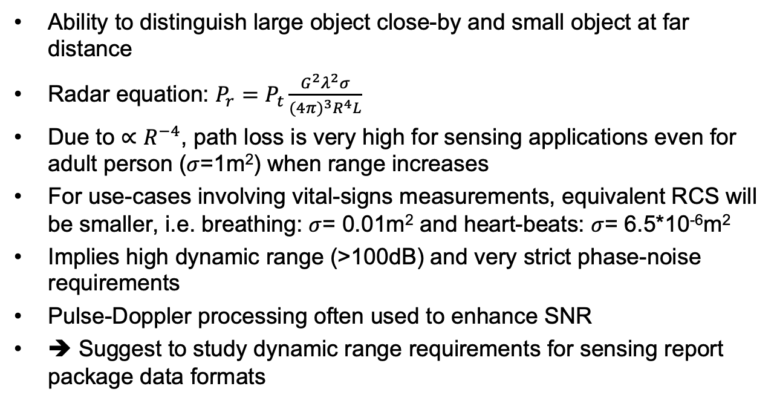
Dynamic range requirements
Ability to distinguish large object close-by and small object at far distance
Radar equation: $P_{r}=$ $P_{t}\frac{G^{2}λ^{2}σ}{{(4π)}^{3}R^{4}L}$
Due to $∝R^{−4}$, path loss is very high for sensing applications even for adult person ($σ$=1m²) when range increases
For use-cases involving vital-signs measurements, equivalent RCS will be smaller, i.e. breathing: $σ$= 0.01m² and heart-beats: $σ$= 6.5*10⁻⁶m²
Implies high dynamic range (>100dB) and very strict phase-noise requirements
Pulse-Doppler processing often used to enhance SNR
➔ Suggest to study dynamic range requirements for sensing report package data formats

Slide 11
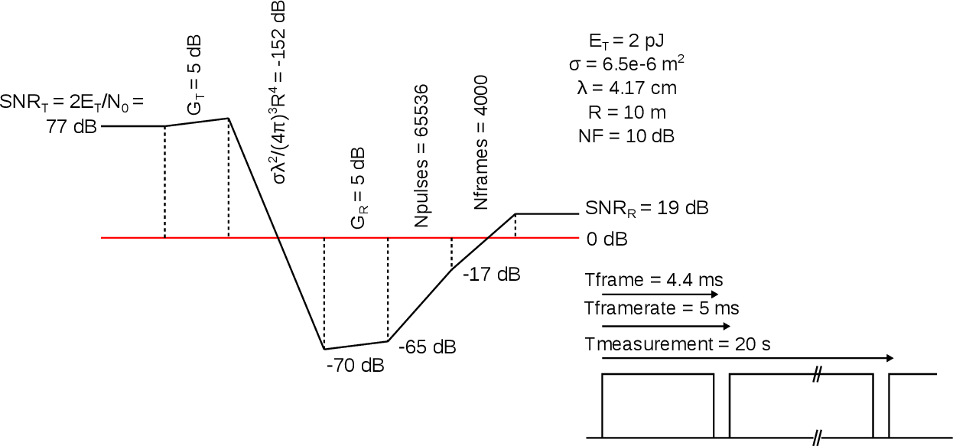
Link budget for human heartbeats

Slide 12
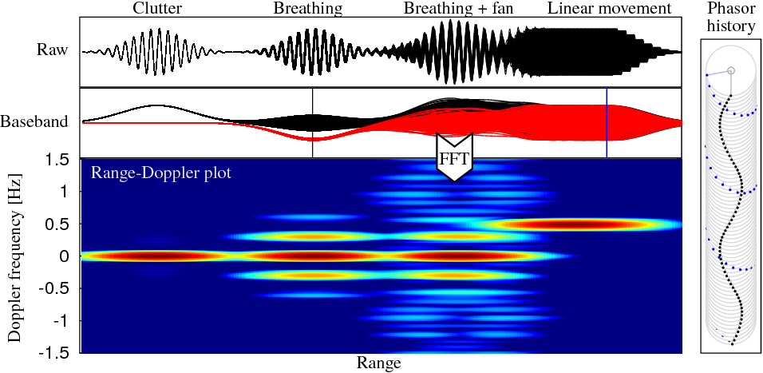
Radar signals overview / classification
Gaussian pulse commonly used offering good sensing characteristics
Pulse-Doppler processing very useful to enhance SNR and as basis for classification
Processing may be performed by edge-nodes or in a centralized processor
Suggest to further study CIR window size and sampling-rate

Slide 13
Monostatic MIMO / Digital RX beamforming
Multiple TRX-antennas utilizing digital RX-beamforming may enhance angular resolution through virtual aperture
Diversity through orthogonal codes or time-multiplexing
Re-use data-packet for sensing
Resolves ambiguities
Enables full-duplex
May share detection / track list
➔ Sensing report should include option for this configuration
➔ Optional support for orthogonal codes

Slide 14
Discussions / proposals
Gaussian pulse-shape offers good trade-off between pulse duration and spectrum-mask filling → Further study Gaussian approximated pulse-shape for 4ab sensing devices
Range resolution of 30cm sufficient for most sensing scenarios, but may limit some use-cases → Suggest 499.2 MHz sensing BW for packet re-use, but include optional support of scheme like the one proposed in [5]
Monostatic sensing may play important role in use-cases with marginal SNR and to resolve ambiguities → Standardize packet formats for re-use between ranging / sensing and data format for sensing measurement report
Many 4ab-compliant devices will have multiple coherent TRX-channels enabling digital RX beamforming → Include optional support for orthogonal sensing codes and include in data format for sensing measurement report
Centralized processing most likely required in complex use-cases → Align on CIR window size(s) and associated sampling rate

Slide 15
References
Frank Leong, Wolfgang Küchler, Riku Pirhonen, “UWB Sensing in 802.15”, IEEE 802.15-21-0399-00-04ab, July 2021
Xiaohui Peng, David Xun Yang, Chenchen Liu, Rani Keren, Kuan Wu, “CIR feedback for UWB sensing,” IEEE 802.15-21-057-00-04ab, November 2021
Xiaohui Peng, David Xun Yang, Chenchen Liu, Rani Keren, Kuan Wu, “Waveform design for UWB sensing,” IEEE 802.15-22-0040-00-04ab, January 2022
Pooria Pakrooh, Bin Tian, Steve Shellhammer, and Koorosh Akhavan “UWB Sensing Scenarios for 802.15.4ab”, IEEE 802.15-22-0012-01-04ab, January 2022
Frank Leong, Wolfgang Küchler, Riku Pirhonen, “Sensing - Continued, IEEE 802.15-22-0061-00-04ab, January 2022
Pooria Pakrooh, Bin Tian, Steve Shellhammer, and Koorosh Akhavan “Link budget analysis and CIR reporting for UWB RF sensing”, IEEE 802.15-22-0066-01-04ab, January 2022
IEEE Std. 686TM-2017, IEEE Standard for Radar Definitions

