Slide 1
Project: IEEE P802.15 Working Group for Wireless Personal Area Networks (WPANs)
Submission Title: NBA-MMS-UWB MAC Followup
Date Submitted: Jan. 24, 2022
Source: Yong Liu, Santhosh Kumar Mani, Sam Schaevitz, Robert Golshan (Apple Inc.)
Address: One Apple Park Way, Cupertino, CA 95104, USA
E-Mail:
Abstract: MAC design considerations for narrow-band assisted (NBA)-multi-millisecond (MMS)-UWB ranging protocols
Purpose:
Notice: This document has been prepared to assist the IEEE P802.15. It is offered as a basis for discussion and is not binding on the authoring individual(s) or organization(s). The material in this document is subject to change in form and content after further study. The authors(s) reserve(s) the right to add, amend or withdraw material contained herein.

Slide 2
PAR Objective | Proposed Solution (how addressed)
Safeguards so that the high throughput data use cases will not cause significant disruption to low duty-cycle ranging use cases
Interference mitigation techniques to support higher density and higher traffic use cases
Other coexistence improvement
Backward compatibility with enhanced ranging capable devices (ERDEVs)
Improved link budget and/or reduced air-time | Use coordinated PHY signaling (NB and UWB) to improve link budget and/or to reduce air-time
Additional channels and operating frequencies
Improvements to accuracy / precision / reliability and interoperability for high-integrity ranging
Reduced complexity and power consumption | Off-loading of functionality to lower-complexity/power NB PHY helps reduce complexity of “heavier” UWB sub-system
Hybrid operation with narrowband signaling to assist UWB | Exploit tightly coupled concurrent operation of NB to help UWB
Enhanced native discovery and connection setup mechanisms
Sensing capabilities to support presence detection and environment mapping
Low-power low-latency streaming
Higher data-rate streaming allowing at least 50 Mbit/s of throughput
Support for peer-to-peer, peer-to-multi-peer, and station-to-infrastructure protocols
Infrastructure synchronization mechanisms

Slide 3
Contents
Recap (15-21-0605)
NB Channel Hopping
Protocol Design Considerations
Conclusions

Slide 4
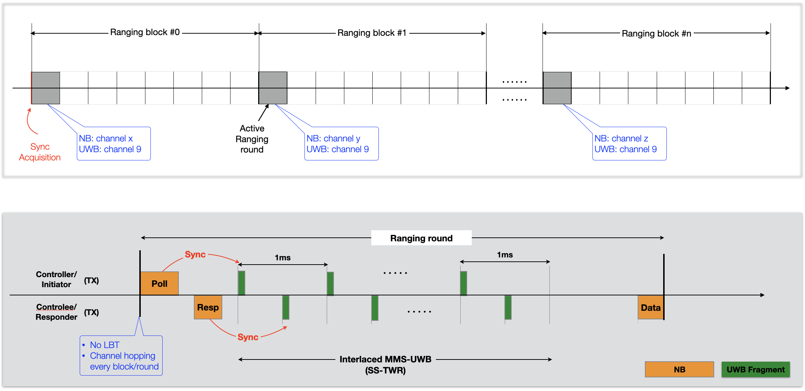
NBA-MMS-UWB Ranging Session (Recap)

Slide 5
NB MAC Considerations (Recap)
Low power
Contention free channel access (no LBT)
Small protocol overhead
Short NB packets
Channel congestion / fading mitigation
UNII-3 @ 5GHz band (refer to 15-21-0593-02-04ab-more-on-nba-mms)
Channel hopping every ranging round
Adaptive configuration
Configurable ranging block/round, # of UWB fragments per round, ranging report methods, etc.

Slide 6
NB Channel Hopping
hop_channel = hop_function(shared_context, block/round_index)
where:
shared_context = some random bits generated per device pair or group
block/round_index = monotonically increasing (in sync on both sides)
hop_function = a pseudorandom function (outputs: 0 to N-1, where N=number of channels in the selected band)
Channel blocklist
Channels in the blocklist are skipped

Slide 7
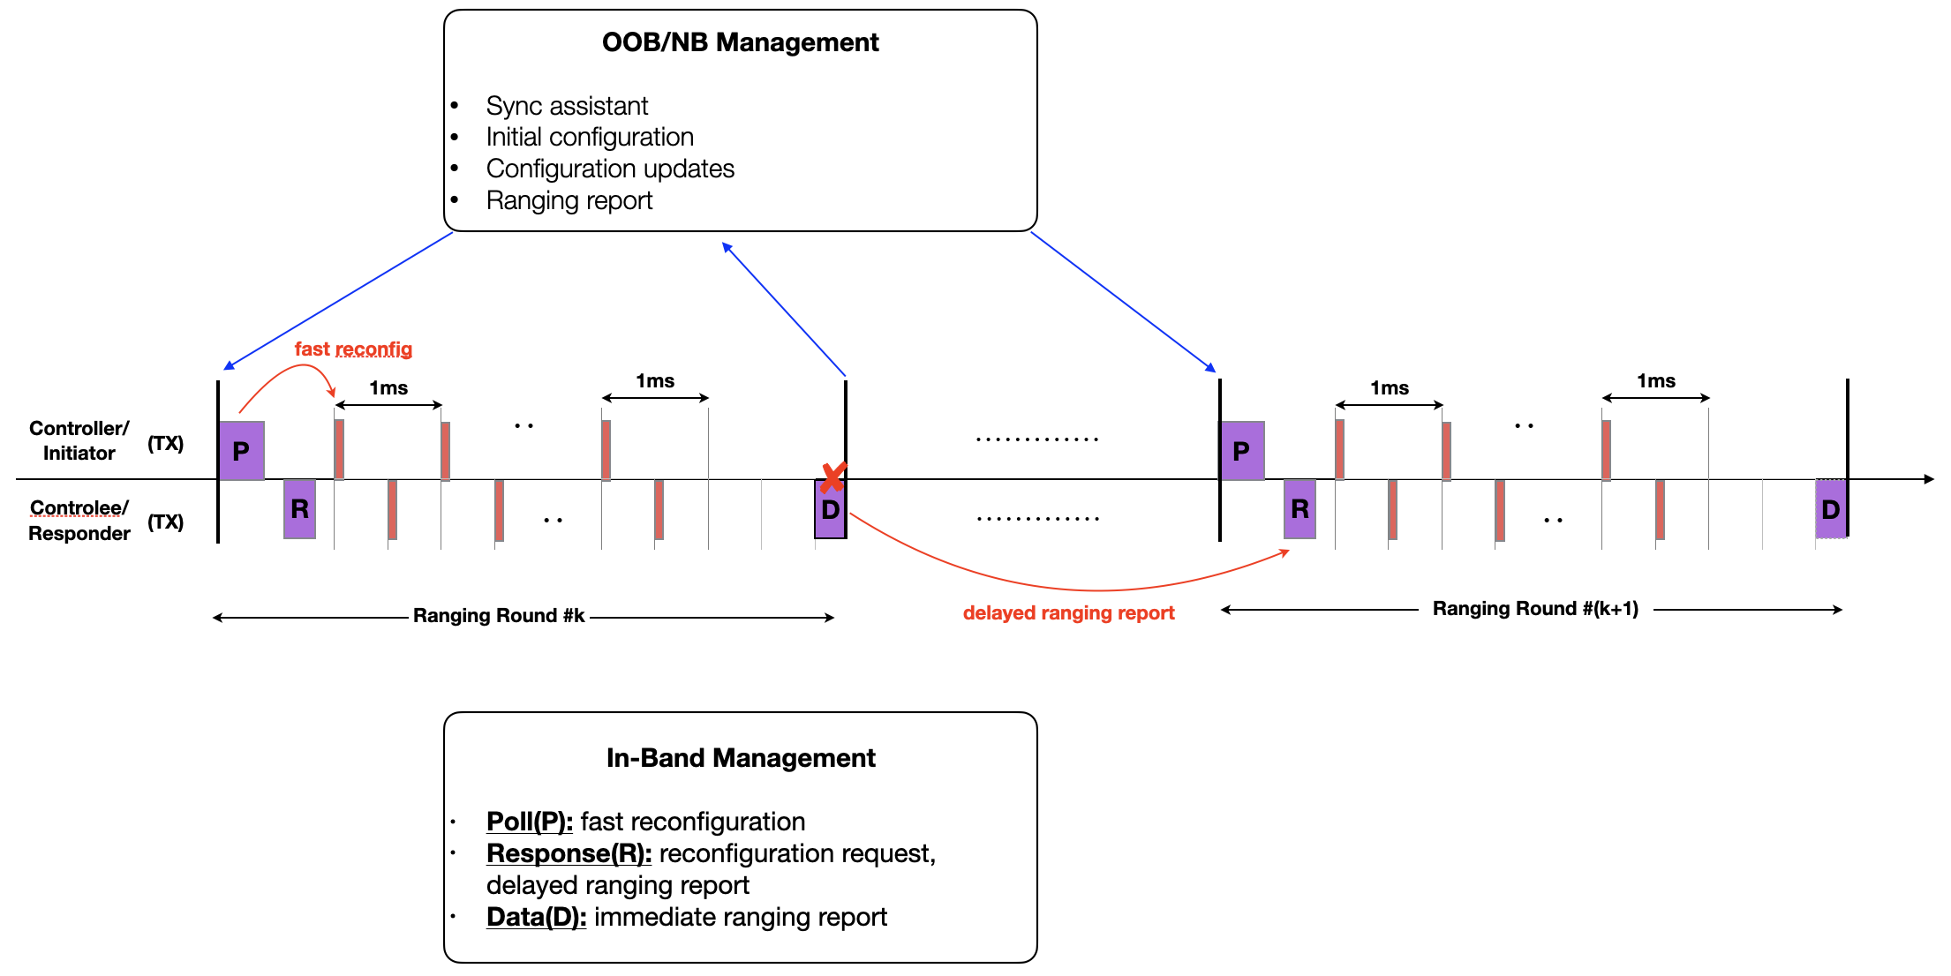
Protocol Design Considerations

Slide 8
Conclusions
NB assisted MMS UWB can provide substantial link budget gains.
We propose to explore the usage of UNII-3@5GHz band and channel hopping to mitigate NB channel contention and fading.
Some high-level protocol design considerations are presented to support an efficient and flexible NBA-MMS-UWB ranging sequence.

Slide 9
References
15-21-0409-01-04ab-narrowband-assisted-multi-millisecond-uwb
15-21-0593-02-04ab-more-on-nba-mms
15-21-0605-00-04ab-nba-mms-uwb-mac-considerations

