Slide 1
Project: IEEE P802.15 Working Group for Wireless Specialty Networks (WSN)
Submission Title: Interference detection for high-integrity ranging in UWB systems: Part II (the updated version of the contribution “A method to evaluate the quality of ToF measurement for IR-UWB”)
Source: Li Sun, Peng Liu, Yuwei Wang, David Xun Yang (Huawei Technologies)
Address : [Huawei Bantian Base, Longgang District, Shenzhen, 518129 China]
E-Mail: [sunli50@huawei.com]
Re: Task Group 4ab: UWB Next Generation for 802.15.4
Abstract: [ToF, Measurement quality evaluation, Trustworthiness level, Ranging]
Purpose:
Notice: This document has been prepared to assist the IEEE P802.15. It is offered as a basis for discussion and is not binding on the contributing individual(s) or organization(s). The material in this document is subject to change in form and content after further study. The contributor(s) reserve(s) the right to add, amend or withdraw material contained herein.
Release: The contributor acknowledges and accepts that this contribution becomes the property of IEEE and may be made publicly available by P802.15.
Notes:
Jul 12, 2010
Page 1

Slide 2
PAR Objective | Proposed Solution (how addressed)
Safeguards so that the high throughput data use cases will not cause significant disruption to low duty-cycle ranging use cases
Interference mitigation techniques to support higher density and higher traffic use cases
Other coexistence improvement
Backward compatibility with enhanced ranging capable devices (ERDEVs)
Improved link budget and/or reduced air-time
Additional channels and operating frequencies
Improvements to accuracy / precision / reliability and interoperability for high-integrity ranging | This proposal presents a new metric to evaluate the trustworthiness level of ToF measurements, which can be used to adjust the ranging procedure flexibly.
Reduced complexity and power consumption
Hybrid operation with narrowband signaling to assist UWB
Enhanced native discovery and connection setup mechanisms
Sensing capabilities to support presence detection and environment mapping
Low-power low-latency streaming
Higher data-rate streaming allowing at least 50 Mbit/s of throughput
Support for peer-to-peer, peer-to-multi-peer, and station-to-infrastructure protocols
Infrastructure synchronization mechanisms

Slide 3
Related Contributions and Objectives
Related Contributions
A method to evaluate the quality of ToF measurement for IR-UWB <15-22-0073-00-04ab>, Jan. 2022, Li Sun et. al.
Objectives of this contribution
This presentation provides updates to the above contribution 15-22-0073-00-04ab
To clarify the background and motivations of the proposed technique in above contribution, and clearly describe the problem that the proposed technique wants to solve
To provide more explanations on how to exploit the proposed metric to optimize the ranging procedure

Slide 4
Background and Motivations
Due to the openness of wireless medium, accidental or intentional interference from other transmitters may undermine the leading edge detection and cause performance degradation in ranging accuracy
If the receiver detects the possible existence of an interference, the ranging measurement result cannot be fully trusted or exploited for round-trip time estimation
It is desired to give a quantitative evaluation on the trustworthiness of the ranging measurement results and use this evaluation report to improve ranging performance

Slide 5
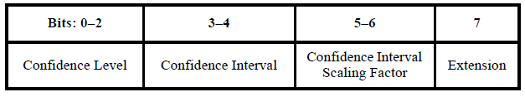
Current Standard: FoM
FoM with extension bit=0 (Source: IEEE 802.15.4z-2020)0
If extension bit = 0, the Figure-of-Merit (FoM) characterizes the accuracy of the PHY estimate of the arrival time of the RMARKER at the antenna.
While FoM gives an evaluation of the ranging accuracy, there is no metric in current standard to provide an explicit indication of whether or not the ranging procedure is being interfered with.
FoM with extension bit 0 has a clear meaning, but FoM with extension bit 1 is not defined (unless bits 0~6 are all zeroes, which means the ranging result is incorrect).

Slide 6
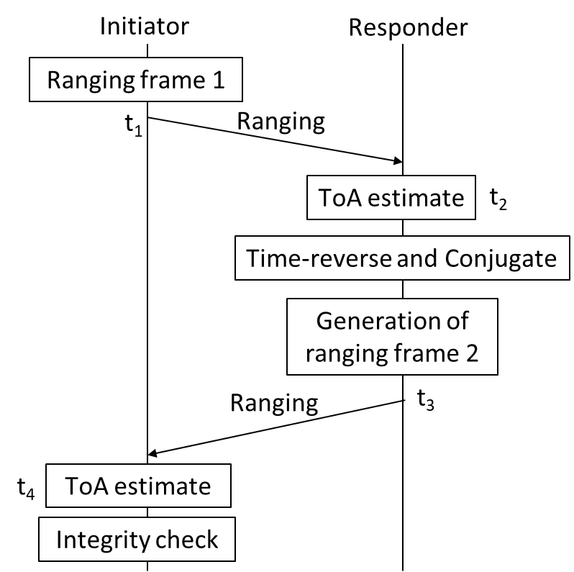
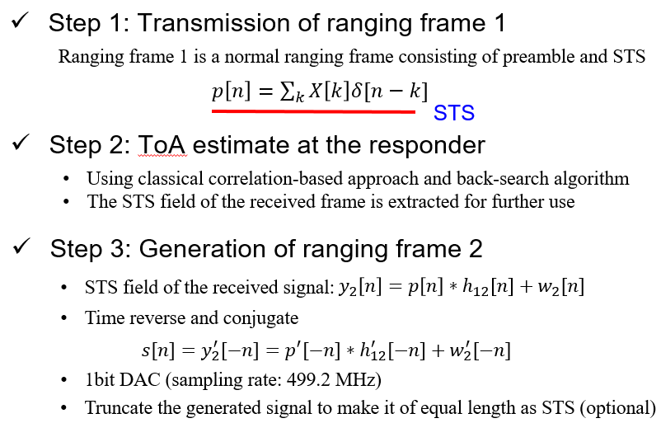
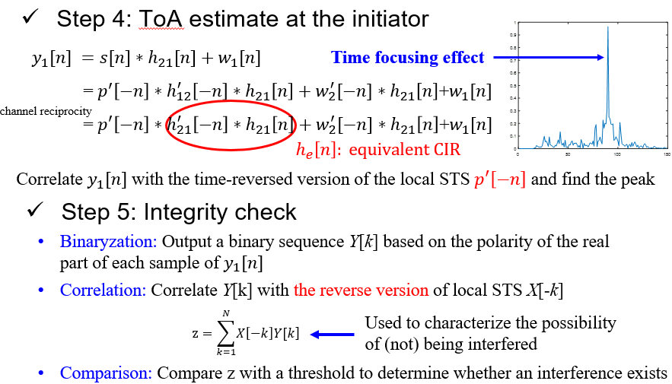
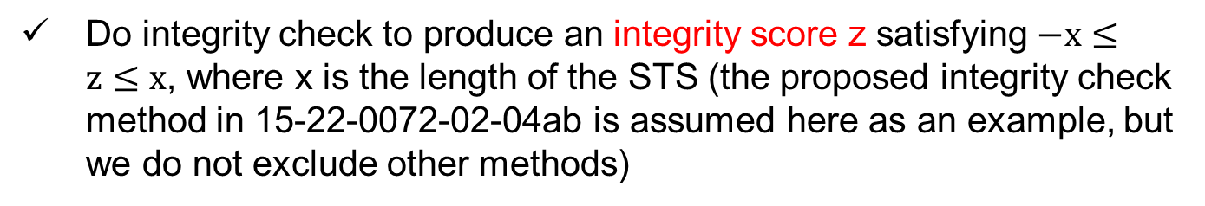
Proposal 1: Extend the Definition of FoM
Do integrity check to produce an integrity score z satisfying $−x≤z≤x$, where x is the length of the STS (the proposed integrity check method in 15-22-0072-02-04ab is assumed here as an example, but we do not exclude other methods)
Example (doc: 15-22-0072-02-04ab)

Slide 7

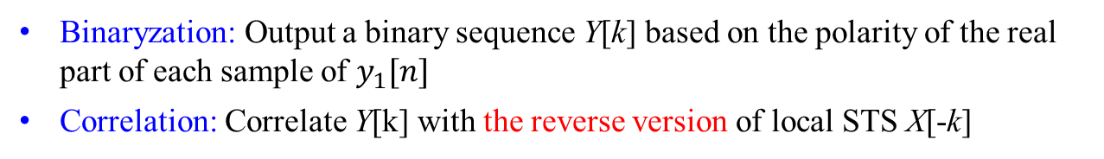

Proposal 1: Extend the Definition of FoM
Modified definition of FoM
z=x: this corresponds to the case where the receiver is sure that no interference exists. In this case, bit 7 is set to be 0, and other bits are defined as is done in current standard to reflect ranging accuracy
$−x≤z≤0$: this corresponds to the case where the receiver is sure that an interference occurs. In this case, set bit 7=1 and all other bits to be 0 → the measurement result cannot be used (compatible with current standard)
$1≤z≤x−1$: the ranging procedure is being interfered with a possibility that is inversely proportional to z. Set bit 7=1, and other bits are the binary representation of the trustworthiness level, defined as
$$round\left(\frac{z−1}{∆}\right)+1$$
where
$$∆=\frac{x−2}{2^{7}−2}$$
$$(z≥1 and x>2)$$

Slide 8
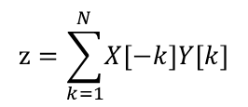
Proposal 1: Extend the Definition of FoM
Main points for the modified definition of FoM :
Bits 0~6
Bit 7
Bit 7=0: there is no interference, and bits 0~6 characterizes the accuracy of the ToF estimate, as is defined in current standard
Bit 7=1: there might be an interferer, and bits 0~6 characterizes the trustworthiness level of the ToF estimate (i.e., the possibility of not being interfered), defined as
Trustworthiness level=$\left\{\begin{aligned}round\left(\frac{z−1}{∆}\right)+1 , integrity score z≥1 \\ 0, integrity score z≤0\end{aligned}\right.$
You cannot characterize both accuracy and trustworthiness using one FoM unless bit 7=0 → introduce a new metric

Slide 9
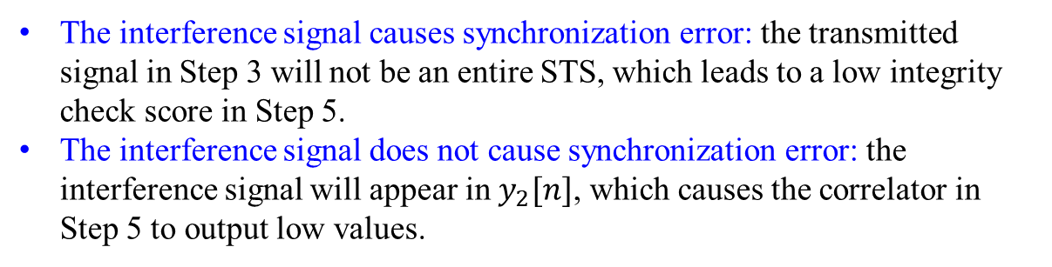
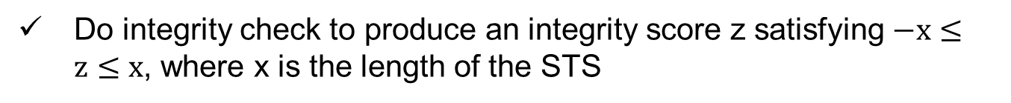
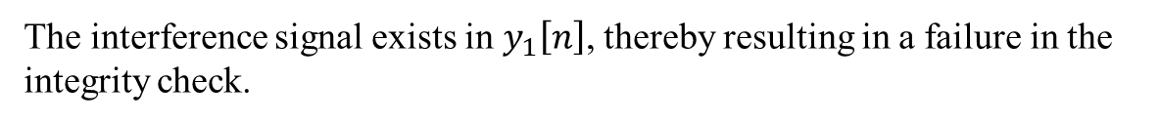

Proposal 2: A new metric—— Trustworthiness Level (TL)
Bits 0~6
Bit 7
Trustworthiness characterization
usefulness indicator
Do integrity check to produce an integrity score z satisfying $−x≤z≤x$, where x is the length of the STS
TL definition:
bit 7=0 if $−x≤z≤0$ (the receiver is sure that the ranging procedure is being interfered and the measurement is thus useless) and bit 7=1 if $1≤z≤x$ (there might be an interference, but the receiver is not pretty sure, so the measurement can still be used)
If bit 7=0, bits 0~6 are all equal to 0 to indicate the measurement is useless
If bit 7=1, bits 0~6 are the binary representation of the trustworthiness level, defined as
$$round\left(\frac{z−1}{∆}\right)$$
where
$$∆=\frac{x−1}{2^{7}−1}$$
$$(z≥1 and x>1)$$

Slide 10
The feedback of TL
Whether or not the feedback of TL is necessary depends on where the TL is computed and what it is used for.
For example, if the proposed integrity check method in slide 6 is used, TL is computed at the initiator and is used to measure the trustworthiness of the entire ranging round: No need to feedback
There are also other choices for integrity check. For example, if the receiver-only method is used (i.e., the benchmark B method shown in doc: 15-22-0072-02-04ab), TL is computed at the responder and is used to measure the trustworthiness of a single ToA measurement: Feedback is needed

Slide 11
The feedback of TL from responder to initiator
Based on the collected TL reports, the initiator can adjust the ranging procedure flexibly.
For example, if multiple consecutive “poor” TL reports are collected, implying a higher possibility of being interfered, the ranging procedure should be suspended, and restarted after some time. This is because that ranging in heavily interfered environments is useless and only causes waste in energy.
More broadly, the TL reports can be provided to higher layers to enable various applications such as environmental sensing.
The TL reports can be included in the “RangingReportDescriptor” as a new element, and fed back from the responder to the initiator.
Initiator
Responder
t1
Ranging
t2
t3
t4
Ranging
timestamp repots & the associated TLs

Slide 12
Summary
It is desired to evaluate the quality of ToF measurements in a more comprehensive way, which can reflect not only the accuracy but also the trustworthiness of the measurements
We propose two methods in this contribution, i.e., to extend the current definition of FoM or to introduce a new metric called trustworthiness level (TL)
When necessary, TL reports can be fed back from the responder to the initiator to enable a more flexible ranging procedure

