Slide 1
Project: IEEE P802.15 Working Group for Wireless Specialty Networks (WSN)
Submission Title: A method to evaluate the quality of ToF measurement for IR-UWB
Source: Li Sun, Peng Liu, Yuwei Wang, David Xun Yang (Huawei Technologies)
Address : [Huawei Bantian Base, Longgang District, Shenzhen, 518129 China]
E-Mail: [sunli50@huawei.com]
Re: Task Group 4ab: UWB Next Generation for 802.15.4
Abstract: [ToF, Measurement quality evaluation, Trustworthiness level, Secure ranging]
Purpose:
Notice: This document has been prepared to assist the IEEE P802.15. It is offered as a basis for discussion and is not binding on the contributing individual(s) or organization(s). The material in this document is subject to change in form and content after further study. The contributor(s) reserve(s) the right to add, amend or withdraw material contained herein.
Release: The contributor acknowledges and accepts that this contribution becomes the property of IEEE and may be made publicly available by P802.15.
Notes:
Jul 12, 2010
Page 1

Slide 2
PAR Objective | Proposed Solution (how addressed)
Safeguards so that the high throughput data use cases will not cause significant disruption to low duty-cycle ranging use cases
Interference mitigation techniques to support higher density and higher traffic use cases
Other coexistence improvement
Backward compatibility with enhanced ranging capable devices (ERDEVs)
Improved link budget and/or reduced air-time
Additional channels and operating frequencies
Improvements to accuracy / precision / reliability and interoperability for high-integrity ranging | This proposal presents a new metric to evaluate the trustworthiness level of ToF measurements, which can be used to combine multiple measurements in a better way and obtain a more reliable ranging result.
Reduced complexity and power consumption
Hybrid operation with narrowband signaling to assist UWB
Enhanced native discovery and connection setup mechanisms
Sensing capabilities to support presence detection and environment mapping
Low-power low-latency streaming
Higher data-rate streaming allowing at least 50 Mbit/s of throughput
Support for peer-to-peer, peer-to-multi-peer, and station-to-infrastructure protocols
Infrastructure synchronization mechanisms

Slide 3
Background and Motivations
Ranging is usually done in complicated wireless environments, and the ranging accuracy is heavily affected by multipath, noise, interference, etc. —— measurements might be inaccurate
Besides that, ranging is also vulnerable to several forms of distance reduction attacks such as Cicada[1], Cicada++[2], Ghost peak[3], etc. —— measurements might be untrustworthy
It is necessary to give a quantitative evaluation on both the accuracy and trustworthiness of the ranging measurement results.

Slide 4
Current Standard: FoM
FoM with extension bit=0 (Source: IEEE 802.15.4z-2020 [4])0
If extension bit = 0, the Figure-of-Merit (FoM) characterizes the accuracy of the PHY estimate of the arrival time of the RMARKER at the antenna.
While FoM gives an evaluation of the ranging accuracy, there is no metric in current standard to provide an explicit indication of whether or not the ranging procedure is being attacked.
FoM with extension bit 0 has a clear meaning, but FoM with extension bit 1 is not defined (unless bits 0~6 are all zeroes, which means the ranging result is incorrect).

Slide 5
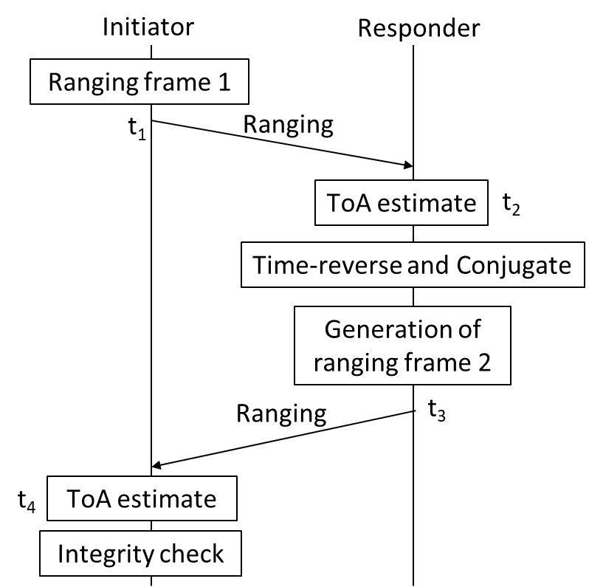
Proposal 1: Extend the Definition of FoM
Do integrity check to produce an integrity score z satisfying $−x≤z≤x$, where x is the length of the STS (correlation-based integrity check method is assumed here as an example, but we do not exclude other methods)
Example
15-22-0072-00-04ab: Integrity protection to support secure ranging in IR-UWB

Slide 6
Proposal 1: Extend the Definition of FoM
Modified definition of FoM
z=x: this corresponds to the case where the receiver is sure that no attack exists. In this case, bit 7 is set to be 0, and other bits are defined as is done in current standard to reflect ranging accuracy
$−x≤z≤0$: this corresponds to the case where the receiver is sure that an attack occurs. In this case, set bit 7=1 and all other bits to be 0 → the measurement result cannot be used (compatible with current standard)
$1≤z≤x−1$: the ranging procedure is being attacked with a possibility that is inversely proportional to z. Set bit 7=1, and other bits are the binary representation of the trustworthiness level, defined as
$$round\left(\frac{z−1}{∆}\right)+1$$
where
$$∆=\frac{x−2}{2^{7}−2}$$
$$(z≥1 and x>2)$$

Slide 7
Proposal 1: Extend the Definition of FoM
Main points for the modified definition of FoM :
Bits 0~6
Bit 7
Bit 7=0: there is no attack, and bits 0~6 characterizes the accuracy of the ToF estimate, as is defined in current standard
Bit 7=1: there might be an attack, and bits 0~6 characterizes the trustworthiness level of the ToF estimate (i.e., the possibility of not being attacked), defined as
Trustworthiness level=$\left\{\begin{aligned}round\left(\frac{z−1}{∆}\right)+1 , integrity score z≥1 \\ 0, integrity score z≤0\end{aligned}\right.$
You cannot characterize both accuracy and trustworthiness using one FoM unless bit 7=0 → introduce a new metric

Slide 8
Proposal 2: A new metric—— Trustworthiness Level (TL)
Bits 0~6
Bit 7
Trustworthiness characterization
usefulness indicator
Do integrity check to produce an integrity score z satisfying $−x≤z≤x$, where x is the length of the STS
TL definition:
bit 7=0 if $−x≤z≤0$ (the receiver is sure that the ranging procedure is being attacked and the measurement is thus useless) and bit 7=1 if $1≤z≤x$ (there might be an attack, but the receiver is not pretty sure, so the measurement can still be used)
If bit 7=0, bits 0~6 are all equal to 0 to indicate the measurement is useless
If bit 7=1, bits 0~6 are the binary representation of the trustworthiness level, defined as
$$round\left(\frac{z−1}{∆}\right)$$
where
$$∆=\frac{x−1}{2^{7}−1}$$
$$(z≥1 and x>1)$$

Slide 9
The feedback of TL
Whether or not the feedback of TL is necessary depends on where the TL is computed and what it is used for.
In this example, TL is computed at the initiator and is used to measure the trustworthiness of the entire ranging round: No need to feedback

Slide 10
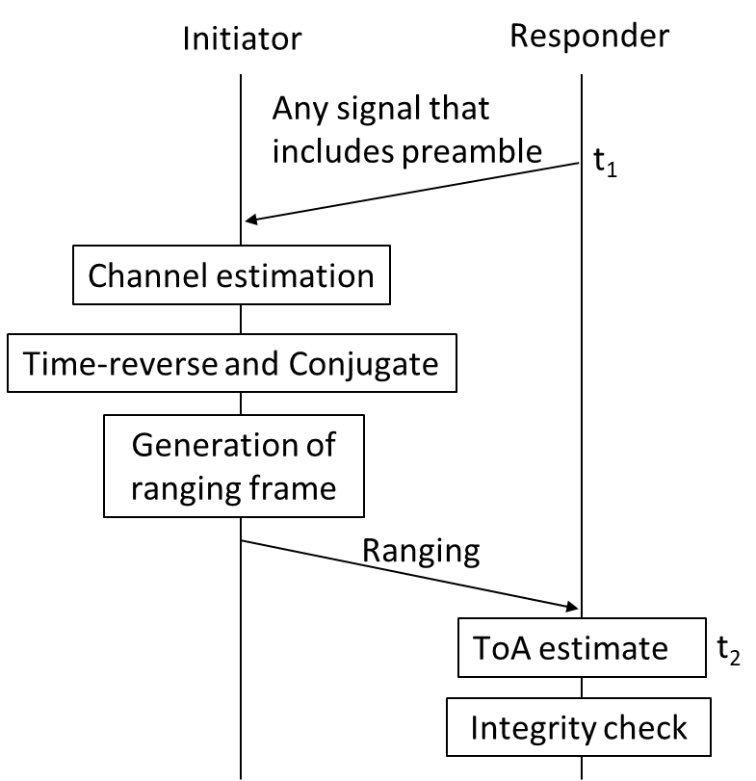
The feedback of TL
Whether or not the feedback of TL is necessary depends on where the TL is computed and what it is used for.
In this example, TL is computed at the responder and is used to measure the trustworthiness of a single ToA measurement: Feedback is needed

Slide 11
The feedback of TL from responder to initiator
With the TLs available, the initiator can perform a weighted average (soft combining) of several measurements of a timestamp (e.g., t2) to get a more reliable result, where the weights are the TLs associated with these measurements (TLs should be normalized to be within the interval [0,1] such that they can be used as weights).
The number of ranging rounds can be adjusted flexibly according to the collected TL reports. For example, more ranging rounds are needed if there are too many “poor” TL reports, implying the higher possibility of being attacked.
The TL reports can be included in the “RangingReportDescriptor” as a new element, and fed back from the responder to the initiator.
Initiator
Responder
t1
Ranging
t2
t3
t4
Ranging
timestamp repots & the associated TLs

Slide 12
Summary
The quality of ToF measurements needs to be evaluated in a more comprehensive way, which can reflect not only the accuracy but also the trustworthiness of the measurements
We propose two methods to address the aforementioned issue, i.e., to extend the current definition of FoM or to introduce a new metric called trustworthiness level (TL)
When necessary, TL reports should be fed back from the responder to the initiator to obtain a more reliable ranging result and enable a more flexible ranging procedure

Slide 13
References
[1] M. Poturalski, M. Flury, P. Papadimitratos, J.-P. Hubaux, J.-Y. Le Boudec, “The Cicada attack: Degradation and denial of service in IR ranging,” in Proceedings of the IEEE ICUWB’2010.
[2] M. Singh, M. Roschlin, E. Zalzala, P. Leu, S. Capkun, “Security analysis of IEEE 802.15.4z/HRP UWB time-of-flight distance measurement,” in Proceedings of the 14th ACM Conference on Security and Privacy in Wireless and Mobile Networks, June 2021.
[3] P. Leu, G. Gamurati, A. Heinrich, M. Rosechlin, C. Anliker, M. Hollick, S. Capkun, J. Classen, “Ghost peak: Practical distance reduction attacks against HRP UWB ranging,” https://arxiv.org/abs/2111.05313, Nov. 2021.
[4] 802.15.4z-2020 - IEEE Standard for Low-Rate Wireless Networks--Amendment 1: Enhanced Ultra Wideband (UWB) Physical Layers (PHYs) and Associated Ranging Techniques.

