Slide 1
Project: IEEE P802.15 Working Group for Wireless Specialty Networks (WSN)
Submission Title: Integrity protection to support secure ranging in IR-UWB
Source: Li Sun, Peng Liu, Yuwei Wang, David Xun Yang (Huawei Technologies)
Address : [Huawei Bantian Base, Longgang District, Shenzhen, 518129 China]
E-Mail: [sunli50@huawei.com]
Re: Task Group 4ab: UWB Next Generation for 802.15.4
Abstract: [Integrity protection, time-reversal, PHY security, secure ranging, UWB]
Purpose:
Notice: This document has been prepared to assist the IEEE P802.15. It is offered as a basis for discussion and is not binding on the contributing individual(s) or organization(s). The material in this document is subject to change in form and content after further study. The contributor(s) reserve(s) the right to add, amend or withdraw material contained herein.
Release: The contributor acknowledges and accepts that this contribution becomes the property of IEEE and may be made publicly available by P802.15.
Notes:
Jul 12, 2010
Page 1

Slide 2
PAR Objective | Proposed Solution (how addressed)
Safeguards so that the high throughput data use cases will not cause significant disruption to low duty-cycle ranging use cases
Interference mitigation techniques to support higher density and higher traffic use cases
Other coexistence improvement
Backward compatibility with enhanced ranging capable devices (ERDEVs)
Improved link budget and/or reduced air-time
Additional channels and operating frequencies
Improvements to accuracy / precision / reliability and interoperability for high-integrity ranging | The proposed solution can be used to detect whether or not the ranging procedure is subject to distance reduction attack. If detected, the ranging results will be rejected. Thus, it provides supports for high-integrity ranging.
Reduced complexity and power consumption
Hybrid operation with narrowband signaling to assist UWB
Enhanced native discovery and connection setup mechanisms
Sensing capabilities to support presence detection and environment mapping
Low-power low-latency streaming
Higher data-rate streaming allowing at least 50 Mbit/s of throughput
Support for peer-to-peer, peer-to-multi-peer, and station-to-infrastructure protocols
Infrastructure synchronization mechanisms

Slide 3
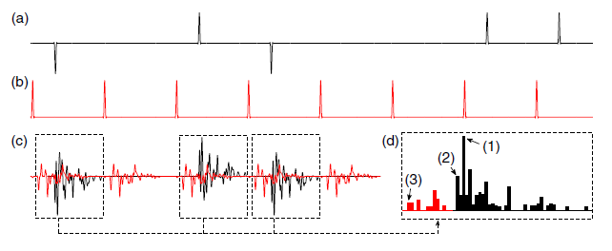
Background and Motivations (1)
Many UWB ranging applications are security sensitive, i.e., the ranging procedure is vulnerable to distance reduction attacks such as Cicada[1], Cicada++[2], Ghost peak[3], etc.
The adversary transmits ultra-wideband pulses during the transmission of the legitimate preamble or STS, thus undermining the leading edge detection and resulting in a reduction in estimated distance.
The back-search algorithm at the receiver incorrectly finds the first-arriving path due to the injection of attack signals
Source: M. Poturalski, M. Flury, P. Papadimitratos, et al, “The Cicada attack: Degradation and denial of service in IR ranging,” IEEE ICUWB’2010

Slide 4
Background and Motivations (2)
Distance reduction attack can cause serious consequences in applications such as keyless car entry, contactless payments, etc.
The encryption of the ranging sequence, as is done in 15.4z standard by using STS [4], cannot solve this problem.
Other solutions include:
  Choosing appropriate MPEP and PAPR thresholds at receiver [2]
  Disadvantages: No general method to choose the thresholds; hard to balance security and ranging accuracy
  Use of Message Time of Arrival Codes [5]
  Disadvantages: In multipath environments, the secure distortion test may still fail even though no attacker exists, due to inter-pulse interference
  An integrity protection method is proposed to detect distance reduction attack and enable both reliable and secure ranging

Slide 5
Time-Reversal based Integrity Protection: General Framework
Initiator
Responder
Ranging frame 1
t₁
Ranging
ToA estimate
t₂
Time-reverse and Conjugate
Generation of
ranging frame 2
Ranging
t₃
t₄
ToA estimate
Integrity check

Slide 6
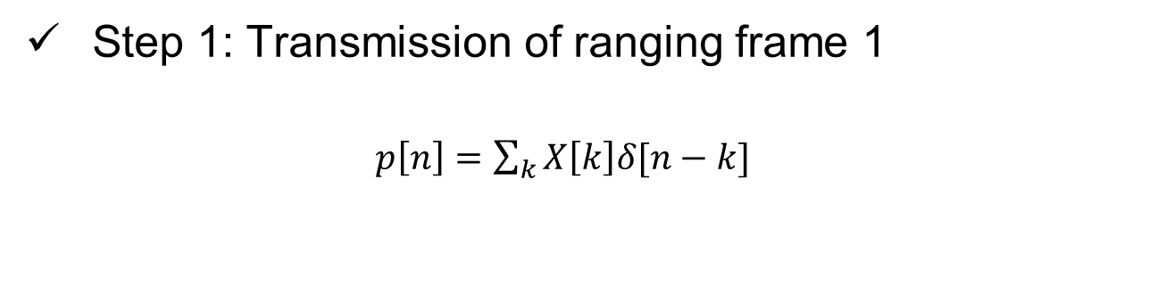

Detailed Implementation (1)
Step 1: Transmission of ranging frame 1
$p\left[n\right]=\sum_{k}{X\left[k\right]δ[n−k]}$
Ranging frame 1 is a normal ranging frame consisting of preamble and STS
STS
Step 2: ToA estimate at the responder
Based on classical correlation-based approach and back-search algorithm
The STS part of the received frame is extracted for further use
Step 3: Generation of ranging frame 2
STS part of the received signal:
$$y_{2}\left[n\right]=p\left[n\right]∗h_{12}[n]+w_{2}[n]$$
Time reverse and conjugate
$$s[n]=y_{2}^{′}[−n]=p^{′}[−n]∗h_{12}^{′}[−n]+w_{2}^{′}[−n]$$
1bit DAC
Truncate the generated signal to make it of equal length as STS (optional)

Slide 7
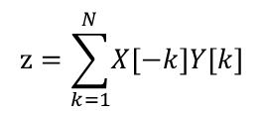

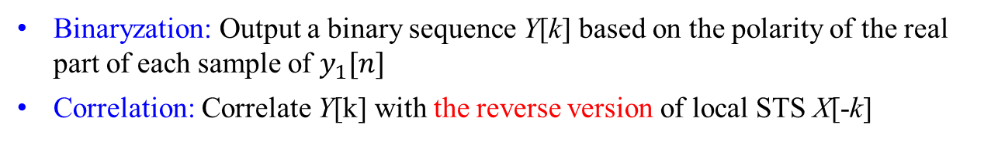



Detailed Implementation (2)
Step 4: ToA estimate at the initiator
$$y_{1}[n] =s[n]∗h_{21}[n]+w_{1}[n]$$
Time focusing effect
= $p^{′}\left[−n\right]∗h_{12}^{′}\left[−n\right]∗h_{21}\left[n\right]+w_{2}^{′}[−n]$+$w_{1}[n]$
channel reciprocity
= $p^{′}\left[−n\right]∗h_{12}^{′}\left[−n\right]∗h_{12}\left[n\right]+w_{2}^{′}[−n]$+$w_{1}[n]$
$$h_{e}\left[n\right]: equivalent CIR$$
Correlate $y_{2}[n]$with the time-reversed version of the local STS $p^{′}\left[−n\right]$ and find the peak
Step 5: Integrity check
Binaryzation: Output a binary sequence Y[k] based on the polarity of the real part of each sample of $y_{1}[n]$
Correlation: Correlate Y[k] with the reverse version of local STS X[-k]
$$z=\sum_{k=1}^{N}{\left.X\left[−k\right]Y[k\right]}$$
Used to characterize level of trustworthiness
Comparison: Compare z with a threshold to determine whether an attack exists

Slide 8
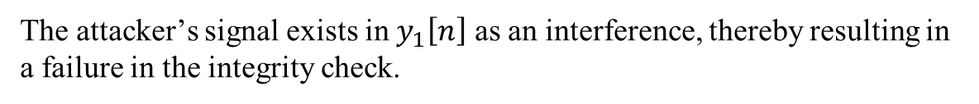
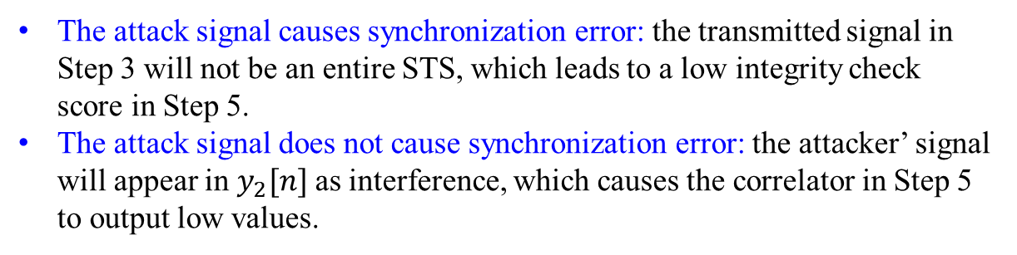
Time-Reversal based Integrity Protection
Security Analysis
The attack signal is injected during ranging phase 1
The attack signal causes synchronization error: the transmitted signal in Step 3 will not be an entire STS, which leads to a low integrity check score in Step 5.
The attack signal does not cause synchronization error: the attacker’ signal will appear in $y_{2}[n]$as interference, which causes the correlator in Step 5 to output low values.
The attack signal is injected during ranging phase 2
The received signal at the initiator will be
$$y_{1}\left[n\right]=s\left[n\right]∗h_{21}\left[n\right]+s_{a}\left[n\right]∗h_{a1}[n]+w_{1}[n]$$
The attacker’s signal exists in $y_{1}\left[n\right]$ as an interference, thereby resulting in a failure in the integrity check.

Slide 9
Simulation Parameters
128 bits STS packet with configuration three (SP3)
8th order Butterworth pulse
SYNC Preamble Code 1 (length 31)
Sampling frequency 500MHz
Peak PRF 499.2MHz
802.15.4a UWB channel model (Residential LOS/NLOS mode), 1000 channel realizations
No frequency offset
Integrity score threshold: 124

Slide 10
Simulation results for LoS Scenario
Attack success rate
A distance reduction attack is considered to be successful if this attack is not detected (i.e., the integrity check passes) and the measured round-trip time is advanced by 6ns or more, corresponding to a distance reduction of 1.8m.
Without integrity protection, the distance reduction attack is successful for almost 50% of the time.
The attack success rate is less than 1% for all SNR values, fully demonstrating the capability of attack detection of the proposed method.

Slide 11
Simulation results for LoS Scenario
False alarm rate
False alarm rate is defined as the probability that the initiator declares attack (i.e., the integrity check fails) but no attack is launched by a malicious device.
The false alarm rate is negligibly small, which demonstrates that the proposed integrity check method is not sensitive to low-resolution quantization, inter-pulse-interference, noise, etc.

Slide 12
Simulation results for LoS Scenario
Ranging accuracy
Ranging accuracy is characterized by the cumulative distribution function (CDF) of the absolute value of the round-trip-time measurement error.
For non-adversarial environments where no attack exists, the proposed method can still bring in a slightly enhanced ranging performance
Significant improvement in terms of ranging accuracy in adversarial environments
Without attack
With attack

Slide 13
Simulation results for NLoS Scenario
Attack success rate
Compared to legacy systems where no integrity protection is used, the proposed method can reduce the attack success rate from ~40% to less than 2% (for phase 1 attack) or almost zero (for phase 2 attack and phase 1&2 attack)
Compared to LoS scenario, the attack success rate is slightly increased, as expected

Slide 14
Simulation results for NLoS Scenario
False alarm rate
Similar false alarm rate performance can be observed as compared to the LoS scenario; In contrast to legacy systems without integrity protection mechanism, the performance loss is negligible

Slide 15
Simulation results for NLoS Scenario
The ranging accuracy is degraded compared to the LoS scenario, but the proposed scheme still helps to maintain a relatively high ranging performance
Ranging accuracy
Ranging accuracy is improved compared to legacy systems no matter whether or not an attack exists
Without attack
With attack

Slide 16
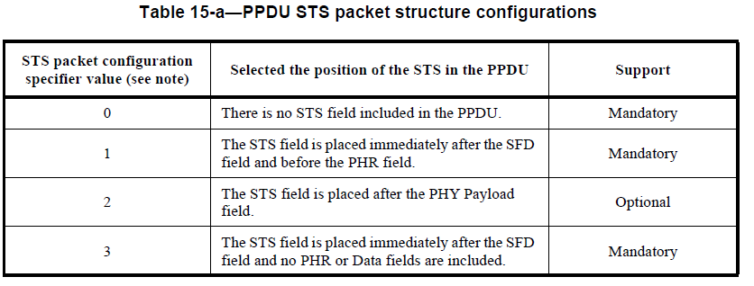
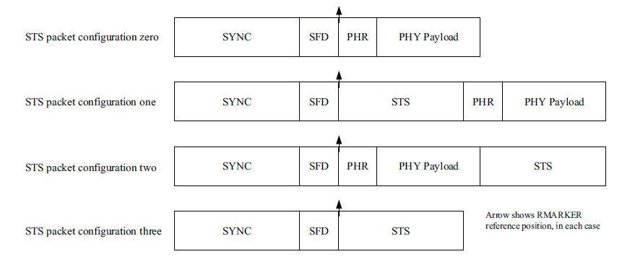
STS+: A new STS to Support Integrity Protection
Source: IEEE 802.15.4z-20200
Source: IEEE 802.15.4z-20200
STS
STS+
STS+ is generated using the proposed approach
$$s[n]=y_{2}^{′}[−n]=p^{′}[−n]∗h_{12}^{′}[−n]+w_{2}^{′}[−n]$$
New STS packet configurations should be provided in addition to the existing ones in 15.4z standard

Slide 17






Two Formats for STS+
$$s[n]=y_{2}^{′}[−n]=p^{′}[−n]∗h_{12}^{′}[−n]+w_{2}^{′}[−n]$$
Format 1: Plain Format
STS
STS+
$$L\left(STS\right)$$
$$L\left(STS\right) +L\left(CIR\right)−1$$
Format 2: Truncated Format
$$L\left(STS\right)$$
STS
STS+
$$L\left(STS\right)$$
$$L\left(STS\right) +L\left(CIR\right)−1$$
$$L\left(STS\right)$$

Slide 18
Negotiation Procedure
Initiator
Responder
A negotiation procedure needs to be added between the initiator and the responder to make an agreement on whether or not to support ranging with integrity protection capability.
The information to be exchanged includes but is not limited to:
  ranging frame configuration (normal frame or integrity-protection supporting frame)
  STS configuration
  STS+ format
  the number of STS/STS+ segments in each ranging frame
  PRF configuration for STS+
Negotiation
Ranging
Ranging

Slide 19
Summary
It is necessary to incorporate integrity protection mechanism in the next generation UWB standard to combat distance reduction attack and enable secure ranging
A general framework is proposed to provide integrity protection, under which a time-reversal based method is developed
The proposed solution is effective in detecting distance reduction attack and improving ranging accuracy, despite its simplicity
New STS formats should be defined to support integrity protection, and a negotiation procedure needs to be added in the ranging protocols in the standard

Slide 20
References
[1] M. Poturalski, M. Flury, P. Papadimitratos, J.-P. Hubaux, J.-Y. Le Boudec, “The Cicada attack: Degradation and denial of service in IR ranging,” in Proceedings of the IEEE ICUWB’2010.
[2] M. Singh, M. Roschlin, E. Zalzala, P. Leu, S. Capkun, “Security analysis of IEEE 802.15.4z/HRP UWB time-of-flight distance measurement,” in Proceedings of the 14th ACM Conference on Security and Privacy in Wireless and Mobile Networks, June 2021.
[3] P. Leu, G. Gamurati, A. Heinrich, M. Rosechlin, C. Anliker, M. Hollick, S. Capkun, J. Classen, “Ghost peak: Practical distance reduction attacks against HRP UWB ranging,” https://arxiv.org/abs/2111.05313, Nov. 2021.
[4] 802.15.4z-2020 - IEEE Standard for Low-Rate Wireless Networks--Amendment 1: Enhanced Ultra Wideband (UWB) Physical Layers (PHYs) and Associated Ranging Techniques.
[5] P. Leu, M. Singh, M. Roschlin, K. G. Paterson, S. Capkun, “Message time of arrival codes: a fundamental primitive for secure distance measurement,” https://arxiv.org/abs/1911.11052.

