Slide 1
Project: IEEE P802.15 Working Group for Wireless Specialty Networks (WSN)
Submission Title: The Capacity and Accuracy Optimization for DL-TDoA of UWB
Date Submitted: 21th Jan 2022
Source: Libra Xiao (NewRadio Technology), Weidong Tang (NewRadio Technology)
Contact: 1408, Building 4, Phase 1, Tianan Yungu, Bantian Street, Longgang District, Shenzhen, Guangdong, China
E-Mail: xiaojiaxing@newradiotech.com, tangweidong@newradiotech.com
Re: Call for contributions to IEEE 802.15 TG4ab
Abstract: UWB related capacity and accuracy solution for optimizing DL-TDoA
Purpose: Discussion of how to improve 802.15.4(z) to serve industrial positioning systems
Notice: This is a basis for discussion and is not binding on the contributing individual(s) or document prepared to assist the IEEE P802.15. The material in this document is subject to change in form and content after further study. The contributor(s) reserve(s) the right to add, amend or withdraw material contained herein.
Release: The contributor acknowledges and accepts that this contribution becomes the property of IEEE and may be made publicly available by P802.15.
submission

Slide 2
PAR Objective | The Proposed Solution (how addressed)
Safeguards so that the high throughput data will not cause significant disruption to low duty-cycle ranging use cases
Interference mitigation techniques to support higher density and higher traffic use cases | Using FDMA/CDMA/SDMA schemes to improve capacity by reducing the interference among many UWB devices with higher density
Other coexistence improvements
Backward compatibility with enhanced ranging capable devices (ERDEVs)
Improved link budget and/or reduced air-time
Additional channels and operating frequencies
Improvements to accuracy / precision / reliability and interoperability for high-integrity ranging | Using channel pool, code pool or antenna pool to improve position accuracy / precision with the DL-TDoA algorithm against the TDMA scheme
Reduced complexity and power consumption
Hybrid operation with narrowband signaling to assist UWB
Enhanced native discovery and connection setup mechanisms
Sensing capabilities to support presence detection and environment mapping
Low-power low-latency streaming
Higher data-rate streaming allowing at least 50 Mbit/s of throughput
Support for peer-to-peer, peer-to-multi-peer, and station-to-infrastructure protocols
Infrastructure synchronization mechanisms
submission

Slide 3
Previous submissions
Reverse TDOA Applications and Technical Characteristics
<15-21-0223-00-04ab>, April 2021, Zhenzhen Ye (Red Point Positioning)
Downlink TDOA (DL-TDOA) Location Service in 802.15
<15-21-0488-00-04ab>, Sept 2021, Zhenzhen Ye (Red Point Positioning)
DL-TDOA positioning TDMA scheme
<15-21-0530-00-04ab>, Oct 2021, Jean-Marie André (ST microelectronics), Sven Zeisberg (Zigpos)
Beacon and Ranging Frames to Support Downlink TDOA (DL-TDOA) Location Service in 802.15
<15-21-0616-00-04ab>, Nov 2021, Yongsen Ma and Zhenzhen Ye (Red Point Positioning)
submission

Slide 4
Terminology
UWB Anchor: the FFD in page 57 of IEEE 802.15.4-2020 operated as a coordinator
UWB Tag: the FFD in page 57 of IEEE 802.15.4-2020 operated as a device
Channel pool: communication channels approved in a region
Code pool: a set of codes defined for the CDMA scheme.
Antenna pool: a set of antennae used in the SDMA scheme
submission

Slide 5
Recap of DL-TDoA
Full Blown UWB anchors are regular anchors. They are connected to the mains and can communicate as much as needed.
    Battery Powered UWB anchors are not connected to the mains. They are easy for installation and useful for densifying a place where accurate DL-TDoA is needed. For such devices, the operation time must be minimized in order to save power and maximize the lifetime of battery.
submission

Slide 6
The Problems of DL-TDoA with TDMA
Extra Scheduling
  Complicate scheduling makes deployment more difficult and reduces capacity.
Inaccurate Positioning
  A moving UWB tag can not achieve accurate ranging result, because it receives messages at different locations.
submission

Slide 7


Positioning of a moving tag
UWB Anchor A
UWB Anchor B
UWB Anchor A
UWB Anchor B
T1
T2
Moving UWB Tag
Moving UWB Tag
➀
➁
➂
➃
➀
➁
➂
➃
UWB Anchor C
UWB Anchor D
UWB Anchor C
UWB Anchor D
R_{a}
R_{b}
Figure1.T1
Figure2. T2
UWB Anchor A
UWB Anchor B
UWB Anchor A
UWB Anchor B
R_{c}
R_{d}
Moving UWB Tag
Moving UWB Tag
➀
➁
➂
➃
➀
➁
➂
➃
T3
T4
UWB Anchor C
UWB Anchor D
UWB Anchor C
UWB Anchor D
Figure3. T3
Figure4. T4
Note:
➀
➁
➂
➃
stand for the locations of the UWB tag during ranging
submission

Slide 8
FDMA Solution
Inaccuracy caused by moving can be addressed by FDMA scheme, CDMA (Code Division Multiple Access) scheme, or SDMA (Space Division Multiple Access) scheme.
FDMA scheme
  Different UWB anchors operate at different frequencies.
  No scheduling is required during ranging.
submission

Slide 9
An example of FDMA
B
A
Note：This example uses the channel pool of CH5/CH6/CH8/CH9 in IEEE 802.15.4-2020 as showed in the figure above
submission

Slide 10
CDMA and SDMA Solutions
  CDMA
    Full available spectrum
    Each UWB anchor with a unique code
    Low power spectrum density
  SDMA
    All devices operate at the same time and use the same space.
    A single UWB anchor can communicate with more UWB tags with the same frequency.
    Because directional spot-beam antennae are used, the UWB anchors in SDMA can track a moving UWB tag.
submission

Slide 11
Advantages of Proposed Solutions
  FDMA: mature technology, simple equipment, no need for network synchronization, reliable work, high-capacity lines, high-efficiency, suitable for occasions with few stations and large capacity
  CDMA: no frequency planning, good confidentiality, strong anti-jamming and anti-interception capabilities, using multi-path characteristics and using RAKE technology to improve performance
    Cons: low spectrum utilization rate, not suitable for large-capacity systems
  SDMA: the same space using multiple beams
submission

Slide 12
Summary of Proposed Schemes
FDMA uses four or more channels at the same time.
CDMA uses one channel, and four or more spread codes to differentiate UWB anchors.
SDMA uses directional information to tell the difference between UWB anchors.
submission

Slide 13
Proposed changes for MAC & PHY
MAC: to support channel, code or antenna pools as option in specifications
PHY: to support multiple channels , codes or antennae to work at the same time.
submission

Slide 14
Thank you for listening!
submission

Slide 15
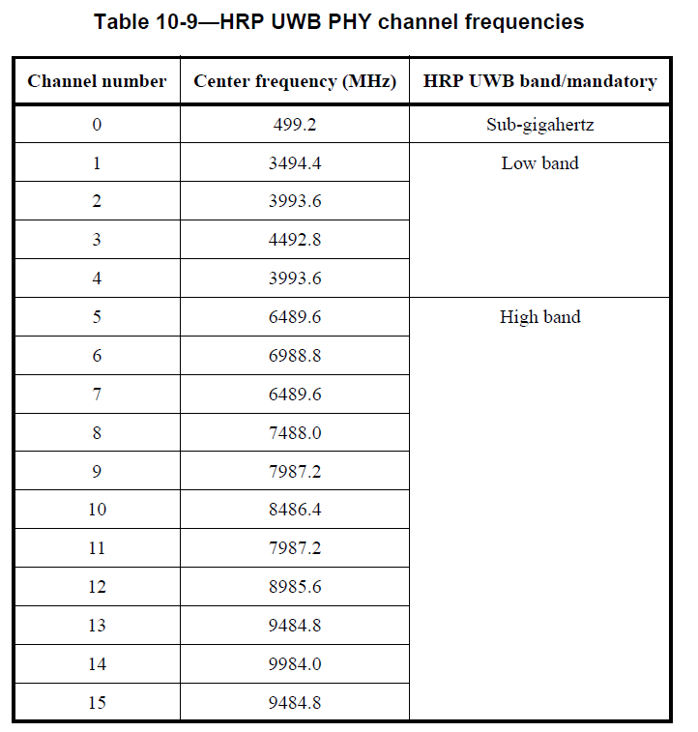
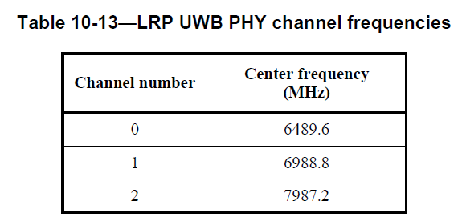
Channels in IEEE 802.15.4-2020
submission

