Slide 1
Project: IEEE P802.15 Working Group for Wireless Specialty Networks (WSN)
Submission Title: Link budget analysis and CIR reporting for UWB RF sensing
Date Submitted: 21 January 2022
Source: Pooria Pakrooh, Bin Tian, Steve Shellhammer and Koorosh Akhavan (Qualcomm)
E-Mail: {ppakrooh, btian, sshellha, kakhavan}@qti.qualcomm.com
Abstract: This presentation discusses the characteristics of Channel Impulse Response (CIR) for UWB RF sensing. Then, the design of CIR report is discussed.
Purpose: Present technical content for consideration by the group
Notice: This document has been prepared to assist the IEEE P802.15. It is offered as a basis for discussion and is not binding on the contributing individual(s) or organization(s). The material in this document is subject to change in form and content after further study. The contributor(s) reserve(s) the right to add, amend or withdraw material contained herein.
Release: The contributor acknowledges and accepts that this contribution becomes the property of IEEE and may be made publicly available by P802.15.

Slide 2
PAR Objective | Proposed Solution (how addressed)
Safeguards so that the high throughput data use cases will not cause significant disruption to low duty-cycle ranging use cases
Interference mitigation techniques to support higher density and higher traffic use cases
Other coexistence improvement
Backward compatibility with enhanced ranging capable devices (ERDEVs)
Improved link budget and/or reduced air-time
Additional channels and operating frequencies
Improvements to accuracy / precision / reliability and interoperability for high-integrity ranging
Reduced complexity and power consumption
Hybrid operation with narrowband signaling to assist UWB
Enhanced native discovery and connection setup mechanisms
Sensing capabilities to support presence detection and environment mapping | We investigate the characteristics of Channel Impulse Response (CIR) for UWB RF sensing. Then, the design of CIR report is discussed.
Low-power low-latency streaming
Higher data-rate streaming allowing at least 50 Mbit/s of throughput
Support for peer-to-peer, peer-to-multi-peer, and station-to-infrastructure protocols
Infrastructure synchronization mechanisms

Slide 3
Introduction
RF sensing has different requirements than ranging and communication
Ranging relies on the estimation of earliest path in Channel Impulse Response (CIR).
Communication mostly utilizes the few strongest CIR taps.
RF sensing makes inferences about the changes in the environment by measuring changes in the wireless channel(s) and relies on channel consistency from one packet to the next.
Sensing information may be contained in a window of CIR taps.

Slide 4
Introduction
We investigate the channel impulse response (CIR) characteristics for RF sensing through link budget analysis.
The CIR taps could have low power and large dynamic range.
The design of the sensing CIR report format should address these two challenges in RF sensing:
Large dynamic range in CIR taps
Consistency in CIR report for multiple CIR measurements to identify changes in the environment
Based on the characteristics of CIR and sensing requirements, we share our thoughts on sensing report design.

Slide 5
Sensing link budget analysis
Consider a bi-static UWB sensing scenario in which CIR measurement report is required.
Here, we provide a UWB RF sensing link budget based on the radar equation
Based on that, we look at the dynamic range of the received power difference between the direct path and the reflected path off the object being sensed
$$d_{3}$$
Initiator/ Tx
Responder/Rx
$$d_{2}$$
$$d_{1}$$
Sensing packet
OTA CIR measurement report
Object being
sensed

Slide 6
Radar equation for UWB sensing
Dynamic range and received power analysis, using standard radar equation
$$P_{RX}=\left(\frac{G_{TX}{ G}_{RX} λ^{2}σ}{{\left(4π\right)}^{3}d_{1}^{2} d_{2}^{2}}\right) P_{TX}$$
Parameter | Typical Value | Notes
$$P_{TX}$$ | -14.3 dBm | There is a regulatory limit of -41.3 dBm/MHz Using 500 MHz Bandwidth gives us a transmit power of -14.3 dBm
$$G_{TX}$$ | 1 = (0 dB) | Omni Antenna with no Antenna Loss (Optimistic)
$$G_{RX}$$ | 1 = (0 dB) | Omni Antenna with no Antenna Loss (Optimistic)
$$λ$$ | 0.0375 meters | IEEE 802.15.4z states “Ten frequency channels are available with center frequencies from 6489.6 MHz to 9945.6 MHz and various bandwidths.” Here we use 8 GHz as the carrier frequency.
$$σ$$ | 0.02 (hand), 0.2 (child), 1 (adult) in ${meters}^{2}$ | The actual radar cross section of sensing object.
$$d_{1}$$ | A few meters | Depends on the application
$$d_{2}$$ | A few meters | Depends on the application

Slide 7
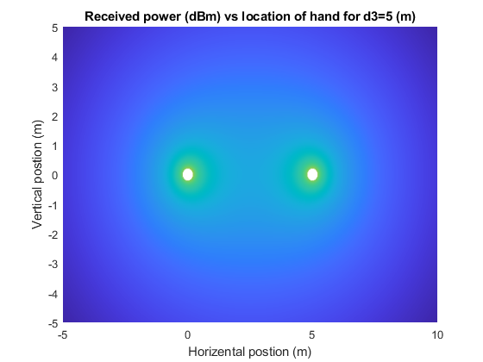
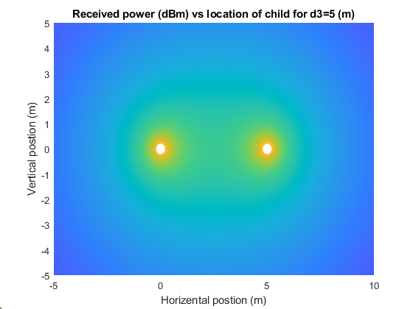
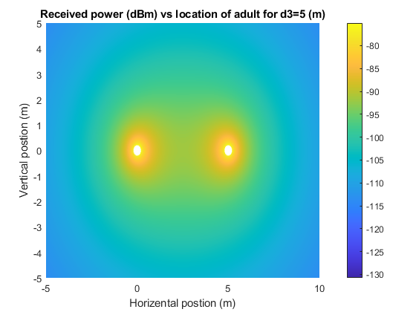
UWB Sensing received power
Received power vs object location for Tx/Rx distance of 5(m)
Far field radiation starts at d>2 $\frac{D^{2}}{\text{λ}}$, where D is antenna dimension. Assuming d>5λ:
Heatmap colors represent received signal power from sensing objects placed at different locations
The near field region d<5λ where the far field radiation assumption is invalid is omitted by white circles around Tx/Rx antennas.
UWB Tx
UWB Rx

Slide 8
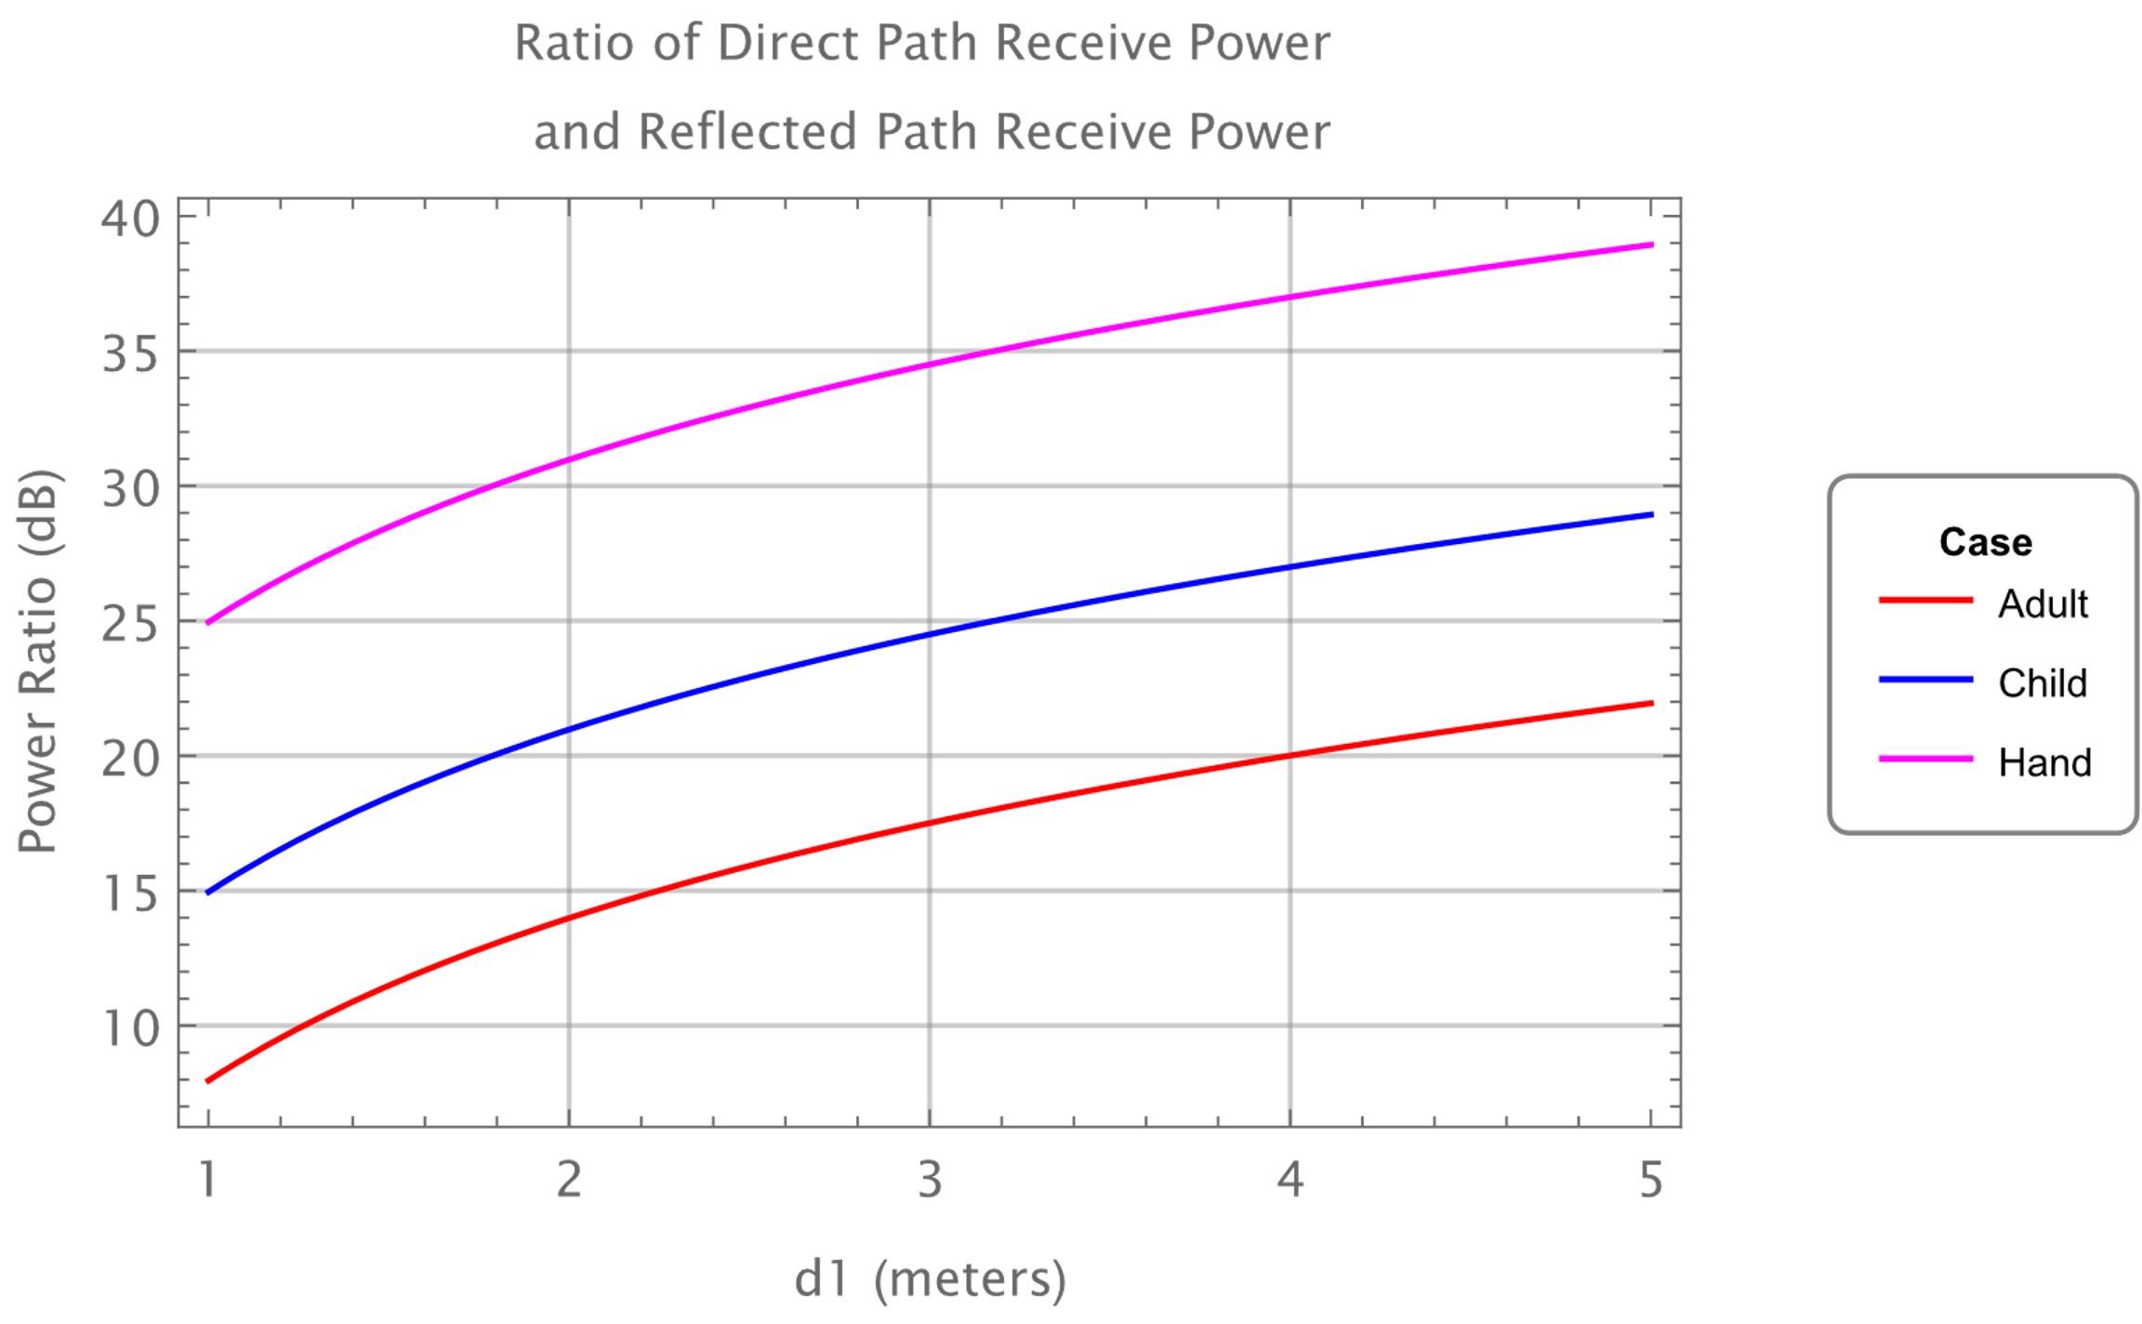
UWB Sensing dynamic range
Ratio of RX power of direct path and RX power of reflected path:
Depending on the distance, the main challenges for UWB sensing are therefore large dynamic range and potentially low received signal level.
For example, at 5(m) Tx/Rx distance: Large dynamic range of 22-38dB, and weak received power of around -120 dBm at 5(m) sensing object distance
Assuming d1=d2=d, Ratio Direct/Reflected received power increases according to $d^{2}$

Slide 9
CIR Report
In some RF Sensing applications, the channel impulse response (CIR) may need to be sent over-the-air from responder to the initiator [1, 2]
A presentation on CIR report feedback has been provided in [3].
In the design of the CIR measurement report we need to address the large dynamic range and low level for CIR report.
Specifically, CIR measurement report format needs to be decided:
Which CIR taps to be included in the report (approaches 1a-1c in this presentation)
Alignment of the CIR measurement report across packets
Feedback format for the CIR tap values

Slide 10
Approach 1a: Thresholding CIR taps
Report the strongest tap, and the taps whose power are above a threshold.
Challenges:
Needs careful selection of the threshold value, potentially relative to the strongest tap:
For conservative selection of threshold, this could end up with large overhead.
For large threshold, the object(s) of interest could be missed.
Leads to a variable length for the CIR measurement report
Non-uniform CIR samples
This requires indication of tap offsets as well as the tap values.
Difficulty in comparing CIR reports across measurements, since reported taps could be different in different measurements.

Slide 11
Approach 1b: $n$strongest CIR taps
Top $n$ strongest taps are included in the CIR report, where $n$ is a parameter
Challenges:
Needs careful selection of the value $n$ to report in various sensing conditions
For small selection of $n$, the sensing object of interest could be missed due to weak reflection
For conservative selection of $n$, this could end up with large overhead.
Leads to a variable length for the CIR measurement report
Non-uniform CIR samples
This requires indication of tap offsets as well as the tap values.
Difficulty in comparing CIR reports across measurements, since reported taps could be different in different measurements.

Slide 12
Approach 1c: Fixed window duration in time domain
Here we propose to use a CIR reporting window of fixed length.
The duration of the window depends on the sensing distance spread to be covered
Note that this window needs to be large enough to capture the important CIR taps expected for the RF sensing application, needs to be adjustable depending on the application
In this approach, the receiver needs a reference for which to define the CIR Window.

Slide 13
Approach 1c: Fixed window duration in time domain
In this approach, the receiver needs a reference for the CIR window
Option 1: The strongest tap in the CIR: Fixed duration around the strongest tap; this is possibly the most consistent marker we can get.
Option 2: Earliest detected tap: For example, in [3] it was suggested to start the CIR reporting window with the first detected tap
No significant different between two options. Strongest tap as a reference may be more consistent, and easy to define. The earliest tap can be weak, and its detection is implementation specific.
Strongest detected tap
Noise Threshold
$t_{0}$- $t_{lead}$
$$t_{0}$$
$$t_{0}\text{+} t_{lag}$$
Fixed window around the strongest detected tap
Earliest detected tap
Noise Threshold
$t_{0}$- $t_{lead}$
$$t_{0}\text{+} t_{lag}$$
$$t_{0}$$
Fixed window around the earliest detected tap

Slide 14
Approach 1c: Fixed window duration in time domain
If LOS is not blocked, potentially the strongest tap is close to the first tap. Therefore, the window could be selected asymmetrically around the strongest tap.
Signaling from initiator to responder could be used on how many taps to report before/after the strongest tap (parameterized as $t_{lead}$ and $t_{lag}$ in the figure below).
The benefits of the proposed approach:
As the window length is fixed, this approach does not need much processing at the responder to identify the taps for the CIR report.
This does not require indication of tap offset since the taps are reported in order.

Slide 15
Analysis on feedback size for approach 1c
Depending on the sensing range under coverage, the number of required taps can be computed as:
$Tap_{num}=\frac{d_{spread}}{T_{chip}∗c}$ , where$d_{spread}$ is the sensing range spread to be covered in the sensing application:
Difference between the shortest and longest paths in the sensing application: that is, $d_{spread}$= $d_{1}+d_{2}$- $d_{3}$in the figure below
$$d_{3}$$
Initiator/ Tx
Responder/Rx
$$d_{1}$$
$$d_{2}$$
Object being
sensed

Slide 16
Analysis on feedback size for approach 1c
Example: 16 taps at chip rate (2ns) or 32 taps at 2x chip rate (1ns) can cover sensing range spread close to 10 (m)
At $d_{spread}$ greater than 10(m) the signal level drops very low. See slide 7.
CIR report duration: Here, for simplicity we assume 16 bits for each I/Q to achieve dynamic range of 90 dB. Further compression is possible.
At 2x chip rate sampling, total number of bits: 32bits*32=128 bytes
128 bytes per 10m of coverage at 2x chip rate
Sensing range spread (m) | # of taps at twice chip rate (1ns) | Feedback size (bytes) | HPRF CIR feedback duration (us) | BPRF CIR feedback duration (us)
5 | 16 | 64 | 18.75 | 75
10 | 32 | 128 | 37.5 | 150

Slide 17
CIR report alignment across packets
As discussed, RF Sensing makes inferences about the changes in the environment by measuring changes in the wireless channel.
In the fixed widow approach (1c), each packet is reported with the reference point as either strongest tap or earliest detected tap.
Across multiple packets, if reference point [strongest or earliest in the standard] is kept consistent and the reference point does not change, then the packets are roughly aligned.
Post-processing methods for further fine alignment can be left to implementation.
If there is change on the reference point, strongest or earliest tap, across different packets, the report window may have a mis-alignment.
The window size can be selected large enough so that there is margin to compensate for mis-alignment.
Implementation specific post-processing is required at application layer to further align the CIR windows across packets.

Slide 18
CIR value feedback format
Feedback sampling rate: 2x of the UWB chip rate (998.4MHz) to achieve proper resolution for interpolation.
Feedback format for CIR values needs to be specified in the standard
IQ domain: In-phase and quadrature CIR value
The CIR values can be compressed before reporting.

Slide 19
Summary
The CIR for RF sensing applications has large dynamic range and potentially low power.
We recommend a window of fixed duration for the CIR measurement report in UWB sensing (approach 1c).
The duration of the window depends on the sensing distance spread to be covered.
The strongest or the earliest detected CIR tap was proposed as the reference for defining the CIR Window
This does not require indication of tap offset since the taps are reported in order.
The overhead of the report is reasonable.

Slide 20
References
Frank Leong, Wolfgang Küchler, Riku Pirhonen, “UWB Sensing in 802.15, IEEE 802.15-21/399r0,” July 2021
Pooria Pakrooh, Bin Tian, Steve Shellhammer, and Koorosh Akhavan “UWB Sensing Scenarios for 802.15.4ab”, IEEE 802.15-22-0012-02-4ab, January 2022
Xiaohui Peng, David Xun Yang, Chenchen Liu, Rani Keren, Kuan Wu, “CIR feedback for UWB sensing,” IEEE 802.15-21/570r0, November 2021
R1-2112493, 3GPP TSG RAN WG1 #107-e, “ Feature Lead Summary #2 for Potential multipath/NLOS mitigation”, Moderator (Nokia)

