Slide 1
Project: IEEE P802.15 Working Group for Wireless Personal Area Networks (WPANs)
Submission Title: Pilot NB radio for assisting UWB channel access
Date Submitted: January 21, 2022
Source: Huan-Bang Li, Takeshi Matsumura (NICT, Japan)
Address: 3-4 Hikarino-oka, Yokosuka-shi, Kanagawa, 239-0847 Japan
E-Mail: {lee, matsumura}@nict.go.jp
Abstract: Discussion on cooperated UWB and NB radio for enhancing UWB channel access.
Purpose: To improve coexistence among UWB systems.
Notice: This document has been prepared to assist the IEEE P802.15. It is offered as a basis for discussion and is not binding on the authoring individual(s) or organization(s). The material in this document is subject to change in form and content after further study. The authors(s) reserve(s) the right to add, amend or withdraw material contained herein.

Slide 2
PAR Objective | Proposed Solution (how addressed)
Safeguards so that the high throughput data use cases will not cause significant disruption to low duty-cycle ranging use cases | Effective and efficient CCA reduce disruption between UWB devices
Interference mitigation techniques to support higher density and higher traffic use cases | Use pilot NB radio as pilot to facilitate CCA so as to improve coexistence.
Other coexistence improvement | Use pilot NB radio to improve coexistence among UWB devices.
Backward compatibility with enhanced ranging capable devices (ERDEVs)
Improved link budget and/or reduced air-time
Additional channels and operating frequencies
Improvements to accuracy / precision / reliability and interoperability for high-integrity ranging
Reduced complexity and power consumption
Hybrid operation with narrowband signaling to assist UWB | Exploiting pilot NB PHY and concurrent operation with UWB to assist UWB channel access
Enhanced native discovery and connection setup mechanisms
Sensing capabilities to support presence detection and environment mapping
Low-power low-latency streaming
Higher data-rate streaming allowing at least 50 Mbit/s of throughput
Support for peer-to-peer, peer-to-multi-peer, and station-to-infrastructure protocols
Infrastructure synchronization mechanisms

Slide 3
Contents
Pilot NB radio for assisting UWB channel access
  FCP and PCP
  Features
Consideration of pilot narrow band radio
Use of sub-GHz spectrum in Japan
  Rules on using the sub-GHz
  Candidate spectrum
  Examples of usage and benefits
Conclusion

Slide 4
Pilot NB radio for assisting UWB channel access
According to 802.15.4-2020, a compliant UWB PHY is required to perform CCA when accessing UWB channels with one of the following six CCA modes.
CCA Mode 1: Energy above threshold.
CCA Mode 2: Carrier sense only.
CCA Mode 3: Carrier sense with energy above threshold.
CCA Mode 4: ALOHA.
CCA Mode 5: HRP UWB preamble sense based on the SHR of a frame.
CCA Mode 6: HRP UWB preamble sense based on the packet with the multiplexed
preamble as specified in 15.6.
We proposed to add an additional CCA mode to the above
CCA Mode #: Pilot NB radio assisted channel sensing.
how the multiple devices to coordinate when sensing the channel and possible fairness issues

Slide 5
Two Realizations
CCA
Pilot
NB
CCA
Pilot
NB
CCA
Pilot
NB
Start and stop of transmission are fully synchronized.
TX signal
UWB
task
UWB
task
UWB
task
#1 Fully concurrent pilot (FCP)
time
Pilot NB Pilot NB Pilot NB
Pilot NB signal is of short length and is used as an indicator.
CCA
CCA
CCA
TX signal
UWB
task x
UWB
task y
UWB
task z
#2 Partially concurrent pilot (PCP)
time

Slide 6
Features
Avoid the difficulties of sensing noise-like UWB signal.
Provide unified structure and procedure that can be commonly used by different UWB schemes including HRP, LRP, 15.6.
Exploit legacy sensing methods developed with NB radios and benefit from their effectiveness and efficiency, such as
CCA Mode 1: Energy above threshold.
CCA Mode 2: Carrier sense only.
CCA Mode 3: Carrier sense with energy above threshold.
No need to touch into preamble of UWB packet.
(For details, please refer to 15-21-0589-00-04ab)

Slide 7
Pilot NB radio consideration
Find a proper NB spectrum
  Less of regulatory restriction
  Off-the-shelf devices/chips
Provide fairness among devices for channel access
  From viewpoint of regulatory requirement as well as control design
Coexistence between pilot NB radio and other NB radio
  No heavy usage and no long duration of occupancy.

Slide 8
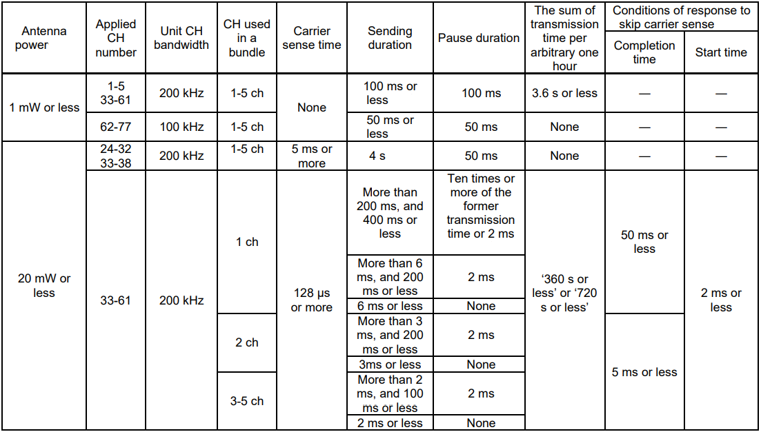
License-exempt sub-GHz radios in Japan
TX

Slide 9
Proper candidate spectrum for pilot NB radio
Restriction to use the spectrum
maximum TX power | maximum antenna gain | Channel occupation | maximum TX duration | TX pause duration
1mW | 3 dBi | Up to 5 | 50ms | 50ms

Slide 10
Benefits as pilot NB radio
Free spectrum with less restriction.
  Availability of frequent channel access (every 50 ms)
  Up to 50ms transmission for each access
Multiple available channels
  16 channels enable various combinations
Light expected usage with restricted TX power
  Active RFID

Slide 11
Example of usage (without overlap)

Slide 12
Example of usage (with overlap)
pttn i-1 pttn i
#62 #63 #64 #65 #66 #67 #68 #69 #70 #71 #72 #73 #74 #75 #76 #77
#71 #73 #74 #75
#71 #72 #74 #75
#71 #72 #73 #75
pttn i1 pttn i2 pttn i3

Slide 13
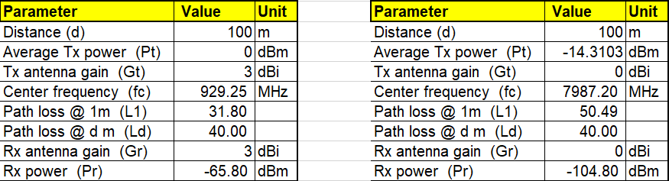
Improved RX power
Sub GHz band UWB CH 9
Difference of RX power is 39 dB

Slide 14
Conclusions
The proposed pilot NB radio assisted UWB channel access provides a common framework that can be used by different UWB schemes.
Examples of pilot NB radio using Japanese sub-GHz band is presented, which is suitable for the considered purpose with low emission power and multiple channels.
Significant improvement can be achieved in the sense of RX power to be sensed.

Slide 15
Reference Slides

Slide 16
Mapping pilot multiple carriers
Mapping multiple carriers:
Form a multiple carriers group for the purpose of indicating UWB channels (MCG-ch). Each element in the MCG-ch corresponds to a single specified UWB channel.
Form a multiple carriers group for the purpose of indicating UWB task durations (MCG-td). Each element in the MCG-td corresponds to a pre-determined duration to execute a UWB task.
f_{i} f_{j}
frequency

