Slide 1
Project: IEEE P802.15 Working Group for Wireless Personal Area Networks (WPANs)
Submission Title: Measurement based BAN channel model for XR applications: Part I
Source: Carlos Aldana (Meta), Andreas Molisch (USC), Morteza Mehrnoush (Meta), Chunyu Hu (Meta)
Address : [1 Hacker Way, Menlo Park, CA 94025]
E-Mail: [caldana (at) fb.com]
Re: Study Group 4ab: UWB Next Generation
Abstract: [Measurement based channel model for body area networks]
Purpose:
Notice: This document has been prepared to assist the IEEE P802.15. It is offered as a basis for discussion and is not binding on the contributing individual(s) or organization(s). The material in this document is subject to change in form and content after further study. The contributor(s) reserve(s) the right to add, amend or withdraw material contained herein.
Release: The contributor acknowledges and accepts that this contribution becomes the property of IEEE and may be made publicly available by P802.15.
Notes:
Jul 12, 2010
Page 1

Slide 2
Technical Guidance [1]
PAR Objective | Proposed Solution (how addressed)
Safeguards so that the high throughput data use cases will not cause significant disruption to low duty-cycle ranging use cases.
Interference mitigation techniques to support higher density and higher traffic use cases
Other coexistence improvement
Backward compatibility with enhanced ranging capable devices (ERDEVs).
Improved link budget and/or reduced air-time | Channel model for body area networks applies here
Additional channels and operating frequencies
Improvements to accuracy / precision / reliability and interoperability for high-integrity ranging; | Channel model for body area networks applies here
Reduce complexity and power consumption;
Hybrid operation with narrowband signaling to assist UWB;
Enhanced native discovery and connection setup mechanisms;
Sensing capabilities to support presence detection and environment mapping;
Low-power low-latency streaming | channel model for body area networks applies here
higher data-rate streaming allowing at least 50 Mbit/s of throughput. | Chanel model for body area networks applies here
Support for peer-to-peer, peer-to-multi-peer, and station-to-infrastructure protocols;
Infrastructure synchronization mechanisms.

Slide 3
Background
IEEE 802.15.4 Channel Models
  [1] 15-04-0662 “IEEE 802.15.4a channel model – final report”
    BAN model based on Remcom Finite Difference Time Domain (FDTD) simulator for freq range from 2-6 GHz
IEEE 802.15.6 Channel Models
  [2] 15-08-780 “Channel Model for Body Area Network”
  [3]15-08-418-01 “Channel Models WBAN – Holst Centre / IMEC-NL”
  [4]15-08-416-04 “Channel Models for WBANs – NICT”

Slide 4
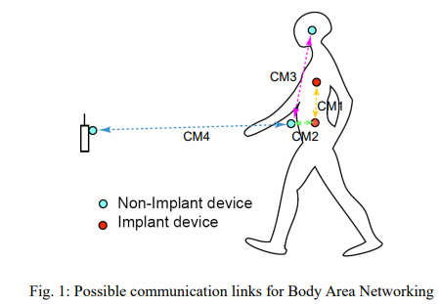
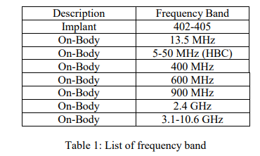
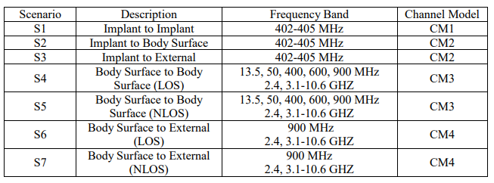
Background on 15.6
Ref[2] is a comprehensive list of BAN channel models.

Slide 5
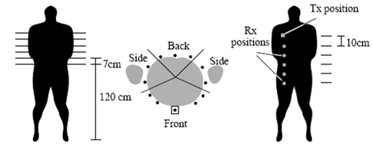

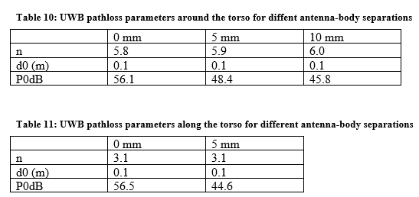
Background [3]
Transmitter is placed in front of the body. “Around torso” has worse path loss (n~6) than “along torso” (n~3). Skycross SMT-3TO10M antennas used. Freq: 3-6 GHz

Slide 6
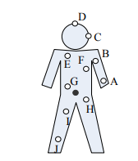
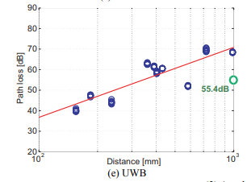
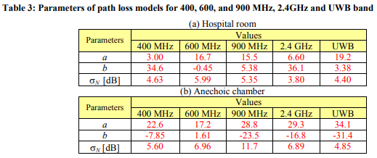
Background [4]
Controller is placed in middle of the body. A single path loss equation is given and n~3. This is fine as long as measurements are in front of the body. Antenna used is Skycross antenna.
PL model = alog₁₀d + b
(d is in mm)

Slide 7
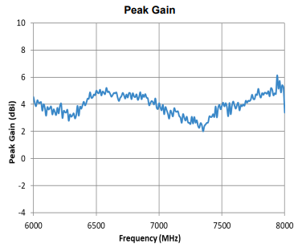
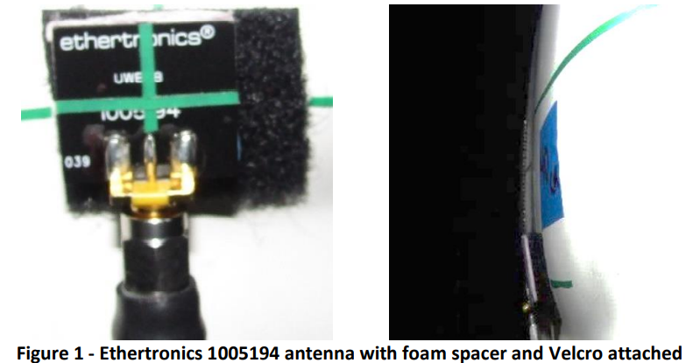
Antenna used for measurement
Ethertronics 1005194 with foam spacer and velcro attached
PCB antenna (linear polarization) that measures 20.6x18.6x0.8mm
Ref : datasheet

Slide 8
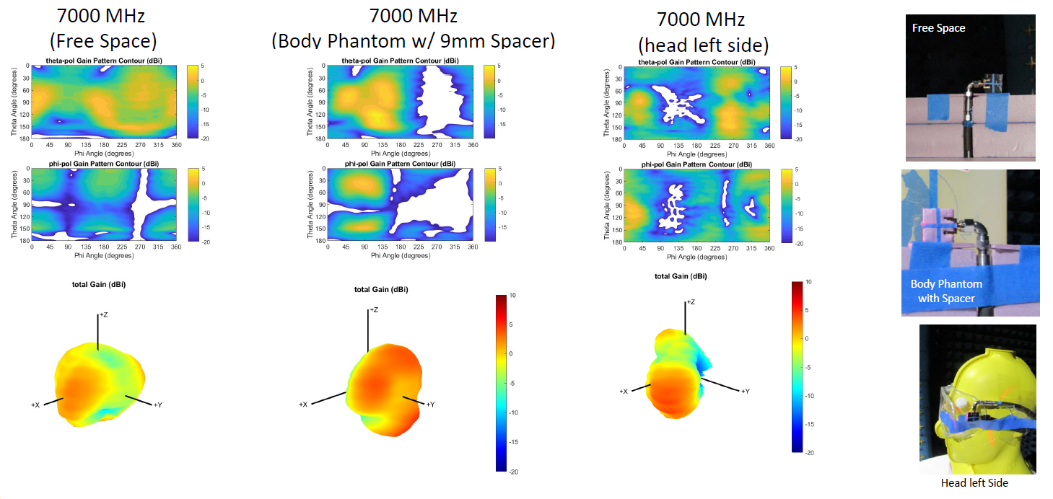
3D Antenna Pattern Measurements
Peak gain can increase when placed on the body and the pattern can have nulls depending on body location

Slide 9
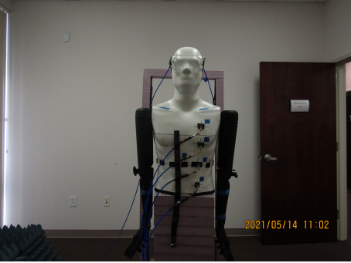
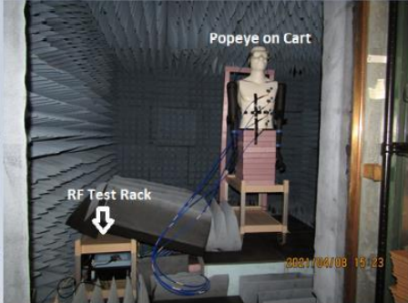
3 scenarios
Empty Office
Anechoic
Office with desk

Slide 10
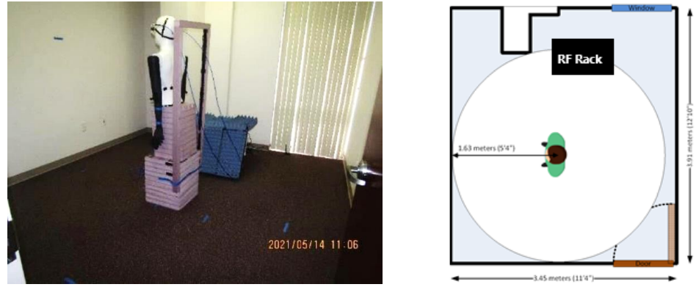
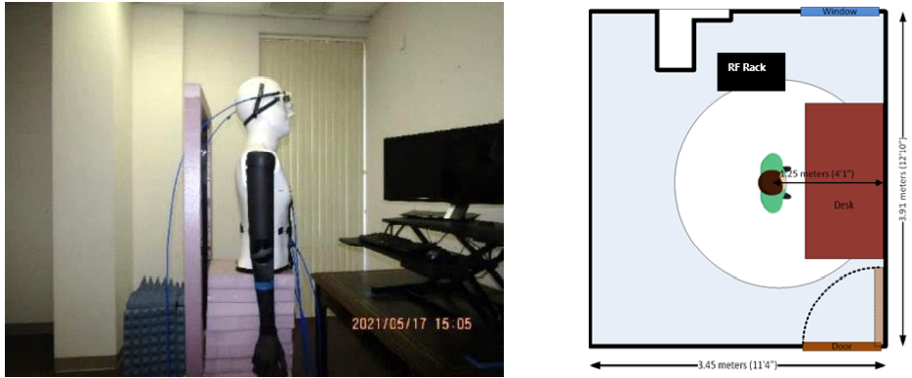
Office Measurements
Empty Office
Office with Desk

Slide 11
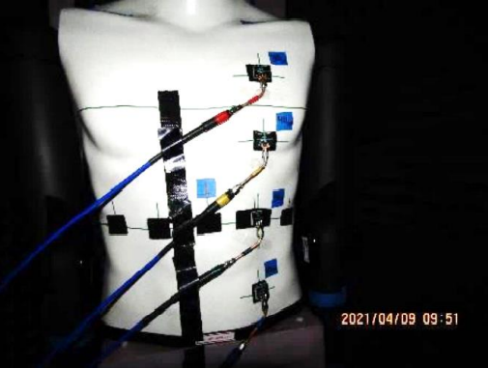
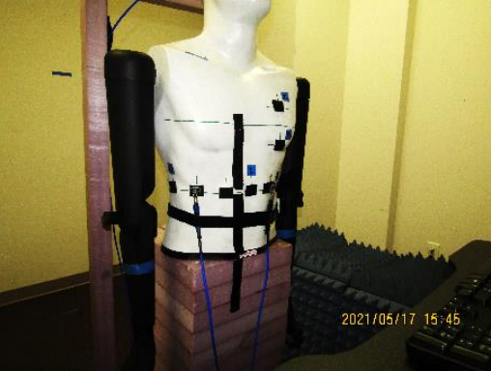
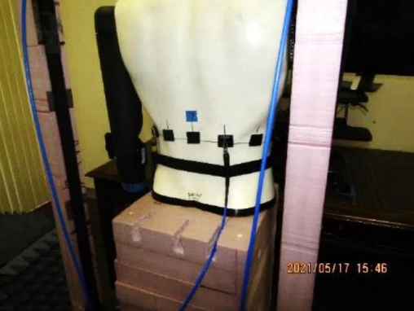
Measurement Details
30,40,50,60 cm below the left head antenna
At 50cm, 0,30,60,90,…,330 degrees

Slide 12
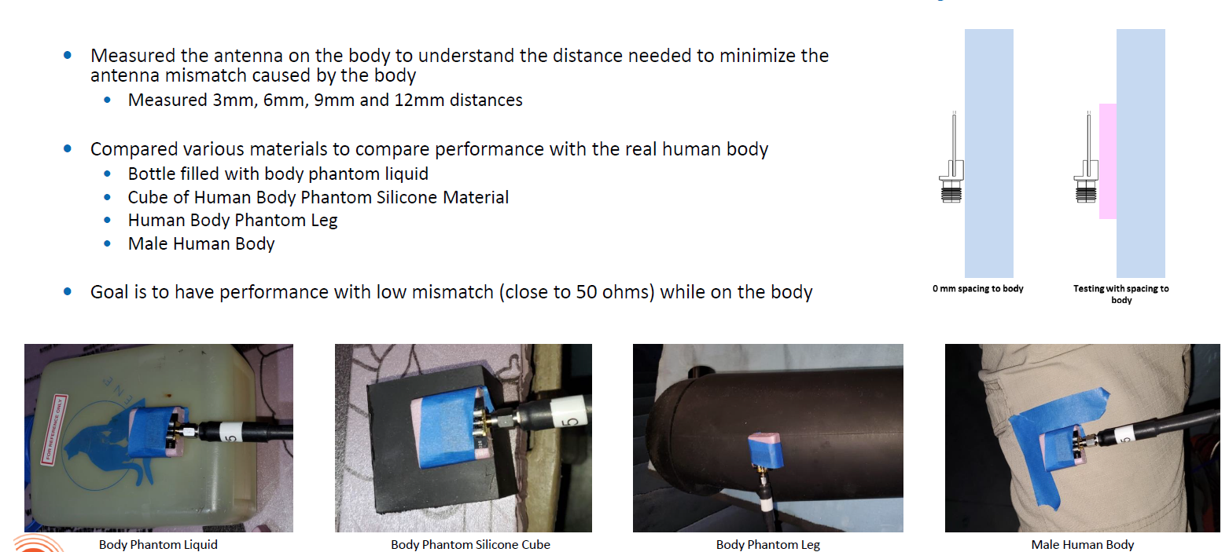
Antenna Distance to Body

Slide 13
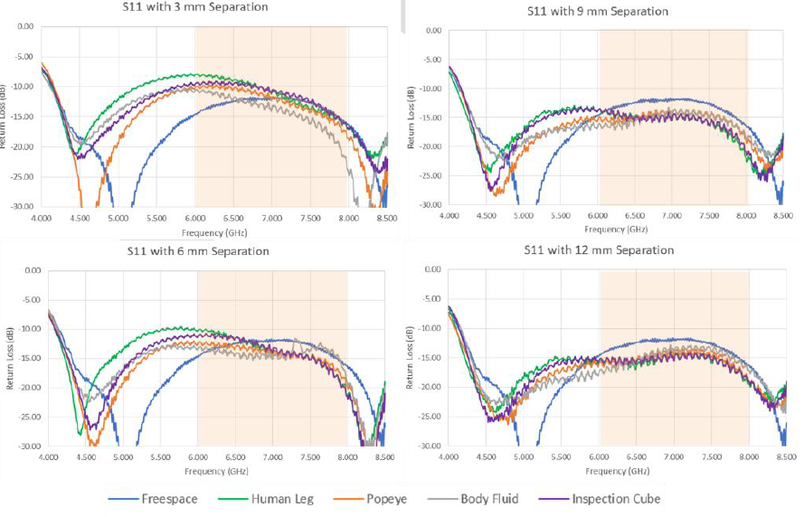
Antenna Distance to Body
9mm separation is recommended as similar performance can be seen between different measurements
Also, return loss was lower (<-10 dB) in desired frequency range (i.e. <10% reflected power)

Slide 14
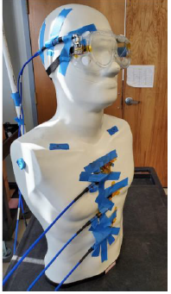
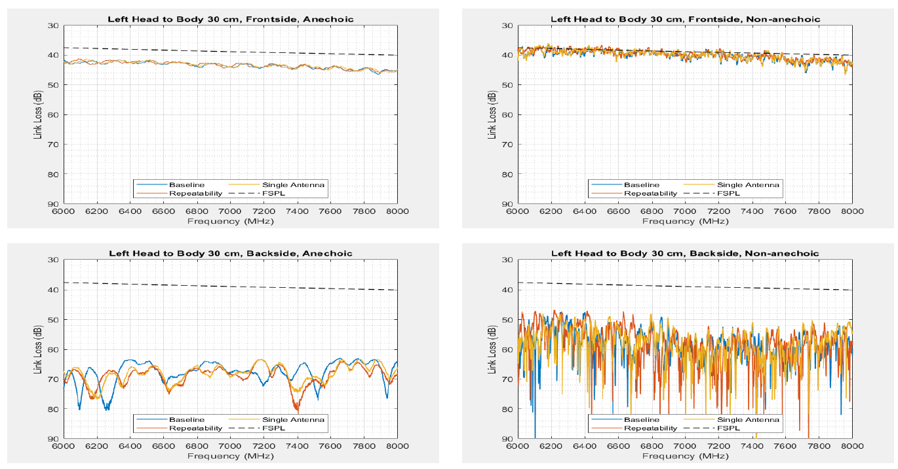
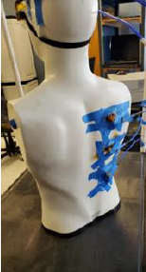
Left head to body 30cm Frequency Domain Measurement
Example Link Loss Measurement
Link Loss (f) = -20 * log (| s₂₁(f) | )
Due to reflections from walls, channel in non-anechoic chamber is less lossy than the one in anechoic chamber
~25 difference between frontside and backside measurements. Frequency dependence is minimal

Slide 15
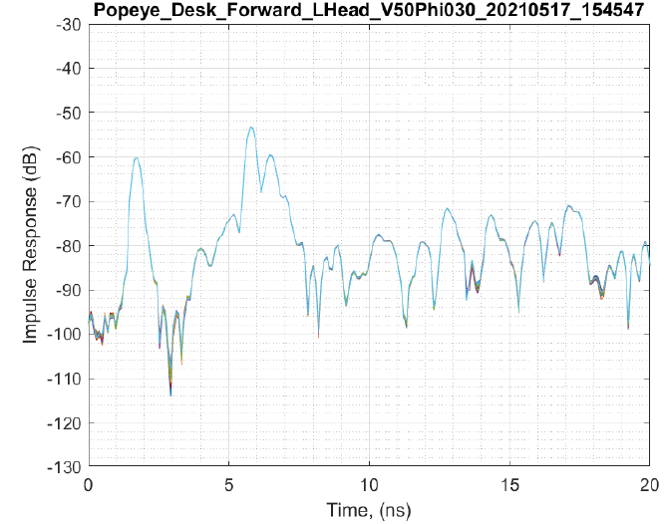
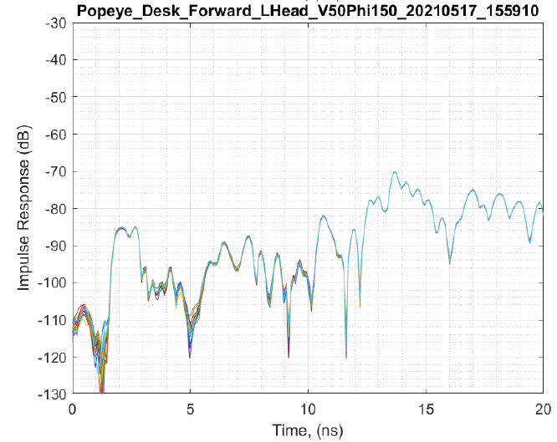
Left head to body 50cm Time Domain Measurement PDP
Example Link Loss Measurement
For frontside, strong impulse at 1.7 ns and 6ns corresponding to 50cm in the frontside and monitor at ~0.9m
For backside, small energy seen at 1.7ns and 6ns, but strongest energy at 14ns, which corresponds to ~2m reflection from either back wall or ceiling. The “environment” helps the path loss of the backside.
Front
Back

Slide 16
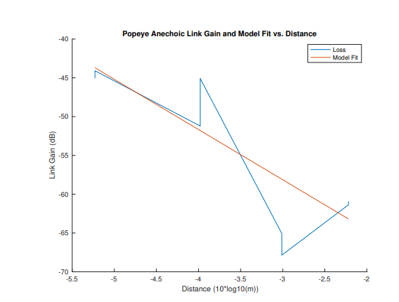
Vertical Fit
Measurements from left and right side combined
30 cm
40 cm
50 cm
60 cm

Slide 17
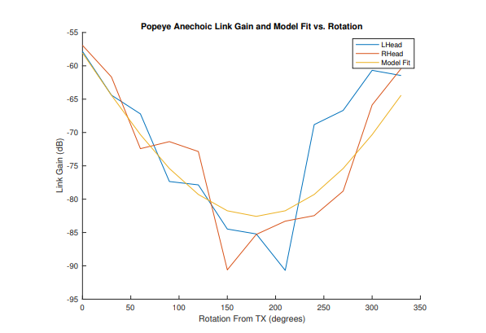
Circumference Fit
Measurements from left and right side combined

Slide 18
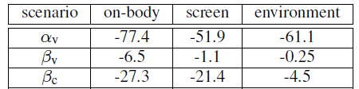
Summary of Parameters
Pathloss formula that takes both vertical distance and angle into account
d₀ = 1m; S, for shadowing, is zero-mean Gaussian distributed random variable with standard deviation sigma (dB)
 | on_body | screen | environment (env)
sigma (dB) | 8.1 | 9.4 | 1.85
Note that the on-body/screen/environment approximation states that ~80%/70%/100% of the model realizations are within +-10 dB
When combining effect of all 3, Path loss = 10log₁₀(10^(on_body/10) + 10 ^(screen/10) + 10 ^ (env/10))

Slide 19
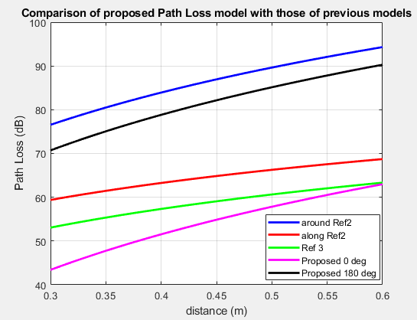
Comparison of “on-body” with 802.15.6 models
0 degrees is close to [4] and “along” in [3] and 180 deg is close to “around” in [3]. The ~5dB delta could be due to differences in the antennas used and their corresponding gains.

Slide 20
Conclusions
A unified path loss channel model (for Popeye) is presented that takes both angle and distance into account.
Next steps
Discuss power delay profile in “Part II”
Develop channel model on human
More sampling points throughout the body
Generalize for different body types (e.g., different BMI)
Consider different environment (e.g. large hall)

Slide 21
Appendix

Slide 22
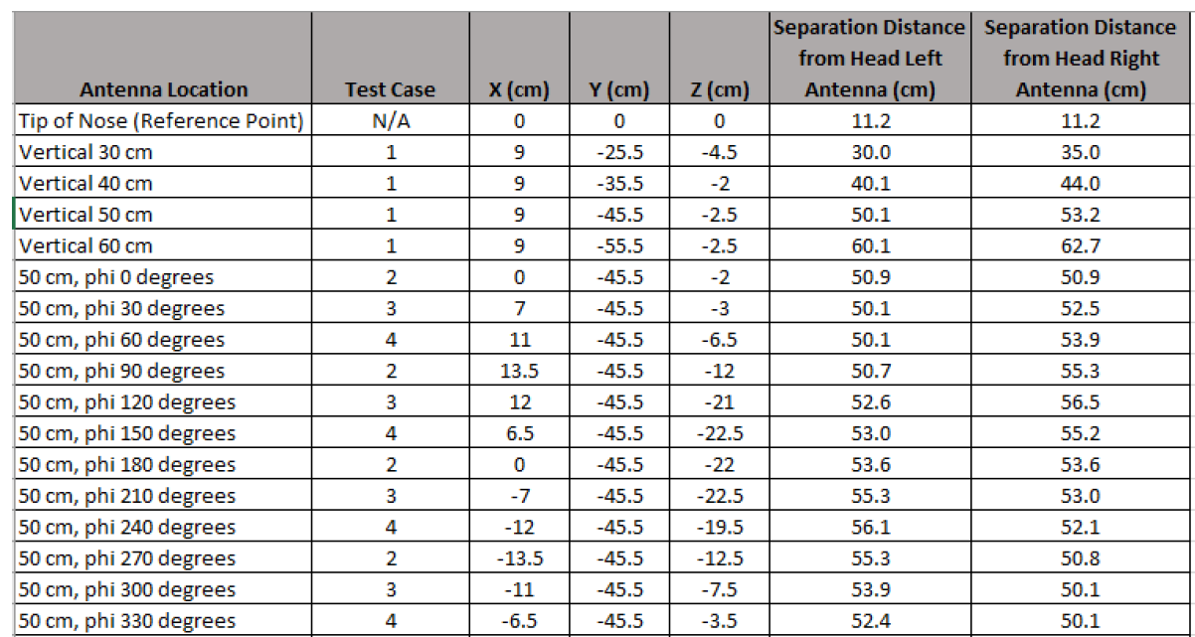
Exact Separation Distance
3-D system measured with origin = tip of Popeye's nose. (X,Y,Z) coordinates recorded and distance computed, without taking actual traversal distance into account.

Slide 23
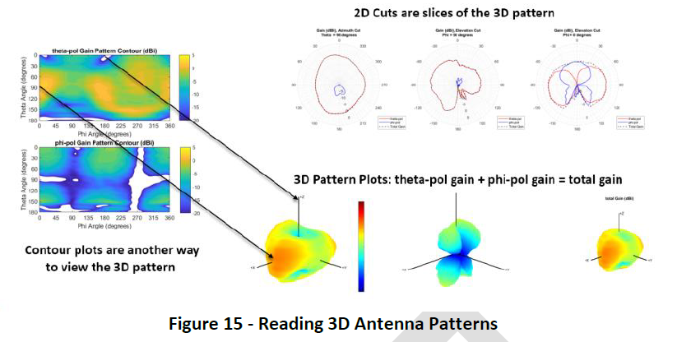
Appendix

