Slide 1
Project: IEEE P802.15 Working Group for Wireless Personal Area Networks (WPANs)
Submission Title: [Sensing - Continued]
Date Submitted: [20 January, 2022]
Source: [Frank Leong, Wolfgang Küchler, Riku Pirhonen] Company [NXP Semiconductors]
Re: [Input to the Working Group]
Abstract: [Presentation, UWB in 802.15, sensing]
Purpose: []
Notice: This document has been prepared to assist the IEEE P802.15. It is offered as a basis for discussion and is not binding on the contributing individual(s) or organization(s). The material in this document is subject to change in form and content after further study. The contributor(s) reserve(s) the right to add, amend or withdraw material contained herein.
Release: The contributor acknowledges and accepts that this contribution becomes the property of IEEE and may be made publicly available by P802.15.

Slide 2
PAR Objective | Proposed Solution (how addressed)
Safeguards so that the high throughput data use cases will not cause significant disruption to low duty-cycle ranging use cases
Interference mitigation techniques to support higher density and higher traffic use cases
Other coexistence improvement
Backward compatibility with enhanced ranging capable devices (ERDEVs) | Re-use of existing PHY elements
Improved link budget and/or reduced air-time
Additional channels and operating frequencies | Carrier frequency plan in line with Sensing requirements
Improvements to accuracy / precision / reliability and interoperability for high-integrity ranging
Reduced complexity and power consumption
Hybrid operation with narrowband signaling to assist UWB
Enhanced native discovery and connection setup mechanisms
Sensing capabilities to support presence detection and environment mapping | Outlining key Sensing PHY and MAC aspects
Low-power low-latency streaming
Higher data-rate streaming allowing at least 50 Mbit/s of throughput
Support for peer-to-peer, peer-to-multi-peer, and station-to-infrastructure protocols
Infrastructure synchronization mechanisms

Slide 3
Sensing - Continued

Slide 4
802.15.4ab – Context Recap
Focus on key functionalities to be provided by UWB:
Ranging with high integrity (handsfree access use cases)
Localization (indoor navigation use cases)
Sensing (presence detection use cases)
Coordination & scheduling to support the above
Provide accurate ranging via a low-cost, mass-market solution
Low energy-per-ranging
Low channel-occupancy-per-ranging a.k.a. spectral efficiency (many devices operating at the same time & place)
Re-use of hardware between use cases

Slide 5
UWB Sensing – Terminology Recap
CIR = Channel Impulse Response (estimated characteristics)
Stations/Modules
Monostatic Operation (N_{stations} = 1)
Multistatic Operation (N_{stations} = 2...16)
Sensing Initiator/Responder
One-Way/Two-Way Multistatic Sensing
CIR Transmitter/Receiver
Parallel/Sequential Multi-Antenna Operation
Virtual Antennas (e.g., electronic beamsteering*)
*) E.g., see: U. Nickel: “Fundamentals of Signal Processing for Phased Array Radar”, in Advanced Radar Systems, Signal and Data Processing (pp. 1-1 – 1-22), 2007.

Slide 6
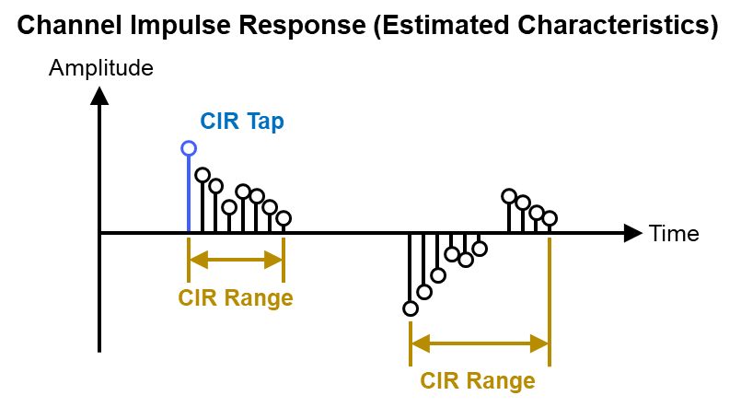
UWB Sensing – More Terminology
Illuminating Signal (from Sensing Transmitter/Initiator)
Echo Signal (to Sensing Receiver/Responder):
Sensing Processor creates Sensing Result from Sensing Measurement

Slide 7
Use of Multiple Antennas per Station
Specify existing ternary (Ipatov) sequences to be used for sensing as drop-in replacement for STS segments (i.e., support multiple Ipatov segments separated by gaps)
This could support per-segment assignment of (virtual) TX antennas
Consider explicit signaling to indicate intention to use a packet for sensing (e.g., setting a PHR bit)

Slide 8
UWB Sensing – Pulse Shape
Avoid both pre-ringing and post-ringing
Approximate a Gaussian pulse shape to be used for Sensing
For Sensing, specify a smooth Kaiser window (time-bounded) with L equivalent to 3 chips and β = πα = 10 as reference shape

Slide 9
UWB Sensing – Carrier Grid Spacing
Performing sensing at multiple carrier frequencies allows to achieve large effective total bandwidth
In order to avoid artifacts, some overlap may be desirable
Overlap somewhere between 25-75% may be desirable
Carrier grid spacing of 124.8 MHz allows to choose between 124.8 MHz (N+1, i.e., ~75% overlap), 249.6 MHz (N+2, i.e., ~50% overlap), and 374.4 MHz (N+3, i.e., ~25% overlap) configurations

Slide 10
UWB Sensing – CIR Sharing (I)
Dedicated Information Element for CIR sharing
Facilitate centralized processing (i.e., support the use of “dumb” edge nodes)
Support transmission of selected ranges of CIR taps (referred to 0 meters)
Support complex CIR tap sizes of 2*{8,12,16,24} bits
CIR tap I&Q amplitudes encoded in linear scale, with sampling rate ({1,2,4,8} times the chip rate), reference level and tap size (I&Q always of same size) to be set via dedicated IE or OOB means
Structure / Order of Transmission:
Main Header
Range Header 1
Range Body 1
Range Header 2
Range Body 2
...
Range Header N
Range Body N

Slide 11
UWB Sensing – CIR Sharing (II)
Main Header (transmitted 1x)
Field Name | Field Length (Bits) | Description
Compression | 1 | Set when using DEFLATE (i.e., Zip) compression of fields beyond the first octet
Reserved | 7 | Reserved
Number of Ranges | 8 | Number of CIR ranges transmitted

Slide 12
UWB Sensing – CIR Sharing (III)
Range Header (transmitted for each range)
Field Name | Field Length (Bits) | Description
Local Antenna Number | 5 | Antenna associated with current CIR range
Timeslot Number | 3 | Transmitted (Ipatov) segment associated with current CIR range, i.e., (virtual) TX antenna; all 1s means the current CIR range is associated with the preamble
Line-Of-Sight Available | 2 | Signals whether (slow-moving/stationary) LOS path has been searched for (MSB) and whether it has been found (LSB)
Reserved | 3 | Reserved
Target Mode | 1 | Enabled if current CIR range contains target distance-velocity pairs instead of CIR tap amplitudes
Range Start Index | 16 | Starting index (sample) of current range
Length of Range (LoR) | 10 | Number of taps/elements in current range

Slide 13
UWB Sensing – CIR Sharing (IV)
Range Body (transmitted LoR times for each range,
i.e., I&Q amplitude pairs for each tap or delay velocity pairs for each element)
Field Name | Field Length (Bits) | Description
In-Phase Amplitude | {8,12,16,24} | Amplitude scaled to pre-agreed level, encoded as signed integer (not transmitted in Target Mode)
Quadrature Amplitude | {8,12,16,24} | Amplitude scaled to pre-agreed level, encoded as signed integer (not transmitted in Target Mode)
Target Delay | 12 | Estimated distance of the current target, expressed in number of samples (only transmitted in Target Mode)
Target Velocity | 12 | Estimated target velocity as signed integer multiple of 2.5e-3 m/s (only transmitted in Target Mode)

