Slide 1
Project: IEEE P802.15 Working Group for Wireless Specialty Networks (WSN)
Submission Title: Wireless Next Generation Meeting Slides
Date Submitted: 20 January 2021
Source: Benjamin A. Rolfe (Blind Creek Associates)
Contact:
Voice: +1 408 395 7207, E-Mail: ben.rolfe @ ieee.org
Re: Wireless Next Generation Standing Committee
Abstract: Agenda and Meeting Slides for the January 2022 WNG meeting
Purpose: Stimulate thoughts for the next round of innovations and for other purposes
Notice: This document has been prepared to assist the IEEE P802.15. It is offered as a basis for discussion and is not binding on the contributing individual(s) or organization(s). The material in this document is subject to change in form and content after further study. The contributor(s) reserve(s) the right to add, amend or withdraw material contained herein.
Release: The contributor acknowledges and accepts that this contribution becomes the property of IEEE and may be made publicly available by P802.15.
Notes:
Jul 12, 2010
Page 1

Slide 2
January 2021 Wireless Interim
Virtual Session
Meeting will begin at 10 minutes after the hour

Slide 3
Electronic Interim
Please remember to enter your attendance in IMAT
Reminder:
This is a non-PAR activity
All the rules of conduct apply https://grouper.ieee.org/groups/802/sapolicies.shtml

Slide 4
Registration for 802 LMSC Plenaries and 802 Wireless Interims
This 802.15 meeting (WNG) is part of an IEEE 802 LMSC Plenary or IEEE 802 Wireless Interim session
You must pay the registration fee in order to attend
If you have not already done so, you can register here or follow the registration link here Meeting Information
If you do not intend to register for this session you must leave this meeting and, if you have logged attendance on IMAT, email the appropriate WG chair or vice chairs to have your attendance cancelled

Slide 5
Deadbeat Consequences (Deadbeat: in default of paying registration fee for a prior mtg.)
No participation credit will be granted for said session.
Any participation credit acquired before said session toward membership in any IEEE 802 LMSC group is revoked.
Membership in any IEEE 802 LMSC group is terminated.
No participation credit will be granted for attendance at any subsequent IEEE 802 LMSC session until the individual has complied with the registration requirements for all previously attended IEEE 802 LMSC sessions by the start of said subsequent session.

Slide 6
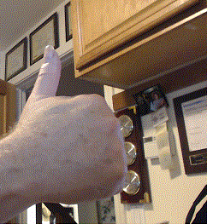
Registration Reminder
Please Register now if you have not already done so!
Register here

Slide 7
Agenda 20 January 2022
Opening and Meeting Reminders
Presentations
TG 12 concepts and future (Kinney)
Collaboration with 802.1 report (Rolfe)
Future planning
Any other business
Reminders and announcements
Adjourn

Slide 8
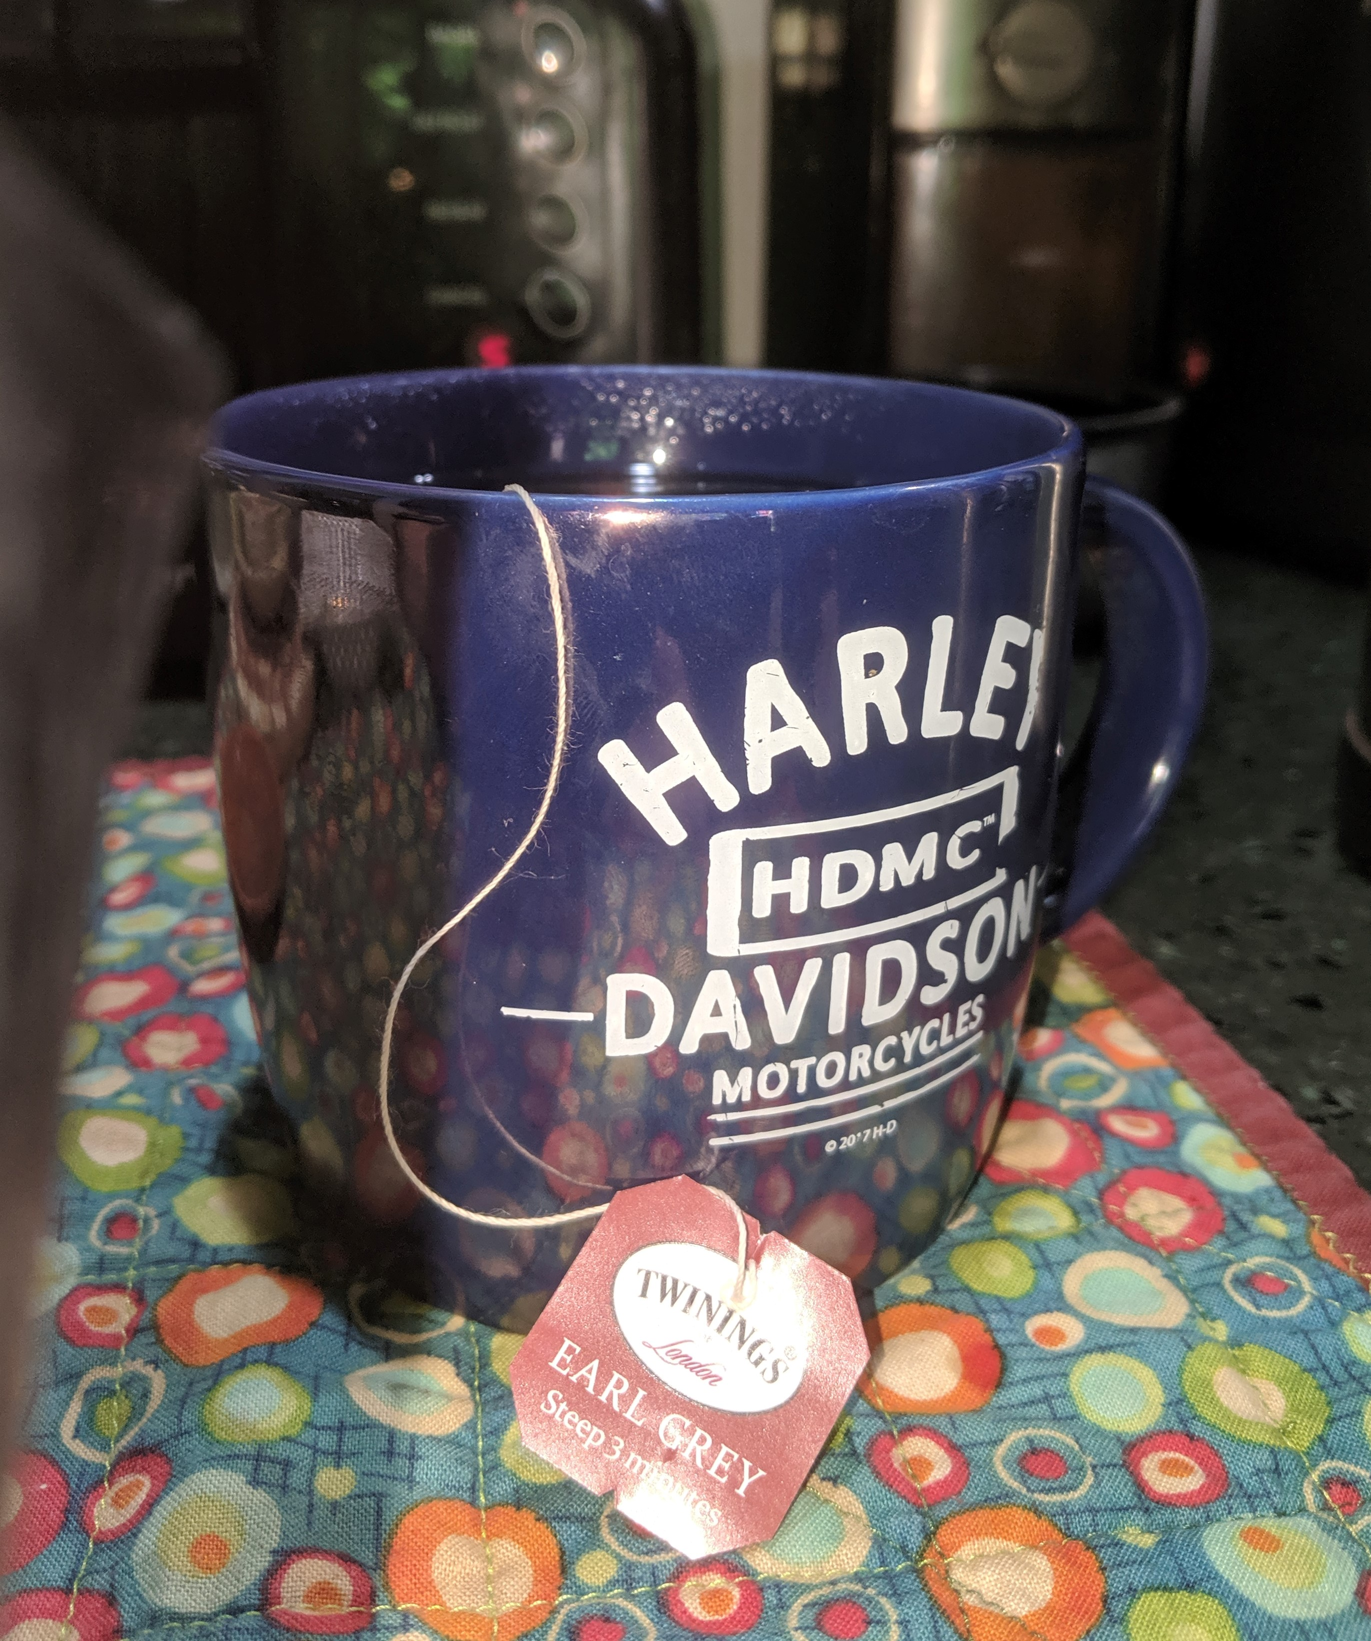
The usual question
What do you propose the Working Group do next?

Slide 9
Collaboration with 802.1 report
B. Rolfe, Blind Creek Associates

Slide 10
802.1 and 802.15 Collaboration
Goals:
Global 802 technical coherence
Leverage experience across working groups
Collaboration with 802.1 and 802.15 underway
May spawn new projects in either/both WGs
Concepts of mutual interest: how to adapt features of various 802.1 standards to applications and use cases for 802.15 standards
Many technical topics have been identified

Slide 11
Itemized list of topics
Address questions
Supporting non-globally unique addresses and/or non-static addresses
E.g. randomized or truncated
Bridging and barriers beyond addressing
Timing, data volumes, energy consumption
Performance and reliability assumptions built into 802.1
Wireless in shared spectrum vs dedicated medium (no guarantees)
Network topology and characteristics assumed
Handling different frame sizes from one medium to another
Issues we don’t even know about
Other 802.1 Features
What are the barriers to applying 802.1 to the uncertain world of wireless?
Flexible network topologies and sizes
Working without a single controller
TSN in non-deterministic wireless networks
Considerations with integrating with non-802 networks (smart city, IoT)
What else should be of interest (usefulness) to 802.15 adopters?

Slide 12
Summary Questions
What should WG15 members do with this information?
Consider the following questions and bring your thoughts to the joint 802.15/802.1 Effort
We have the experts on 802.15 standards and how they are used in the real world
The key questions:
What features make sense on a wireless medium?
What are the barriers to using 802.1 features?
What are considered “essential to be called 802.1 compliant”?

Slide 13
Future Planning
IEEE 802 Tech Talks
Brief overview of a technical activity within 802
Intended for external education and generate interest and participation
Current schedule full through Sept 2022
Opportunity for future tech talks to showcase specific work

Slide 14
Reminders and Announcements
Register if you haven’t already!
Registration for the March plenary is open (http://802world.org/plenary/)
Early bird rate ends 28-January-2022
Call for Contributions for WNG March 2022: Provide your request to the WNG chair

Slide 15
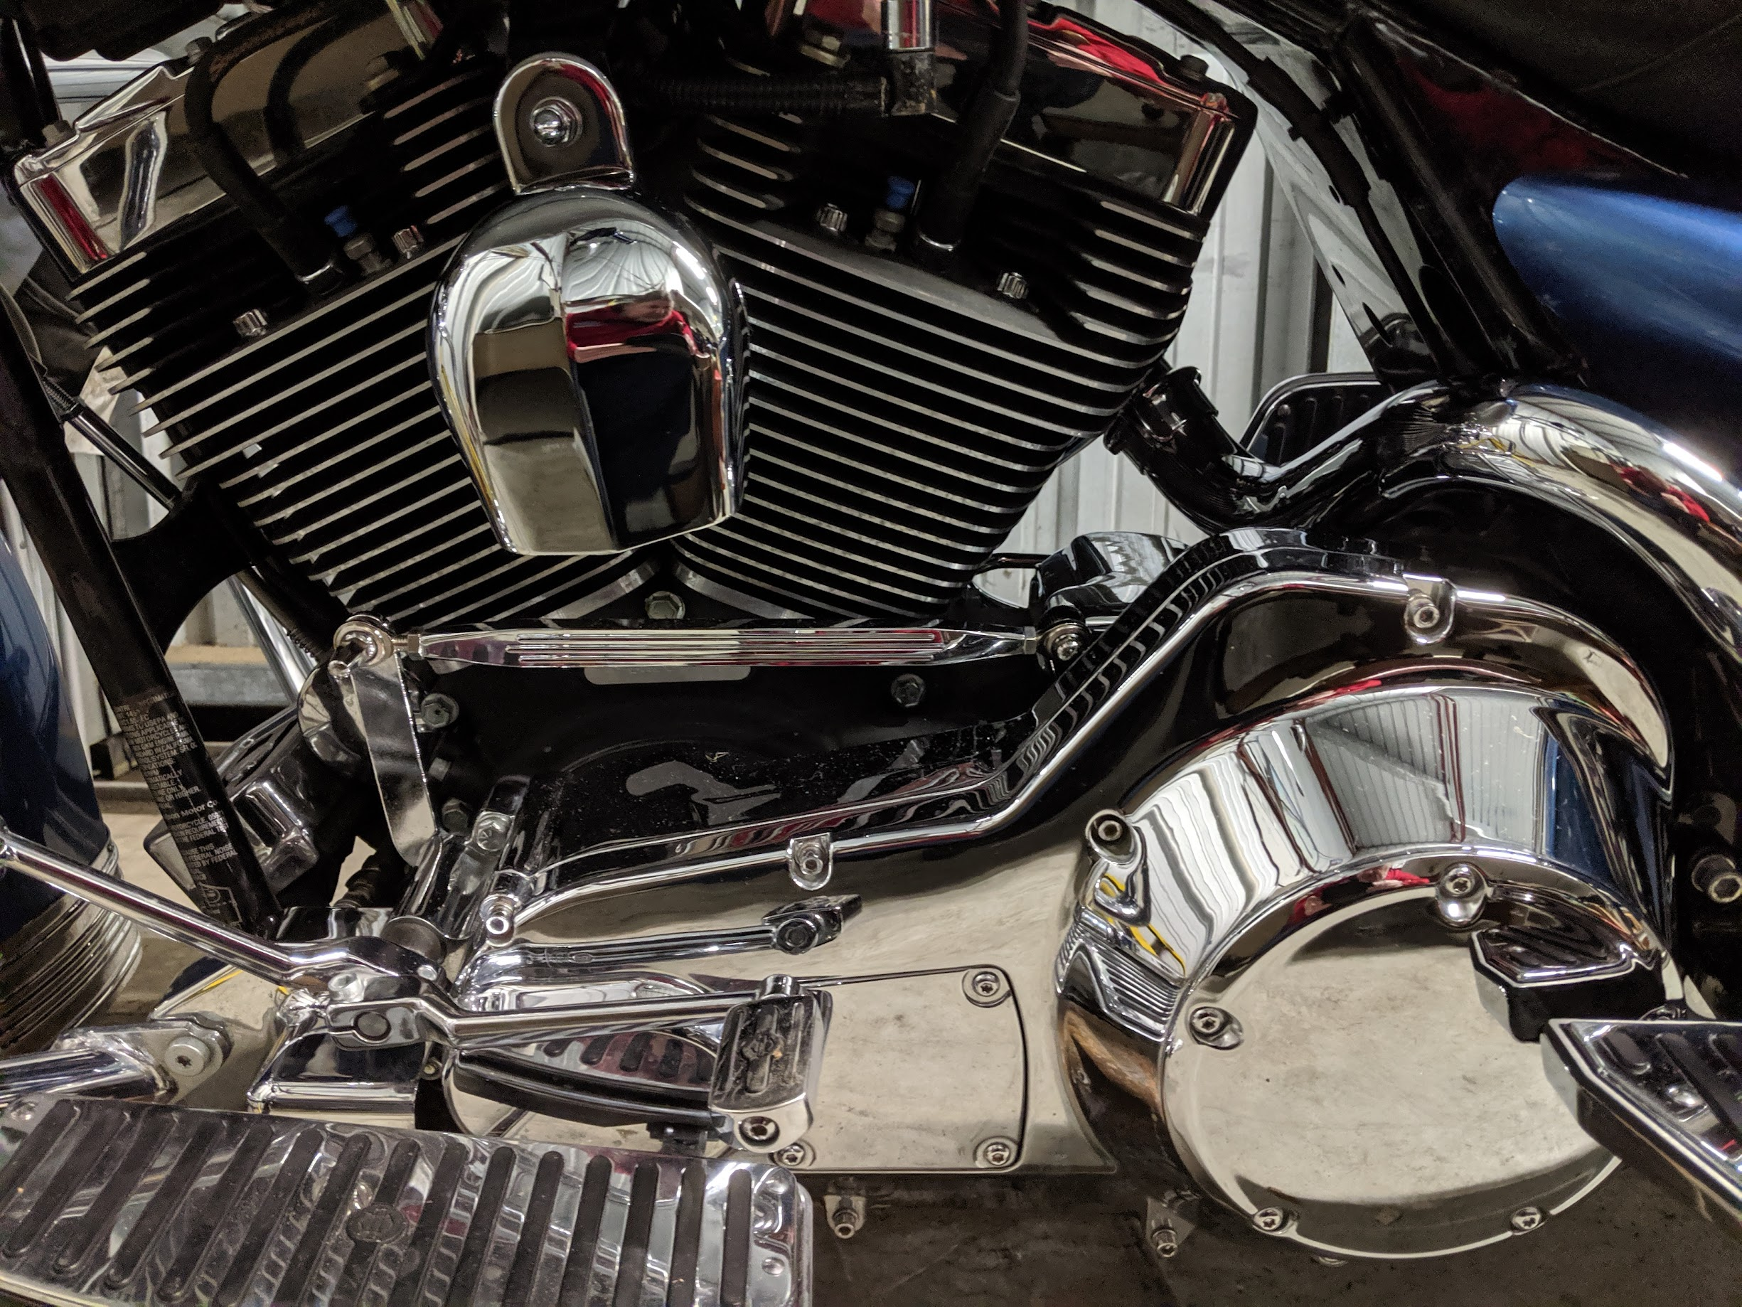
Meeting Adjourned Thanks
Something Shiny to look at while mingling

