Slide 1
Project: IEEE P802.15 Working Group for Wireless Personal Area Networks (WPANs)
Submission Title: UWB and NB link budget comparison
Date Submitted: Jan, 2022
Source: Ziyang Guo, Peng Liu, Rani Keren, Xun Yang (Huawei Technologies)
Email: guoziyang@huawei.com
Abstract: Compare link budget between UWB, UNII-3, 15.4 OQPSK, BLE, BLE-coded
Purpose: Provide more link budget analysis and discuss whether NB signaling is more efficient than UWB signaling.
Notice: This document has been prepared to assist the IEEE P802.15. It is offered as a basis for discussion and is not binding on the contributing individual(s) or organization(s). The material in this document is subject to change in form and content after further study. The contributor(s) reserve(s) the right to add, amend or withdraw material contained herein.
Release: The contributor acknowledges and accepts that this contribution becomes the property of IEEE and may be made publicly available by P802.15.

Slide 2
PAR Objective | Proposed Solution (how addressed)
Safeguards so that the high throughput data use cases will not cause significant disruption to low duty-cycle ranging use cases
Interference mitigation techniques to support higher density and higher traffic use cases
Other coexistence improvement
Backward compatibility with enhanced ranging capable devices (ERDEVs)
Improved link budget and/or reduced air-time
Additional channels and operating frequencies
Improvements to accuracy / precision / reliability and interoperability for high-integrity ranging
Reduced complexity and power consumption
Hybrid operation with narrowband signaling to assist UWB | Link budget analysis for UWB and how it compares with NB signaling schemes under different conditions
Enhanced native discovery and connection setup mechanisms
Sensing capabilities to support presence detection and environment mapping
Low-power low-latency streaming
Higher data-rate streaming allowing at least 50 Mbit/s of throughput
Support for peer-to-peer, peer-to-multi-peer, and station-to-infrastructure protocols
Infrastructure synchronization mechanisms

Slide 3
Narrowband assisted UWB - Overview
UWB next generation task group (TG 4ab) is considering the definition of an NB PHY that is coupled to UWB PHY in order to assist it in various ways, for example, transmission offload or synchronization.
Such a UWB+NB coupled operation requires a NB PHY range that is equal or higher than the next generation UWB PHY range.
[1] proposed a new UWB transmit scheme aimed for increased UWB range that relies on synchronization assistance from a NB PHY but no range comparison analysis.
[3] initiated a link budget comparison and suggested that current UWB PHY (BPRF mode) is more or less balanced with some candidate NB PHYs, but states that there is no decisive conclusion.
[4] provided a link budget calculation at the end showing that an NB PHY will not necessarily meet the required range of a potential new generation UWB.

Slide 4
Purpose
Analyze LM for ranging and LM improvement due to ranging preamble segmentation [1]
Analyze LM for different SYNC PHY candidates, including NB and UWB PHYs
Ranging Preamble
SYNC
Packet
Frag 1
Frag 2
Frag 3
Frag N
Time and Freq Sync
1
2
3
N
t/ms

Slide 5
Link Margin Analysis for Ranging
Where is link margin gain of ranging preamble segmentation from?

Slide 6
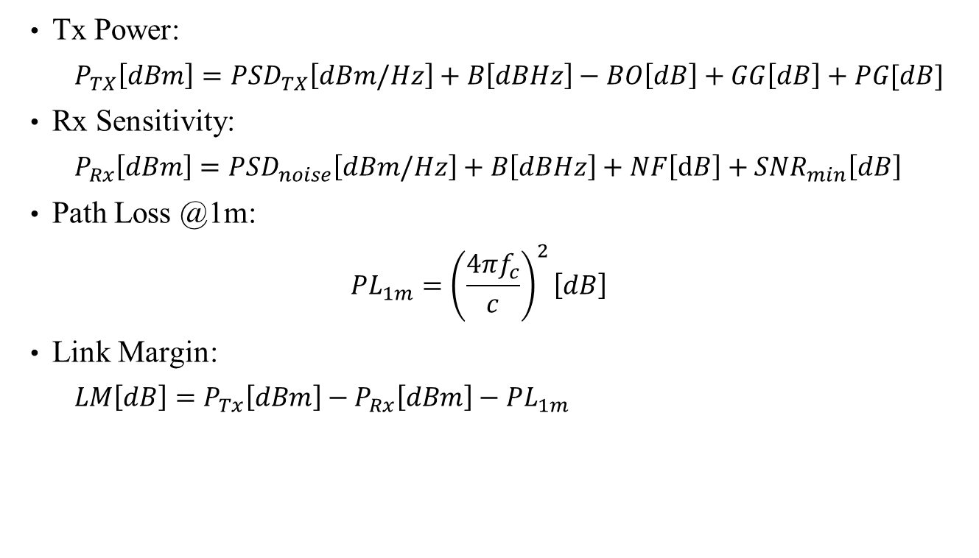
Link Margin Analysis for Ranging
Tx Power:
$$P_{TX}\left[dBm\right]=PSD_{TX}\left[dBm/Hz\right]+B\left[dBHz\right]−BO\left[dB\right]+GG\left[dB\right]+PG[dB]$$
Rx Sensitivity:
$$P_{Rx}\left[dBm\right]=PSD_{noise}\left[dBm/Hz\right]+B\left[dBHz\right]+NF\left[dB\right]+SNR_{min}\left[dB\right]$$
Path Loss @1m:
$$PL_{1m}={\left(\frac{4πf_{c}}{c}\right)}^{2}\left[dB\right]$$
Link Margin:
$$LM\left[dB\right]=P_{Tx}\left[dBm\right]−P_{Rx}\left[dBm\right]−PL_{1m}$$
BO: backoff
GG: gating gain (Tx power gain for short packets)
PG: Processing Gain
NF: noise figure

Slide 7
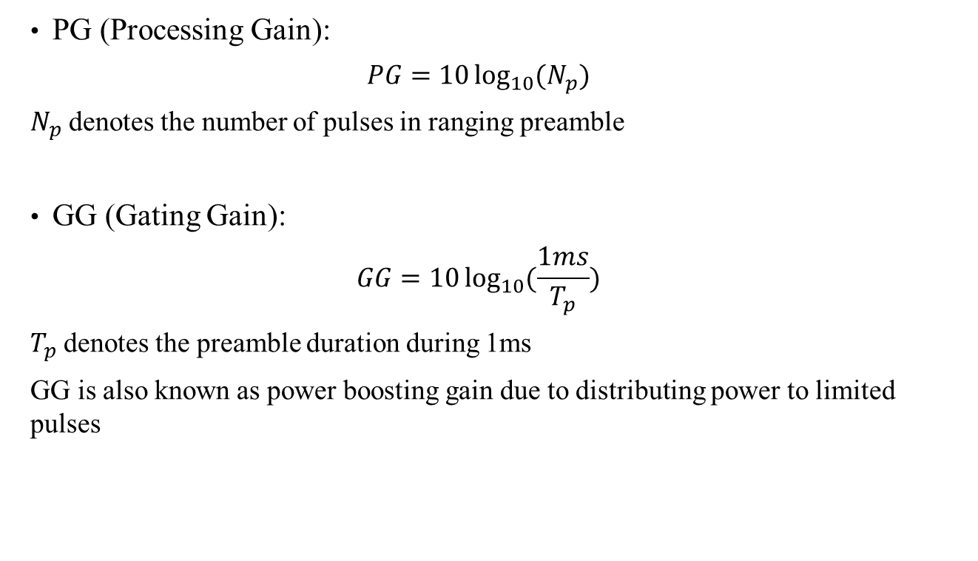
Link Margin Analysis for Ranging
PG (Processing Gain):
$$PG=10\log_{10}{(N_{p})}$$
$N_{p}$ denotes the number of pulses in ranging preamble
GG (Gating Gain):
$$GG=10\log_{10}{(\frac{1ms}{T_{p}}})$$
$T_{p}$ denotes the preamble duration during 1ms
GG is also known as power boosting gain due to distributing power to limited pulses

Slide 8
Link Margin Analysis for Ranging
CRB Bound of UWB pulse [7]:
$$RMS(d)≥\sqrt{CRB}=\frac{c}{2\sqrt{2}πW\sqrt{SNR}}$$
where $W$ is effective bandwidth, W=533MHz for the IEEE 802.15.4z reference pulse [8]
Supposing $±2$cm ragning accuracy, at least SNR=10dB is required
In the LM calculation, assuming $SNR_{min}=10$dB

Slide 9
Link Margin Analysis for Ranging
configurations | cfg0 | cfg1 | cfg2 | cfg3 | cfg4 | cfg5
Total preamble duration(us) | 960 | 960 | 960 | 960 | 960 | 960
N | NA | 32 | 16 | 8 | 4 | 2
PRF(MHz) | 64 | 64 | 64 | 64 | 64 | 64
Fragment Duration(us) | NA | 30 | 60 | 120 | 240 | 480
PSD(dBm/MHz) | -41.3 | -41.3 | -41.3 | -41.3 | -41.3 | -41.3
fc(Hz) | 7983000000 | 7983000000 | 7983000000 | 7983000000 | 7983000000 | 7983000000
B(Hz) | 499200000 | 499200000 | 499200000 | 499200000 | 499200000 | 499200000
backoff(dB) | 1 | 1 | 1 | 1 | 1 | 1
NF(dB) | 6 | 6 | 6 | 6 | 6 | 6
Processing Gain | 47.88451207 | 47.88451207 | 47.88451207 | 47.88451207 | 47.88451207 | 47.88451207
Preamble Duration | 0.00096 | 0.00003 | 0.00006 | 0.00012 | 0.00024 | 0.00048
GG | 0.17728767 | 15.22878745 | 12.2184875 | 9.20818754 | 6.197887583 | 3.187587626
Ptx | -15.1399666 | -0.08846678 | -3.09876674 | -6.10906669 | -9.11936665 | -12.1296666
SNRmin(1.5cm@CRB) | 10 | 10 | 10 | 10 | 10 | 10
Prx | -71.0172542 | -71.0172542 | -71.0172542 | -71.0172542 | -71.0172542 | -71.0172542
Path Loss | 55.87728767 | 70.92878745 | 67.9184875 | 64.90818754 | 61.89788758 | 58.88758763
PL_1m | 50.48509477 | 50.48509477 | 50.48509477 | 50.48509477 | 50.48509477 | 50.48509477
LM | 53.27670497 | 68.32820475 | 65.31790479 | 62.30760484 | 59.29730488 | 56.28700493
Cfg0: conventional approach without preamble fragment
Cfg1: N=32, Cfg2: N=16, Cfg3: N=8, Cfg4: N=4, Cfg5: N=2
Configurations refer to [2].

Slide 10
Link Margin Analysis for Ranging
Lower than 18dB, stated in [2]
LM can be boosted by preamble segmentation
The LM improvement is all from Gating Gain, which is limited by regulation and power amplifier complexity

Slide 11
Link Margin Analysis for SYNC Packet Transmission
How to pick the PHY for SYNC packet transmission to get a comparable LM with ranging?

Slide 12
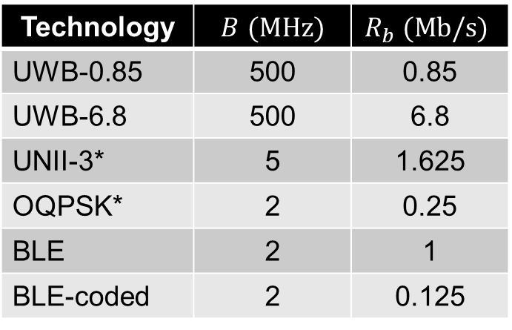
Technologies of interest
We would like to perform a link budget analysis for the following technologies:
Technology | $B$ $(MHz)$ | $$R_{b} (Mb/s)$$
UWB-0.85 | 500 | 0.85
UWB-6.8 | 500 | 6.8
UNII-3* | 5 | 1.625
OQPSK* | 2 | 0.25
BLE | 2 | 1
BLE-coded | 2 | 0.125
$B$ is bandwidth, $R_{b}$ is data rate.
UNII-3 and OQPSK are NB radios proposed in [2]. The data rate of UNII-3 is calculated from Wi-Fi (20MHz, MCS0, 6.5Mb/s).

Slide 13
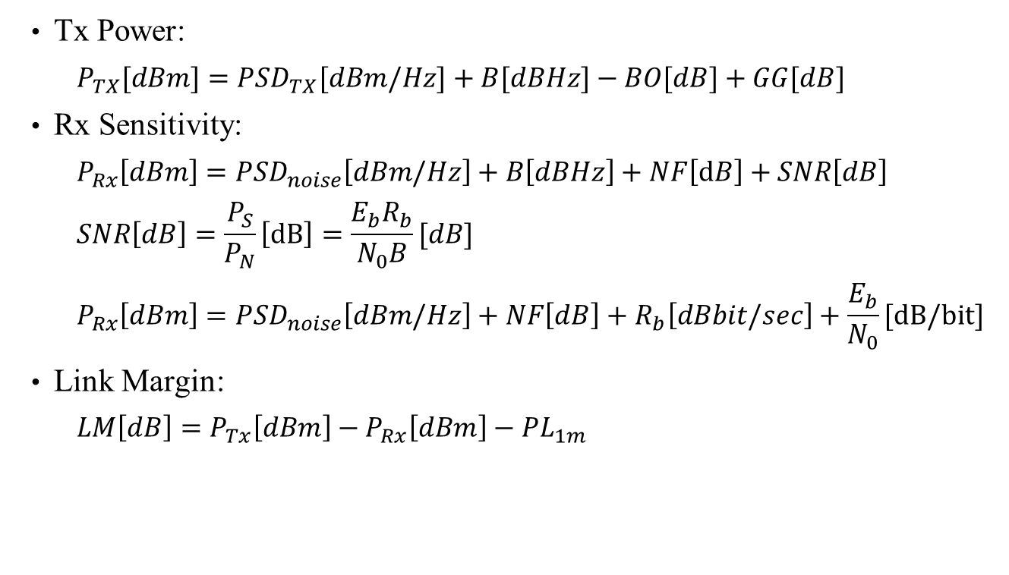
Link Margin Analysis for SYNC Packet
Tx Power:
$$P_{TX}[dBm]=PSD_{TX}[dBm/Hz]+B[dBHz]−BO[dB]+GG[dB]$$
Rx Sensitivity:
$$P_{Rx}\left[dBm\right]=PSD_{noise}\left[dBm/Hz\right]+B\left[dBHz\right]+NF\left[dB\right]+SNR\left[dB\right]$$
$$SNR\left[dB\right]=\frac{P_{S}}{P_{N}}\left[dB\right]=\frac{E_{b}R_{b}}{N_{0}B}[dB]$$
$$P_{Rx}\left[dBm\right]=PSD_{noise}\left[dBm/Hz\right]+NF\left[dB\right]+R_{b}\left[dBbit/sec\right]+\frac{E_{b}}{N_{0}}[dB/bit]$$
Link Margin:
$$LM\left[dB\right]=P_{Tx}\left[dBm\right]−P_{Rx}\left[dBm\right]−PL_{1m}$$
BO: backoff
GG: gating gain (Tx power gain for short packets)
NF: noise figure

Slide 14
Link Margin Analysis for SYNC Packet
According to FCC and CE regulations [5, 6],
For OQPSK, BLE, BLE-coded, the maximum output power can go up to 20dBm.
For UNII-3, the maximum output power for non-specific short-range device is 14dBm; If an adequate spectrum sharing mechanism (e.g., DFS and DAA) is implemented, the maximum output power can go up to 26dBm.
LM of NB are larger than UWB.
Parameters | UWB(BPRF-0.85) | UWB(BPRF-6.8) | UNII-3 | OQPSK | BLE | BLE-coded
CC_rate | 0.5 | 0.5
RS_rate | 0.87 | 0.87
meanPRF(Hz) | 15600000 | 15600000
Ncpb | 16 | 2
Tdsym | 1.02564E-06 | 1.28205E-07
Nsync | 64 | 64
Nsfd | 8 | 8
Tpsym | 9.9359E-07 | 9.9359E-07
payload(bits) | 160 | 160
EbN0(dB) | 3.5 | 3.5 | 1.5 | 8.5 | 8.5 | 4
PSD(dBm/MHz) | -41.3 | -41.3
Output power(dBm) | -14.31725423 | -14.31725423 | 14 | 10 | 10 | 10
fc(Hz) | 7983000000 | 7983000000 | 5800000000 | 2450000000 | 2450000000 | 2450000000
B(Hz) | 499200000 | 499200000 | 5000000 | 2000000 | 2000000 | 2000000
Backoff(dB) | 1 | 1 | 1 | 1 | 1 | 1
Noise figure(dB) | 6 | 6 | 6 | 6 | 6 | 6
Rb | 848250 | 6786000 | 1625000 | 250000 | 1000000 | 125000
Td | 0.00030641 | 0.000100897
GG | 5.136966756 | 9.961197909 | 0 | 0 | 0 | 0
Ptx | -10.18028748 | -5.356056325 | 13 | 9 | 9 | 9
Prx | -105.2147613 | -96.18386145 | -104.3914663 | -105.5205999 | -96 | -100
Path Loss | 95.03447384 | 90.82780512 | 117.3914663 | 114.5205999 | 105 | 109
PL@1m | 50.48509477 | 50.48509477 | 47.71033206 | 40.22509387 | 40.22509387 | 40.22509387
LM | 44.54937907 | 40.34271035 | 69.68113429 | 74.29550604 | 64.77490613 | 68.77490613

Slide 15
Multipath Fading Effect
For NB systems, 20dB multipath fading is assumed.
When multipath fading is considered, LM of NB using previous Tx power are comparable to UWB.
Increasing Tx power to the limit of regulations can further increase the LM of NB PHYs.
Parameters | UWB(BPRF-0.85) | UWB(BPRF-6.8) | UNII-3 | OQPSK | BLE | BLE-coded
Output power(dBm) | -14.31725423 | -14.31725423 | 14 | 10 | 10 | 10
LM | 44.54937907 | 40.34271035 | 49.68113429 | 54.29550604 | 44.77490613 | 48.77490613
Parameters | UWB(BPRF-0.85) | UWB(BPRF-6.8) | UNII-3 | OQPSK | BLE | BLE-coded
Output power(dBm) | -14.31725423 | -14.31725423 | 26 | 20 | 20 | 20
LM | 44.54937907 | 40.34271035 | 61.68113429 | 64.29550604 | 54.77490613 | 58.77490613

Slide 16
Summary
LM for ranging is usually larger than that for data transmission and can be improved by preamble segmentation
To obtain a comparable LM as ranging, NB PHYs for SYNC packet might be a good candidate, especially at LoS scenario
Alternatively, other methods might be required to improve LM of UWB PHY for SYNC packet transmission, e.g., new channel coding

Slide 17
References
15-21-0605, Nba-mms-uwb-mac-considerations, Yong Liu et al (Apple Inc.)
15-21-0593, More on narrowband assisted multi-millisecond UWB, Ersen Ekrem et al (Apple Inc.)
15-21-0394, IR-UWB link budget analysis and how it compares with NB signaling, Koorosh Akhavan (Qualcomm Inc.)
15-21-0557, UWB Wakeup Signaling, Michael Mc Laughlin et al (Qorvo)
FCC: Sec 15.247
ETSI: EN 300 328
D. Dardari et al, Ranging With Ultrawide Bandwidth Signals in Multipath Environments, Proceedings of the IEEE, vol. 97, no. 2, pp. 404-426, 2009
I. Domuta et al, Timestamp Estimation in P802.15.4z Amendment, Sensors, vol. 20, no. 18, 2020

