Slide 1
Project: IEEE P802.15 Working Group for Wireless Personal Area Networks (WPANs)
Submission Title: [Channel Coding Considerations for 802.15.4ab]
Date Submitted: [10th Jan 2022]
Source: [Wei Lin, Jiaqi Gu, Rani Keren, Xun Yang] Company [Huawei]
Address [Huawei base, Shenzhen, CHINA]
E-Mail:[lin.linwei@huawei.com]
Re: [Study Group 4ab: UWB Next Generation]
Abstract: [Discuss on Channel Coding related issues for 802.15.4ab]
Purpose: []
Notice: This document has been prepared to assist the IEEE P802.15. It is offered as a basis for discussion and is not binding on the contributing individual(s) or organization(s). The material in this document is subject to change in form and content after further study. The contributor(s) reserve(s) the right to add, amend or withdraw material contained herein.
Release: The contributor acknowledges and accepts that this contribution becomes the property of IEEE and may be made publicly available by P802.15.

Slide 2
Technical Guidance
PAR Objective | Proposed Solution (how addressed)
Safeguards so that the high throughput data use cases will not cause significant disruption to low duty-cycle ranging use cases.
Interference mitigation techniques to support higher density and higher traffic use cases
Other coexistence improvement
Backward compatibility with enhanced ranging capable devices (ERDEVs).
Improved link budget and/or reduced air-time | New channel Coding Schemes can provide improved link budgets and reduced air time
Additional channels and operating frequencies
Improvements to accuracy / precision / reliability and interoperability for high-integrity ranging;
Reduce complexity and power consumption;
Hybrid operation with narrowband signaling to assist UWB;
Enhanced native discovery and connection setup mechanisms;
Sensing capabilities to support presence detection and environment mapping;
Low-power low-latency streaming
higher data-rate streaming allowing at least 50 Mbit/s of throughput. | New channel Coding Schemes with higher rates can support high data-rate
Support for peer-to-peer, peer-to-multi-peer, and station-to-infrastructure protocols;
Infrastructure synchronization mechanisms.

Slide 3
Related Submissions
[1] 15-21-0506-01-04ab-advanced-coding-for-data-comm, Aldana (Facebook)
[2] 15-21-0592-00-04ab-high-data-rates, Murray, et al (Qorvo)

Slide 4
Channel Coding Considerations - Overview
As of today, IEEE 802.15.4z standard supports data communication of relative small amounts of data with throughput of 31.2 mbps.
  No Capacity-Approaching FEC codes (LDPC, Turbo, Polar, etc.) has been adopted yet
IEEE 802.15.4a employed a rate-1/2 convolutional codes of K=3 (4 states) as well as an (63, 55) GF(2⁶) Reed-Solomon Codes
To further enhance the performance, 802.15.4z optionally introduced an standard rate-1/2 convolutional codes of K=7 (64 states)
For the current 802.15.4ab standard, the needs for higher throughput as well as higher reliability have been discussed
  The introduction of advanced-coding has been discussed in [1], [2]
  To consider the inclusion of new FEC codes, especially block codes (LDPC, Polar), the candidate code-lengths and code-rates shall be carefully considered

Slide 5
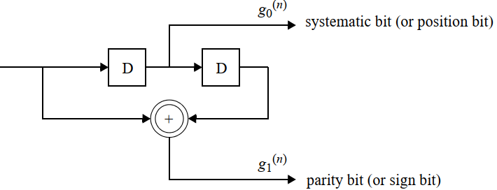
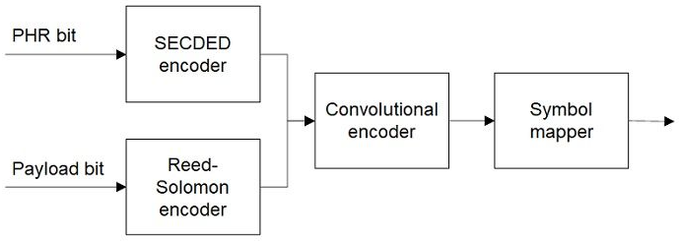
Channel Coding in 15.4a
The channel coding process of payload consists of several steps
  The payload data is RS encoded with RS(63,55) → (378, 330), R=0.87.
  The next step performs further systematic convolutional coding for the PHR and the payload data
    The inner rate R = ½ BCC encoder: generator polynomials g0 = [010] and g1 = [101].
    Each PPDU, the encoder shall be initialized to the all zero state, and shall be returned to the all zero state by appending two zero bits to the PPDU.
  During the standardization of 15.4a, varies FEC codes were discussed
    Convolutional codes with K = 3,4,5 were considered and compared → K = 3 Final
    BCH codes and RS codes of varies lengths and rates were also discussed
    The final selection was a balance between performance and decoding complexities, e.g., the RS(63, 55) on GF(2⁶) was compared with RS(40,32) on GF(2⁸)

Slide 6
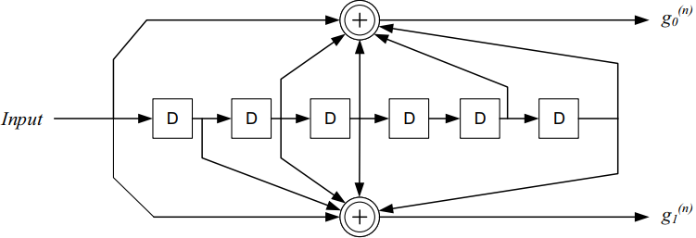
Channel Coding in 15.4z
The HRP-ERDEV in its HPRF mode may optionally employ the K = 7 convolutional encoder, with the generator polynomials (133,171).
  Before transmission of each PPDU, this encoder shall be initialized to all zero state, and shall be returned to all zero state by separately appending six zero bits to both the PHR and the PSDU.
Non-systematic convolutional encoder
Simulation performed for 21-byte PSDU
15-18-0335-00-004z-srdev-ppdu-for-enhanced-impulse-radio

Slide 7
Channel Coding Considerations in 15.4ab
The consideration of introducing new advanced coding schemes were discussed in [1] and [2]
  [1] proposed to include LDPC codes as an optional solution after an extensive comparison of Turbo, Polar, NR LDPC, and 11n LDPC codes
  [2] proposed to identify suitable candidate advanced codes for high-speed data, e.g., NR LDPC, 11n LDPC, candidates for Turbo and Polar codes and possibly additional LDPC codes
  [2] states that the power consumption at a given performance should be a central selection metric
To compare and select a candidate code, several parameters shall be agreed for further investigations
  The candidate code rates: the standard code rate is R = ½ for 15.4z HPRF mode, do we need higher code rates (e.g. 2/3, 3/4) to further increase the peak data throughput?
  The candidate code length selection is very important for further evaluations.

Slide 8
Discussion on Code Length
During the development of 15.4a, the employed RS(63, 55) of length n = 63x6 = 378 bits was extensively compared with BCH codes (e.g., BCH(292,256), BCH(328,256)) and other RS codes (e.g., RS(40,32) over GF(2⁸), RS(51,43) over GF(2⁶))
The selected codeword length shall best balance the performance, padding/puncturing, and complexity
  The codeword lengths of 11n LDPC were selected to minimize the padding bits for OFDM symbols
  Short Length: the number of shortening/padding bits can be minimized, while the error correction capability of the code is limited → suitable for short payloads
  Long Length: the inherent error correction capability is strong, however, relative large amount of shortening or padding bits are incurred, which would deteriorate the code performance → suitable for relative long payloads
  Since the maximum PSDU length has been increased from 127 bytes in 15.4a to 1023 bytes in 15.4z (optionally to 4095 bytes), shall we consider longer lengths (e.g., around n = 648 (11n) ~672(11ad))?

Slide 9
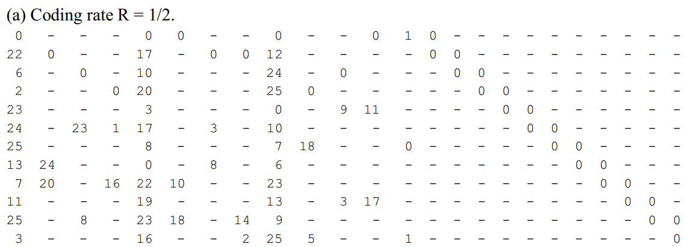
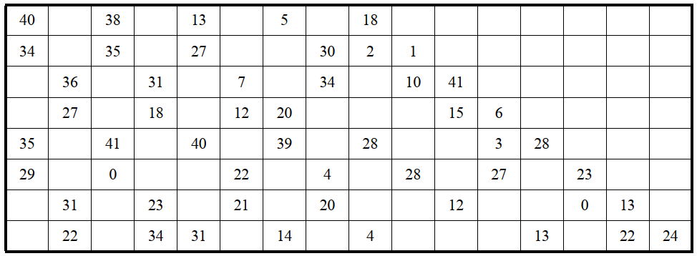
LDPC Codes in WLAN
Low-Density Parity-Check (LDPC) codes in 11n/ac and 11ad/ay → Rate-1/2 & Shortest
  LDPC encoding with shortening & puncturing for small payloads
11n LDPC: Rate-1/2, Base Matrix: 12x24, N = 648, Z = 27
11ad LDPC: Rate-1/2, Base Matrix: 8x16, N = 672, Z = 42
Encoded Codeword Bits
Information Bits
Shortened Zeros
Parity Bits
Punctured Bits
Transmitted Bits
Information Bits
Parity Bits

Slide 10
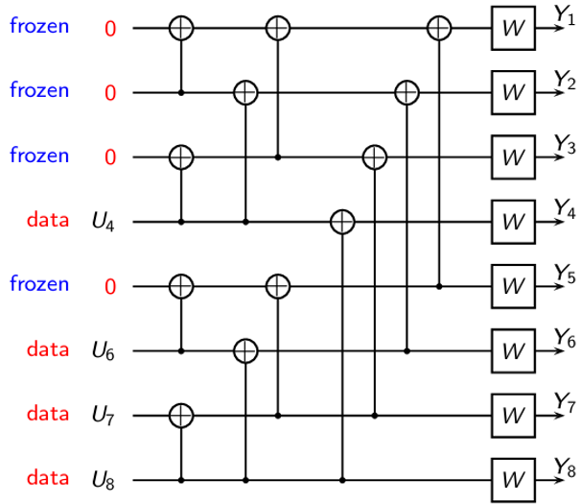
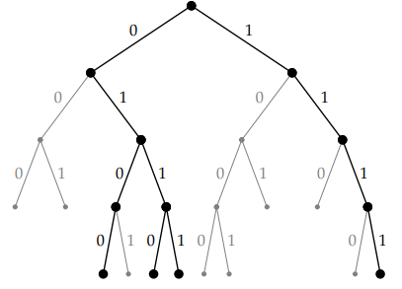
Polar Codes: Preliminaries
Channel polarization [1]: the key idea behind polar coding
  N independent copies of sub-channels can be transformed into multiple synthetic channels.
  The synthetic channels are polarized → their capacity are either approaching 0 or 1 as code length tends to infinity
  Information bits are placed at the most K reliability positions, while frozen bits are set to 0 and placed at rest positions
Successive Cancellation Decoding (SC) [1]
Low complexity, simple decoding structure
Successive Cancellation List Decoding (SCL) [2]
Retaining L decoding paths during the decoding process and select the one with the highest probability
CRC can be added to further enhance the performance (CA-SCL)
Ref: https://simons.berkeley.edu/sites/default/files/docs/2689/slidesarikan.pdf
[1] E. Arıkan, “Channel polarization: A method for constructing capacity achieving codes for symmetric binary-input memoryless channels,” IEEE Trans. Inform. Theory, vol. 55, no. 7, pp. 3051–3073, July 2009
[2] I. Tal and A. Vardy, "List Decoding of Polar Codes," in IEEE Transactions on Information Theory, vol. 61, no. 5, pp. 2213-2226, May 2015

Slide 11
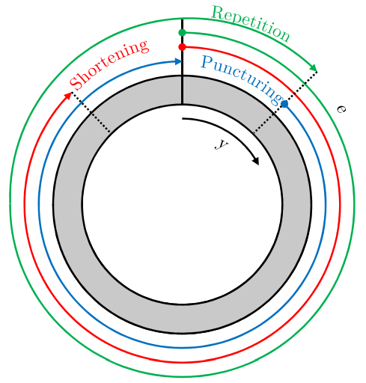
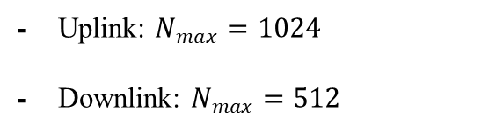
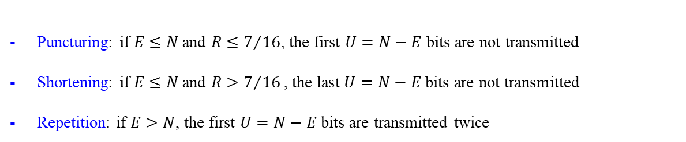
Polar Codes in NR
Polar encoding for NR control channel (Blue blocks are for uplink only, and red blocks are for downlink only)
UCI/DCI
CRC
attachment
Polar
encoding
Rate
Matching
Segmentation
interleaver
Concatenation
Uplink: $N_{max}=1024$
Downlink: $N_{max}=512$
Sub-block interleaving
Rate matching circular buffer
Channel Interleaver
Puncturing: if $E≤N$and $R≤7/{16}$, the first $U=N−E$ bits are not transmitted
Shortening: if $E≤N$and $R>7/{16}\text{, }\text{the} \text{last} U=N−E \text{bits} \text{are} \text{not} \text{transmitted}$
Repetition: if $E>N$, the first $U=N−E$ bits are transmitted twice
Circular buffer design for rate-matching [1]
[1] V. Bioglio, C. Condo and I. Land, "Design of Polar Codes in 5G New Radio," in IEEE Communications Surveys & Tutorials, vol. 23, no. 1, pp. 29-40, Firstquarter 2021, doi: 10.1109/COMST.2020.2967127.

Slide 12
Simulation Assumptions
BCC (K = 7)
LDPC Code: 11n LDPC, 11ad LDPC, New LDPC?
Polar Code: NR Polar and New Polar?
Code Rate: R = ½ as a start point
Code Length: N around (320~672 bits)
  648 bits: the current shortest code length of 11n/ac/ax LDPC
  672 bits: the current shortest code length of 11ad/ay LDPC
  512 bits: for Polar codes as an initial evaluation
  320 bits: The final transmitted bits after rate matching for payload of 20 bytes (to align with packet length of BCC)
PER/BLER: the performance were compared at 1% PER in 15.4a
Mode: HPRF mode with Data Rate of 31.2Mbps

Slide 13
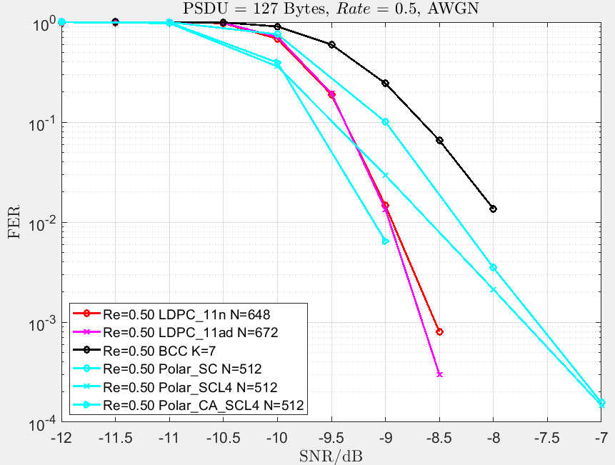
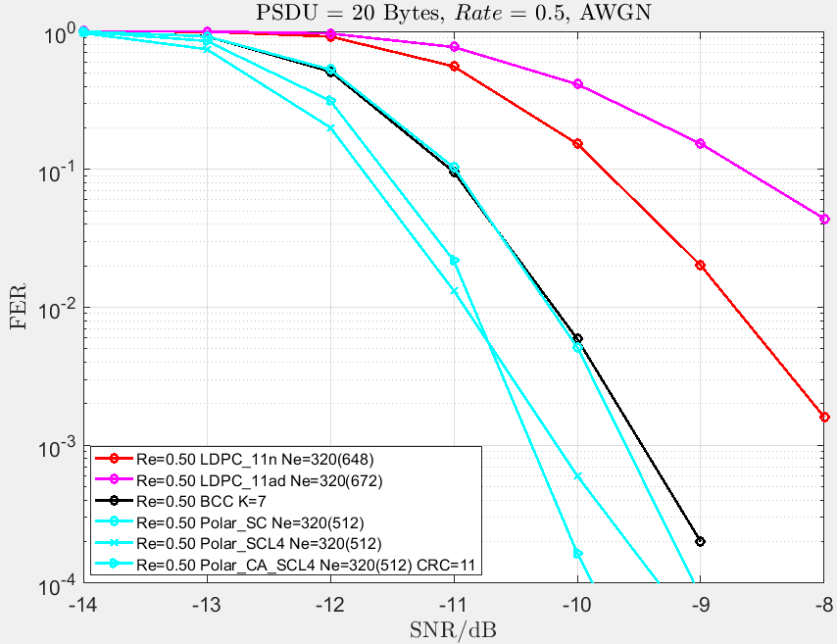
Preliminary Simulations
HPRF mode with Data Rate of 31.2Mbps

Slide 14
Straw Poll 1
Which code rate are you in favor of in 15.4ab?
  Option 1: Only one base code rate: R = 1/2
  Option 2: Include an additional higher code rate: e.g., R = 2/3, or R = 3/4
  Abstain

Slide 15
Straw Poll 2
Which code lengths shall we consider for 15.4ab?
  Option 1: around 378 bits (RS in BPRF mode)
  Option 2: around 512 bits (power of 2)
  Option 3: around 672 bits (Shortest 11n LDPC)
  Option 4: longer, e.g., > 672 bits
  Abstain

Slide 16
Thank You

