Slide 1
Project: IEEE P802.15 Working Group for Wireless Personal Area Networks (WPANs)
Submission Title: [waveform design for UWB sensing]
Date Submitted: []
Source: [Xiaohui Peng, David Xun Yang, Chenchen Liu, Kuan Wu] Company [Huawei Technologies]
Re: [Input to the Working Group]
Abstract: [Sensing, UWB in 802.15, waveform]
Purpose: []
Notice: This document has been prepared to assist the IEEE P802.15. It is offered as a basis for discussion and is not binding on the contributing individual(s) or organization(s). The material in this document is subject to change in form and content after further study. The contributor(s) reserve(s) the right to add, amend or withdraw material contained herein.
Release: The contributor acknowledges and accepts that this contribution becomes the property of IEEE and may be made publicly available by P802.15.

Slide 2
PAR Objective | Proposed Solution (how addressed)
Safeguards so that the high throughput data use cases will not cause significant disruption to low duty-cycle ranging use cases
Interference mitigation techniques to support higher density and higher traffic use cases
Other coexistence improvement
Backward compatibility with enhanced ranging capable devices (ERDEVs)
Improved link budget and/or reduced air-time
Additional channels and operating frequencies
Improvements to accuracy / precision / reliability and interoperability for high-integrity ranging
Reduced complexity and power consumption
Hybrid operation with narrowband signaling to assist UWB
Enhanced native discovery and connection setup mechanisms
Sensing capabilities to support presence detection and environment mapping | Waveform design for sensing
Low-power low-latency streaming
Higher data-rate streaming allowing at least 50 Mbit/s of throughput
Support for peer-to-peer, peer-to-multi-peer, and station-to-infrastructure protocols
Infrastructure synchronization mechanisms

Slide 3
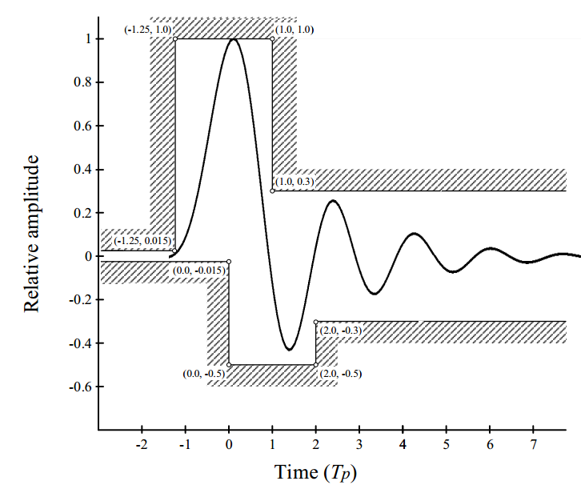
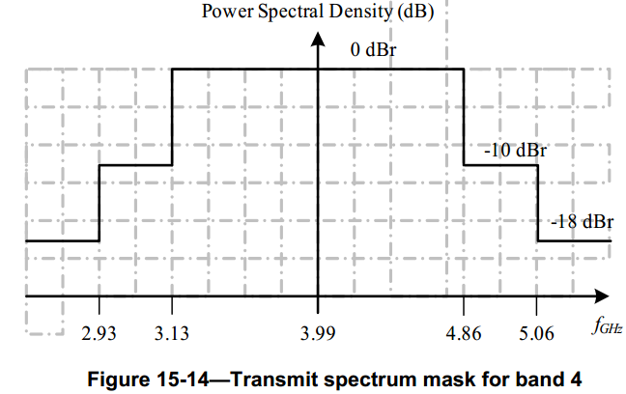
Existing waveform for ranging
Time domain mask: it is recommended that the pulse should monotonically rise to a first peak amplitude; the first peak amplitude is defined as the maximum amplitude of the pulse before it first drops more than 1.25%. The 8 order Butterworth pulse with a 3dB bandwidth of 500MHz is taken as an example.
PSD mask: the transmitted spectrum shall be less than -10dB relative to the maximum spectral density of the signal for 0.65/T_{p}<|f-f_{c}|<0.8/T_{p} and -18dB for |f-f_{c}|>0.8/T_{p}. For example, the transmit spectrum mask for channel 4 is shown as below.
Recommended time domain mask for the HRP UWB PHY pulse [1]
Transmit spectrum mask for band 4 [2]

Slide 4
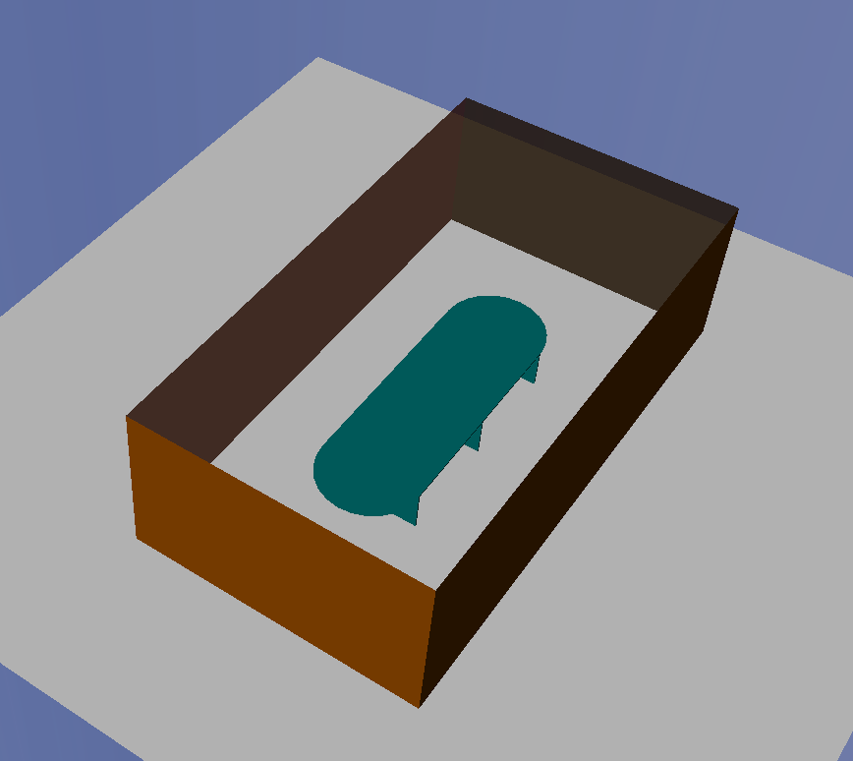

Motivation of existing waveform for ranging
For ranging application, it focuses on how to accurately measure the timestamp of the earliest path. The reflected path is considered as interference in this case.
In order to minimize the impact of the reflected path on the earliest path. so the sidelobe on the left side of the mainlobe is tend to be zero. As you can see in the following map, the peak position of the earliest path is not changed after superposition with the reflected path.
The earliest path
Reflected path
Node B
Node A
The earliest path and the reflected path
Superposition of the earliest path and the reflected path
Ranging application

Slide 5
Limitations of existing waveform for sensing
For sensing application, it focuses on how to accurately measure the parameters of the reflected path. The earliest path is considered as interference in this case.
If we use the same waveform as in the ranging application, the sidelobe of the earliest path will affect the amplitude of the reflected path. As you can see in the following map, the peak position of the reflected path is changed by the sidelobe of the earliest path, which will lead to a wrong estimation of the reflection point.
The earliest path
Node B
Node A
Reflected path
Reflection point1
Sensing application
The earliest path and the reflected path
Superposition of the earliest path and the reflected path

Slide 6
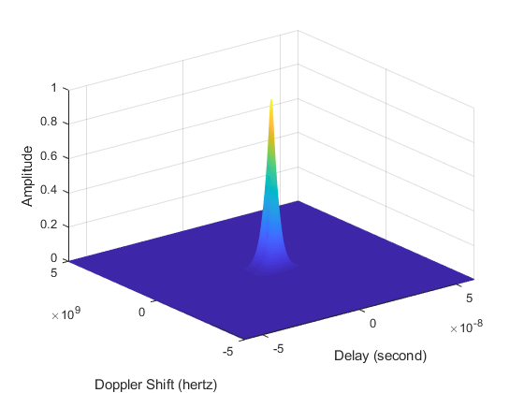
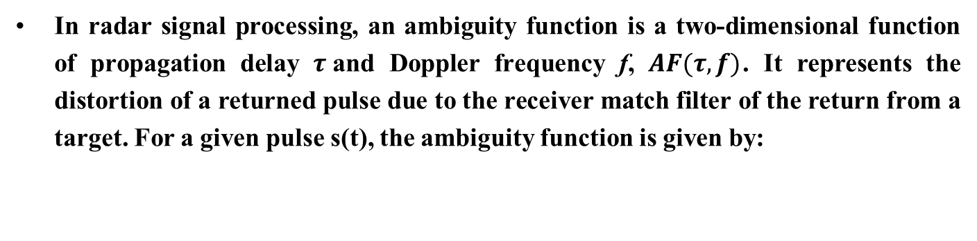

Ambiguity function
In radar signal processing, an ambiguity function is a two-dimensional function of propagation delay $τ$and Doppler frequency f, $AF(τ,f)$. It represents the distortion of a returned pulse due to the receiver match filter of the return from a target. For a given pulse s(t), the ambiguity function is given by:
$$AF\left(τ,f\right)=\int_{−∞}^{+∞}{s\left(t\right)s^{∗}\left(t−τ\right)e^{j2πft}dt}$$
Where * denotes the complex conjugate.
Two dimensional ambiguity function
Zero-Doppler cut of the ambiguity function

Slide 7
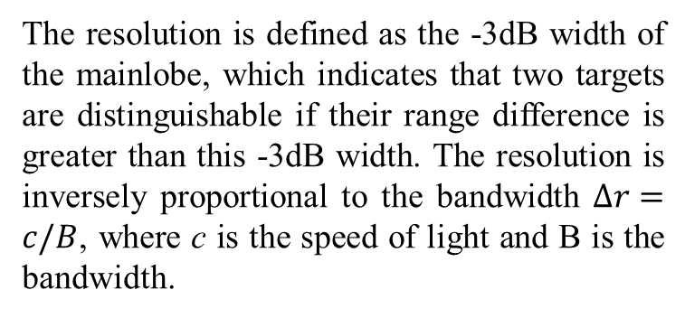
KPIs of the sensing waveform
Resolution
The resolution is defined as the -3dB width of the mainlobe, which indicates that two targets are distinguishable if their range difference is greater than this -3dB width. The resolution is inversely proportional to the bandwidth $Δr=c/B$, where c is the speed of light and B is the bandwidth.
-3dB width
Sidelobe level
Peak sidelobe ratio
The main cause of ringing artifacts is due to a signal being band-limited. The sidelobe ratio, usually expressed in decibels (dB), of the amplitude at the peak of the mainlobe to the amplitude at the peak of the sidelobe.
PSD mask
The sensing waveform should have a spectrum comply with the PSD mask defined by 802.15.4z [3].

Slide 8
Analysis of sensing waveform
-3dB
-14.37dB
Here, 8 order Butterworth pulse is taken as an example to analyze the sensing performance. From the result we can see that the 3dB resolution is about 1.6ns, and the PSLR (peak sidelobe ratio) is about -14.73dB.

Slide 9
Waveform after applying window
8th order Butterworth pulse p(t)
Gaussian pulse g(t)
Pulse after applying window p_{w}(t)=p(t)*g(t)
Here, in order to reduce the sidelobe of the pulse, we applying a Gaussian window to the 8th order Butterworth pulse and get a new pulse with reduced sidelobe level. The new pulse also comply with the PSD mask.
Pulse power density spectrum

Slide 10
Analysis of the waveform after applying window
-14.37dB
-23.26dB
The waveform after applying the Gaussian window has the same range resolution as the 8th Butterworth pulse, but the waveform has a -23.26dB PSLR which is 8.89dB lower than that of the 8th Butterworth pulse.
Both waveforms can comply with the time and PSD mask given by 802.15.4z, but these two waveforms have different PSLR which is important for sensing applications. In addition to the time and PSD mask, other constraints should be considered for sensing waveform.

Slide 11
Summary
First, we introduced the waveform used for ranging application and pointed out its limitation for sensing application.
Then, the ambiguity function is used to evaluate the performance of the sensing waveform.
Lastly, we analyze the sensing performance of two waveforms that both comply with the time and PSD mask given by 802.15.4z, but these two waveforms have different PSLR which is important for sensing application. In addition to the time and PSD mask, other constraints (e.g. ambiguity function mask or time-domain mask with lower side lobe) should be considered for sensing waveform.

Slide 12
References
Amendment1: Enhanced ultra wideband (UWB) physical layers (PHYs) and associated ranging techniques
IEEE standard for low-rate wireless networks
UWB spectral mask and FFC part 15 limits

