Slide 1
Project: IEEE P802.15 Working Group for Wireless Specialty Networks (WSN)
Submission Title: Snapshot of TG4ab PHY topics Jan 2022Date
Submitted: January 18, 2022
Source: Benjamin Rolfe (Blind Creek Associates)
Contact:
E-Mail: ben.rolfe@ieee.org
Voice: NA
Re: Task Groups Joint Meeting, TG4ab/6a/14
Abstract: Quick update on PHY topics presented in TG4ab so far
Purpose: Task Group Coordination
Notice: This document has been prepared to assist the IEEE 802. It is offered as a basis for discussion and is not binding on the contributing individual(s) or organization(s). The material in this document is subject to change in form and content after further study. The contributor(s) reserve(s) the right to add, amend or withdraw material contained herein.
Release: The contributor acknowledges and accepts that this contribution becomes the property of IEEE and may be made publicly available by 802.15.
Notes:
Jul 12, 2010
Page 1

Slide 2
Task Group 15.4ab
Next Generation UWB Amendment
Opening Report

Slide 3
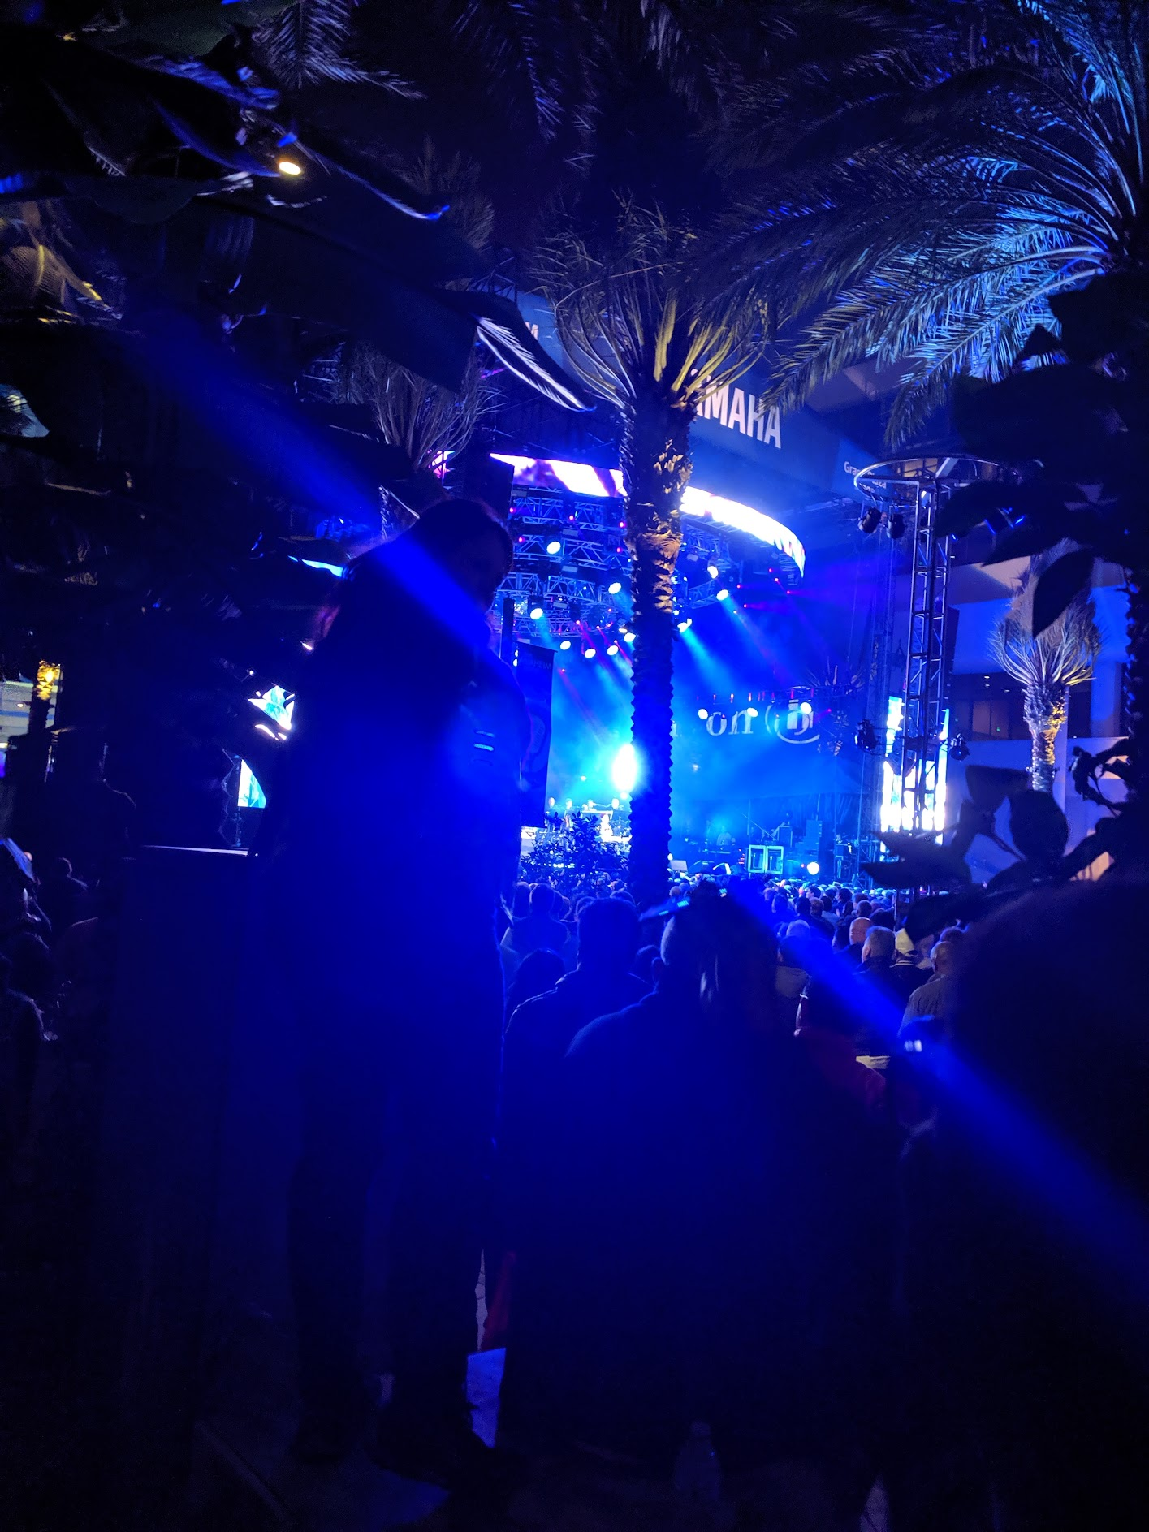

Task Group 15.4ab
Summary January 2022

Slide 4
UWB PHY Topics
UWB / narrow band coupling
UWB Sensing (monostatic and multi-static)
CIR estimation and feedback
Improved support for real-time data and non-ranging applications
Improving UWB link budget
Higher PHY data rates
Additional coding and modulation options
Further improvements to ranging accuracy and integrity
Ranging QoS
Even lower power operation
UWB wake-up signalling
Improved performance and coexistence

Slide 5
Useful Links
TG4ab Agenda January 2022 https://mentor.ieee.org/802.15/dcn/21/15-21-0644-05-04ab-tg-4ab-agenda-jan-2022.xlsx
TG4ab January 2022 Meeting Slides
https://mentor.ieee.org/802.15/dcn/22/15-22-0020-00-04ab-tg4ab-january-2022-meeting-slides.pptx
TG4ab Presentations by TGD Categories
https://mentor.ieee.org/802.15/dcn/21/15-21-0638-00-04ab-tg4ab-presentations-by-tgd-categories.xlsx
Task Group 15.4ab Call For Propsals
https://mentor.ieee.org/802.15/dcn/21/15-21-0635-01-04ab-task-group-15-4ab-call-for-propsals.docx
Technical Specification Framework
https://mentor.ieee.org/802.15/dcn/21/15-21-0442-00-04ab-technical-specification-framework.docx
15.4ab Technical Guidance Framework
https://mentor.ieee.org/802.15/dcn/21/15-21-0268-01-04ab-15-4ab-technical-guidance-framework.pptx
Objectives Checklist Table
https://mentor.ieee.org/802.15/dcn/21/15-21-0280-00-04ab-objectives-checklist-table.docx

Slide 6
Technical Contributions Links
Year | DCN | Title | URL
2022 | 12 | UWB Sensing Scenarios for 802.15.4ab
2021 | 616 | Beacon and Ranging Frames to Support Downlink TDOA (DL-TDOA) Location Service in 802.15 | https://mentor.ieee.org/802.15/dcn/21/15-21-0616-01-04ab-beacon-and-ranging-frames-to-support-downlink-tdoa-dl-tdoa-location-service-in-802-15.pptx
2021 | 610 | Higher PHY data rates | https://mentor.ieee.org/802.15/dcn/21/15-21-0610-00-04ab-higher-phy-data-rates.pptx
2021 | 605 | NBA-MMS-UWB MAC Considerations | https://mentor.ieee.org/802.15/dcn/21/15-21-0605-00-04ab-nba-mms-uwb-mac-considerations.pptx
2021 | 593 | More on NBA-MMS | https://mentor.ieee.org/802.15/dcn/21/15-21-0593-02-04ab-more-on-nba-mms.pptx
2021 | 592 | High Data Rates | https://mentor.ieee.org/802.15/dcn/21/15-21-0592-00-04ab-high-data-rates.pptx
2021 | 590 | Ranging QoS | https://mentor.ieee.org/802.15/dcn/21/15-21-0590-00-04ab-ranging-qos.pptx
2021 | 589 | UWB channel access aided by pilot narrow band radio | https://mentor.ieee.org/802.15/dcn/21/15-21-0589-00-04ab-uwb-channel-access-aided-by-pilot-narrow-band-radio.pptx
2021 | 585 | Low power operation for non-ranging applications | https://mentor.ieee.org/802.15/dcn/21/15-21-0585-02-04ab-low-power-operation-for-non-ranging-applications.pdf
2021 | 570 | CIR feedback for UWB sensing | https://mentor.ieee.org/802.15/dcn/21/15-21-0570-00-04ab-cir-feedback-for-uwb-sensing.pptx
2021 | 557 | UWB-Wake-up-signalling | https://mentor.ieee.org/802.15/dcn/21/15-21-0557-01-04ab-uwb-wake-up-signalling.pdf
2021 | 556 | UWB ranging accuracy limiting factor | https://mentor.ieee.org/802.15/dcn/21/15-21-0556-00-04ab-uwb-ranging-accuracy-limiting-factor.pptx
2021 | 530 | DL-TDOA positioning TDMA scheme | https://mentor.ieee.org/802.15/dcn/21/15-21-0530-00-04ab-dl-tdoa-positioning-tdma-scheme.pptx
2021 | 506 | Advanced Coding for Data comm | https://mentor.ieee.org/802.15/dcn/21/15-21-0506-01-04ab-advanced-coding-for-data-comm.pptx
2021 | 505 | UWB sensing methods and KPIs | https://mentor.ieee.org/802.15/dcn/21/15-21-0505-00-04ab-uwb-sensing-methods-and-kpis.pptx

Slide 7
Technical Contributions Links
Year | DCN | Title | URL
2021 | 504 | Narrowband-UWB Coupling MAC | https://mentor.ieee.org/802.15/dcn/21/15-21-0504-00-04ab-narrowband-uwb-coupling-mac.pptx
2021 | 501 | Ways to achieve higher date rate for the hrp-uwb phy | https://mentor.ieee.org/802.15/dcn/21/15-21-0501-00-04ab-ways-to-achieve-higher-date-rate-for-the-hrp-uwb-phy.pptx
2021 | 488 | DL TDOA location service | https://mentor.ieee.org/802.15/dcn/21/15-21-0488-00-04ab-dl-tdoa-location-service.pptx
2021 | 412 | Channel Accesss using Clear Channel Assessment (CCA), useful tool for efficient UWB communication | https://mentor.ieee.org/802.15/dcn/21/15-21-0412-02-04ab-channel-accesss-using-clear-channel-assessment-cca-useful-tool-for-efficient-uwb-communication.pdf
2021 | 409 | Narrowband assisted multi-millisecond UWB | https://mentor.ieee.org/802.15/dcn/21/15-21-0409-01-04ab-narrowband-assisted-multi-millisecond-uwb.pptx
2021 | 399 | UWB Sensing in 802.15 | https://mentor.ieee.org/802.15/dcn/21/15-21-0399-00-04ab-uwb-sensing-in-802-15.pptx
2021 | 394 | IR-UWB link budget analysis and comparison with NB signaling | https://mentor.ieee.org/802.15/dcn/21/15-21-0394-02-04ab-ir-uwb-link-budget-analysis-and-comparison-with-nb-signaling.pptx
2021 | 377 | Preamble codes for Data Communications | https://mentor.ieee.org/802.15/dcn/21/15-21-0377-02-04ab-preamble-codes-for-data-communications.pptx
2021 | 377 | Preamble codes for Data Communications | https://mentor.ieee.org/802.15/dcn/21/15-21-0377-00-04ab-preamble-codes-for-data-communications.pptx
2021 | 294 | Input to tech requirements for the NG UWB project | https://mentor.ieee.org/802.15/dcn/21/15-21-0294-00-04ab-input-to-tech-requirements-for-the-ng-uwb-project.pptx
2021 | 292 | Opportunities for improved UWB/NB coordination | https://mentor.ieee.org/802.15/dcn/21/15-21-0292-00-04ab-opportunities-for-improved-uwb-nb-coordination.pptx
2021 | 289 | Coupling between NB and UWB | https://mentor.ieee.org/802.15/dcn/21/15-21-0289-00-04ab-coupling-between-nb-and-uwb.pptx
2021 | 276 | Receiver Requirements for Realistic Interference Scenarios | https://mentor.ieee.org/802.15/dcn/21/15-21-0276-00-04ab-receiver-requirements-for-realistic-interference-scenarios.pptx
2021 | 272 | Some UAS Use Cases for UWB | https://mentor.ieee.org/802.15/dcn/21/15-21-0272-01-04ab-some-uas-use-cases-for-uwb.pptx
2021 | 223 | Reverse TDOA Applications and Technical Characteristics | https://mentor.ieee.org/802.15/dcn/21/15-21-0223-00-04ab-reverse-tdoa-applications-and-technical-characteristics.pptx
2021 | 222 | Data communications in UWB | https://mentor.ieee.org/802.15/dcn/21/15-21-0222-00-04ab-data-communications-in-uwb.pptx

