Slide 1
Project: IEEE P802.15 Working Group for Wireless Personal Area Networks (WPANs)
Submission Title: [Pseudo-Cyclic Dynamic Channel Model of UWB-BAN]
Date Submitted: [18^{ｔｈ} January 2022]
Source: [Attaphongse Taparugssanagorn(1), Ryuji Kohno(2)] [(1) School of Engineering and Technology, Asian Institute of Technology, Thailand , (2) Yokohama National University(YNU), &YRP International Alliance Instiitute(YRP-IAI)]
Email:[(1) attaphongset@ait.asia, (2) Kohno@ynu.ac.jp & Kohno@yrp-iai.jp] Re: []
Abstract: [This document contains Pseudo-Cyclic Dynamic On-Body UWB Radio Channel Modeling for the TG15.6a meeting in January 2022.]
Purpose: [information]
Notice: This document has been prepared to assist the IEEE P802.15. It is offered as a basis for discussion and is not binding on the contributing individual(s) or organization(s). The material in this document is subject to change in form and content after further study. The contributor(s) reserve(s) the right to add, amend or withdraw material contained herein.
Release: The contributor acknowledges and accepts that this contribution becomes the property of IEEE and may be made publicly available by P802.15.

Slide 2
Pseudo-Cyclic Dynamic Channel Model of UWB-BAN Attaphongse Taparugssanagorn∗’†’^, Bin Zhen‡ , Raffaello Tesi∗, Matti Hämäläinen∗ , Jari Iinatti∗, and Ryuji Kohno∗ ’† ∗Centre for Wireless Communications, University of Oulu, Oulu, Finland †Center of Medical Information & Communication Technology, Yokohama National University, Yokohama, Japan ‡National Institute of Information and Communications Technology (NICT), Yokosuka, Japan ^School of Engineering and Technology, Asian Institute of Technology, Thailand (currently)
Ref. Presented in ISMICT 2010 −
(1) A.Taparugssanagorn, B.Zhen, R.Tesi, M. Hämäläinen∗, J.Iinatti, R.Kohno,” A Dynamic Channel Model of UWB-WBAN for Some Medical Applications”
(2) "A UWB WBAN Channel Model based on A Pseudo-Dynamic Measurement,“ Journals of telecommunications - annales des télécommunications, Springer, volume 66, pages177-185 (2011)

Slide 3
Contents
Introduction
Measurement Setup
Measurement Scenario
Results
Conclusions and Future Work

Slide 4
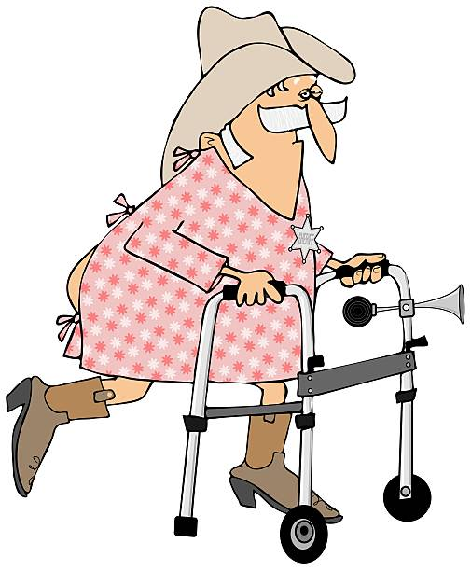
Various Mobility in Hospitals or Clinics
In hospitals patients and other medical facilities have various levels of mobility, e.g., walking, wheelchairing, etc.
Also growing evidence that for most medical conditions having patients move or walk, as much as they can tolerate, will improve their health.

Slide 5
"A UWB WBAN Channel Model based on A Pseudo-Dynamic Measurement,“ annals of telecommunications - annales des télécommunications, Springer, volume 66, pages177-185 (2011)
Not only static wireless body area network (WBAN) radio channels usually investigated, but also dynamic scenarios due to the effect of body motion.
To expand the knowledge of the ultra-wideband (UWB) channel in the frequency range of 3.1-10 GHz in close proximity of a dynamic human body.
Based on experimental measurements a two-state alternating Weibull renewal process is modelled for the dynamic fade characteristics of the channel.
The model can then be used to better design communication network protocols for WBANs.

Slide 6
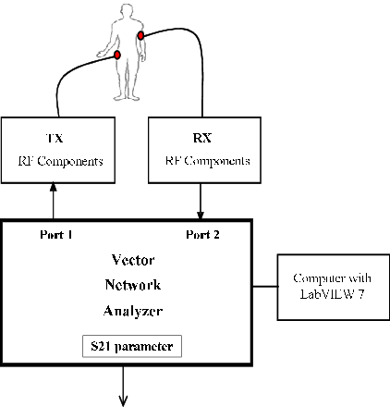
Channel Measurement Setup and Scenarios
An HP Agilent 8720ES, a vector network analyzer (VNA), SkyCross SMT-3TO10M-A antennas, 5-m long SUCOFLEXr RF cables with 7.96 dB loss and a control computer with LabVIEWTM 7 software.
The measurements were taken corresponding to realistic scenarios in a regular hospital room with the size of 6.3 m×7.2 m×2.5 m in the Oulu university hospital.

Slide 7
Channel Measurement Setup and Scenarios
Two measured radio links,
A1 and A2
For the radio link A1, the Rx antenna was at the middle front of the torso and the Tx antenna was placed on the left wrist.
These locations are comfortable for most patients and they are potential places for antennas/transceivers connected to electrocardiogram (ECG) sensors and a pulse oximeter.
For the radio link A2, the subject was 2-m away from and facing toward the Rx antenna placed on a 2-m high pole and the Tx antenna was on the left wrist of the subject.
Usual situations of patients in the regular hospital room, i.e., walking, lying, as well as eating while lying.

Slide 8
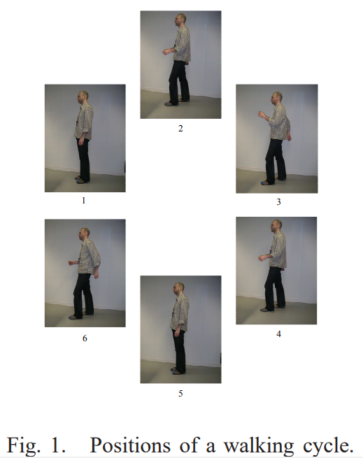
Channel Measurement Setup and Scenarios
A pseudo-dynamic measurement method was applied, where each position in a walking cycle in Fig. 1 was kept still for the whole measurement period (e.g. 100 snapshots or realizations per position), and was modified according to the walking cycle.
Processing a single frequency domain measurement in the 3.1-10 GHz band takes several seconds, a real-time measurement of the radio channel fluctuations due to body motions is not feasible.

Slide 9
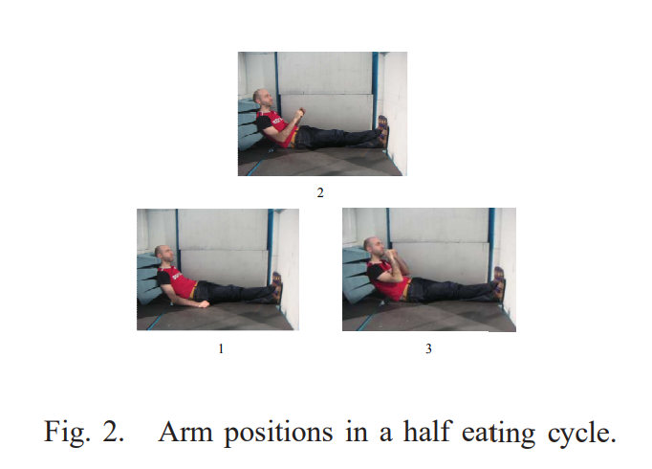
Channel Measurement Setup and Scenarios
A pseudo-dynamic measurement emulates the situation when the subject is eating while lying down as shown in Fig. 2 was also taken.
Based on an actual measurement, a walking cycle or an eating cycle lasts 0.6 s assuming an equal time interval between consecutive positions, i.e., 0.1 s.
To be able to study the dynamic features, the measurements were extended from a walking or an eating cycle til 10 s walk or eating.
In addition, an interpolation was done in order to obtain 0.1 ms sampling interval.

Slide 10
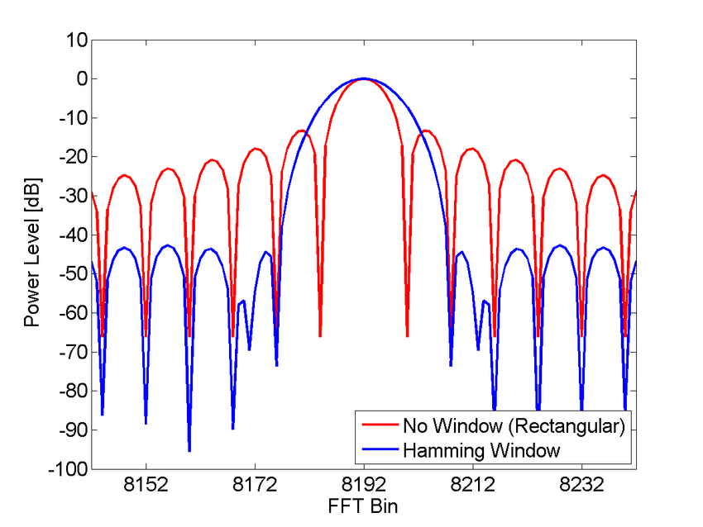
Results and Analysis
The measured S21-parameters or channel transfer functions are converted to the time domain, i.e., channel impulse responses (IR) using an inverse fast Fourier transform (IFFT).
A Hamming windowing is used to reduce sidelobes.
The characteristics of on-body WBAN channels are altered time-variantly since the link distance changes when arm moves, body will block the LOS link, and the antenna polarization mismatch due to the misalignment of the transmit (Tx) and receive (Rx) antennas.

Slide 11
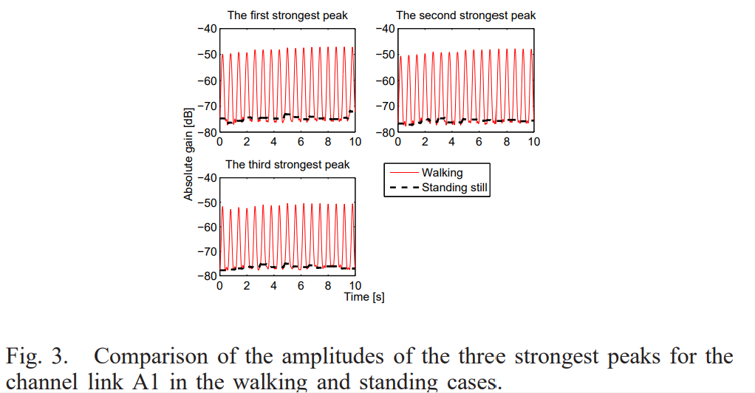
Results and Analysis
According to selective rake (SRake), only some (three) strongest peaks capture most of the energy of the channel and are considered in our study.
The comparison of the gain of the three strongest peaks of the impulse response for the channel link A1 in the walking and standing cases are shown in Fig. 3.
The averaged path gain in the standing still case is also plotted as a reference and its mean is later set to be a threshold level.

Slide 12
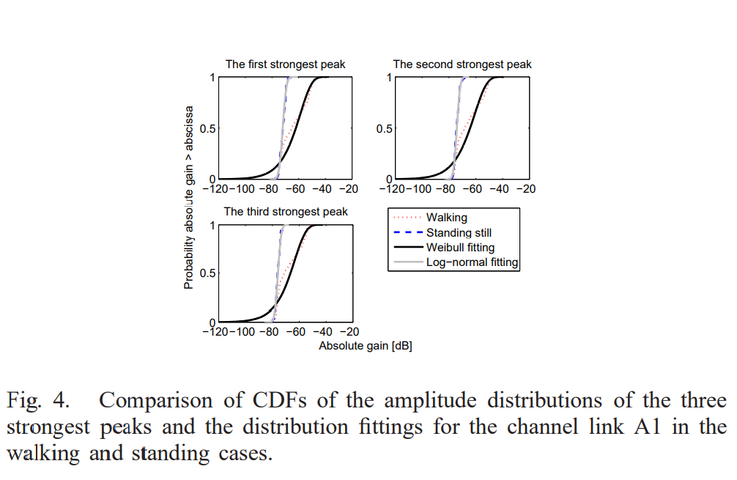
Statistic Analysis
The amplitude distributions of the three strongest peaks and the distribution best fitting the static and pseudo-dynamic channels.
A least squares parameter estimation is applied for distribution fitting.

Slide 13
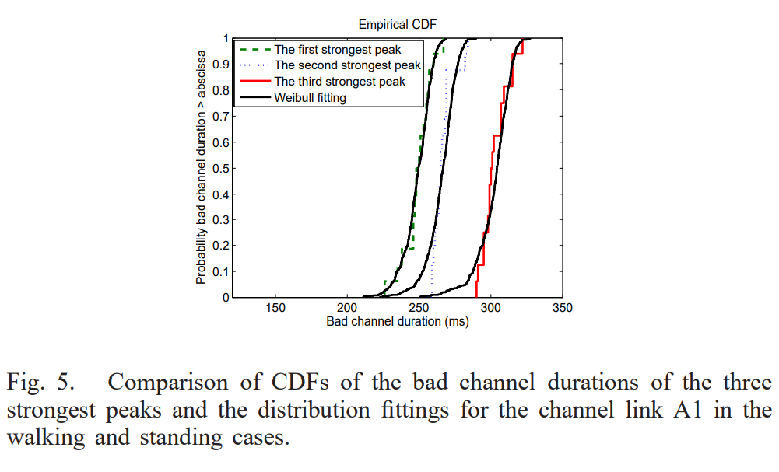
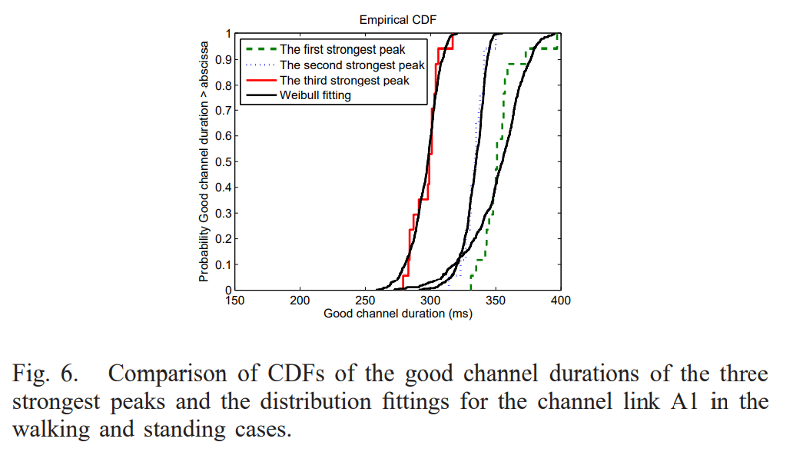
Statistic Analysis
The fade or bad channel duration determining how long the amplitude lies below a given threshold level chosen from the mean amplitude of the first peak in the standing case (-72 dB) is shown in Fig. 5.
This helps to determine the most likely number of signaling bits that may be lost during a fade.
On the other hand, the non-fade or good channel duration determining how long the amplitude lies above a given threshold level is shown in Fig. 6.

Slide 14
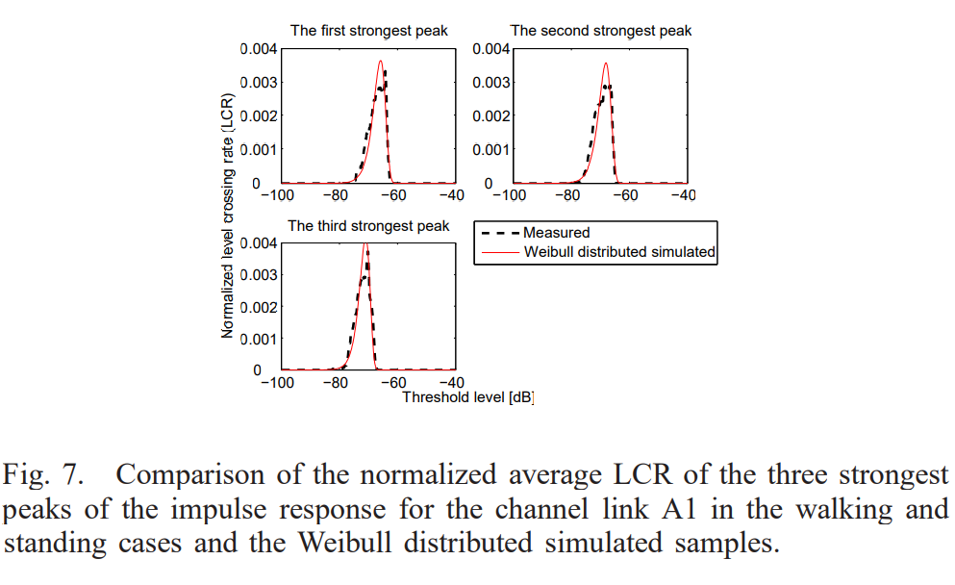
Statistic Analysis
Level crossing rate (LCR) at any threshold level is defined as the expected rate at which the signal envelope crosses that level in positive (or negative) going direction.
Fig. 7 shows the average normalized LCRs in positive as a function of threshold level for the first peak, the second peak, and the third peak, which are all found to be 0.0007 (absolute values are 18.64, 18.91, and 17.87, respectively) at the threshold level (-72 dB).
The signal crosses the threshold for each 0.53 s, 0.52 s, and 0.56 s of observation time.
Provision of 8 dB extra margin increases this to 5 s, which clarifies the favorable slow fading..
The received signal experience periods insufficient signal strength or fading interval during which the bit error rate is close to one half and the receiver may not function reliably.
These are useful in predicting the burst of errors without doing the end-to-end system simulation and in the design of the error control codes, interleaver

Slide 15
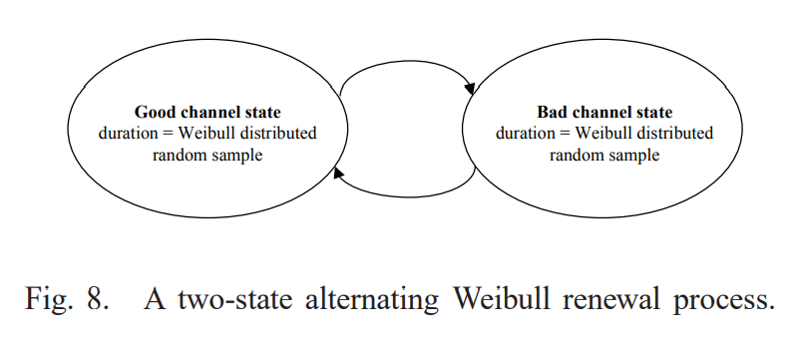
Statistic Analysis
Two-state Markov or the simplified Gilbert model cannot be used since the durations of both bad channel and good channel do not follow a geometric distribution.
We propose a two-state alternating Weibull renewal process, where in one state good channel duration and in the other state bad channel duration are generated, as shown in Fig. 8.
The model represents an alternating renewal process meaning that the probability of producing a bad channel duration is independent of the previous bad channel duration and is also independent of the previous good channel.
channel. Each state has its own Weibull distribution functions Fgd (x |a, b ) and Fbd (x |a, b ) for the good state and the bad state, respectively, where their corresponding parameters are summarized in Table II.

Slide 16
Conclusions
The dynamic characteristics of UWB WBAN radio channel due to the body motions were investigated.
Since a real-time measurement of the radio channel fluctuations due to the body motions is not technically feasible over a frequency band of several GHz, a pseudo-dynamic method was applied.
Three strongest peaks capturing most of the energy of the channel were taken into account in the study.
The dynamic features of path fading process, e.g., the good and bad channel durations as well as the LCR, which were important for a cross layer design, was statistically analyzed.
Finally, a two-state alternating Weibull renewal process was found to excellently fit the observation.
The model can provide good usability and high accuracy with low complexity.

Slide 17
Thank You for Your attention!
17

