Slide 1
Project: IEEE P802.15 Working Group for Wireless Specialty Networks
Submission Title: MAC Bridging for Time-Sensitive Networking of 802.15.6ma
Date Submitted: March 15th, 2023
Source: Minsoo Kim¹, Takumi Kobayashi^{1,2}, Marco Hernandez¹, Ryuji Kohno^{1,2}
Company: ¹Yokosuka Research Park International Alliance Institute (YRP-IAI), Japan; ²Yokohama National University (YNU), Japan
Address: ¹YRP 1, 3-4 Hikarino-oka, Yokosuka, 239-0847 Japan; ²79-5 Tokiwadai, Hodogaya-ku, Yokohama, 240-8501 Japan
Voice: ²+81-90-5408-0611, Fax: ²+81-45-383-5528, E-Mail:[minsoo@minsookim.com; kobayashi-takumi-ch@ynu.ac.jp, Marco.Hernandez@ieee.org; kohno@ynu.ac.jp]
Re: In response to call for technical contributions
Abstract: This document contains a discussion of MAC Bridging for Time-Sensitive Networking to realize the enhanced reliability of P802.15.6ma.
Purpose: Material for discussion in P802.15.6ma TG
Notice: This document has been prepared to assist the IEEE P802.15.6ma. It is offered as a basis for discussion and is not binding on the contributing individual(s) or organization(s). The material in this document is subject to change in form and content after further study. The contributor(s) reserve(s) the right to add, amend or withdraw material contained herein.
Release: The contributor acknowledges and accepts that this contribution becomes the property of IEEE and may be made publicly available by P802.15.6ma.

Slide 2
MAC Bridging for Time-Sensitive Networking of 802.15.6ma
Minsoo Kim¹, Takumi Kobayashi^{1,2},
Marco Hernandez¹, Ryuji Kohno^{1,2}
¹Yokosuka Research Park International Alliance Institute (YRP-IAI)
²Yokohama National University (YNU)

Slide 3
Introduction
Major use cases of 802.15.6ma Body Area Networks (BAN) are for human and vehicle bodies in medical and automotive applications.
Some of these applications such as vital signs (e.g. ECG) monitoring are similar to the audio/video traffic in IEEE Std 802.1Q-2018: Bridges and Bridged Networks, in that they are sensitive to transmission latency and packet loss.
Hence, goals of Time-Sensitive Networking (TSN) such as low latency and reliability are also important for BAN.
We present some potential ideas of using concepts of TSN in wireless networks, especially for Human-BAN and Vehicle-BAN.

Slide 4
Bridge operation
The principal elements of Bridge operation are
Relay and filtering of frames
Frame reception.
Discard on received frame in error.
...
Frame transmission.
Maintenance of the information required to make frame filtering and relaying decisions.
Management of the above.
(From 802.1Q-2018 Bridges and Bridged Networks)

Slide 5
Possible bridging in 802.15.6ma
BAN
(wireless)
WLAN
(wireless)
LAN
(wired)
Sensor
(Talker)
Bridge
Bridge
Bridge
BAN
Node
BAN
Coordinator
WLAN
terminal
Access Point
Switch / Router
BAN
Node
Vital sign monitor
Server / Nurse station
Sensor
(Talker)
Caretaker
(Listener)
Clinician
(Listener)
BAN coordinator may relay frames to outer network as a MAC Bridge.
End-to-end latency should be kept below permissible value.

Slide 6
Possible bridging in 802.15.6ma
BAN
(wireless)
WLAN
(wireless)
Sensor
(Talker)
Coordinator
(Bridge)
Another
Bridge
BAN
MAC
MAC
WLAN
MAC
BAN
PHY
BAN
PHY
WLAN
PHY
WLAN
PHY
What we want:
End-to-end latency being kept below permissible value
What bridging gives us:
Logical connections between a BAN node and a device outside of the BAN
A BAN node will be able to see other devices outside of its network as if they are in the same network.

Slide 7
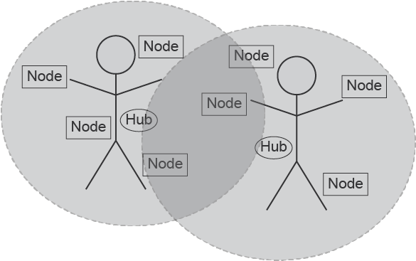
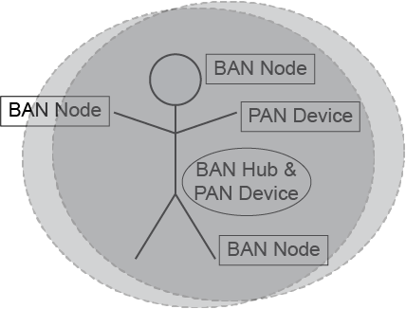
Interference among BANs or BAN and other systems
There would be cases where BANs or BAN and other networks are spatially overlapped.
Coexistence Environment Level 1-2
Coexistence Environment Level 4-6
Case 1: BANs, using same frequency bands
Case 2: BAN and PAN, using same frequency bands

Slide 8
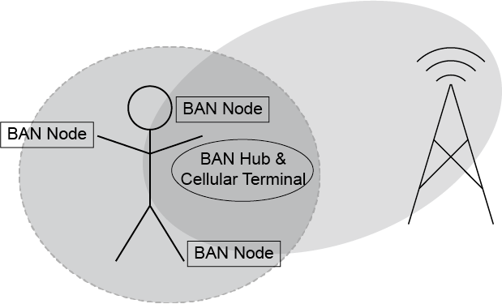
Interference among BANs or BAN and other systems
Coexistence Environment Level 7
Coexistence Environment Level 3
Case 3: BAN and other piconets such as cellular network or Wi-Fi, some part of their frequency bands are overlapped.
Case 4: Case 1 to 3 combined

Slide 9
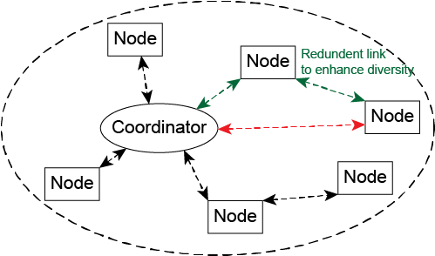
Bridging inside a BAN (Two-hop star topology extension)
The current standard defines star topology with one hop, since there is no Line-of-Sight link between back and front of a human body, as well as a vehicular body. Multiple hops may be included in the revision.
Some concepts from 802.1 TSN may help managing interference or packet collision among same or different BANs (VBAN and/or HBAN), PANs, and other piconets.
Frame Replication and Elimination (802.1CB)
When the revision introduces using more than 2 relay nodes simultaneously.
Link Control (802.1Qca)

Slide 10
Bridging between BANs
BAN # 1
WLAN
LAN
Clinician
(Listener)
Sensor
(Talker)
Server
/ Nurse station
/ etc.
BAN
Coordinator
WLAN
terminal
Access Point
BAN
Node
BAN
Node
As a bridge, a BAN coordinator may relay frames to outer network.
And those frames may be from other BAN coordinator.
Sensor
(Talker)
BAN
Coordinator
BAN # 2
BAN
Node
BAN
Node
Sensor
(Talker)
Sensor
(Talker)

Slide 11
Summary
Time-Sensitive Networking (TSN) can be useful for BAN because end-to-end latency and reliability are also important factors in BAN.
In addition, Some ideas of 802.1 TSN might be applicable for contention-avoidance among the multiple BANs and PANs to enhance the dependability.
Introducing bridging between different types of networks (such as BANs and WLANs) will be very challenging.
If bridging is necessary to realize TSN, we should consider carefully where to apply it.

Slide 12
References
[1] 15-09-0039-00-0006, One MAC with Multi-PHY Method: Bridging Function

Slide 13
Thank you for your attention!

