Slide 1
Project: IEEE P802.15 Working Group for Wireless Specialty Networks
Submission Title: MAC Bridging for Time-Sensitive Networking of 802.15.6a
Date Submitted: January 19th, 2022
Source: Minsoo Kim¹, Takumi Kobayashi^{1,2}, Marco Hernandez¹, Ryuji Kohno^{1,2}
Company: ¹Yokosuka Research Park International Alliance Institute (YRP-IAI), Japan; ²Yokohama National University (YNU), Japan
Address: ¹YRP 1, 3-4 Hikarino-oka, Yokosuka, 239-0847 Japan; ²79-5 Tokiwadai, Hodogaya-ku, Yokohama, 240-8501 Japan
Voice: ²+81-90-5408-0611, Fax: ²+81-45-383-5528, E-Mail:[minsoo@minsookim.com; kobayashi-takumi-ch@ynu.ac.jp, Marco.Hernandez@ieee.org; kohno@ynu.ac.jp]
Re: In response to call for technical contributions
Abstract: This document contains a discussion of MAC Bridging for Time-Sensitive Networking to realize the enhanced reliability of P802.15.6a.
Purpose: Material for discussion in P802.15.6a TG
Notice: This document has been prepared to assist the IEEE P802.15.6a. It is offered as a basis for discussion and is not binding on the contributing individual(s) or organization(s). The material in this document is subject to change in form and content after further study. The contributor(s) reserve(s) the right to add, amend or withdraw material contained herein.
Release: The contributor acknowledges and accepts that this contribution becomes the property of IEEE and may be made publicly available by P802.15.6a.

Slide 2
MAC Bridging for Time-Sensitive Networking of 802.15.6a
Minsoo Kim¹, Takumi Kobayashi^{1,2},
Marco Hernandez¹, Ryuji Kohno^{1,2}
¹Yokosuka Research Park International Alliance Institute (YRP-IAI)
²Yokohama National University (YNU)

Slide 3
Introduction
Major use cases of 802.15.6a Body Area Networks (BAN) are for human and vehicle bodies in medical and automotive applications.
Some of these applications such as vital signs (e.g. ECG) monitoring are similar to the audio/video traffic in IEEE Std 802.1Q-2018: Bridges and Bridged Networks, in that they are sensitive to transmission latency and packet loss.
Hence, goals of Time-Sensitive Networking (TSN) such as low latency and reliability are also important for BAN.
We present some potential ideas of using concepts of TSN in wireless networks, especially for Human-BAN and Vehicle-BAN.

Slide 4
Bridge operation
The principal elements of Bridge operation are
  Relay and filtering of frames
    Frame reception.
    Discard on received frame in error.
    ...
    Frame transmission.
  Maintenance of the information required to make frame filtering and relaying decisions.
  Management of the above.
(From 802.1Q-2018 Bridges and Bridged Networks)

Slide 5
Possible bridging in 802.15.6a
BAN
(wireless)
WLAN
(wireless)
LAN
(wired)
Sensor
(Talker)
Bridge
Bridge
Bridge
BAN
Node
BAN
Coordinator
WLAN
terminal
Access Point
Switch / Router
BAN
Node
Vital sign monitor
Server /
Nurse station
Sensor
(Talker)
Caretaker
(Listener)
Clinician
(Listener)
BAN coordinator may relay frames to outer network as a MAC Bridge.
End-to-end latency should be kept below permissible value.

Slide 6
BAN coordinator
Like bridges in 802.1 which connects two separate networks, 802.15.6 has coordinators (hubs).
A single BAN consists of a coordinator and nodes.
The coordinator connects to the nodes of the network to which it belongs.
  The coordinator can connect to nodes operating on the same PHY as well as nodes operating on different PHYs.
The amendment may introduce coordinator-to-coordinator link, allowing a coordinator to connect to other coordinators.
  To enhance dependability by managing inter-network interference.
  Unlike wired network, wireless network shares same medium and collision occurs which plays significant role in dependability.

Slide 7
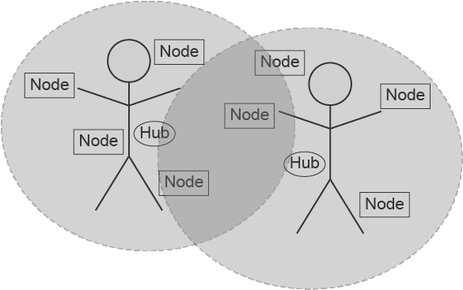
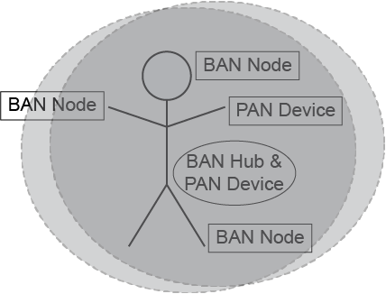
Interference among BANs or BAN and other systems
There would be cases where BANs or BAN and other networks are spatially collapsed.
  Case 1: BANs, using same frequency bands
Case 2: BAN and PAN, using same frequency bands

Slide 8
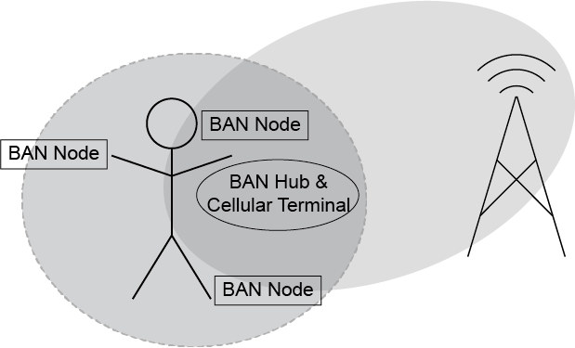
Interference among BANs or BAN and other systems
Case 3: BAN and other piconets such as cellular network or Wi-Fi, some part of their frequency bands are overlapped.
Case 4: Case 1 to 3 combined
The concept of 802.1 MAC Bridge can be extended to enhance dependability.
The coordinator can manage interference or packet collision among same or different BANs (VBAN and/or HBAN), PANs, and other piconets.

Slide 9
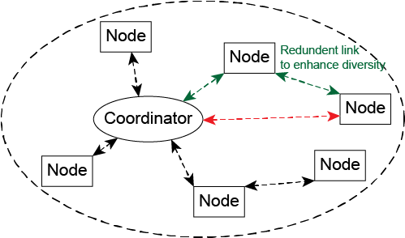
Two-hop star topology extension
Star topology + one hop (current std.)
  Since there is no Line-of-Sight link between back and front of a human body, as well as a vehicular body
Star topology + multiple hops (may be introduced in the amendment)
TSN concept may be applicable.
  Frame Replication and Elimination (802.1CB)
    When the amendment introduces using more than 2 relay nodes simultaneously.
  Link Control (802.1Qca)
Note: The relaying described in this slide operates on MAC layer, though corresponding 802.1 Stds define routing in the network layer.

Slide 10
Coordinator to Coordinator Bridging
BAN # 1
WLAN
LAN
Clinician
(Listener)
Sensor
(Talker)
Server
/ Nurse station
/ etc.
BAN
Coordinator
WLAN
terminal
Access Point
BAN
Node
BAN
Node
As a bridge, a BAN coordinator may relay frames to outer network.
And those frames may be from other BAN coordinator.
Sensor
(Talker)
BAN
Coordinator
BAN # 2
BAN
Node
BAN
Node
Sensor
(Talker)
Sensor
(Talker)

Slide 11
Summary
TSN concept in may be useful for contention-avoidance among the multiple BANs and PANs to enhance the dependability as amendment of the original 802.15.6-2012.
We may extend the star plus 1-hop topology to star plus 2-hops, to guarantee dependable connectivity.
We intend to simplify the contention-free/contention-based hybrid MAC of the original 15.6-2012 for feasible implementations with enhanced dependability.
Priority management in original 15.6-2012 could be re-defined in HBAN and newly defined in VBAN for enhanced dependability.

Slide 12
Thank you for your attention!

