Slide 1
Project: IEEE P802.15 Working Group for Wireless Specialty Networks (WSN)
Submission Title: Task Group 15.4ab Opening Report
Date Submitted: November 9, 2021
Source: Benjamin A. Rolfe (Blind Creek Associates)
Contact:
Voice: +1 408 395 7207, E-Mail: ben.rolfe @ ieee.org
Re: Task Group 4ab: UWB Next Generation for 802.15.4
Abstract: Interim Session Slides
Purpose: Continue to progress the project
Notice: This document has been prepared to assist the IEEE P802.15. It is offered as a basis for discussion and is not binding on the contributing individual(s) or organization(s). The material in this document is subject to change in form and content after further study. The contributor(s) reserve(s) the right to add, amend or withdraw material contained herein.
Release: The contributor acknowledges and accepts that this contribution becomes the property of IEEE and may be made publicly available by P802.15.
Notes:
Jul 12, 2010
Page 1

Slide 2
Task Group 15.4ab Next Generation UWB Amendment
Opening Report

Slide 3
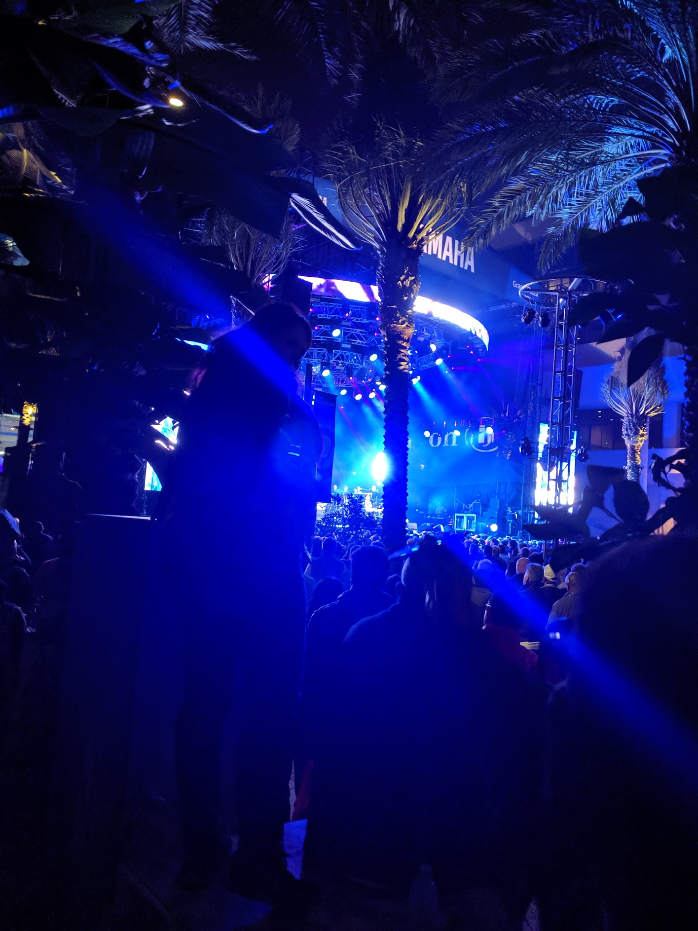
Task Group 15.4ab Virtual Interim January 2022
January 18th through January 26th 2022

Slide 4
5.2.b Scope of the project (As approved):
This amendment enhances the Ultra Wideband (UWB) physical layers (PHYs) medium access control (MAC), and associated ranging techniques while retaining backward compatibility with enhanced ranging capable devices (ERDEVs). Areas of enhancement include:
additional coding, preamble and modulation schemes to additional coding, preamble and modulation schemes to support improved link budget and/or reduced air-time relative to IEEE Std 802.15.4 UWB;
additional channels and operating frequencies;
interference mitigation techniques to support greater device density and higher traffic use cases relative to the IEEE Std 802.15.4 UWB;
improvements to accuracy, precision and reliability and interoperability for high-integrity ranging; schemes to reduce complexity and power consumption;
definitions for tightly coupled hybrid operation with narrowband signaling to assist UWB;
enhanced native discovery and connection setup mechanisms;
sensing capabilities to support presence detection and environment mapping;
and mechanisms supporting low-power low-latency streaming as well as high data-rate streaming allowing at least 50 Mb/s of throughput.
Support for peer-to-peer, peer-to-multi-peer, and station-to-infrastructure protocols are in scope, as are infrastructure synchronization mechanisms. This amendment includes safeguards so that the high throughput data use cases do not cause significant disruption to low duty-cycle ranging use cases.
https://development.standards.ieee.org/myproject-web/app#viewpar/9081

Slide 5
Session Objectives
Hear technical contributions and develop technical content for TFD

Slide 6
January Agenda
https://mentor.ieee.org/802.15/dcn/21/15-21-0644-05-04ab-tg-4ab-agenda-jan-2022.xlsx
 |  | Wednesday | Friday | Tuesday |  | Wednesday |  | Thursday |  | Friday |  |  | Sunday | Monday |  | Tuesday |  | Wednesday
EST | PST | 12-Jan | 14-Jan | 18-Jan |  | 19-Jan |  | 20-Jan |  | 21-Jan |  | UTC | 23-Jan | 24-Jan |  | 25-Jan |  | 26-Jan |  | JST
5:00 | 2:00 |  |  |  |  |  |  |  |  |  |  | 10:00 |  |  |  |  |  |  |  | 19:00
6:00 | 3:00 |  |  |  |  |  |  |  |  |  |  | 11:00 |  |  |  |  |  |  |  | 20:00
7:00 | 4:00 |  |  |  |  | TG13 | AM0 | TG13 | AM0 | AM0 | AM0 | 12:00 |  | TG13 | Joint 3ma/THz | TG13 | AM0 |  |  | 21:00
8:00 | 5:00 |  |  |  |  |  |  |  |  |  |  | 13:00 |  |  |  |  |  |  |  | 22:00
9:00 | 6:00 |  |  | WG Opening Meeting |  | TG7a | TG6a | TG7a | TG6a | Joint 6a/4ab/14 | Joint 3ma/THz | 14:00 |  | TG7a | TG4ab | TG7a | TG6a | WG Closing Meeting |  | 23:00
10:00 | 7:00 | 802.15 CAC |  |  |  |  |  |  |  |  |  | 15:00 |  |  |  |  |  |  |  | 0:00
11:00 | 8:00 |  |  | SC Maint |  | Joint 802.15/802.1 |  | SC WNG |  | TG4ab | AM2 | 16:00 |  | AM2 | AM2 | SC IETF |  |  |  | 1:00
12:00 | 9:00 |  |  |  |  |  |  |  |  |  |  | 17:00 |  |  |  |  |  |  |  | 2:00
13:00 | 10:00 |  |  | TG15 | TG16t | TG15 | PM1 | Joint 14/15/4ab | PM1 | PM1 | PM1 | 18:00 |  | TG15 | TG16t | TG4ab | PM1 |  |  | 3:00
14:00 | 11:00 |  |  |  |  |  |  |  |  |  |  | 19:00 |  |  |  |  |  |  |  | 4:00
15:00 | 12:00 |  |  | TG4aa | PM2 | TG4cor1 | PM2 | TG14 | PM2 | PM2 | PM2 | 20:00 |  | TG14 | PM2 | TG4cor1 | PM2 |  |  | 5:00
16:00 | 13:00 |  |  |  |  |  |  |  |  |  |  | 21:00 |  |  |  |  |  |  |  | 6:00
17:00 | 14:00 |  |  | EV1 | EV1 | TG4ab | EV1 | TG4ab | EV1 | EV1 | EV1 | 22:00 |  | EV1 | TG4ab | EV1 | EV1 |  |  | 7:00
18:00 | 15:00 |  |  |  |  |  |  |  |  |  |  | 23:00 |  |  |  |  |  |  |  | 8:00
19:00 | 16:00 |  |  | EV2 | EV2 | EV2 | EV2 | EV2 | EV2 | EV2 | EV2 | 0:00 |  | EV2 | TG4ab | EV2 | EV2 |  |  | 9:00
20:00 | 17:00 |  |  |  |  |  |  |  |  |  |  | 1:00 |  |  |  |  |  |  |  | 10:00
21:00 | 18:00 |  |  |  |  |  |  |  |  |  |  | 2:00 |  |  |  |  |  |  |  | 11:00
22:00 | 19:00 |  |  |  |  |  |  |  |  |  |  | 3:00 |  |  |  |  |  |  |  | 12:00
23:00 | 20:00 |  |  |  |  |  |  |  |  |  |  | 4:00 |  |  |  |  |  |  |  | 13:00
Current Agenda includes 19 Technical presentations

Slide 7
Thanks!

Slide 8
Task Group Organization
Chair: Benjamin Rolfe (BCA)
Vice Chair and Recording Secretary: David Xun Yang (Huawei)
Vice Chair: Clint Powell (PWCC)
Vice Chair: Clint Chaplin (SRA)
Lead Technical Editor: Billy Verso
Thank you to all the volunteers!

