Slide 1
Project: IEEE P802.15 Working Group for Wireless Specialty Networks (WSN)
Submission Title: TG4ab January 2022 Meeting Slides
Date Submitted: November 9, 2021
Source: Benjamin A. Rolfe (Blind Creek Associates)
Contact:
Voice: +1 408 395 7207, E-Mail: ben.rolfe @ ieee.org
Re: Task Group 4ab: UWB Next Generation for 802.15.4
Abstract: Interim Session Slides
Purpose: Continue to progress the project
Notice: This document has been prepared to assist the IEEE P802.15. It is offered as a basis for discussion and is not binding on the contributing individual(s) or organization(s). The material in this document is subject to change in form and content after further study. The contributor(s) reserve(s) the right to add, amend or withdraw material contained herein.
Release: The contributor acknowledges and accepts that this contribution becomes the property of IEEE and may be made publicly available by P802.15.
Notes:
Jul 12, 2010
Page 1

Slide 2

Task Group 15.4ab
Next Generation UWB Amendment
Objective: enhancements to 802.15.4 Ultra Wideband (UWB) physical layers (PHYs) medium access control (MAC) and associated ranging techniques while retaining backward compatibility with enhanced ranging capable devices (ERDEVs).
Meeting will begin at 10 after the hour

Slide 3
Registration for 802 LMSC Plenaries and 802 Wireless Interims
This 802.15 meeting is part of a IEEE 802 Wireless Interim session
You must pay the registration fee in order to attend
If you have not already done so please register:
  https://touchpoint.eventsair.com/ieee-802-wireless-interim-session-jan-2022
If you do not intend to register for this session you must leave this meeting and, if you have logged attendance on IMAT, email the appropriate WG chair or vice chairs to have your attendance cancelled

Slide 4
Deadbeat Consequences
(Deadbeat: in default of paying registration fee for a prior mtg.)
No participation credit will be granted for said session.
Any participation credit acquired before said session toward membership in any IEEE 802 LMSC group is revoked.
Membership in any IEEE 802 LMSC group is terminated.
No participation credit will be granted for attendance at any subsequent IEEE 802 LMSC session until the individual has complied with the registration requirements for all previously attended IEEE 802 LMSC sessions by the start of said subsequent session.

Slide 5
Registration Reminder
If you are not yet registered (and have paid the meeting fee) please do so now.
Late Registration:
(After 23:59 PM Eastern Time, Friday January 14, 2022
US$125.00)
$US 125.00 for all attendees
Registration information:
https://touchpoint.eventsair.com/ieee-802-wireless-interim-session-jan-2022

Slide 6
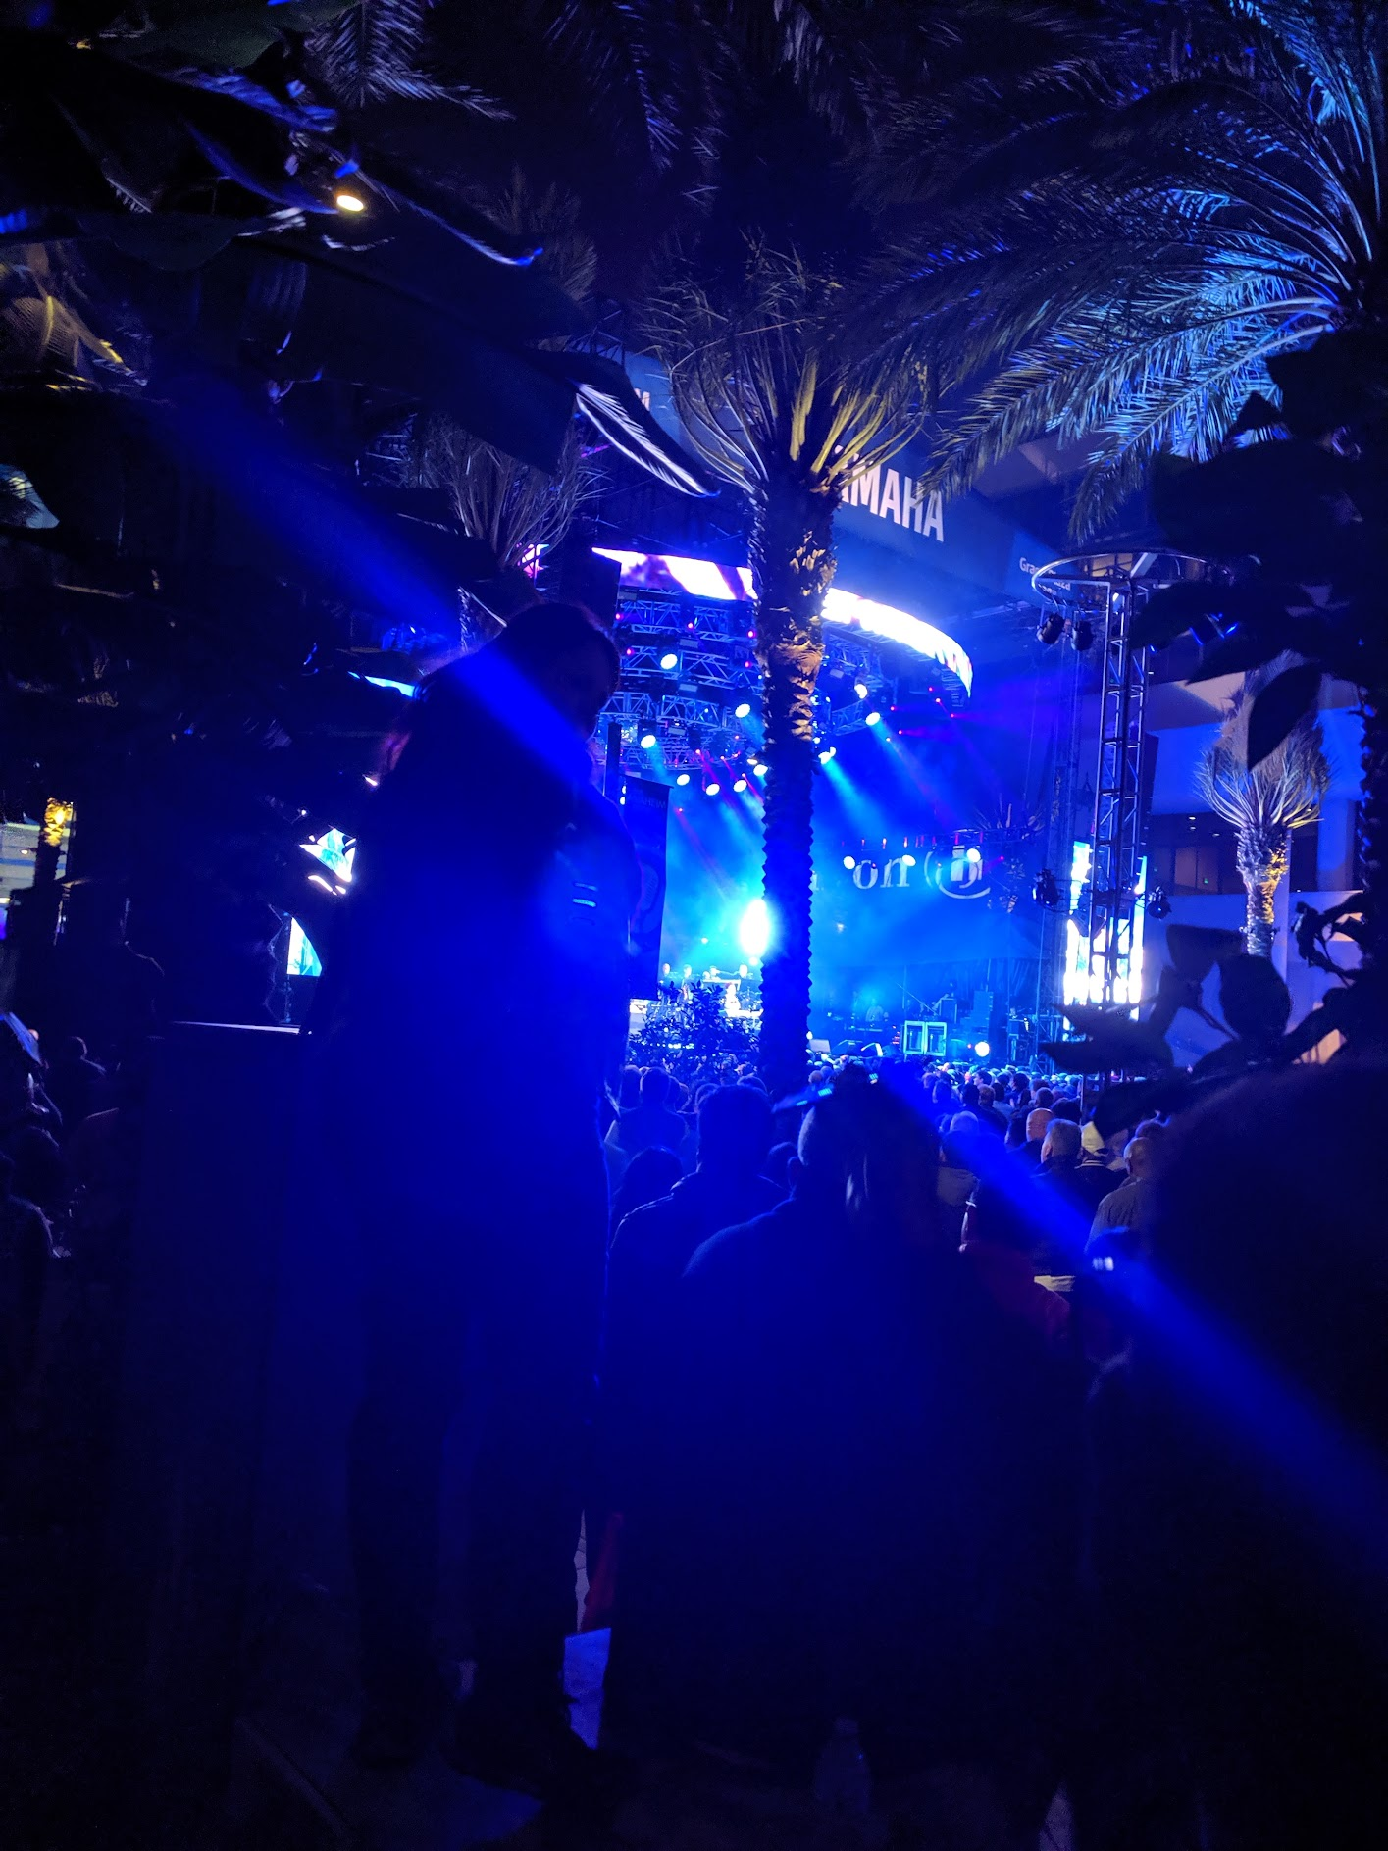
Task Group 15.4ab Virtual Interim January 2022
January 18th through January 26th 2022

Slide 7
Task Group Rules
Discussion: Everyone present is welcome
Straw polls: Everyone present may vote
Formal motions: WG voters
  To make, second and vote
Patent policy for PAR activities applies
All the usual rules of conduct
Please identify yourself on first contact with name and affiliation

Slide 8
IEEE-SA Patent, Copyright, and Participation Policies
See: https://grouper.ieee.org/groups/802/sapolicies.shtml
IEEE-SA Patent Slides for Standards Development Meetings (.pdf)
https://development.standards.ieee.org/myproject/Public/mytools/mob/slideset.pdf
IEEE-SA Standards Board Patent Committee (PatCom) home page
https://standards.ieee.org/content/ieee-standards/en/about/sasb/patcom/index.html
IEEE-SA Participation Policy meeting slide set - individual method (.pdf)
https://standards.ieee.org/content/dam/ieee-standards/standards/web/documents/other/Participant-Behavior-Individual-Method.pdf
Working Group Copyright Materials
https://standards.ieee.org/ipr/copyright-materials.html
https://standards.ieee.org/content/dam/ieee-standards/standards/web/documents/other/ieee-sa-copyright-policy-2019.pdf

Slide 9
IEEE 802 Ground Rules
Respect … give it, get it
NO product pitches
NO corporate pitches
NO prices
NO restrictive notices – (no confidentially notices in email)
Presentations must be openly available

Slide 10
January Agenda
https://mentor.ieee.org/802.15/dcn/21/15-21-0644-04-04ab-tg-4ab-agenda-jan-2022.xlsx
 |  | Wednesday | Friday | Tuesday |  | Wednesday |  | Thursday |  | Friday |  |  | Sunday | Monday |  | Tuesday |  | Wednesday
EST | PST | 12-Jan | 14-Jan | 18-Jan |  | 19-Jan |  | 20-Jan |  | 21-Jan |  | UTC | 23-Jan | 24-Jan |  | 25-Jan |  | 26-Jan |  | JST
5:00 | 2:00 |  |  |  |  |  |  |  |  |  |  | 10:00 |  |  |  |  |  |  |  | 19:00
6:00 | 3:00 |  |  |  |  |  |  |  |  |  |  | 11:00 |  |  |  |  |  |  |  | 20:00
7:00 | 4:00 |  |  |  |  | TG13 | AM0 | TG13 | AM0 | AM0 | AM0 | 12:00 |  | TG13 | Joint 3ma/THz | TG13 | AM0 |  |  | 21:00
8:00 | 5:00 |  |  |  |  |  |  |  |  |  |  | 13:00 |  |  |  |  |  |  |  | 22:00
9:00 | 6:00 |  |  | WG Opening Meeting |  | TG7a | TG6a | TG7a | TG6a | Joint 6a/4ab/14 | Joint 3ma/THz | 14:00 |  | TG7a | TG4ab | TG7a | TG6a | WG Closing Meeting |  | 23:00
10:00 | 7:00 | 802.15 CAC |  |  |  |  |  |  |  |  |  | 15:00 |  |  |  |  |  |  |  | 0:00
11:00 | 8:00 |  |  | SC Maint |  | Joint 802.15/802.1 |  | SC WNG |  | TG4ab | AM2 | 16:00 |  | AM2 | AM2 | SC IETF |  |  |  | 1:00
12:00 | 9:00 |  |  |  |  |  |  |  |  |  |  | 17:00 |  |  |  |  |  |  |  | 2:00
13:00 | 10:00 |  |  | TG15 | TG16t | TG15 | PM1 | Joint 14/15/4ab | PM1 | PM1 | PM1 | 18:00 |  | TG15 | TG16t | TG4ab | PM1 |  |  | 3:00
14:00 | 11:00 |  |  |  |  |  |  |  |  |  |  | 19:00 |  |  |  |  |  |  |  | 4:00
15:00 | 12:00 |  |  | TG4aa | PM2 | TG4cor1 | PM2 | TG14 | PM2 | PM2 | PM2 | 20:00 |  | TG14 | PM2 | TG4cor1 | PM2 |  |  | 5:00
16:00 | 13:00 |  |  |  |  |  |  |  |  |  |  | 21:00 |  |  |  |  |  |  |  | 6:00
17:00 | 14:00 |  |  | EV1 | EV1 | TG4ab | EV1 | TG4ab | EV1 | EV1 | EV1 | 22:00 |  | EV1 | TG4ab | EV1 | EV1 |  |  | 7:00
18:00 | 15:00 |  |  |  |  |  |  |  |  |  |  | 23:00 |  |  |  |  |  |  |  | 8:00
19:00 | 16:00 |  |  | EV2 | EV2 | EV2 | EV2 | EV2 | EV2 | EV2 | EV2 | 0:00 |  | EV2 | TG4ab | EV2 | EV2 |  |  | 9:00
20:00 | 17:00 |  |  |  |  |  |  |  |  |  |  | 1:00 |  |  |  |  |  |  |  | 10:00
21:00 | 18:00 |  |  |  |  |  |  |  |  |  |  | 2:00 |  |  |  |  |  |  |  | 11:00
22:00 | 19:00 |  |  |  |  |  |  |  |  |  |  | 3:00 |  |  |  |  |  |  |  | 12:00
23:00 | 20:00 |  |  |  |  |  |  |  |  |  |  | 4:00 |  |  |  |  |  |  |  | 13:00

Slide 11
Approval of Minutes
Motion to approve November plenary session minutes, document # 15-21-0628, and Conference Call minutes (November 2021 through January 2022) document # 15-22-0009-00
  Moved by: David Xun Yang (Huawei)
  Second by: Clint Powell (PWCC)
Links:
https://mentor.ieee.org/802.15/dcn/21/15-21-0628-00-04ab-tg15-4ab-nov-plenary-mtg-mins.docx
https://mentor.ieee.org/802.15/dcn/22/15-22-0009-00-04ab-tg4ab-conf-call-mins-nov-2021-to-jan-2022.docx

Slide 12
Session Objectives
Hear technical contributions and develop technical content for TFD

Slide 13
General Announcements
DO NOT FORGET
REGISTRATION (and the meeting fee) is REQUIRED TO PARTICPATE in any meeting during the plenary session.
Bad things happen if you fail to register and pay the fee. Please don’t let that happen to you!

Slide 14
Recap and TG Operation

Slide 15
5.2.b Scope of the project (As approved):
This amendment enhances the Ultra Wideband (UWB) physical layers (PHYs) medium access control (MAC), and associated ranging techniques while retaining backward compatibility with enhanced ranging capable devices (ERDEVs).
Areas of enhancement include:
  additional coding, preamble and modulation schemes to additional coding, preamble and modulation schemes to support improved link budget and/or reduced air-time relative to IEEE Std 802.15.4 UWB;
  additional channels and operating frequencies;
  interference mitigation techniques to support greater device density and higher traffic use cases relative to the IEEE Std 802.15.4 UWB;
  improvements to accuracy, precision and reliability and interoperability for high-integrity ranging; schemes to reduce complexity and power consumption;
  definitions for tightly coupled hybrid operation with narrowband signaling to assist UWB;
  enhanced native discovery and connection setup mechanisms;
  sensing capabilities to support presence detection and environment mapping;
  and mechanisms supporting low-power low-latency streaming as well as high data-rate streaming allowing at least 50 Mb/s of throughput.
Support for peer-to-peer, peer-to-multi-peer, and station-to-infrastructure protocols are in scope, as are infrastructure synchronization mechanisms. This amendment includes safeguards so that the high throughput data use cases do not cause significant disruption to low duty-cycle ranging use cases.
https://development.standards.ieee.org/myproject-web/app#viewpar/9081

Slide 16
Task Group Organization
Chair: Benjamin Rolfe (BCA)
Vice Chair and Recording Secretary: David Xun Yang (Huawei)
Vice Chair: Clint Powell (PWCC)
Vice Chair: Clint Chaplin (SRA)
Lead Technical Editor: Billy Verso
  Thank you to all the volunteers!

Slide 17
Proposed Project Schedule (baseline)
Proposed project schedule | Nov-21 | Dec-21 | Jan-22 | Feb-22 | Mar-22 | Apr-22 | May-22 | Jun-22 | Jul-22 | Aug-22 | Sep-22 | Oct-22 | Nov-22 | Dec-22 | Jan-23 | Feb-23 | Mar-23 | Apr-23 | May-23 | Jun-23 | Jul-23 | Aug-23 | Sep-23 | Oct-23 | Nov-23 | Dec-23 | Jan-24 | Feb-24 | Mar-24 | Apr-24 | May-24 | Jun-24 | Jul-24 | Aug-24 | Sep-24 | Oct-24 | Nov-24
Call for proposals
Hear and evaluate proposals
Cut-off for new proposals, PHY
Cut-off for new proposals, MAC
Integrate poposals/contributions into TFD
Develop draft from TFD
Draft 0
TG draft review and revision
Working group pre-ballot review
Pre-ballot review and comment resolution
First letter ballot |  |  |  |  |  |  |  |  |  |  |  |  |  |  |  |  | LB
LB Comment Resolution
WG Recirculatoin |  |  |  |  |  |  |  |  |  |  |  |  |  |  |  |  |  |  |  |  | LB-R
Comment resolution, 1st recirc
Conditional approval for SA ballot
WG Recirculatoin |  |  |  |  |  |  |  |  |  |  |  |  |  |  |  |  |  |  |  |  |  |  | LB-R
Comment resolution, 2nd recirc and final recirc
First SA ballot |  |  |  |  |  |  |  |  |  |  |  |  |  |  |  |  |  |  |  |  |  |  |  |  | SA
Comment resolution, first SA ballot
SA Resirculation |  |  |  |  |  |  |  |  |  |  |  |  |  |  |  |  |  |  |  |  |  |  |  |  |  |  |  | SA-R
Comment resolution, SA recirculation
SA Resirculation |  |  |  |  |  |  |  |  |  |  |  |  |  |  |  |  |  |  |  |  |  |  |  |  |  |  |  |  |  |  | SA-R
Comment resolution, 2nd SA recirc
Conditional or unconditional approval to RevCom |  |  |  |  |  |  |  |  |  |  |  |  |  |  |  |  |  |  |  |  |  |  |  |  |  |  |  |  | ?? |  |  |  | ??
Optional 3rd SA recirc if needed |  |  |  |  |  |  |  |  |  |  |  |  |  |  |  |  |  |  |  |  |  |  |  |  |  |  |  |  |  |  |  |  | SA-R
RevCom meets |  |  |  |  |  |  |  |  |  |  |  |  |  |  |  |  |  |  |  |  |  |  |  |  |  |  |  |  |  |  |  |  |  | ` |  |  |  | `
As Presented in November
Notes: SASB/RevCom schdule for 2024 a guess

Slide 18
Schedule Major Milestones
Work in Progress
√
Call for proposals | November 2021
Cut-off for new features (high level feature set), PHY | May 2022
Cut-off for new features (high level feature set), MAC
Draft 0 | September 2022 [Discuss]
TG draft review and revision complete | November 2022
Working group pre-ballot review complete | January 2022 (before meeting)
First letter ballot | March 2023 (following meeting)
Conditional approval for SA ballot | July 2023 [questionable]
WG balloting complete | November 2023
First SA ballot | November 2023 (post meeting)
SA Balloting complete | June/July 2024
Conditional or unconditional approval to RevCom | March or July 2024
RevCom meets | September or October 2024

Slide 19

Technical Contributions

Slide 20
List of presentations

Slide 21

Next Steps

Slide 22
Teleconference Schedule
Usual pattern:
Frequency: Bi-weekly
Phase: Tuesday
Time: 09:00 ET (06:00 PT)
Offset: First call Feb 8th^{th}
  [skip week following the plenary]
Duration: 1 hour.
 |  |  | Jan-22
Sun | Mon | Tue | Wed | Thr | Fri | Sat
2 | 3 | 4 | 5 | 6 | 7 | 8
9 | 10 | 11 | 12 | 13 | 14 | 15
16 | 17 | 18 | 19 | 20 | 21 | 22
23 | 24 | 25 | 26 | 27 | 28 | 29
30 | 31
 |  |  | Feb-22
Sun | Mon | Tue | Wed | Thr | Fri | Sat
 |  | 1 | 2 | 3 | 4 | 5
6 | 7 | 8 | 9 | 10 | 11 | 12
13 | 14 | 15 | 16 | 17 | 18 | 19
20 | 21 | 22 | 23 | 24 | 25 | 26
27 | 28
 |  |  | Mar-22
Sun | Mon | Tue | Wed | Thr | Fri | Sat
 |  | 1 | 2 | 3 | 4 | 5
6 | 7 | 8 | 9 | 10 | 11 | 12
13 | 14 | 15 | 16 | 17 | 18 | 19
20 | 21 | 22 | 23 | 24 | 25 | 26
27 | 28 | 29 | 30 | 31

Slide 23
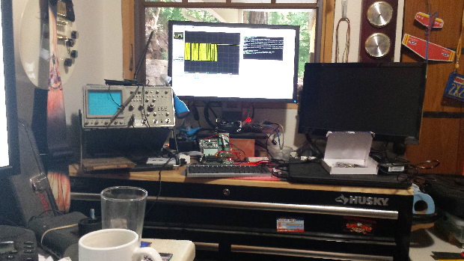
Other Business

Slide 24
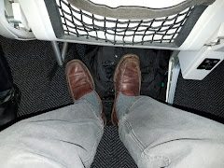
Adjourned
Thanks

