Slide 1
Project: IEEE P802.15 Working Group for Wireless Personal Area Networks (WPANs)
Submission Title: [TG4aa JRE January Virtual Interim 2022 Closing report]
Date Submitted: [21th January, 2022]
Source: [Takashi Kuramochi] Company [LAPIS TECHNOLOGY]
Address [2-4-8 Shinyokohama,Kouhoku-ku,Yokohama 222-8575 Japan]
Voice:[+81-45-476-9295], FAX: [], E-Mail:[kuramochi722@lapis-tech.com]
Re: [] Abstract: [This document contains TG4aa JRE closing report from Virtual January Interim sessions,2022] Purpose: [information]
Notice: This document has been prepared to assist the IEEE P802.15. It is offered as a basis for discussion and is not binding on the contributing individual(s) or organization(s). The material in this document is subject to change in form and content after further study. The contributor(s) reserve(s) the right to add, amend or withdraw material contained herein.
Release: The contributor acknowledges and accepts that this contribution becomes the property of IEEE and may be made publicly available by P802.15.

Slide 2
IEEE 802.15 TG4aa JRE Virtual January Interim Closing report on January 18th ,2022

Slide 3
About TG4aa
TG 4aa – Japanese Rate Enhancement (JRE) amendment
Objective: data rate extensions for the SUN FSK modulation and channel parameters focusing on the Japanese frequency band
Chair :Takashi Kuramochi(LAPIS)
Vice-Chair : Hiroshi Harada(Kyoto University)
Secretary : Kiyoshi Fukui(OKI)
Technical Editor : Kiyoshi Fukui(OKI)

Slide 4
TG4aa JRE sessions in January Interim
 | Monday 17th January | Tuesday 18th January | Wednesday 19th January | Thursday 20th January | Friday 21th January
AM1 |  | Opening
AM2
PM1
PM2 |  | TG4aa-JRE
EV1
 | Monday 24th January | Tuesday 25th January | Wednesday 26th January | Thursday 27th January | Friday 28th January
AM1 |  |  | Closing
AM2
PM1
PM2
EV1

Slide 5
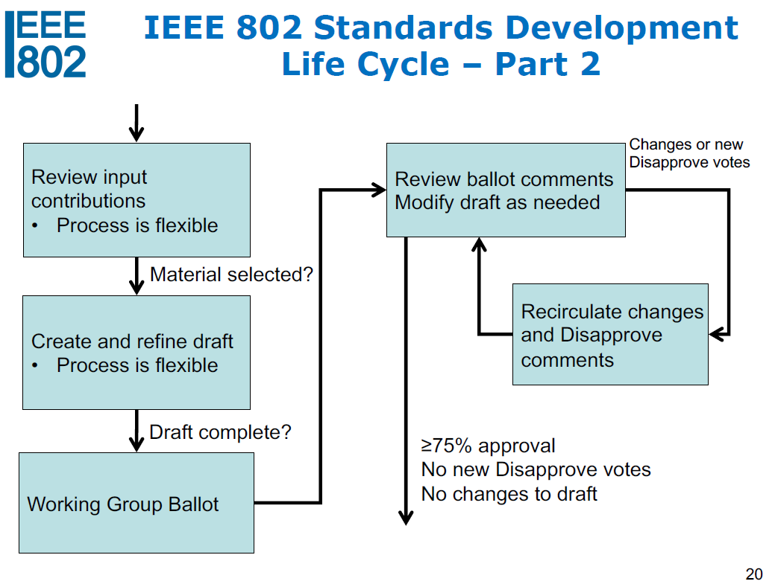
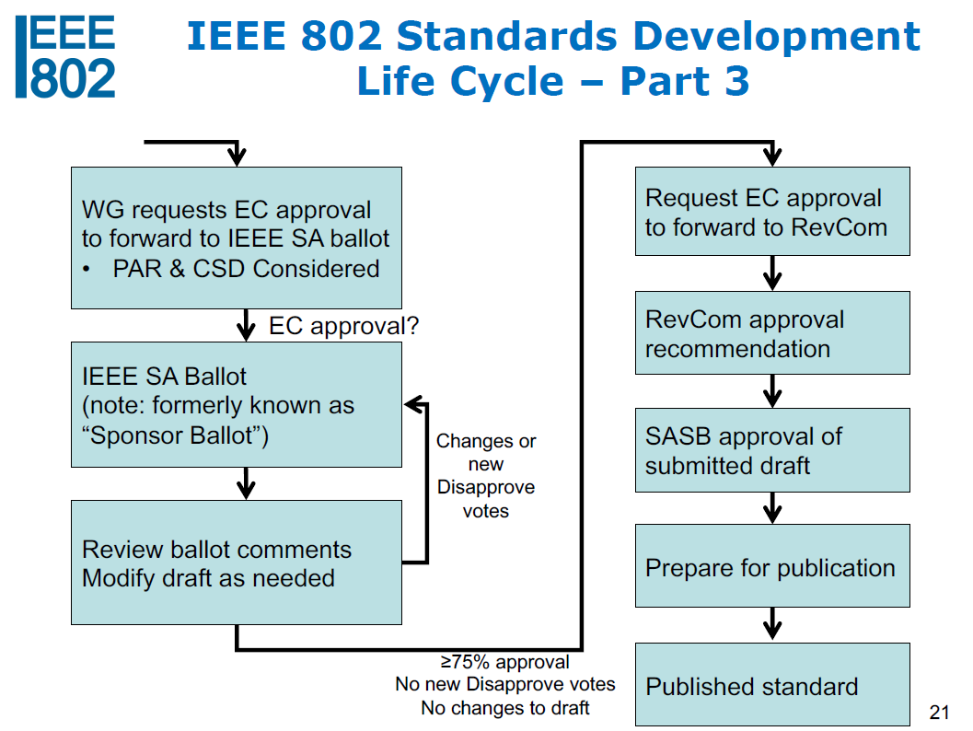
Update Status
We are here!

Slide 6
Agenda for TG4aa meetings
Update status
Create CRG
Update timeline and create closing report

Slide 7
Accomplishments:
One TG motions were moved to create CRG.
Planned March Plenary(# of Sessions)
Minutes posted(15-22-0016-00-04aa)

Slide 8
TG Motion: Approve the CRG formation
Task Group TG4aa requests 802.15WG to approve the formation of a Comment Resolution Group (CRG) for the Standards Association Recirculation balloting of the P802.15.4aa_D10 or latest draft with the following membership: Takashi Kuramochi(Chair), Hiroshi Harada, Don Sturek, Henk De Ruijter, and Kiyoshi Fukui. The 802.15.4aa CRG is authorized to approve comment resolutions, edit the draft according to the comment resolutions, and to approve the start of recirculation ballots of the revised draft on behalf of the 802.15 WG. Comment resolution on recirculation ballots between sessions will be conducted via reflector email and via teleconferences announced to the reflector as per the LMSC 802 WG P&P.
Moved: Phil Beecher(Wi-SUN Alliance)
Seconded: Don Sturek(ITRON)
There is no discussion or objections.
The motion is approved unanimous consent

Slide 9
WG Motion to form TG4aa CRG:
Move that 802.15 WG approve the formation of a Comment Resolution Group (CRG) for the Standards Association Recirculation balloting of the P802.15.4aa_D10 or latest draft with the following membership: Takashi Kuramochi(Chair), Hiroshi Harada, Don Sturek, Henk De Ruijter, and Kiyoshi Fukui. The 802.15.4aa CRG is authorized to approve comment resolutions, edit the draft according to the comment resolutions, and to approve the start of recirculation ballots of the revised draft on behalf of the 802.15 WG. Comment resolution on recirculation ballots between sessions will be conducted via reflector email and via teleconferences announced to the reflector as per the LMSC 802 WG P&P.
Moved by: Takashi Kuramochi
Second by:
There is no discussion or objections.
The motion is approved unanimous consent

Slide 10
Agenda for March Plenary
One slot will be planned.
Reformulate the CRG (just in case)
Wrap up work on 4aa and close
 | Monday 7th March | Tuesday 8th March | Wednesday 9th March | Thursday 10th March | Friday 11th March
AM1 |  | Opening
AM2
PM1
PM2
EV1 |  | TG4aa-JRE

Slide 11
P802.15.4aa Timeline
Event | Date
Request approval from EC to forward draft to RevCom | 18 Nov 2021
Post to RevCom (submittal deadline) | 16 Dec 2021
RevCom meeting (teleconference) | 25 Jan 2022
SASB meeting | 23 Mar 2022
CRG meeting will be planned according to the feedbacks

