Slide 1
Project: IEEE P802.15 Working Group for Wireless Personal Area Networks (WPANs)
Submission Title: [TG4aa JRE January Interim 2022 Virtual meeting Opening report]
Date Submitted: [18th January,2022]
Source: [Takashi Kuramochi] Company [LAPIS TECHNOLOGY]
Address [2-4-8 Shinyokohama,Kouhoku-ku,Yokohama 222-8575 Japan]
Voice:[+81-45-476-9295], FAX: [], E-Mail:[kuramochi722@lapis-tech.com]
Re: [] Abstract: [This document contains opening information and meeting agenda for the TG4aa JRE January Interim Teleconference,2022] Purpose: [information]
Notice: This document has been prepared to assist the IEEE P802.15. It is offered as a basis for discussion and is not binding on the contributing individual(s) or organization(s). The material in this document is subject to change in form and content after further study. The contributor(s) reserve(s) the right to add, amend or withdraw material contained herein.
Release: The contributor acknowledges and accepts that this contribution becomes the property of IEEE and may be made publicly available by P802.15.

Slide 2
IEEE 802.15 TG4aa JRE January Interim Virtual Meeting Opening report on January 18th,2022

Slide 3
Administrative Items
Required notices
Affiliation FAQ - http://standards.ieee.org/faqs/affiliationFAQ.html
Anti-Trust FAQ - http://standards.ieee.org/resources/antitrust-guidelines.pdf
Ethics - http://www.ieee.org/portal/cms_docs/about/CoE_poster.pdf
Chair/Vice-Chair/Secretary/Technical Editor
Chair :Takashi Kuramochi(LAPIS)
Vice-Chair : Hiroshi Harada(Kyoto University)
Secretary : Kiyoshi Fukui(OKI)
Technical Editor : Kiyoshi Fukui(OKI)

Slide 4
Participants have a duty to inform the IEEE
Participants shall inform the IEEE (or cause the IEEE to be informed) of the identity of each holder of any potential Essential Patent Claims of which they are personally aware if the claims are owned or controlled by the participant or the entity the participant is from, employed by, or otherwise represents
Participants should inform the IEEE (or cause the IEEE to be informed) of the identity of any other holders of potential Essential Patent Claims
Early identification of holders of potential Essential Patent Claims is encouraged

Slide 5
Ways to inform IEEE
Cause an LOA to be submitted to the IEEE-SA (patcom@ieee.org); or
Provide the chair of this group with the identity of the holder(s) of any and all such claims as soon as possible; or
Speak up now and respond to this Call for Potentially Essential Patents
If anyone in this meeting is personally aware of the holder of any patent claims that are potentially essential to implementation of the proposed standard(s) under consideration by this group and that are not already the subject of an Accepted Letter of Assurance, please respond at this time by providing relevant information to the WG Chair

Slide 6
Other guidelines for IEEE WG meetings
All IEEE-SA standards meetings shall be conducted in compliance with all applicable laws, including antitrust and competition laws.
Don’t discuss the interpretation, validity, or essentiality of patents/patent claims.
Don’t discuss specific license rates, terms, or conditions.
Relative costs of different technical approaches that include relative costs of patent licensing terms may be discussed in standards development meetings.
Technical considerations remain the primary focus
Don’t discuss or engage in the fixing of product prices, allocation of customers, or division of sales markets.
Don’t discuss the status or substance of ongoing or threatened litigation.
Don’t be silent if inappropriate topics are discussed … do formally object.
---------------------------------------------------------------
For more details, see IEEE-SA Standards Board Operations Manual, clause 5.3.10 and Antitrust and Competition Policy: What You Need to Know at http://standards.ieee.org/develop/policies/antitrust.pdf

Slide 7
Patent-related information
The patent policy and the procedures used to execute that policy are documented in the:
IEEE-SA Standards Board Bylaws
https://standards.ieee.org/about/policies/bylaws/sect6-7.html#6
IEEE-SA Standards Board Operations Manual
https://standards.ieee.org/about/policies/bylaws/sect6-7.html#6.3
Material about the patent policy is available at
http://standards.ieee.org/about/sasb/patcom/materials.html
If you have questions, contact the IEEE-SA Standards Board Patent Committee Administrator at patcom@ieee.org

Slide 8
Attendance
Visit “https://imat.ieee.org” and click “802 Plenary Session” and click “C/LM/WG802.15 Attendance” shown below.
Register
Indicate attendance
Please click yellow bar on the attendance sheet.
the collar bar will be changed to green.
Important Note: Attendance will be counted session based. Each session gives you 6% of attendance.
In order to get voting right, you need to get at least 12 sessions.

Slide 9
TG4aa JRE sessions in January Interim
 | Monday 17th January | Tuesday 18th January | Wednesday 19th January | Thursday 20th January | Friday 21th January
AM1 |  | Opening
AM2
PM1
PM2 |  | TG4aa-JRE
EV1
 | Monday 24th January | Tuesday 25th January | Wednesday 26th January | Thursday 27th January | Friday 28th January
AM1 |  |  | Closing
AM2
PM1
PM2
EV1

Slide 10
Main Agenda Items for the Week
Update status
Create CRG
Update timeline and create closing report

Slide 11
Draft Agenda
18th Tuesday PM2(15:00-17:00)
OPEN/Patent Policy
IEEE-SA Stds. Board Bylaws on Patents in Std's. & Guidelines
Approval of the Agenda
Approve Meeting Minutes from Nov Plenary: 15-21-0611-00-04aa
Update status
Create CRG
Update timeline and create closing report
Plan for March Plenary(# of sessions)
Any other business
Adjourn TG4aa JRE
Approval of the Agenda
Moved: Hiroshi Harada(Kyoto University)
Second: Phil Beecher(Wi-SUN Alliance)
There is no discussion or objections.
Agenda is approved unanimous consent.

Slide 12
Approval of the last meeting minutes [November Plenary] November 9th : 15-21-0611-00-04aa
Approval of the last meeting minutes
Moved: Phil Beecher(Wi-SUN Alliance)
Second:Hiroshi Harada(Kyoto University)
no discussion or objections.
Last meeting minutes is approved unanimous consent.

Slide 13
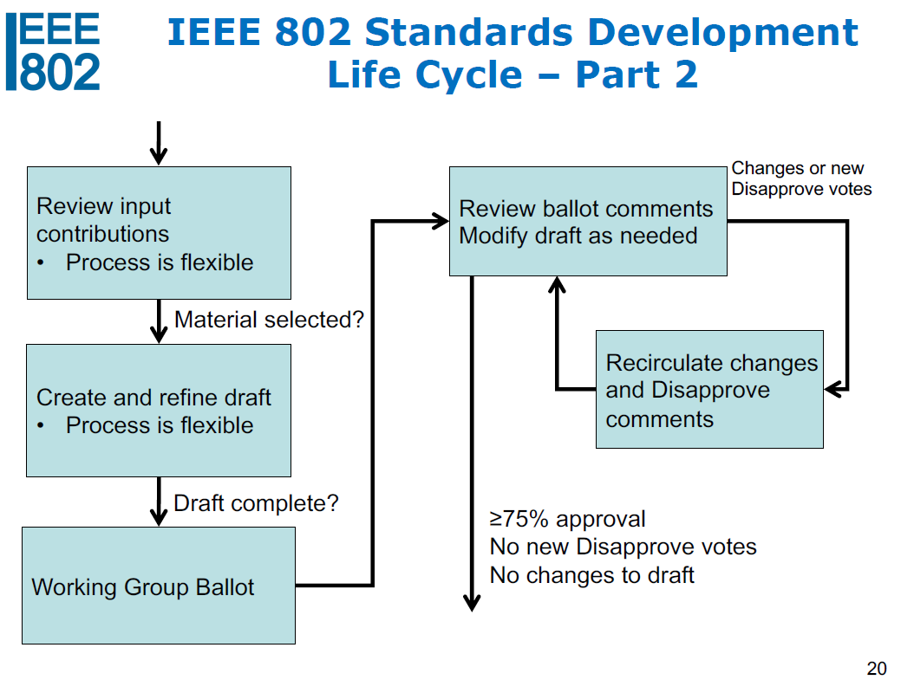
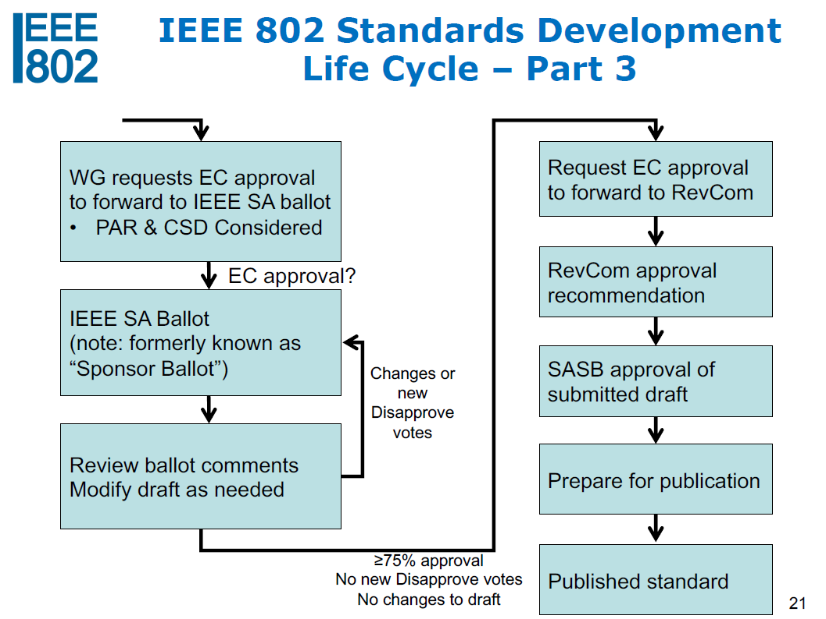
Update Status
We are here!

Slide 14
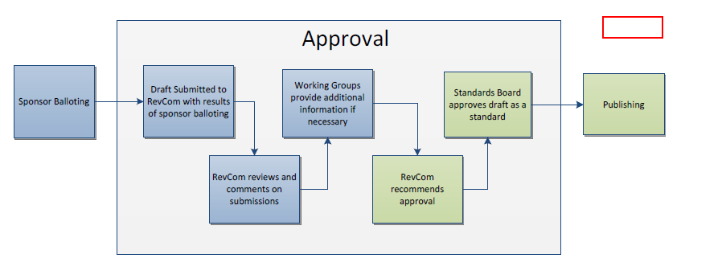
Update Status
RevCom
We are here!

Slide 15
Update Status
Project IEEE P802.15.4aa Standard for Low-Rate Wireless Networks Amendment: Higher data rate extension to IEEE 802.15.4 Smart Utility Network (SUN) Frequency Shift Keying (FSK) Physical layer (PHY) has been assigned to a RevCom agenda 25 Jan 2022.

Slide 16
TG Motion
TG Motion to Create CRG(15-22-0015-00-04aa)

Slide 17
TG15.4aa Timeline
 | Open | Close | Status
First SA Ballot | 15th August,2021 | 14th September,2021 | Done
Second SA Ballot | 1st October,2021 | 15th October,2021 | Done
Third SA Ballot | 19th October,2021 | 28th October,2021 | Done
WG ballot to EC for Revcom Submission | 17th November,2021 | 17th November,2021 | Done
EC to RevCom | 19th November,2021 | 19th November,2021 | Done
RevCom Submission | 16 Dec 2021 RevCom Submission Deadline | 22th November,2021 | Done
RevCom to SB | 25 January,2022

Slide 18
Create closing report
Closing Report (15-22-0017-00-04aa)

Slide 19
Agenda for March Plenary
One slot will be planned.
Reformulate the CRG (just in case)
Wrap up work on 4aa and close
 | Monday 7th March | Tuesday 8th March | Wednesday 9th March | Thursday 10th March | Friday 11th March
AM1 |  | Opening
AM2
PM1
PM2
EV1 |  | TG4aa-JRE

Slide 20
Any other business?

Slide 21
Adjourn TG4aa
Moved :Don Sturek(ITRON)
Second : Phil Beecher(Wi-SUN Alliance)
There is no discussion or objections. Adjourn is approved unanimous consent.

