Slide 1
Project: IEEE P802.15 Working Group for Wireless Specialty Networks (WSN)
Submission Title: TG 15.4ab Agenda and Meeting Slides
Date Submitted: January 3, 2022
Source: Benjamin A. Rolfe (Blind Creek Associates)
Contact:
Voice: +1 408 395 7207, E-Mail: ben.rolfe @ ieee.org
Re: Task Group 4ab: 802.15.4 UWB Next Generation
Abstract: Teleconference (WebEx) Agenda and Meeting Slides
Purpose: Emulate organization, encourage participation and make further progress
Notice: This document has been prepared to assist the IEEE P802.15. It is offered as a basis for discussion and is not binding on the contributing individual(s) or organization(s). The material in this document is subject to change in form and content after further study. The contributor(s) reserve(s) the right to add, amend or withdraw material contained herein.
Release: The contributor acknowledges and accepts that this contribution becomes the property of IEEE and may be made publicly available by P802.15.
Notes:
Jul 12, 2010
Page 1

Slide 2
Task Group 15.4ab Next Generation UWB Amendment
Teleconference / Virtual Meeting
January 4th 2022

Slide 3
Happy New Year!

Slide 4
Task Group Rules
Discussion: Everyone present is welcome
Straw polls: Everyone present may vote
Formal motions: WG voters
To make, second and vote
Patent policy for PAR activities applies
All the usual rules of conduct
Please identify yourself on first contact with name and affiliation

Slide 5
IEEE-SA Patent, Copyright, and Participation Policies
See: https://grouper.ieee.org/groups/802/sapolicies.shtml
IEEE-SA Patent Slides for Standards Development Meetings (.pdf)
https://development.standards.ieee.org/myproject/Public/mytools/mob/slideset.pdf
IEEE-SA Standards Board Patent Committee (PatCom) home page
https://standards.ieee.org/content/ieee-standards/en/about/sasb/patcom/index.html
IEEE-SA Participation Policy meeting slide set - individual method (.pdf)
https://standards.ieee.org/content/dam/ieee-standards/standards/web/documents/other/Participant-Behavior-Individual-Method.pdf
Working Group Copyright Materials
https://standards.ieee.org/ipr/copyright-materials.html
https://standards.ieee.org/content/dam/ieee-standards/standards/web/documents/other/ieee-sa-copyright-policy-2019.pdf

Slide 6
IEEE 802 Ground Rules
Respect … give it, get it
NO product pitches
NO corporate pitches
NO prices
NO restrictive notices – (no confidentially notices in email)
Presentations must be openly available

Slide 7
Proposed Agenda
Opening and meeting preamble
Recap and Reminders
Review Call for Proposals and Process
Review January Agenda
Continuation of technical discussions as needed
Editor’s corner
Any other Business

Slide 8
Recap

Slide 9
5.2.b Scope of the project (As approved):
This amendment enhances the Ultra Wideband (UWB) physical layers (PHYs) medium access control (MAC), and associated ranging techniques while retaining backward compatibility with enhanced ranging capable devices (ERDEVs). Areas of enhancement include:
additional coding, preamble and modulation schemes to additional coding, preamble and modulation schemes to support improved link budget and/or reduced air-time relative to IEEE Std 802.15.4 UWB;
additional channels and operating frequencies;
interference mitigation techniques to support greater device density and higher traffic use cases relative to the IEEE Std 802.15.4 UWB;
improvements to accuracy, precision and reliability and interoperability for high-integrity ranging; schemes to reduce complexity and power consumption;
definitions for tightly coupled hybrid operation with narrowband signaling to assist UWB;
enhanced native discovery and connection setup mechanisms;
sensing capabilities to support presence detection and environment mapping;
and mechanisms supporting low-power low-latency streaming as well as high data-rate streaming allowing at least 50 Mb/s of throughput.
Support for peer-to-peer, peer-to-multi-peer, and station-to-infrastructure protocols are in scope, as are infrastructure synchronization mechanisms. This amendment includes safeguards so that the high throughput data use cases do not cause significant disruption to low duty-cycle ranging use cases.
https://development.standards.ieee.org/myproject-web/app#viewpar/9081

Slide 10
Review and Status
November Closing Report:
https://mentor.ieee.org/802.15/dcn/21/15-21-0621-00-04ab-november-2021-closing-report.pptx
Meeting Slides from November
https://mentor.ieee.org/802.15/dcn/21/15-21-0565-04-04ab-tg4ab-november-meeting-slides.pptx
Draft November meeting minutes
https://mentor.ieee.org/802.15/dcn/21/15-21-0628-00-04ab-tg15-4ab-nov-plenary-mtg-mins.docx
Meeting slides from December 14th call
https://mentor.ieee.org/802.15/dcn/21/15-21-0632-02-04ab-tg-15-4ab-agenda-and-meeting-slides.pptx
Call for Proposal
https://mentor.ieee.org/802.15/dcn/21/15-21-0635-01-04ab-task-group-15-4ab-call-for-propsals.docx

Slide 11
January Agenda
https://mentor.ieee.org/802.15/dcn/21/15-21-0644-01-04ab-tg-4ab-agenda-jan-2022.xlsx
 |  | Wednesday | Friday | Tuesday |  | Wednesday |  | Thursday |  | Friday |  |  | Sunday | Monday |  | Tuesday |  | Wednesday
EST | PST | 12-Jan | 14-Jan | 18-Jan |  | 19-Jan |  | 20-Jan |  | 21-Jan |  | UTC | 23-Jan | 24-Jan |  | 25-Jan |  | 26-Jan |  | JST
5:00 | 2:00 |  |  |  |  |  |  |  |  |  |  | 10:00 |  |  |  |  |  |  |  | 19:00
6:00 | 3:00 |  |  |  |  |  |  |  |  |  |  | 11:00 |  |  |  |  |  |  |  | 20:00
7:00 | 4:00 |  |  |  |  | TG13 | AM0 | TG13 | AM0 | AM0 | AM0 | 12:00 |  | TG13 | Joint 3ma/THz | TG13 | AM0 |  |  | 21:00
8:00 | 5:00 |  |  |  |  |  |  |  |  |  |  | 13:00 |  |  |  |  |  |  |  | 22:00
9:00 | 6:00 |  |  | WG Opening Meeting |  | TG7a | TG6a | TG7a | TG6a | Joint 6a/4ab/14 | Joint 3ma/THz | 14:00 |  | TG7a | AM1 | TG7a | TG6a | WG Closing Meeting |  | 23:00
10:00 | 7:00 | 802.15 CAC |  |  |  |  |  |  |  |  |  | 15:00 |  |  |  |  |  |  |  | 0:00
11:00 | 8:00 |  |  | SC Maint |  | Joint 802.15/802.1 |  | SC WNG |  | TG4ab | AM2 | 16:00 |  | TG4ab | AM2 | SC IETF |  |  |  | 1:00
12:00 | 9:00 |  |  |  |  |  |  |  |  |  |  | 17:00 |  |  |  |  |  |  |  | 2:00
13:00 | 10:00 |  |  | TG15 | TG16t | TG15 | PM1 | Joint 14/15/4ab | PM1 | PM1 | PM1 | 18:00 |  | TG15 | TG16t | TG4ab | PM1 |  |  | 3:00
14:00 | 11:00 |  |  |  |  |  |  |  |  |  |  | 19:00 |  |  |  |  |  |  |  | 4:00
15:00 | 12:00 |  |  | TG4aa | PM2 | TG4cor1 | PM2 | TG14 | PM2 | PM2 | PM2 | 20:00 |  | TG14 | PM2 | TG4cor1 | PM2 |  |  | 5:00
16:00 | 13:00 |  |  |  |  |  |  |  |  |  |  | 21:00 |  |  |  |  |  |  |  | 6:00
17:00 | 14:00 |  |  | EV1 | EV1 | TG4ab | EV1 | TG4ab | EV1 | EV1 | EV1 | 22:00 |  | EV1 | TG4ab | EV1 | EV1 |  |  | 7:00
18:00 | 15:00 |  |  |  |  |  |  |  |  |  |  | 23:00 |  |  |  |  |  |  |  | 8:00
19:00 | 16:00 |  |  | EV2 | EV2 | EV2 | EV2 | EV2 | EV2 | EV2 | EV2 | 0:00 |  | EV2 | EV2 | EV2 | EV2 |  |  | 9:00
20:00 | 17:00 |  |  |  |  |  |  |  |  |  |  | 1:00 |  |  |  |  |  |  |  | 10:00
21:00 | 18:00 |  |  |  |  |  |  |  |  |  |  | 2:00 |  |  |  |  |  |  |  | 11:00
22:00 | 19:00 |  |  |  |  |  |  |  |  |  |  | 3:00 |  |  |  |  |  |  |  | 12:00
23:00 | 20:00 |  |  |  |  |  |  |  |  |  |  | 4:00 |  |  |  |  |  |  |  | 13:00
 |  | Required mtg slots |  |  |  | 15.4ab
 |  | Extra credit slots |  |  |  |  | TG4ab Meeting slots
 |  |  |  |  |  | Joint
 |  |  |  |  |  |  | Joint meetings with TG4ab

Slide 12
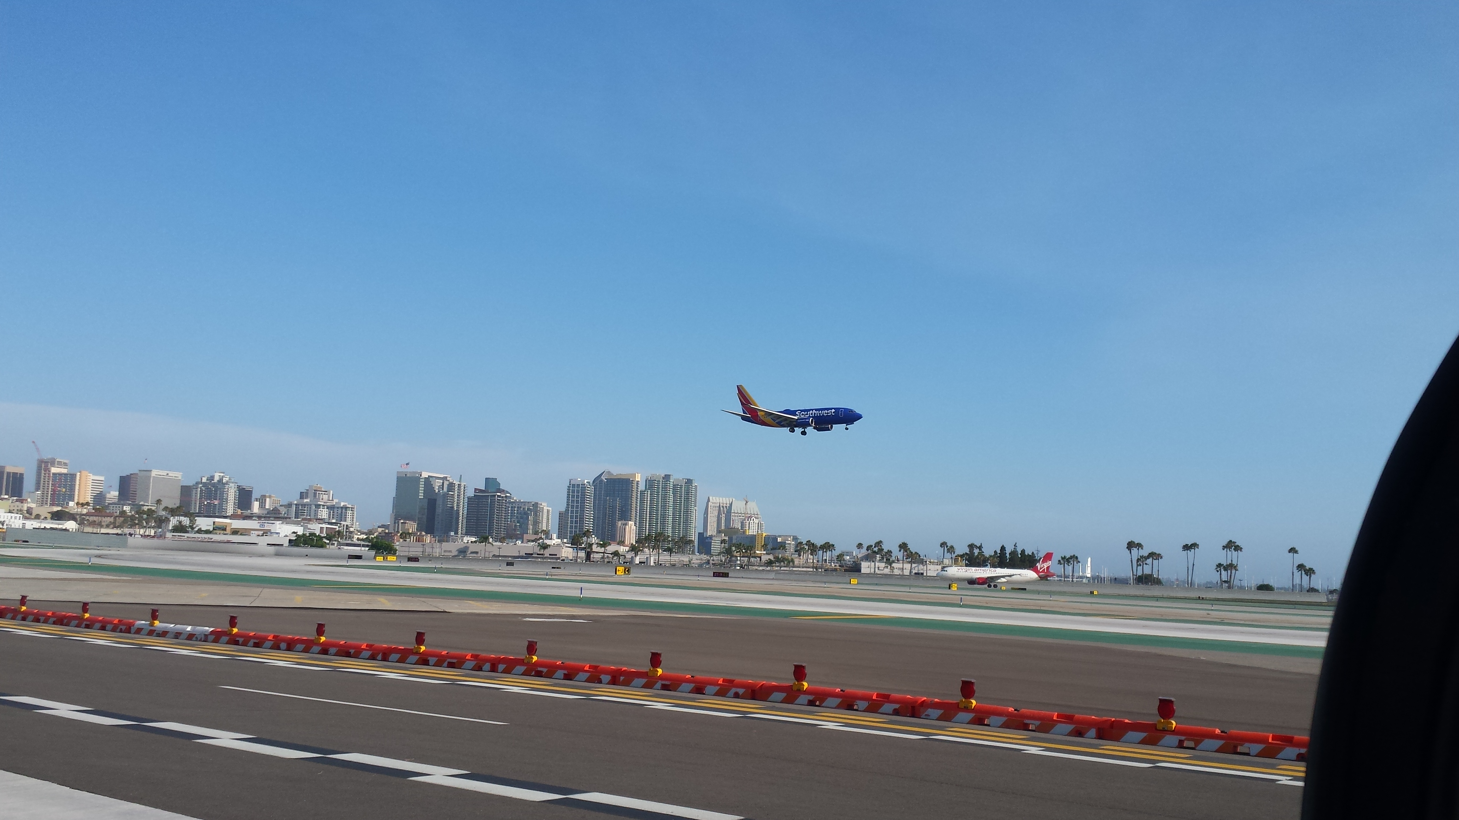
Proposals Process

Slide 13
Proposals
Call for Proposals document:
https://mentor.ieee.org/802.15/dcn/21/15-21-0635-01-04ab-task-group-15-4ab-call-for-propsals.docx
Timeline:
Submission of feature sets, PHY: Close of May 2022 Interim Session
Submission of feature sets, MAC: Close of July 2022 Plenary Session
Technically complete content by July 2022
Preliminary Proposals:
Identify scope, main features and relevant background/support
Build consensus and identify areas for additional work
Foundation for developing text
Detailed Proposals:
Technically complete feature set definition and specification

Slide 14
Process Suggestions
Preliminary proposals
Consensus to proceed: the group indicates to contributor interest in seeing technically complete contribution
Integration into the Technical Framework Document
Technical Framework Document
Follows outline of the standard
Includes placeholders based on scope of the project
Integrates proposals and supporting contributions
Working tool for pre-draft efforts
Identifies potential gaps and readiness for drafting
Technical Guidance Document
https://mentor.ieee.org/802.15/dcn/21/15-21-0297-01-04ab-15-4ab-technical-guidance-doc.docx
Content Tracker
Table of presentations mapped to TGD categories
https://mentor.ieee.org/802.15/dcn/21/15-21-0638-00-04ab-tg4ab-presentations-by-tgd-categories.xlsx

Slide 15
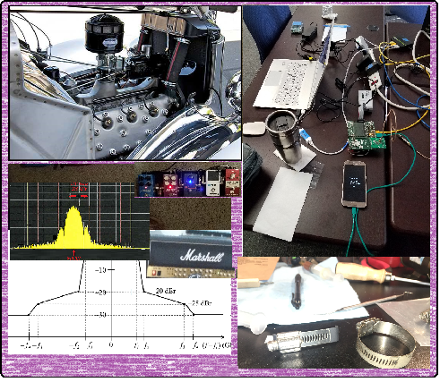
Technical Discussion

Slide 16
Discussions cut short in Nov.
Out-of-band signaling and narrow band assist
Preamble and Equalization
Coding and related discussion
Wake-up radio
Updating channel models and related topics
Schedule discussion

Slide 17
Editor’s Corner

Slide 18
Editor’s Corner
Time allocated for direction from the technical editor
Provide guidance and feedback to contributors
Identify and resolve any problems
Whatever else the TE may need
Role of the Technical Editor
Integrates content
Manages the process of building and maintaining the draft (controls the pen)
Doesn’t do all the work!
Needs technically complete content from each contributor to complete the draft

Slide 19
Next Steps

Slide 20
Teleconference Schedule
 |  |  | Nov-21 |  |  |  |  |  |  | Dec-21
Sun | Mon | Tue | Wed | Thr | Fri | Sat | Sun | Mon | Tue | Wed | Thr | Fri | Sat
 | 1 | 2 | 3 | 4 | 5 | 6 |  |  |  | 1 | 2 | 3 | 4
7 | 8 | 9 | 10 | 11 | 12 | 13 | 5 | 6 | 7 | 8 | 9 | 10 | 11
14 | 15 | 16 | 17 | 18 | 19 | 20 | 12 | 13 | 14 | 15 | 16 | 17 | 18
21 | 22 | 23 | 24 | 25 | 26 | 27 | 19 | 20 | 21 | 22 | 23 | 24 | 25
28 | 29 | 30 |  |  |  |  | 26 | 27 | 28 | 29 | 30 | 31
 |  |  | Jan-22
Sun | Mon | Tue | Wed | Thr | Fri | Sat
 |  |  |  |  |  | 1
2 | 3 | 4 | 5 | 6 | 7 | 8
9 | 10 | 11 | 12 | 13 | 14 | 15
16 | 17 | 18 | 19 | 20 | 21 | 22
23 | 24 | 25 | 26 | 27 | 28 | 29
30 | 31 | IEEE 802 Wireless Electronic Interim Session January 14-27, 2022
Week | Time (ET)
November 30 | 09:00 ET
December 14 | 09:00 ET
January 4 | 09:00 ET
January 11 | 09:00 ET
January 14: | Jan Interim
Out of Phase
Frequency: Bi-weekly
Phase: Tuesday
Time: 09:00 ET (06:00 PT)
Offset: First call November 30th
[skip week following the plenary]
Duration: 1 hour.
NEXT

Slide 21
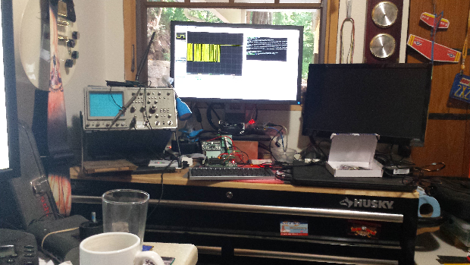
Other Business

Slide 22
Adjourned Thanks

