Slide 1
Project: IEEE P802.15 Working Group for Wireless Personal Area Networks (WPANs)
Submission Title: [TG4aa JRE November Virtual Plenary 2021 Closing report]
Date Submitted: [17th November, 2021]
Source: [Takashi Kuramochi] Company [LAPIS TECHNOLOGY]
Address [2-4-8 Shinyokohama,Kouhoku-ku,Yokohama 222-8575 Japan]
Voice:[+81-45-476-9295], FAX: [], E-Mail:[kuramochi722@lapis-tech.com]
Re: [] Abstract: [This document contains TG4aa JRE closing report from Virtual November Plenary sessions,2021] Purpose: [information]
Notice: This document has been prepared to assist the IEEE P802.15. It is offered as a basis for discussion and is not binding on the contributing individual(s) or organization(s). The material in this document is subject to change in form and content after further study. The contributor(s) reserve(s) the right to add, amend or withdraw material contained herein.
Release: The contributor acknowledges and accepts that this contribution becomes the property of IEEE and may be made publicly available by P802.15.

Slide 2
IEEE 802.15 TG4aa JRE Virtual November Plenary Closing report on November 17th ,2021

Slide 3
About TG4aa
TG 4aa – Japanese Rate Enhancement (JRE) amendment
Objective: data rate extensions for the SUN FSK modulation and channel parameters focusing on the Japanese frequency band
Chair :Takashi Kuramochi(LAPIS)
Vice-Chair : Hiroshi Harada(Kyoto University)
Vice-Chair : Kunal Shah()
Secretary : Kiyoshi Fukui(OKI)
Technical Editor : Kiyoshi Fukui(OKI)

Slide 4
TG4aa JRE sessions in November Plenary
 | Monday 8th November | Tuesday 9th November | Wednesday 10th November | Thursday 11th November | Friday 12th November
AM1 |  | Opening
AM2
PM1
PM2
EV1 |  | TG4aa-JRE
 | Monday 15th November | Tuesday 16th 8th November | Wednesday 17th November | Thursday 18th November | Friday 19th November
AM1 |  |  | Closing
AM2
PM1
PM2
EV1 | TG4aa-JRE (Cancelled)

Slide 5
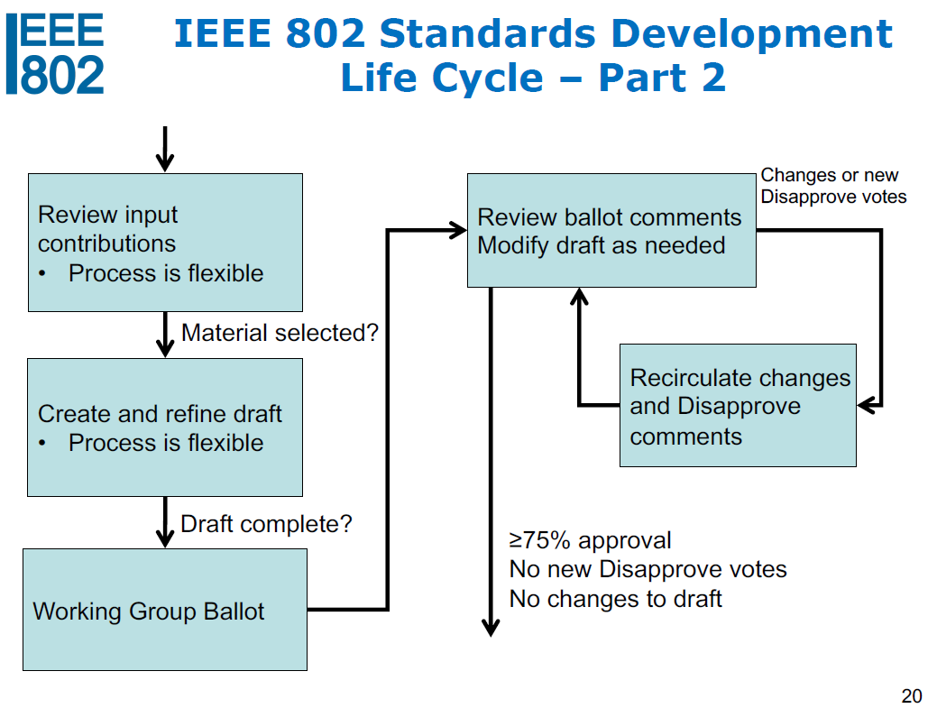
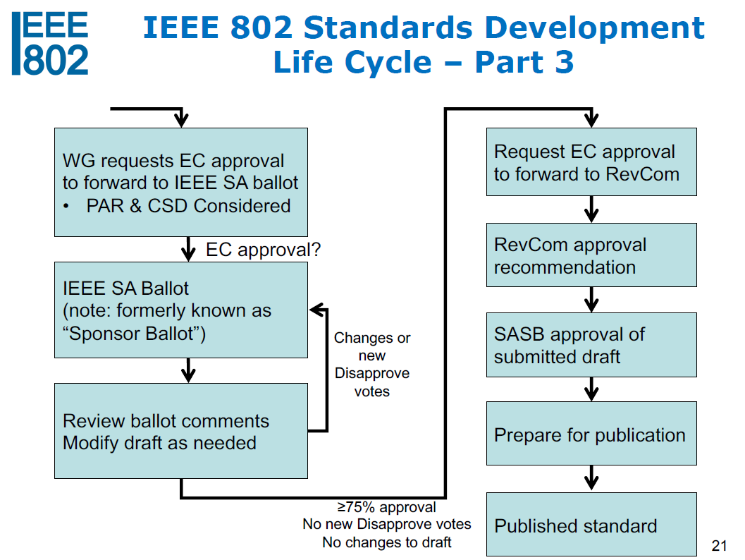
Current Status of TG4aa
We are here!

Slide 6
Agenda for TG4aa meetings
Target: TG Motion for RevCom Submission
Session1:
SA Ballot results
Next Steps(RevCom Submission)

Slide 7
Accomplishments:
Review SA ballot results
Two TG motions were moved.
Planned January Interim(# of Sessions)
Minutes posted(15-21-0611-00-04aa)

Slide 8
SA ballot results
Ballot ID | Ballot Close Date | Title | Ballot Type | Pool | Return | %Return | Abstain | %Abstain | Approve | Disapprove | %Approve | Comments
Initial | 14-September-2021 | IEEE Standards Association Ballot for IEEE P802.15.4aa/D08 | SA Initial Ballot | 71 | 55 | 77 | 1 | 1 | 53 | 1 | 98 | 5
Recirculation | 4- October- 2021 | IEEE Standards Association Ballot for IEEE P802.15.4aa/D09 | SA Recirculation1 Ballot | 71 | 61 | 85 | 1 | 1 | 60 | 0 | 100 | 4
2nd Recirculation | 28 October-2021 | IEEE Standards Association Ballot for IEEE P802.15.4aa/D10 | SA 2nd Recirculation Ballot | 71 | 62 | 87 | 1 | 1 | 61 | 0 | 100 | 0
SA Ballot for P802.15.4aa/D10 was quorate , and passed.

Slide 9
TG Motion
Motion: Task Group TG4aa requests 802.15 WG has reviewed and approves the CSD [15-20-0319-00-04aa] and requests unconditional approval from the EC to submit [P802.15.4aa]-D10 to RevCom
Moved: Hiroshi Harada(Kyoto University)
Seconded: Don Sturek(ITRON)
There is no discussion or objections.
The motion is approved unanimous consent

Slide 10
WG Motion
Motion: that 802.15 WG has reviewed and approves the CSD [15-20-0319-00-04aa] and requests unconditional approval from the EC to submit [P802.15.4aa]-D10 to RevCom
Moved: Takashi Kuramochi(Lapis Technology)
Seconded: Rick Alfvin(Linespeed)

Slide 11
TG Motion: Approve the CRG formation
Task Group TG4aa requests 802.15WG to approve the formation of a Comment Resolution Group (CRG) for the Standards Association Recirculation balloting of the P802.15.4aa_D10 or latest draft with the following membership: Takashi Kuramochi(Chair), Hiroshi Harada, Don Sturek, Henk De Ruijter, and Kiyoshi Fukui. The 802.15.4aa CRG is authorized to approve comment resolutions, edit the draft according to the comment resolutions, and to approve the start of recirculation ballots of the revised draft on behalf of the 802.15 WG. Comment resolution on recirculation ballots between sessions will be conducted via reflector email and via teleconferences announced to the reflector as per the LMSC 802 WG P&P.
Moved: Phil Beecher(Wi-SUN Alliance)
Seconded: Don Sturek(ITRON)
There is no discussion or objections.
The motion is approved unanimous consent

Slide 12
WG Motion to form TG4aa CRG:
Move that 802.15 WG approve the formation of a Comment Resolution Group (CRG) for the Standards Association Recirculation balloting of the P802.15.4aa_D10 or latest draft with the following membership: Takashi Kuramochi(Chair), Hiroshi Harada, Don Sturek, Henk De Ruijter, and Kiyoshi Fukui. The 802.15.4aa CRG is authorized to approve comment resolutions, edit the draft according to the comment resolutions, and to approve the start of recirculation ballots of the revised draft on behalf of the 802.15 WG. Comment resolution on recirculation ballots between sessions will be conducted via reflector email and via teleconferences announced to the reflector as per the LMSC 802 WG P&P.
Moved: Takashi Kuramochi(Lapis Technology)
Seconded: Rick Alfvin(Linespeed)
There is no discussion or objections.
The motion is approved unanimous consent

Slide 13
Plan for January Interim
Topics: Review any feedbacks from RevCom.
One slot will be planned.
 | Monday 10th January | Tuesday 11th January | Wednesday 12th January | Thursday 13th January | Friday 14th January
AM1 |  | Opening
AM2
PM1
PM2
EV1 |  | TG4aa-JRE

Slide 14
P802.15.4aa Timeline
Event | Date
Request approval from EC to forward draft to RevCom | 18 Nov 2021
Post to RevCom (submittal deadline) | 16 Dec 2021
RevCom meeting (teleconference) | 25 Jan 2022
SASB meeting | 23 Mar 2022
CRG meeting will be planned according to the feedbacks

