Slide 1
Project: IEEE P802.15 Working Group for Wireless Personal Area Networks (WPANs)
Submission Title: Higher PHY data rates for 802.15.4ab
Source: Carlos Aldana (Meta)
Address : [1 Hacker Way, Menlo Park, CA 94025]
E-Mail: [caldana (at) fb.com]
Re: Study Group 4ab: UWB Next Generation
Abstract: [Higher PHY data rates for 802.15.4ab]
Purpose:
Notice: This document has been prepared to assist the IEEE P802.15. It is offered as a basis for discussion and is not binding on the contributing individual(s) or organization(s). The material in this document is subject to change in form and content after further study. The contributor(s) reserve(s) the right to add, amend or withdraw material contained herein.
Release: The contributor acknowledges and accepts that this contribution becomes the property of IEEE and may be made publicly available by P802.15.
Notes:
Jul 12, 2010
Page 1

Slide 2
Technical Guidance [1]
PAR Objective | Proposed Solution (how addressed)
Safeguards so that the high throughput data use cases will not cause significant disruption to low duty-cycle ranging use cases.
Interference mitigation techniques to support higher density and higher traffic use cases
Other coexistence improvement
Backward compatibility with enhanced ranging capable devices (ERDEVs).
Improved link budget and/or reduced air-time | Higher PHY rates reduce air-time
Additional channels and operating frequencies
Improvements to accuracy / precision / reliability and interoperability for high-integrity ranging;
Reduce complexity and power consumption;
Hybrid operation with narrowband signaling to assist UWB;
Enhanced native discovery and connection setup mechanisms;
Sensing capabilities to support presence detection and environment mapping;
Low-power low-latency streaming
higher data-rate streaming allowing at least 50 Mbit/s of throughput. | Higher PHY rates will help enable this use case
Support for peer-to-peer, peer-to-multi-peer, and station-to-infrastructure protocols;
Infrastructure synchronization mechanisms.

Slide 3
Related Submissions
15-21-592 “High Data Rates”, Carl Murray et.al (Qorvo)
15-21-501 “Ways to achieve higher data rate for the HRP UWB PHY”, Chenchen Liu (Huawei)

Slide 4
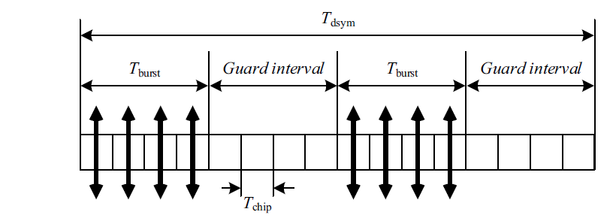
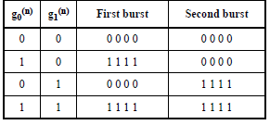
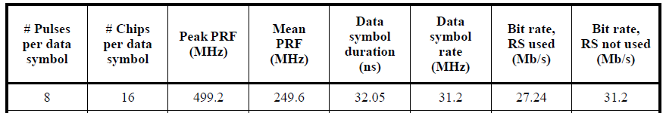
HPRF Data Communications– Review
HPRF mode was introduced
  PRF of 249.6 MHz providing 27.2 (RS)/31.2(no RS) Mbps
For PRF of 249.6 MHz, the following structure is used (8 pulses per bit), with symbol duration = 32.05 ns
PRF: Pulse Repetition Frequency
RS: Reed Solomon

Slide 5
Proposed Modulation, pulse grid
Keep BPSK, PRF, rate = ½, and T_{chip}
62.4 Mbps data rate
124.8 Mbps data rate
g0
g1
Guard Interval
Tdsym=16.03 ns
g0
g1
Guard Interval
Tdsym=8.01 ns

Slide 6
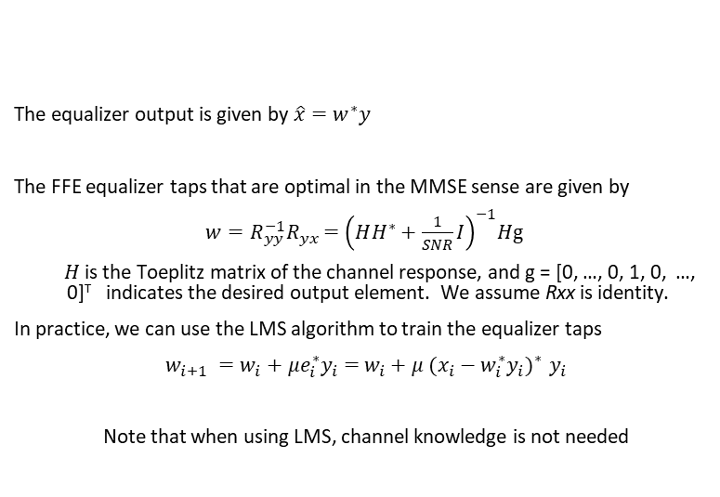

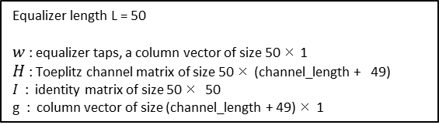


Equalizer Block Diagram
received signal
ADC
$$y$$
FFE w
$$\hat{x}$$
Demodulator/Decoder
The equalizer output is given by $\hat{x}=w^{∗}y$
The FFE equalizer taps that are optimal in the MMSE sense are given by
$w={R_{yy}^{−1}R}_{yx}{ =\left(HH^{∗}+\frac{1}{SNR}I\right)}^{−1}H\text{g}$
$H$ is the Toeplitz matrix of the channel response, and g = [0, …, 0, 1, 0, …, 0]^{T} indicates the desired output element. We assume Rxx is identity.
In practice, we can use the LMS algorithm to train the equalizer taps
$w_{i+1} =w_{i}+μe_{i}^{∗}y_{i}=$ $w_{i}+μ {{(x_{i}−w_{i}^{∗}y_{i})}_{}^{∗}y}_{i}$
Note that when using LMS, channel knowledge is not needed
Equalizer length L = 50
$w$: equalizer taps, a column vector of size 50 × 1
$H$: Toeplitz channel matrix of size 50 × (channel_length + 49)
$I$: identity matrix of size 50 × 50
$\text{g}$: column vector of size (channel_length + 49) × 1
$w_{i}$: equalizer taps at time $i$
$e_{i}{= x}_{i}−w_{i}^{∗}y_{i}$ : scalar estimation error
$μ$: update step-size

Slide 7
Simulation Assumptions
127 byte data payload
Root raised cosine pulse shape with roll-off factor = 0.45
SYNC Preamble Code 9 (length 127)
32 Sync symbols to estimate channel
No frequency offset and perfect timing
Assume (for now) RS is present with CL3 (Constraint Length 3). CL7 does not have RS.
  Without RS, CL7 achieves higher rate (e.g., 31.2 vs 27.2)
No fixed bit-width ADC

Slide 8
PER in AWGN
Required SNR for 10% PER
6.8 Mbps (BPRF) | 6.8 Mbps (HPRF) | 7.8 Mbps (HPRF) | 27.2 Mbps (HPRF) | 31.2 Mbps (HPRF) | 54.5 Mbps (proposed) | 62.4 Mbps (proposed) | 109.0 Mbps (proposed) | 124.8 Mbps (proposed)
-14.9dB | -14.9dB | -14.5dB | -9.2dB | -8.8dB | -6.2dB | -5.7dB | -3.2dB | -2.8dB

Slide 9
PER in CM1 (“Exact” equalizer)
Required SNR for 10% PER
6.8 Mbps (BPRF) | 6.8 Mbps (HPRF) | 7.8 Mbps (HPRF) | 27.2 Mbps (HPRF) | 31.2 Mbps (HPRF) | 54.5 Mbps (proposed) | 62.4 Mbps (proposed) | 109.0 Mbps (proposed) | 124.8 Mbps (proposed)
-14.6dB | -14.7dB | -14.3dB | -8.7dB | -8.2dB | -5.2dB | -4.7dB | -1.5dB | -1.0dB
CM1 results within 1.8 dB from AWGN

Slide 10
PER in CM1 (Equalizer w/ LMS)
Required SNR for 10% PER
6.8 Mbps (BPRF) | 6.8 Mbps (HPRF) | 7.8 Mbps (HPRF) | 27.2 Mbps (HPRF) | 31.2 Mbps (HPRF) | 54.5 Mbps (proposed) | 62.4 Mbps (proposed) | 109.0 Mbps (proposed) | 124.8 Mbps (proposed)
-14.3dB | -14.4dB | -14.1dB | -8.6dB | -8.2dB | -5.3dB | -4.6dB | -1.5dB | -1.1dB
LMS results within 0.3 dB from exact equalizer
Trained

Slide 11
Conclusions
With simple equalizer design,124.8 Mbps PHY rate seems achievable with reasonable complexity
  CM1 results are within 1.8 dB from AWGN
  LMS equalizer close to “exact” equalizer
Higher data rates allow for higher throughput, lower duty cycle and reduced air-time.

