Slide 1
Project: IEEE P802.15 Working Group for Wireless Personal Area Networks (WPANs)
Submission Title: [Solution for Harmonization with ETSI Smart BAN]
Date Submitted: [16^{ｔｈ} November 2021]
Source: [Ryuji Kohno] [1;Yokohama National University(YNU), 2;YRP International Alliance Institute(YRP-IAI)]
Address [1; 79-5 Tokiwadai, Hodogaya-ku, Yokohama, 240-8501 Japan
2; YRP1 Blg., 3-4 HikarinoOka, Yokosuka-City, Kanagawa, 239-0847 Japan]
Voice:[1; +81-90-5408-0611], FAX: [+81-45-383-5528],
Email:[1: kohno@ynu.ac.jp, 2: kohno@yrp-iai.jp] Re: []
Re: []
Abstract: [This document contains solution for harmonizing with ETSI Smart BAN]
Purpose: [information]
Notice: This document has been prepared to assist the IEEE P802.15. It is offered as a basis for discussion and is not binding on the contributing individual(s) or organization(s). The material in this document is subject to change in form and content after further study. The contributor(s) reserve(s) the right to add, amend or withdraw material contained herein.
Release: The contributor acknowledges and accepts that this contribution becomes the property of IEEE and may be made publicly available by P802.15.

Slide 2
IEEE 802.15 TG15.6a Solution for Harmonization with ETSI Smart BAN Virtual Plenary Meeting November 15th, 2021 Ryuji Kohno Yokohama National University(YNU), YRP International Alliance Institute(YRP-IAI)

Slide 3
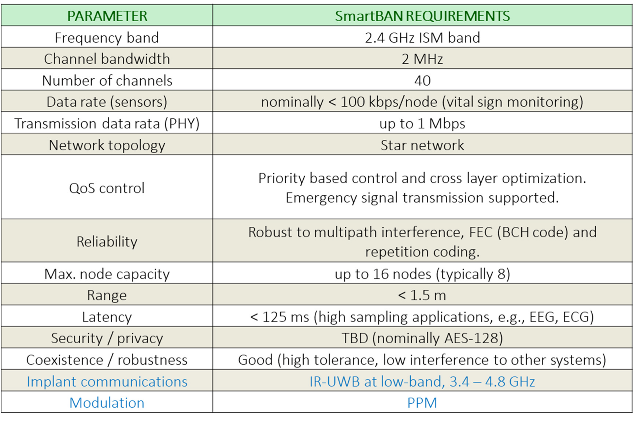
Overview of ETSI Smart BAN

Slide 4
Difference and Commonality between IEEE802.15.6a and ETSI Smart BAN(1/3)
Difference in Aim and Approach
IEEE802.15.6a is amendment/revision of IEEE802.15.6-2012 to update it more enhanced dependability with feasible solution
ETSI Smart BAN is focusing on smart with simpler implementation
Use Cases
IEEE802.15.6a focuses on human BAN(HBAN) for medical healthcare and extends to vehicle BAN(VBAN) for automotive use cases.
ETSI Smart BAN focuses on medical healthcare in human body

Slide 5
Difference and Commonality between IEEE802.15.6a and ETSI Smart BAN(2/3)
Physical Layer(PHY)
IEEE802.15.6a focuses on UWB PHY while keep backward compatibility with UWB, NB and HBC of IEEE802.15.6-2012
ETSI Smart BAN focused on NB in 2.4GHz ISM Band while implant BAN applied UWB PHY.
MAC
IEEE802.15.6a keeps hybrid contention-free and contention-access protocols of IEEE802.15.6 MAC
ETSI Smart BAN specifies simpler contention-access protocol such as slotted ALOHA

Slide 6
Difference and Commonality between IEEE802.15.6a and ETSI Smart BAN(3/3)
QoS Control
IEEE802.15.6a keeps priority order of packets with QoS Levels 0-7
ETSI Smart BAN focuses priority order of packets with Levels 1-3
Coexistence
IEEE802.15.6a applies TSN and MAC bridge in MAC layer while mitigation of intra BAN and inter PAN interference with space-time domain
ETSI Smart BAN applies FEC and hybrid ARQ

Slide 7
Summary
IEEE802.15.6a and ETSI Smart BAN are originated from IEEE802.15.6-2012 but targeting different direction enhanced dependability and simple implementation.
Common use cases are medical healthcare BAN
In PHY, primarily IEEE802.15.6a focuses on UWB while ETSI Smart BAN on NB while secondarily other way round.
QoS control and solution for coexistence are not the same but similar.
At least minimum interoperability could be guaranteed when both standard BAN coexists.

Slide 8
Thank you for your attention

