Slide 1
Project: IEEE P802.15 Working Group for Wireless Personal Area Networks (WPANs)
Submission Title: NBA-MMS-UWB MAC Considerations
Date Submitted: Nov. 15, 2021
Source: Yong Liu, Santhosh Kumar Mani, Sam Schaevitz, Robert Golshan (Apple Inc.)
Address: One Apple Park Way, Cupertino, CA 95104, USA
E-Mail: yongliu@ieee.org
Abstract: MAC design considerations for narrow-band assisted (NBA)-multi-millisecond (MMS)-UWB ranging protocols
Purpose:
Notice: This document has been prepared to assist the IEEE P802.15. It is offered as a basis for discussion and is not binding on the authoring individual(s) or organization(s). The material in this document is subject to change in form and content after further study. The authors(s) reserve(s) the right to add, amend or withdraw material contained herein.

Slide 2
PAR Objective | Proposed Solution (how addressed)
Safeguards so that the high throughput data use cases will not cause significant disruption to low duty-cycle ranging use cases
Interference mitigation techniques to support higher density and higher traffic use cases
Other coexistence improvement
Backward compatibility with enhanced ranging capable devices (ERDEVs)
Improved link budget and/or reduced air-time | Use coordinated PHY signaling (NB and UWB) to improve link budget and/or to reduce air-time
Additional channels and operating frequencies
Improvements to accuracy / precision / reliability and interoperability for high-integrity ranging
Reduced complexity and power consumption | Off-loading of functionality to lower-complexity/power NB PHY helps reduce complexity of “heavier” UWB sub-system
Hybrid operation with narrowband signaling to assist UWB | Exploit tightly coupled concurrent operation of NB to help UWB
Enhanced native discovery and connection setup mechanisms
Sensing capabilities to support presence detection and environment mapping
Low-power low-latency streaming
Higher data-rate streaming allowing at least 50 Mbit/s of throughput
Support for peer-to-peer, peer-to-multi-peer, and station-to-infrastructure protocols
Infrastructure synchronization mechanisms

Slide 3
Contents
Motivations
High Level NBA-MMS-UWB Protocol
NB MAC Considerations
Conclusions

Slide 4
Motivation
15-21-0409-01-04ab-narrowband-assisted-multi-millisecond-uwb:
Distribute UWB over short bursts (“fragments”) spanning N milliseconds, providing an emissions budget of up to N*37 nJ
Reuse high-performance 802.15.4 NB companion link to “anchor” the subsequent fragmented UWB transmissions – providing time (T) and frequency (F) sync & thereby allowing low-complexity, high-performance UWB processing to integrate energies at Rx
Example: UWB fragments contain CIR training sequences while sync and (control) data are offloaded to NB => Link Budget improvement for ranging use case amounting to more than 10*log₁₀(N) dB
Tight coupling (e.g., shared XO & MAC timer) between NB and UWB is required

Slide 5
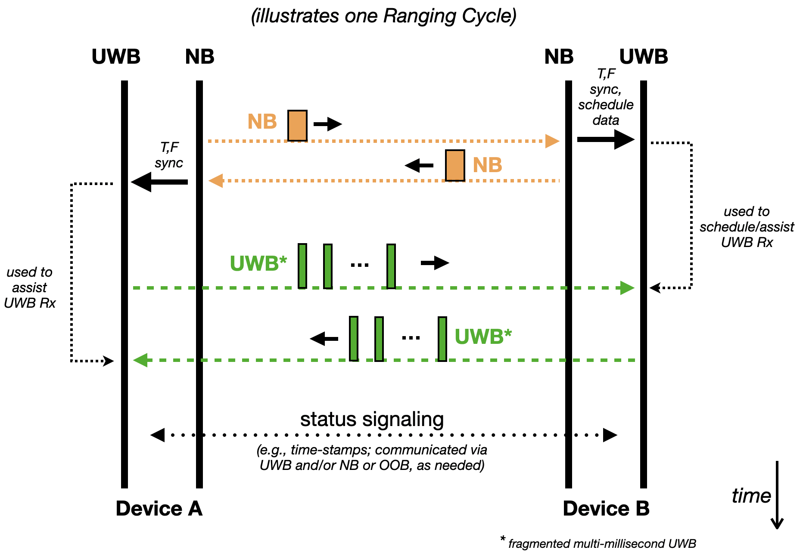
Protocol Perspective (Example)
15-21-0409-01-04ab-narrowband-assisted-multi-millisecond-uwb

Slide 6
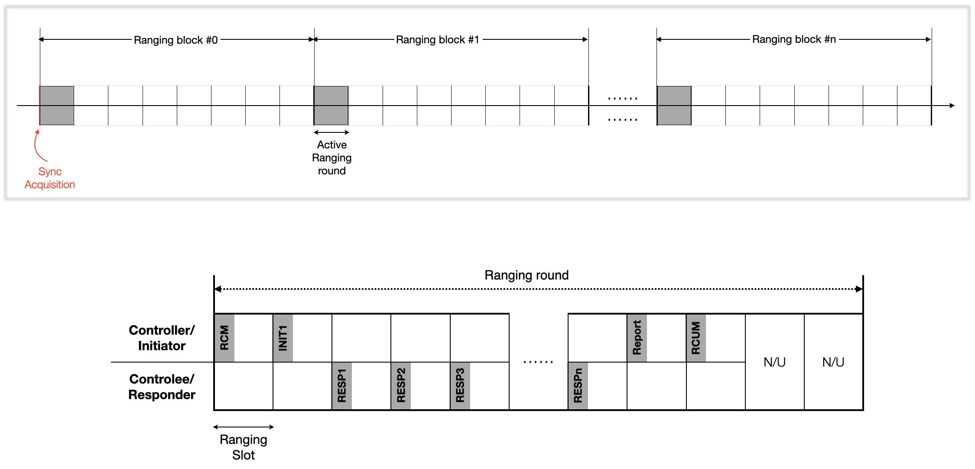
802.15.4z Ranging Session

Slide 7
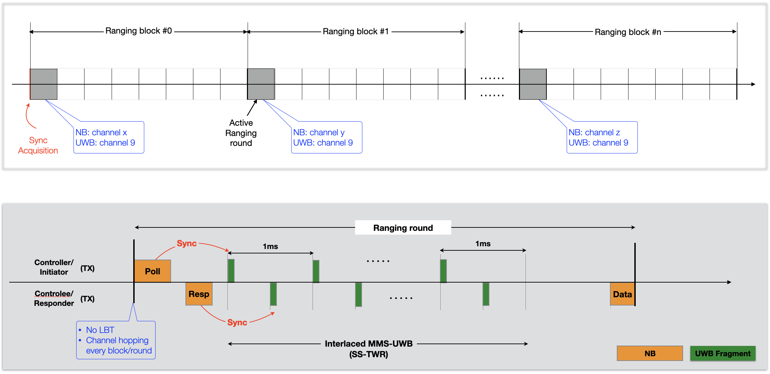
NBA-MMS-UWB Ranging Session (Example)

Slide 8
NB MAC Considerations
Low power
Contention free channel access (no LBT)
Small protocol overhead
Short NB packets
Channel congestion / fading mitigation
UNII-3 @ 5GHz band (refer to 15-21-0593-02-04ab-more-on-nba-mms)
Channel hopping every ranging round
Adaptive configuration
Configurable ranging block/round, # of UWB fragments per round, ranging report methods, etc.

Slide 9
Conclusions
NB assisted MMS UWB can provide substantial link budget gains.
Ranging block/round defined in 802.15.4z can be extended to support the NBA-MMS-UWB ranging sequence.
NB MAC designs should consider power optimization, channel congestion / fading mitigation, adaptive configuration etc.

Slide 10
References
15-21-0409-01-04ab-narrowband-assisted-multi-millisecond-uwb
15-21-0593-02-04ab-more-on-nba-mms.pptx

