Slide 1
Project: IEEE P802.15 Working Group for Wireless Personal Area Networks (WPANs)
Submission Title: More on narrowband assisted multi-millisecond UWB
Date Submitted: 12 November, 2021
Source: Ersen Ekrem, Ido Bettesh, and Moche Cohen (Apple Inc.)
Address: One Apple Park Way, Cupertino, CA 95104, USA
E-Mail: ersenek@gmail.com
Abstract: Discussion of how NB and UWB signaling can cooperate to improve the UWB link budget.
Purpose: Illustrate NB/UWB coordination to improve the operating range of UWB ranging use cases.
Notice: This document has been prepared to assist the IEEE P802.15. It is offered as a basis for discussion and is not binding on the authoring individual(s) or organization(s). The material in this document is subject to change in form and content after further study. The authors(s) reserve(s) the right to add, amend or withdraw material contained herein.

Slide 2
PAR Objective | Proposed Solution (how addressed)
Safeguards so that the high throughput data use cases will not cause significant disruption to low duty-cycle ranging use cases
Interference mitigation techniques to support higher density and higher traffic use cases
Other coexistence improvement
Backward compatibility with enhanced ranging capable devices (ERDEVs)
Improved link budget and/or reduced air-time | Use coordinated PHY signaling (NB and UWB) to improve link budget and/or to reduce air-time
Additional channels and operating frequencies
Improvements to accuracy / precision / reliability and interoperability for high-integrity ranging
Reduced complexity and power consumption | Off-loading of functionality to lower-complexity/power NB PHY helps reduce complexity of “heavier” UWB sub-system
Hybrid operation with narrowband signaling to assist UWB | Exploit tightly coupled concurrent operation of NB to help UWB
Enhanced native discovery and connection setup mechanisms
Sensing capabilities to support presence detection and environment mapping
Low-power low-latency streaming
Higher data-rate streaming allowing at least 50 Mbit/s of throughput
Support for peer-to-peer, peer-to-multi-peer, and station-to-infrastructure protocols
Infrastructure synchronization mechanisms

Slide 3
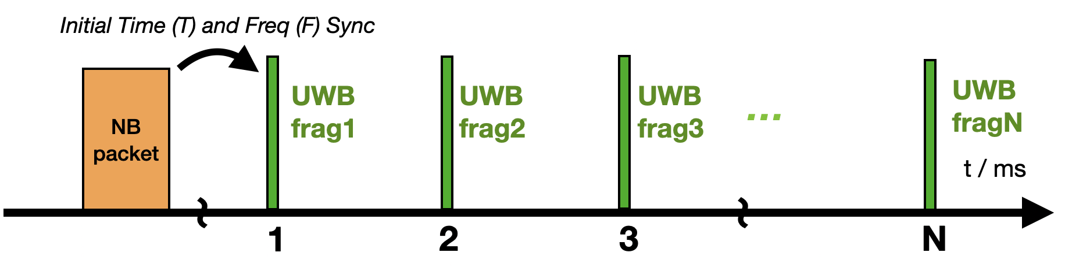
NBA-MMS UWB: A refresher from July 2021
A synergistic interplay between NB and UWB:
  Tight coupling between radios leading to link budget improvement
Tight coupling between NB and UWB radios:
  NB will provide UWB precise timing and frequency offsets to assist in acquisition
  NB will own data exchange on behalf of UWB (status signaling, etc.)
Link budget improvement:
  UWB will have preamble-only packets (no SFD, no data)
  There will be multiple fragments separated by 1 ms for further link budget boost

Slide 4
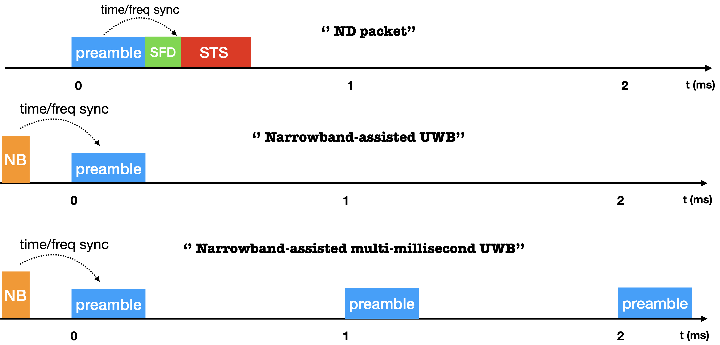
Narrowband Assisted Multi-Millisecond UWB
Each UWB fragment is a preamble-only packet
NB will take care of timing and frequency offset estimation & data exchange.

Slide 5
Possible UWB Fragment Structure
Preamble structure:
  Repetition of the same symbol
  Symbol duration ~ 1-2 microseconds
  Ipatov, Golay sequences could be used
PRF:
  Could be similar the current ones in HRP such as 64, 128 MHz.
Fragment duration:
  Flexible enough to trade-off between co-existence and PA complexity
  Duration ~ 30 - 300 usec
Number of fragments:
  Dynamic adjustment with options such as 1, 2, 4, 8 16, 32.

Slide 6
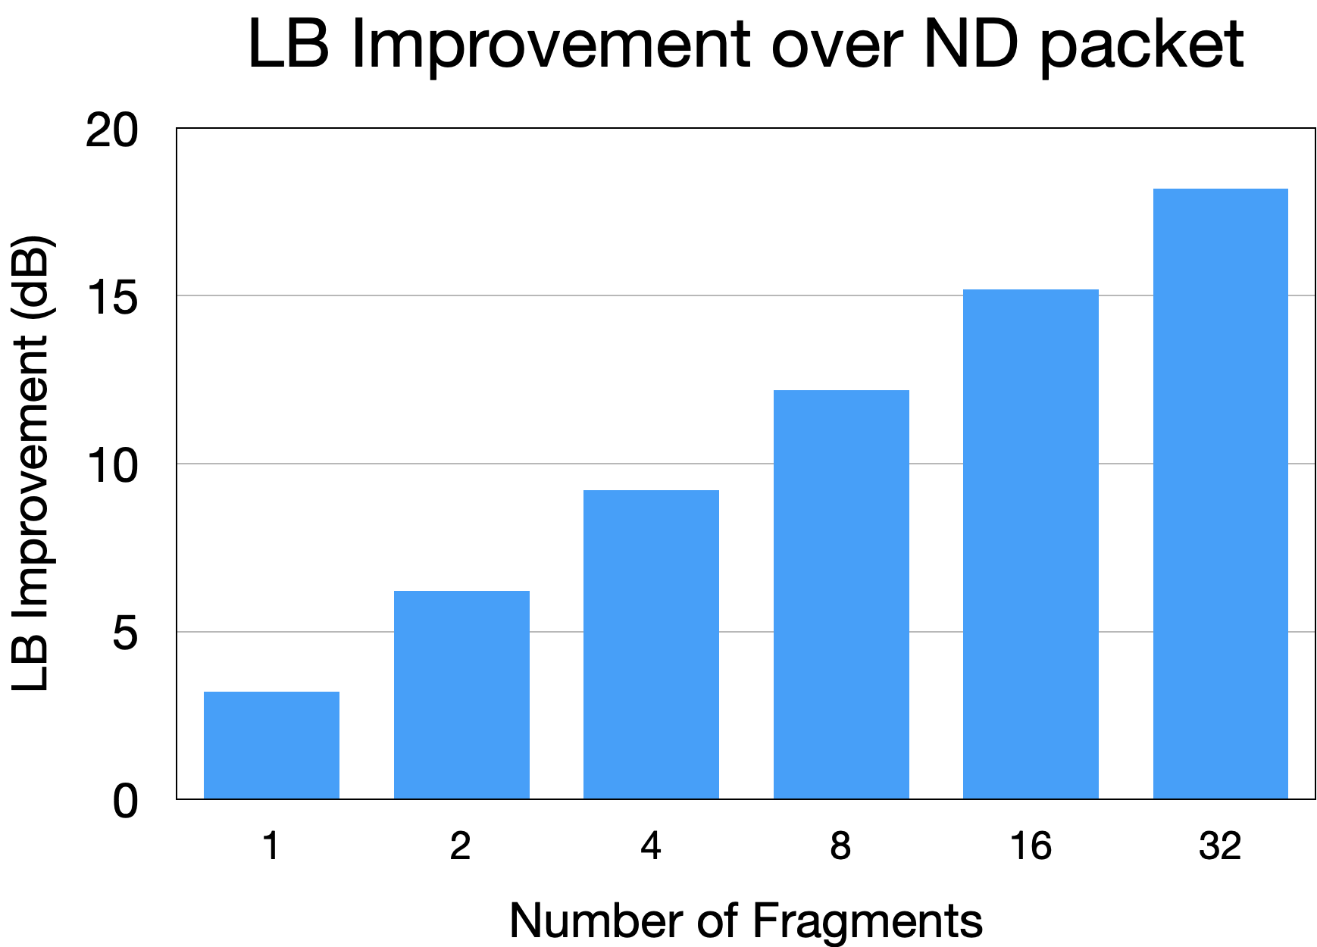
Potential Link Budget Improvement
Almost 18 dB link budget improvement over ND packet!

Slide 7
NB Radio
O-QPSK from 15.4 is very attractive:
  Widely adopted in CSA (formerly ZigBee)/Thread
  Efficient Tx implementation with good Rx sensitivity
UNII-3 band (5725-5850 MHz) is favorable:
  2.4 GHz is crowded and far from UWB bands.
  Among UNII bands, UNII-3 is the only one worldwide available.
  High regulatory Tx power limits.
  Sufficient channel spacing for ACI rejection such as 5 MHz BW.
  Channel hopping to avoid deep fades
  Other UNII bands could be optional to have a future looking standard.

Slide 8
Air-time optimization for O-QPSK
It is highly desirable to optimize the airtime of O-QPSK
  250 kbps mode might be long for certain use cases
Keep backward-compatibility and co-existence in mind:
  Preamble and SFD changes should be minimal
  Keeping spreading rate identical would help for that matter.
Auto-rate detect could help with co-existence, too:
  SFD can be leveraged to distinguish different packet formats.
  Also, more energy efficient approach compared to PHR changes!

Slide 9
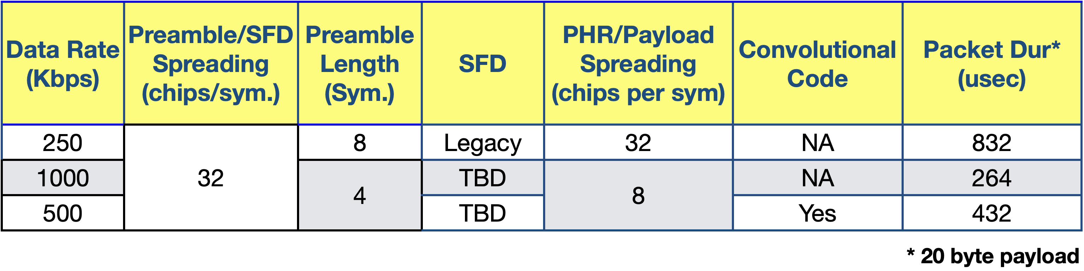
Air-time optimization for O-QPSK
Air-time can be optimized by:
  Preamble length reduction
  Using higher data rates

