Slide 1
Project: IEEE P802.15 Working Group for Wireless Specialty Networks
Submission Title: Coordinator-to-coordinator communication for Body Area Networks
Date Submitted: November 11th, 2021
Source: Minsoo Kim¹, Takumi Kobayashi^{1,2}, Marco Hernandez¹, Ryuji Kohno^{1,2}
Company: ¹Yokosuka Research Park International Alliance Institute (YRP-IAI), Japan; ²Yokohama National University (YNU), Japan
Address: ¹YRP 1, 3-4 Hikarino-oka, Yokosuka, 239-0847 Japan; ²79-5 Tokiwadai, Hodogaya-ku, Yokohama, 240-8501 Japan
Voice: ²+81-90-5408-0611, Fax: ²+81-45-383-5528, E-Mail:[minsoo@minsookim.com; kobayashi-takumi-ch@ynu.ac.jp, Marco.Hernandez@ieee.org; kohno@ynu.ac.jp]
Re: In response to call for technical contributions
Abstract: This document contains a discussion of coordinator-to-coordinator communication to realize the enhanced reliability of P802.15.6a.
Purpose: Material for discussion in P802.15.6a TG
Notice: This document has been prepared to assist the IEEE P802.15.6a. It is offered as a basis for discussion and is not binding on the contributing individual(s) or organization(s). The material in this document is subject to change in form and content after further study. The contributor(s) reserve(s) the right to add, amend or withdraw material contained herein.
Release: The contributor acknowledges and accepts that this contribution becomes the property of IEEE and may be made publicly available by P802.15.6a.

Slide 2
Coordinator-to-coordinator communication for Body Area Networks
Minsoo Kim¹, Takumi Kobayashi^{1,2},
Marco Hernandez¹, Ryuji Kohno^{1,2}
¹Yokosuka Research Park International Alliance Institute (YRP-IAI)
²Yokohama National University (YNU)

Slide 3
Coordinator-to-coordinator communication
Coordinator-to-coordinator (C2C) communication is performed through a link between BAN Coordinators, separate from links between a BAN Coordinator and BAN Nodes.
To avoid complexity, it would be preferable to use the same PHY as the link between a BAN Coordinator and BAN Nodes.
BAN
Node
BAN
Node
BAN
Node
BAN
Coordinator
BAN
Coordinator
BAN
Node
Link between Coordinators
to talk to each other
BAN
Node
BAN
Node

Slide 4
Need for C2C communication
Interference and collisions in dense situations
  Links between coordinators can be utilized to control channel access between 2 or more BANs to reduce collisions and interference, especially in situations where BANs are densely located.
BAN
Node
BAN
Node
desired signal
BAN
Node
desired signal
BAN
Coordinator
BAN
Node
BAN
Coordinator
interference
collision
BAN
Node
BAN
Node

Slide 5

Possible Scenarios
Vehicle BAN and multiple Human BANs (n <= 5)
  As passengers are in the confined space, the probability of collision and the need for interference management increase.
  If a star topology is applied, Vehicle BAN can be a super-coordinator and perform central management.
  A Vehicle BAN coordinator may support up to 5 Human BAN coordinators for a passenger vehicle, such as sedan, pickup, SUV, utility vehicle.
Vehicle BAN
Coordinator
Human BAN
Coordinator
Human BAN
Coordinator

Slide 6
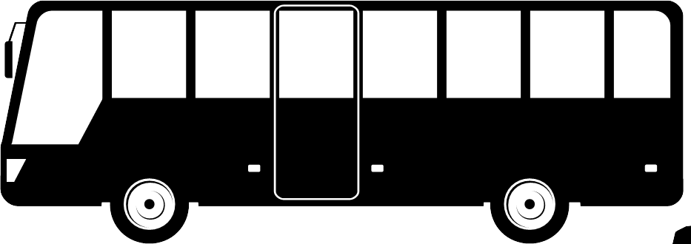
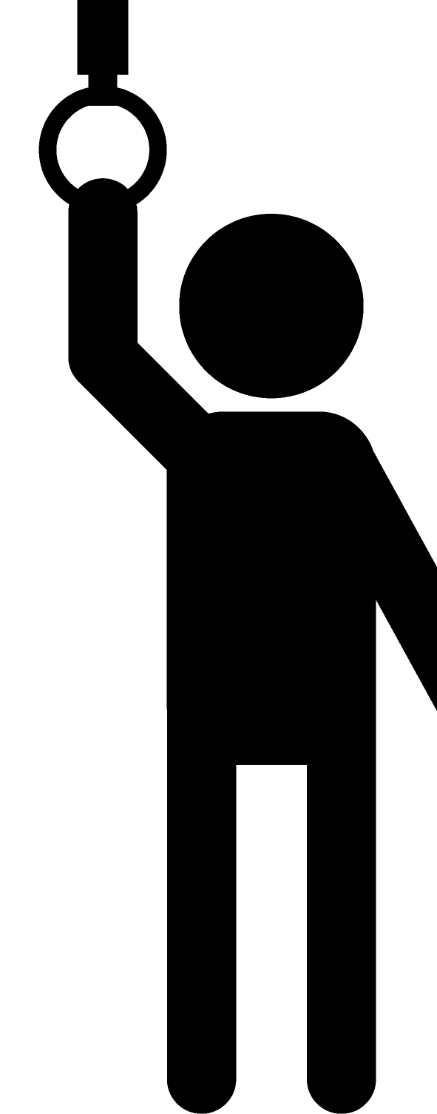
Possible Scenarios
Vehicle BAN and multiple Human BANs (n > 5)
  For a van or a bus that can accommodate more than 5 people, its Vehicle BAN should be able to accommodate more Human BANs. (for instance, up to 15 Human BAN coordinators)
  The communication range of the Vehicle BAN should also be considered along with the size of the vehicle.
Vehicle BAN Coordinator
HC
HC
HC
HC
HC
HC
HC
HC
HC: Human BAN Coordinator

Slide 7
Possible Scenarios
Vehicle BAN and multiple Human BANs (n > 5)
  Grouping Human BANs can also be considered.
Vehicle BAN Coordinator
HC
HC
HC
HC
HC
HC
HC
HC
HC: Human BAN Coordinator
Vehicle BAN Coordinator
Vehicle BAN Coordinator
HC
HC
HC
HC
HC
HC
HC
HC
HC: Human BAN Coordinator

Slide 8
Possible Scenarios
Multiple Human BANs
  A star topology may be undesirable.
    Unlike the case of Vehicle BAN, it is difficult to determine a super-coordinator, because there is no superiority or inferiority between Human BANs.
    Even if a super-coordinator is selected, it cannot cover the wider area of multiple Human BANs.
  If there is no Vehicle BAN, peer-to-peer (P2P) communication is the only option.
    However, distributed control increases complexity and communication overhead.

Slide 9
Possible Scenarios
Multiple Human BANs
  If peer-to-peer communication should be employed, it should be limited to BAN Coordinators, excluding links between BAN Coordinator and BAN Nodes, to reduce overheads.
  Careful considerations are required.
BAN
Coordinator
BAN
Coordinator
BAN
Coordinator
BAN
Coordinator
BAN
Coordinator

Slide 10
Detecting other BANs
Special time periods reserved for coordinator-to-coordinator communication may be required in a superframe.
It should be also noted that Vehicle BAN and Human BAN have different mobility characteristics.
  Vehicle BAN coordinators and nodes are fixed on the vehicle, while Human BAN coordinators and nodes are mobile around a vehicle.

Slide 11
Summary
Coordinator-to-coordinator (C2C) communication is proposed to reduce collisions and interference, especially in situations where BANs are densely located, for instance in a passenger bus.
Scenarios representing several use cases in which multiple Human BANs and/or Vehicle BAN are densely located are presented.
A star topology was suggested for a scenario where a Vehicle BAN and Human BANs coexist, and a peer-to-peer topology where only Human BANs coexist.
We need careful consideration of the mentioned topologies, and how to detect other BANs.

