Slide 1
Project: IEEE P802.15 Working Group for Wireless Specialty Networks (WSN)
Submission Title: Wireless Next Generation Meeting Slides
Date Submitted: 10 November 2021
Source: Benjamin A. Rolfe (Blind Creek Associates)
Contact:
Voice: +1 408 395 7207, E-Mail: ben.rolfe @ ieee.org
Re: Wireless Next Generation Standing Committee
Abstract: Agenda and Meeting Slides for the November WNG meeting
Purpose: Continue the illusion of organization
Notice: This document has been prepared to assist the IEEE P802.15. It is offered as a basis for discussion and is not binding on the contributing individual(s) or organization(s). The material in this document is subject to change in form and content after further study. The contributor(s) reserve(s) the right to add, amend or withdraw material contained herein.
Release: The contributor acknowledges and accepts that this contribution becomes the property of IEEE and may be made publicly available by P802.15.
Notes:
Jul 12, 2010
Page 1

Slide 2
November 2021 Plenary
Virtual Session
Meeting will begin at 10 minutes after the hour

Slide 3
Electronic Interim
Please remember to enter your attendance in IMAT
Reminder:
This is a non-PAR activity
All the rules of conduct apply https://grouper.ieee.org/groups/802/sapolicies.shtml

Slide 4
Registration for 802 LMSC Plenaries and 802 Wireless Interims
This 802.15 meeting (WNG) is part of an IEEE 802 LMSC Plenary or IEEE 802 Wireless Interim session
You must pay the registration fee in order to attend
If you have not already done so, you can register here or follow the registration link here http://802world.org/plenary/
If you do not intend to register for this session you must leave this meeting and, if you have logged attendance on IMAT, email the appropriate WG chair or vice chairs to have your attendance cancelled

Slide 5
Deadbeat Consequences (Deadbeat: in default of paying registration fee for a prior mtg.)
No participation credit will be granted for said session.
Any participation credit acquired before said session toward membership in any IEEE 802 LMSC group is revoked.
Membership in any IEEE 802 LMSC group is terminated.
No participation credit will be granted for attendance at any subsequent IEEE 802 LMSC session until the individual has complied with the registration requirements for all previously attended IEEE 802 LMSC sessions by the start of said subsequent session.

Slide 6
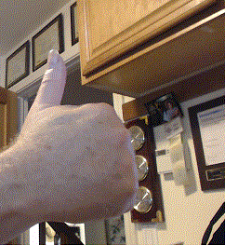
Registration Reminder
Please Register now if you have not already done so!
Register here or follow the registration link here http://802world.org/plenary/

Slide 7
Agenda 10 November 2021
Opening and Meeting Reminders
Presentations
TG 12 concepts and future (Kinney)
802 Next Gen collaboration (Rolfe)
Any other business
Reminders and anouncements
Adjourn

Slide 8
IEEE Networking Standards: Next Gen Technology Workshop
Workshop held 03 November 2021
Slides:
https://mentor.ieee.org/802-ec/dcn/21/ec-21-0257-01-00EC-802-next-gen-workshop-opening-deck.pptx
Goals:
Provide a platform for 802 groups to exchange information on their next-gen activities
Provide a platform for developers of early-stage technologies (e.g., academic and industrial researchers), to get familiar with early stage 802 activities and introduce their early-stage technologies to the 802 community.
Outcomes:
Enable the wider 802 community to become familiar with all 802 next gen activities and identify opportunities for cross-802 collaboration and synergies
Familiarize researchers on the 802 process, introduce them to the 802 community and enable them to make their research more relevant to the interests of the 802 community. Ideally, some of these early-stage technologies could eventually be incorporated in to a relevant 802 standard project.

Slide 9
Organize Next Steps
Identify topics for in depth follow up meeting(s), possibly in December 2021
Choose a few topics from the brainstorm discussion for follow up
Should we hold similar workshops on a regular basis?
Annually around the November plenary?
More often?
How can we improve the workshop structure and content?

Slide 10
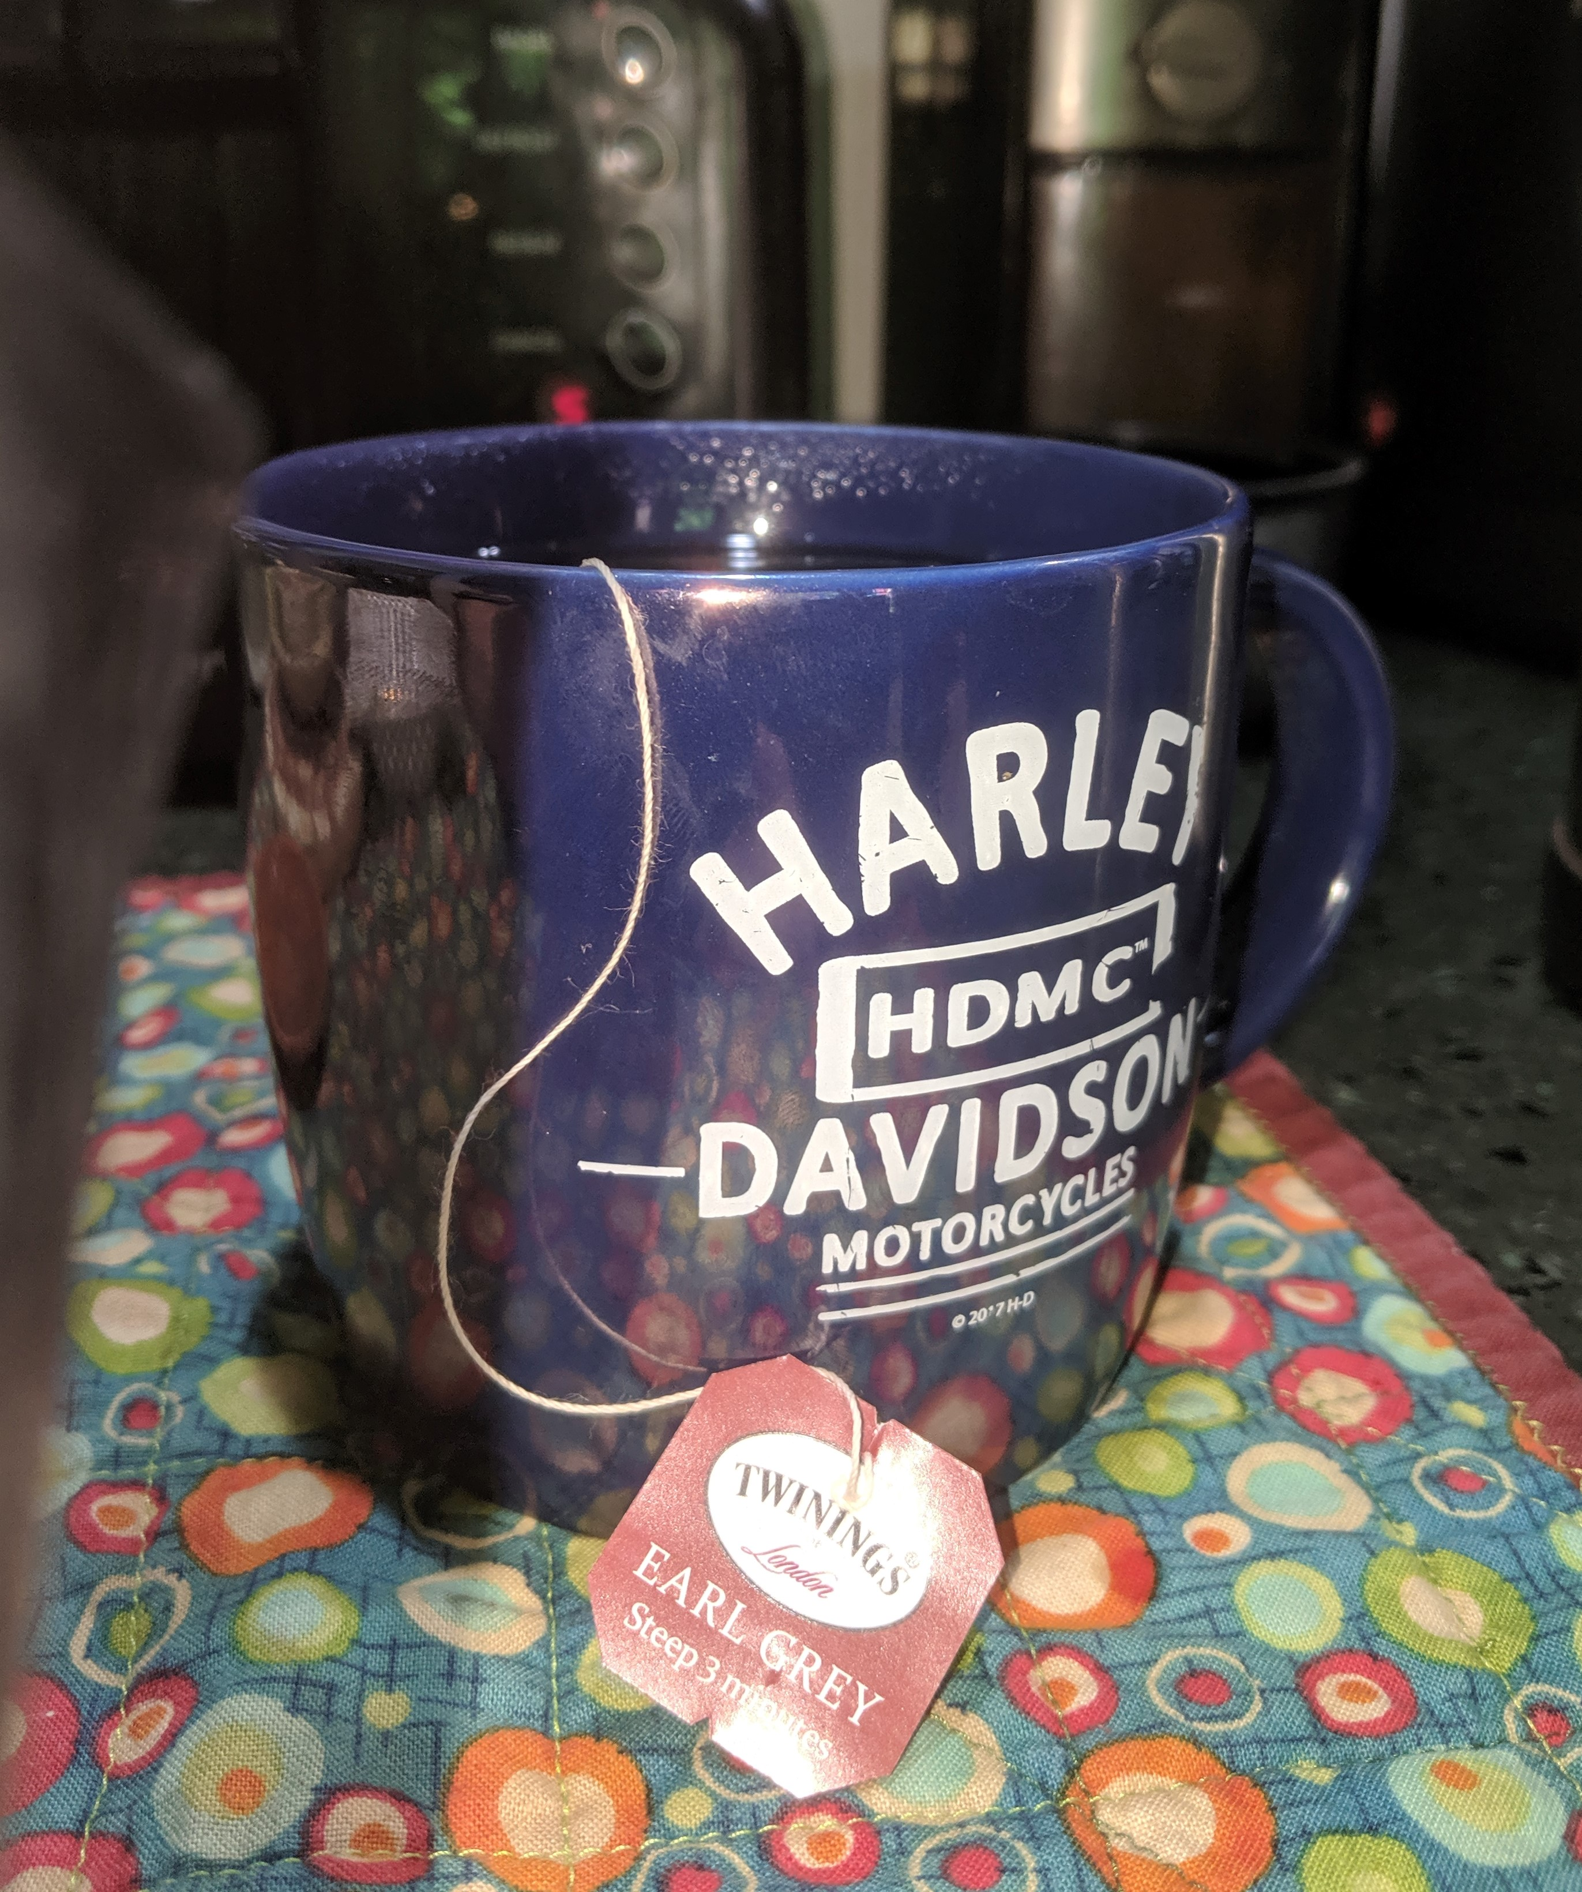
The usual question
What do you propose the Working Group do next?

Slide 11
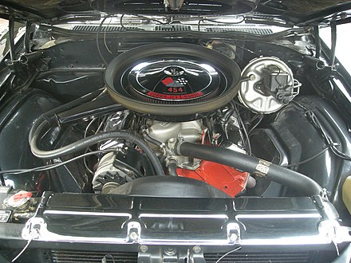
Meeting Adjourned Thanks

Slide 12
Links
PSDO Process: https://mentor.ieee.org/802.15/dcn/21/15-21-0461-00-wng0-the-psdo-process.pptx.
Synthetic Aperture Standards:
https://mentor.ieee.org/802.15/dcn/21/15-21-0473-00-wng0-invitation-to-synthetic-aperture-standards-committee.pptx

