Slide 1
Project: IEEE P802.15 Working Group for Wireless Personal Area Networks (WPANs)
Submission Title: [CIR feedback for UWB sensing]
Date Submitted: []
Source: [Xiaohui Peng, David Xun Yang, Chenchen Liu, Rani Keren, Kuan Wu] Company [Huawei Technologies] Re: [Input to the Working Group]
Abstract: [Sensing, UWB in 802.15, CIR feedback]
Purpose: []
Notice: This document has been prepared to assist the IEEE P802.15. It is offered as a basis for discussion and is not binding on the contributing individual(s) or organization(s). The material in this document is subject to change in form and content after further study. The contributor(s) reserve(s) the right to add, amend or withdraw material contained herein.
Release: The contributor acknowledges and accepts that this contribution becomes the property of IEEE and may be made publicly available by P802.15.

Slide 2
PAR Objective | Proposed Solution (how addressed)
Safeguards so that the high throughput data use cases will not cause significant disruption to low duty-cycle ranging use cases
Interference mitigation techniques to support higher density and higher traffic use cases
Other coexistence improvement
Backward compatibility with enhanced ranging capable devices (ERDEVs)
Improved link budget and/or reduced air-time
Additional channels and operating frequencies
Improvements to accuracy / precision / reliability and interoperability for high-integrity ranging
Reduced complexity and power consumption
Hybrid operation with narrowband signaling to assist UWB
Enhanced native discovery and connection setup mechanisms
Sensing capabilities to support presence detection and environment mapping | CIR feedback for UWB sensing
Low-power low-latency streaming
Higher data-rate streaming allowing at least 50 Mbit/s of throughput
Support for peer-to-peer, peer-to-multi-peer, and station-to-infrastructure protocols
Infrastructure synchronization mechanisms

Slide 3
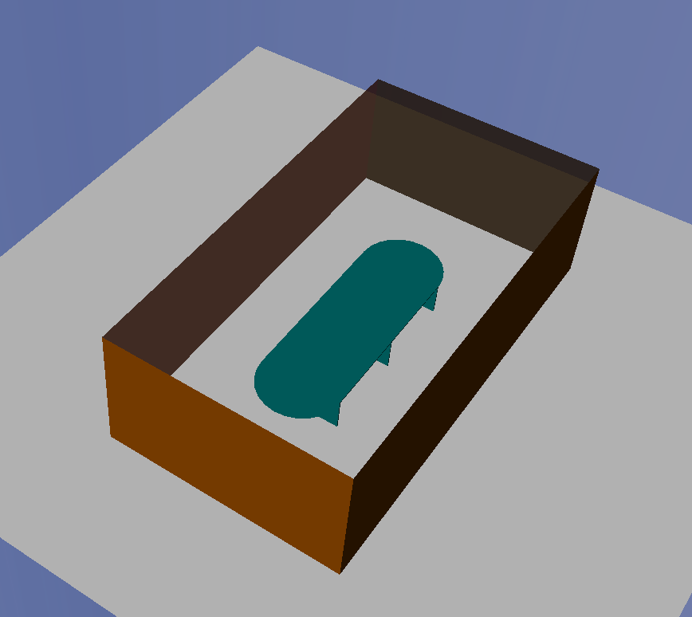

Motivation of CIR feedback
For ranging application, it focuses on how to accurately measure the round trip time between node A and node B. In practice, TOA/TDOA techniques are used to detect the first path of the received signal, and the time stamps can be used to calculate the TOA/TDOA in this application.
For sensing application, it focuses on how to accurately measure the range/angle/velocity of the reflection points. In this case, the CIR (channel impulse response) is needed to get reflection points’ information.
Node B
Reflection point1
Node B
Node A
Node A
Reflection point2
Ranging application
Sensing application

Slide 4

Motivation of CIR feedback
Full-function device
Reduced-function device
Sensing packet
CIR feedback packet
Target
Target
Device C
Responder
Device A
Responder
Device B
Initiator
Device A
Responder
Device B
Initiator
Use case1: only two nodes involved in sensing, but the capabilities of two nodes are not equal.
Use case2: multiple nodes involved in sensing, and one node responsible for computation.

Slide 5


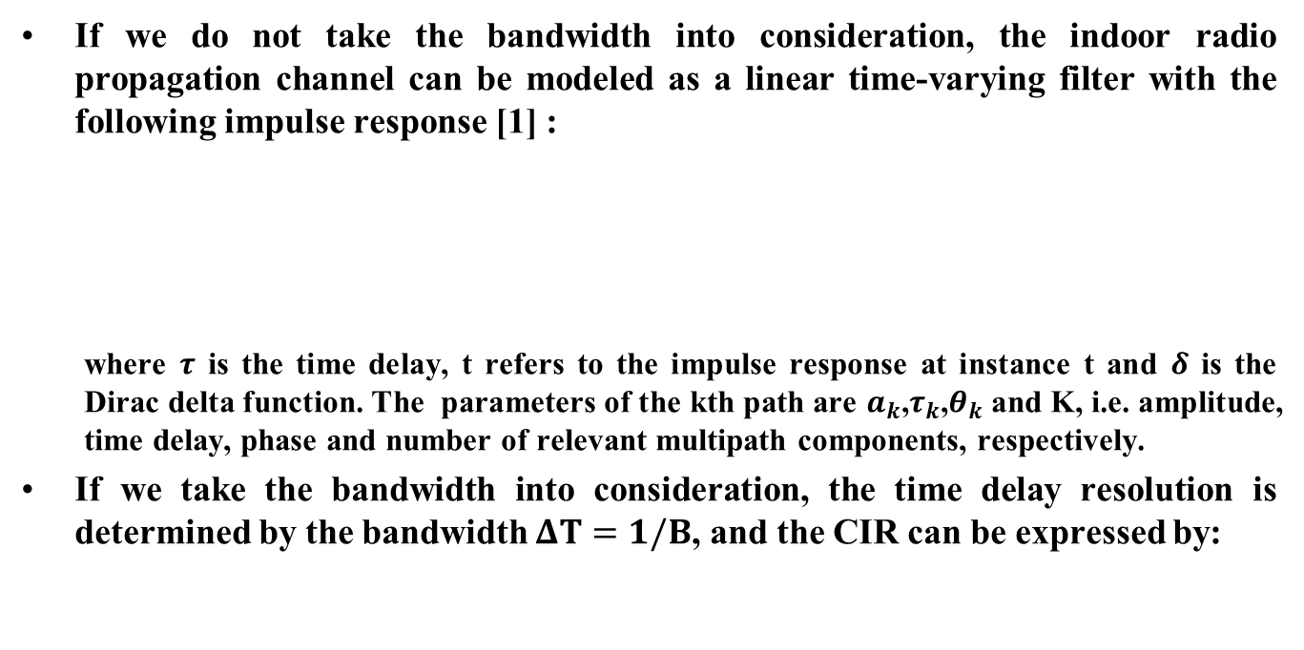










Mathematical model of CIR
If we do not take the bandwidth into consideration, the indoor radio propagation channel can be modeled as a linear time-varying filter with the following impulse response [1] :
  where $τ$ is the time delay, t refers to the impulse response at instance t and $δ$ is the Dirac delta function. The parameters of the kth path are $a_{k}$,$τ_{k}$,$θ_{k}$ and K, i.e. amplitude, time delay, phase and number of relevant multipath components, respectively.
If we take the bandwidth into consideration, the time delay resolution is determined by the bandwidth $ΔT=1/B$, and the CIR can be expressed by:
$$\left|h(τ) \right|$$
$$h\left(t,τ\right)=\sum_{k=0}^{K−1}{a_{k}\left(t\right)δ\left(τ−τ_{k}\left(t\right)\right)e^{jθ_{k}(t)}}$$
$$τ_{0}$$
$$τ_{2}$$
$$τ_{3}$$
$$τ$$
$$τ_{1}$$
$$\left|h(τ) \right|$$
$$h\left(t,τ\right)=\sum_{k=0}^{K−1}{\left[a_{k}\left(t\right)e^{jθ_{k}(t)}\int_{f_{c}−B/2}^{f_{c}+B/2}{e^{−j2πfτ_{k}(t)}df}\right]}$$
$$ΔT$$
where $f_{c}$ is the center frequency.
$$τ_{0}$$
$$τ_{2}$$
$$τ_{3}$$
$$τ$$
$$τ_{1}$$

Slide 6
Characteristics of CIR
Dynamic living room scenario [2]
A target (35cm*35cm*1m) traveling in a straight path at a speed of 1 m/s inside the static living room as illustrated below.
Object | size | material
Chair | 2.8m*1.05m*1m | wood
Chair with feet | 1.05m*1.05m*1m | wood
Table with feet | 1.5m*0.7m*0.8m | wood
Door | width=1m, height=2.5m | wood
Windows | Width=1.5m,height=1m~2.5m | glass
Wall |  | concrete
Floor |  | concrete
Frequency | 3.4944GHz
Bandwidth | 500MHz

Slide 7
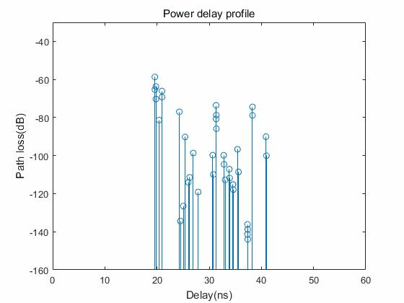
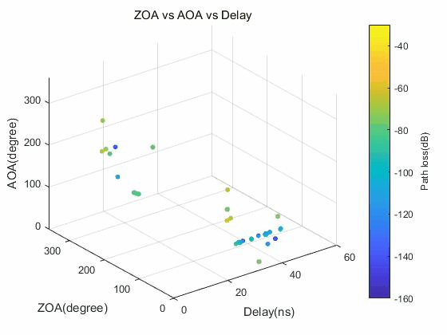
Characteristics of CIR
Main characteristics of CIR
  As the target moves in the environment,
    Parameters (pathloss, AoA, AoD, and delay) of some rays are changing continuously over time;
    Some new rays are generated, like TX→Target→RX，TX→Wall→Target→RX；
    Some rays disappeared;
Since parameters of target-related rays are changing continuously over time, so we can compress the CIR in time domain to reduce the CIR transmission overhead.

Slide 8
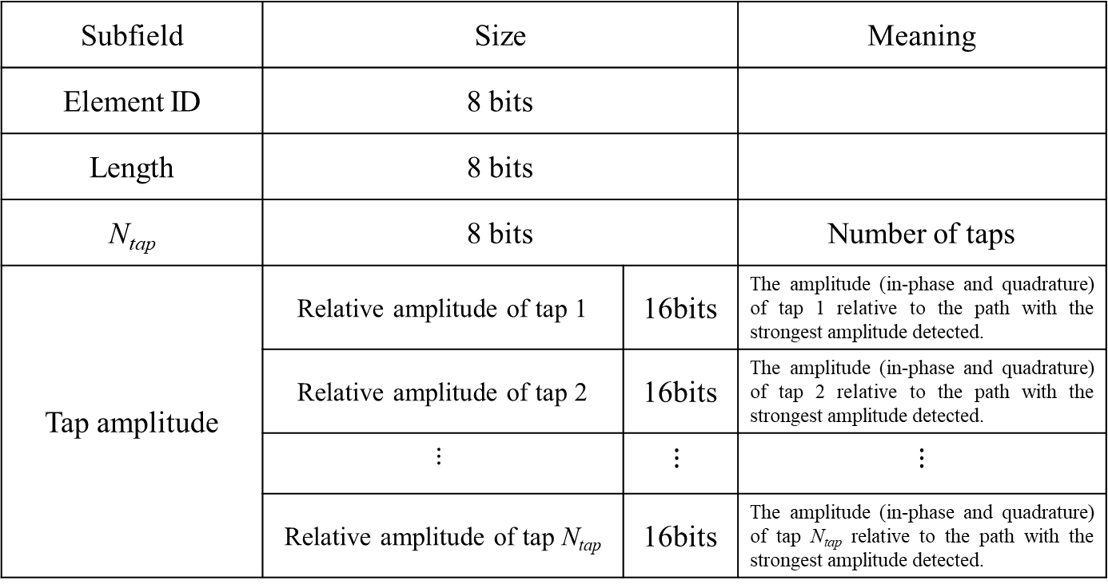
CIR parameters feedback
The CIR information is carried by the channel measurement feedback element, which includes:
Subfield | Size |  | Meaning
Element ID | 8 bits
Length | 8 bits
N_{tap} | 8 bits |  | Number of taps
Tap amplitude | Relative amplitude of tap 1 | 16bits | The amplitude (in-phase and quadrature) of tap 1 relative to the path with the strongest amplitude detected.
 | Relative amplitude of tap 2 | 16bits | The amplitude (in-phase and quadrature) of tap 2 relative to the path with the strongest amplitude detected.
 | $$⋮$$ | $$⋮$$ | $$⋮$$
 | Relative amplitude of tap N_{tap} | 16bits | The amplitude (in-phase and quadrature) of tap N_{tap} relative to the path with the strongest amplitude detected.

Slide 9
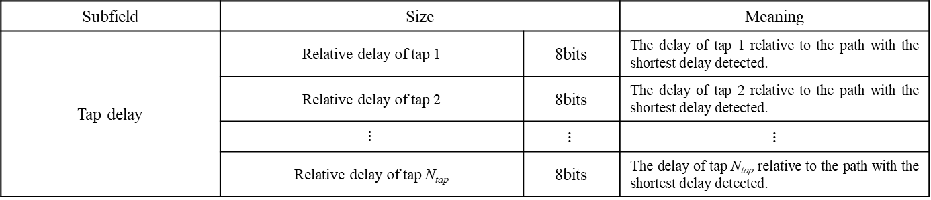
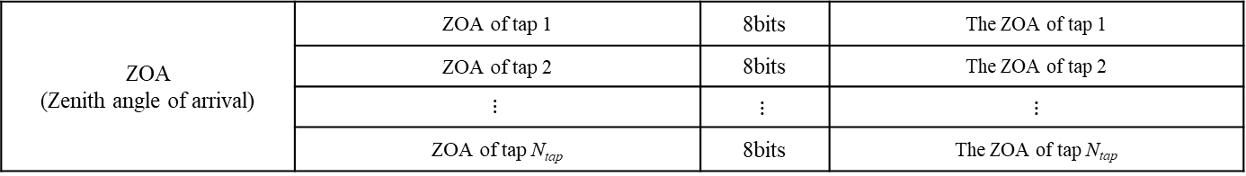
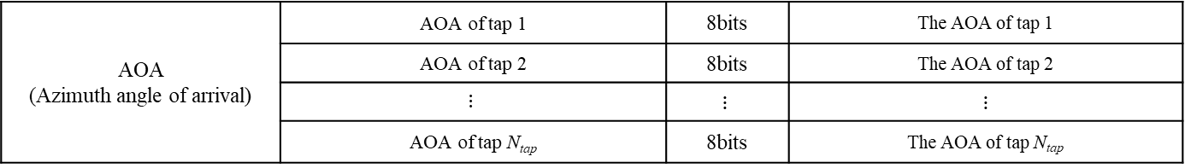
CIR parameters feedback
Subfield | Size |  | Meaning
Tap delay | Relative delay of tap 1 | 8bits | The delay of tap 1 relative to the path with the shortest delay detected.
 | Relative delay of tap 2 | 8bits | The delay of tap 2 relative to the path with the shortest delay detected.
 | $$⋮$$ | $$⋮$$ | $$⋮$$
 | Relative delay of tap N_{tap} | 8bits | The delay of tap N_{tap} relative to the path with the shortest delay detected.
AOA (Azimuth angle of arrival) | AOA of tap 1 | 8bits | The AOA of tap 1
 | AOA of tap 2 | 8bits | The AOA of tap 2
 | $$⋮$$ | $$⋮$$ | $$⋮$$
 | AOA of tap N_{tap} | 8bits | The AOA of tap N_{tap}
ZOA (Zenith angle of arrival) | ZOA of tap 1 | 8bits | The ZOA of tap 1
 | ZOA of tap 2 | 8bits | The ZOA of tap 2
 | $$⋮$$ | $$⋮$$ | $$⋮$$
 | ZOA of tap N_{tap} | 8bits | The ZOA of tap N_{tap}

Slide 10
CIR parameters feedback-use case 1
Note: In this case, device A is a full-function device, and device B is a reduced-function device.
Step 1: Device A sends a PPDU for sensing, a preamble and an optional STS field are contained in this PPDU.
Step 2: Device B receives the sensing PPDU sent by device A, and calculates the CIR via preamble or STS sequence.
Step 3: Device B feedbacks the CIR between device A and device B to device A.
Full function device A
Sensing PPDU
CIR feedback 1
Reduced function device B
Sensing PPDU
CIR feedback 1

Slide 11
CIR parameters feedback-use case 2
Note: In this case, device A is a full-function device, and device B/C can either be a full-function or reduced function device.
Step 1: Device A sends a PPDU for sensing, a preamble and an optional STS field are contained in this PPDU.
Step 2: Device B receives the sensing PPDU sent by device A, and calculates the CIR via preamble or STS sequence.
Step 3: Device B feedbacks the CIR between device A and device B to device A.
Step 4: Device C receives the sensing PPDU sent by device A, and calculates the CIR via preamble or STS sequence.
Step 5: Device C feedbacks the CIR between device B and device C to device A.
Device A
Sensing PPDU
CIR feedback 1
CIR feedback 2
Device B
Sensing PPDU
CIR feedback 1
Device C
Sensing PPDU
CIR feedback 2

Slide 12
Summary
In this presentation, some aspects of CIR feedback in UWB are introduced, we have the following observations:
  Since parameters of target-related rays are changing continuously over time, so we can compress the CIR in time domain to reduce the CIR transmission overhead.
  The CIR information is carried by the channel measurement feedback element, which includes amplitude, time delay, AOA, and ZOA.

Slide 13
References
Irahhauten Z. Ultra-wideband wireless channel: measurements, analysis and modeling[J]. 2009..
Channel modeling for WLAN Sensing indoor scenario, IEEE 802.11-20/1893r1.

