Slide 1
Project: IEEE P802.15 Working Group for Wireless Specialty Networks
Submission Title: Chanel and Environmental Models Classification for Vehicle Body Area Network (VBAN) on TG15.6a
Date Submitted: November 9th , 2021
Source: Takumi Kobayashi, Minsoo Kim, Marco Hernandez, Ryuji Kohno
Company: (1)Yokohama National University (2) YRP International Alliance Institute
Address: (1)79-5 Tokiwadai, Hodogaya-ku, Yokohama, 240-8501 Japan,
(2) YRP1 Blg., 3-4 HikarinoOka, Yokosuka-City, Kanagawa, 239-0847 Japan
Voice:[+81-90-5408-0611] E-Mail:[minsoo@minsookim.com, kobayashi-takumi-ch@ynu.ac.jp, marco.hernandez@ieee.org, kohno@ynu.ac.jp, Kohno@yrp-iai.jp]
Re: In response to call for technical contributions
Abstract: This provides draft of channel and environmental model and its classification for vehicle body area network(VBAN) of amendment of IEEE802.15.6-2012 for wireless body area network(BAN) with enhanced dependability.
Purpose: Material for discussion in P802.15.6a TG corresponding to comments in EC Meeting
Notice: This document has been prepared to assist the IEEE P802.15. It is offered as a basis for discussion and is not binding on the contributing individual(s) or organization(s). The material in this document is subject to change in form and content after further study. The contributor(s) reserve(s) the right to add, amend or withdraw material contained herein.
Release: The contributor acknowledges and accepts that this contribution becomes the property of IEEE and may be made publicly available by P802.15.

Slide 2
Chanel and Environmental Models Classification for Vehicle Body Area Network (VBAN) on TG15.6a
Takumi Kobayashi ^{(1,2)}, Marco Hernandez ⁽²⁾, Minsoo Kim ⁽²⁾, Ryuji Kohno^{(1,2)}
⁽¹⁾Yokohama National University, ⁽²⁾YRP-International Ariane Institute

Slide 3
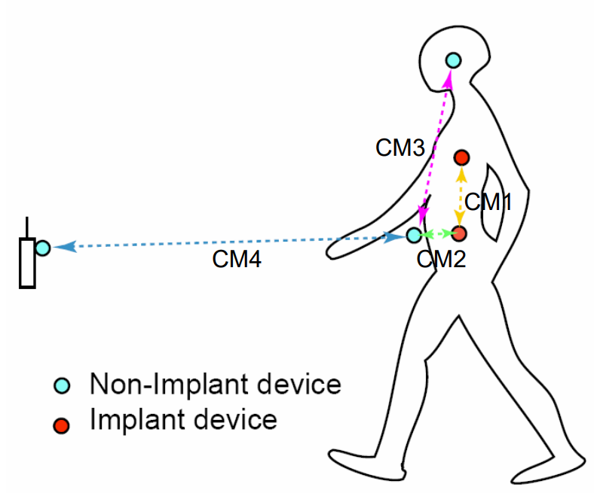
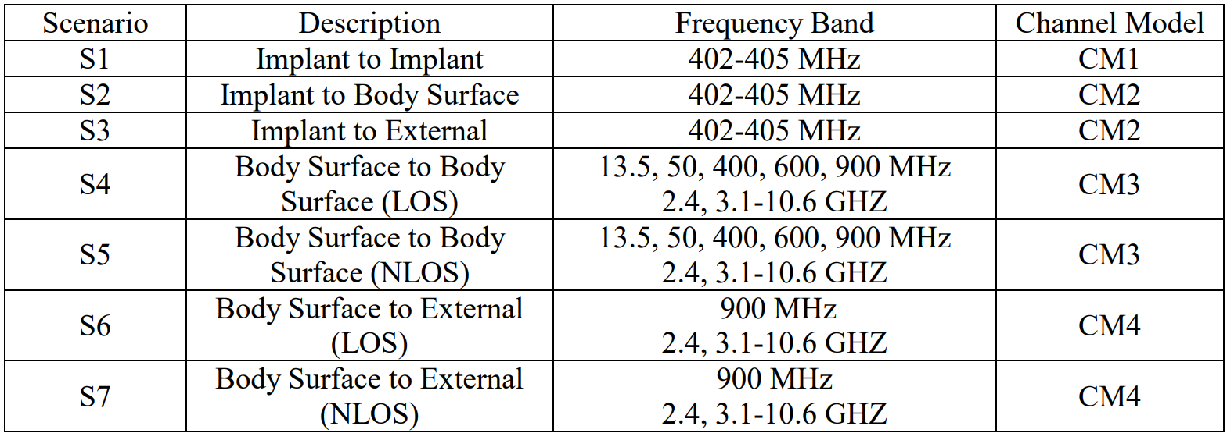
Channel models and scenarios in IEEE802.15.6-2012
IEEE P802.15-08-0780-12-0006-TG6
IEEE 802.15.6-2012 channel models considered
Fading ( Small scale/ large scale)
Path loss
Shadowing
Power delay profile
In-body (implant)
On-body (body surface)
CM1, 2, 3, 4
Scenario 1, to Scenario 7. (S1 – S7)

Slide 4
Classification of Channel and Environment Models for Human and Vehicle Body Area Networks (HBAN&VBAN)
Channel model
※Covered by IEEE 802.15.6-2012
HBAN model
In-body (Implant)
※
On-body
※
Channel model
With environment
Around body
Outdoor
※Around means;
Desk, WiFi AP in the room etc.
※not covered yet
Indoor
※
Home
Office
※
Medical (e.g. Hospital)
※
VBAN model
In-vehicle
Engine compartment
Note:
HBAN-model:
-Environment with co-existing systems is not considered.
VBAN model:
Key-less entry system
Localization in-body, on-body
Most dominant model should be defined and separatory defined as Mandatory and Optional.
Cabin
Through Engine compartment and cabin
On-vehicle
Roof
Around vehicle
Side Right/Left/Front/back
Bottom
Static vehicle
Moving vehicle

Slide 5
Current channel models in std.802.15.6
Senario | Description | Frequency band | Channel Model
S1 | Implant to Implant | 402-405 MHz | CM1
S2 | Implant to Body Surface | 402-405 MHz | CM2
S3 | Implant to External | 402-405 MHz | CM2
S4 | Body Surface to Body Surface (LOS) | 13.5, 50, 400, 600, 900 MHz 2.4, 3.1-10.6 GHZ | CM3
S5 | Body Surface to Body Surface (NLOS) | 13.5, 50, 400, 600, 900 MHz 2.4, 3.1-10.6 GHZ | CM3
S6 | Body Surface to External (LOS) | 900 MHz 2.4, 3.1-10.6 GHZ | CM4
S7 | Body Surface to External (NLOS) | 900 MHz 2.4, 3.1-10.6 GHZ | CM4

Slide 6
Adapt current classifications into this amendment
Scenario | Vehicle BAN description | Frequency band
VS1 | In-vehicle to In-vehicle | UWB band
VS2 | In-vehicle to On-vehicle | UWB band
VS3 | In-vehicle to Around | UWB band
VS4 | On-vehicle to On-vehicle (LOS) | UWB band
VS5 | On-vehicle to On-vehicle Surface (NLOS) | UWB band
VS6 | On-vehicle to On-vehicle to Around vehicle (LOS) | UWB band
VS7 | On-vehicle to Around vehicle (NLOS) | UWB band

Slide 7
Channel and Environmental models between VBAN and HBAN
On-vehicle to On vehicle(LOS)
On-vehicle to On Body
On-body to On-body
In-Vehicle to On-body

Slide 8
UWB and vehicle channel models
 | Model type | feature | reference
IEEE 802.15.4a | Modified S-V model | Normal model and BAN model is defined separately. BAN is HBAN. | “IEEE 802.15.4a channel model – final report”
IEEE 802.15.6 | Impulse response, Tapped Delay Line, path loos and shadowing and S-V model | Small scale fading, large scale fading for HBAN Probabilistic modeling and stochastic modeling, cluttering | “TG6 Channel Model,” IEEE P802.15-08-0780-12-0006
IEEE 802.15.6a | Same as IEEE 802.15.6 | Same for VBAN, HBAN & VBAN. Effect of EMC and EMI | We introduce more multi paths implemented on clutter
IEEE 802.11p | tapped delay line | VTV (vehicle-to-vehicle) , RTV(roadside-to-vehicle) in Expressway, Urban Canyon etc. | doc.: IEEE 802.11-2006/1724r1
(IEEE 802.15.3a) team considered… | Poisson model Δ-K model S-V model |  | P802.15-02/279r0-SG3a, and “The Simulation and Analysis of UWB Modified S-V Channel Model”,2009
S-V model: Adel A. M. Saleh and Reinaldo A. Valenzuela, “A Statistical Model for Indoor Multipath Propagation,” IEEE J-SAC Vol. SAC-5, No.2, Feb. 1987.

Slide 9
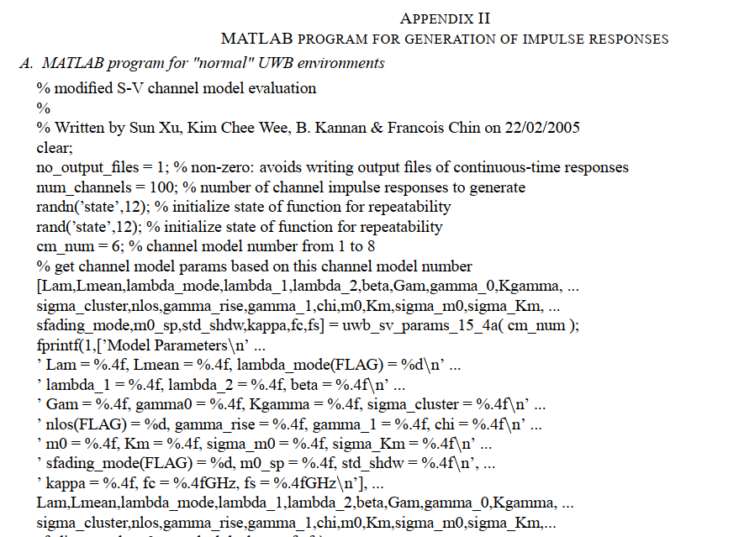
Simulation based on IEEE802.15.4a document
“IEEE 802.15.4a channel model – final report” includes several sample codes for MATLAB.
IEEE 802.15.4a channel model – final report

Slide 10
Channel model parameter sets of IEEE802.15.4a
Frequency | Environments | note
2 – 10 GHz | Residential environments
 | Indoor office environment
 | Outdoor environment
 | Open outdoor environments
 | Industrial environments
100 – 1000 MHz | Indoor, office-like environments
2 – 6 GHz | For HBAN. Closed by human body | Near-field analysis
Designed for UWB
The model treats only radio channel, while antenna effect is modeled separately.
modified Saleh-Valenzuela model

Slide 11
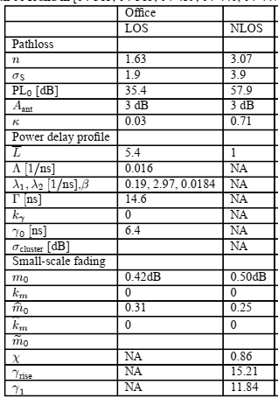
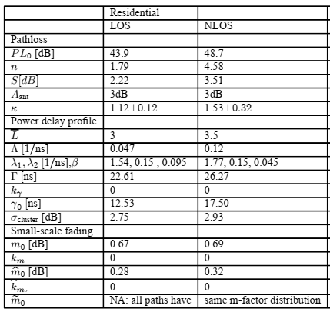
IEEE 802.15.4a parameter sets
office model parameters
Residential model parameters

Slide 12
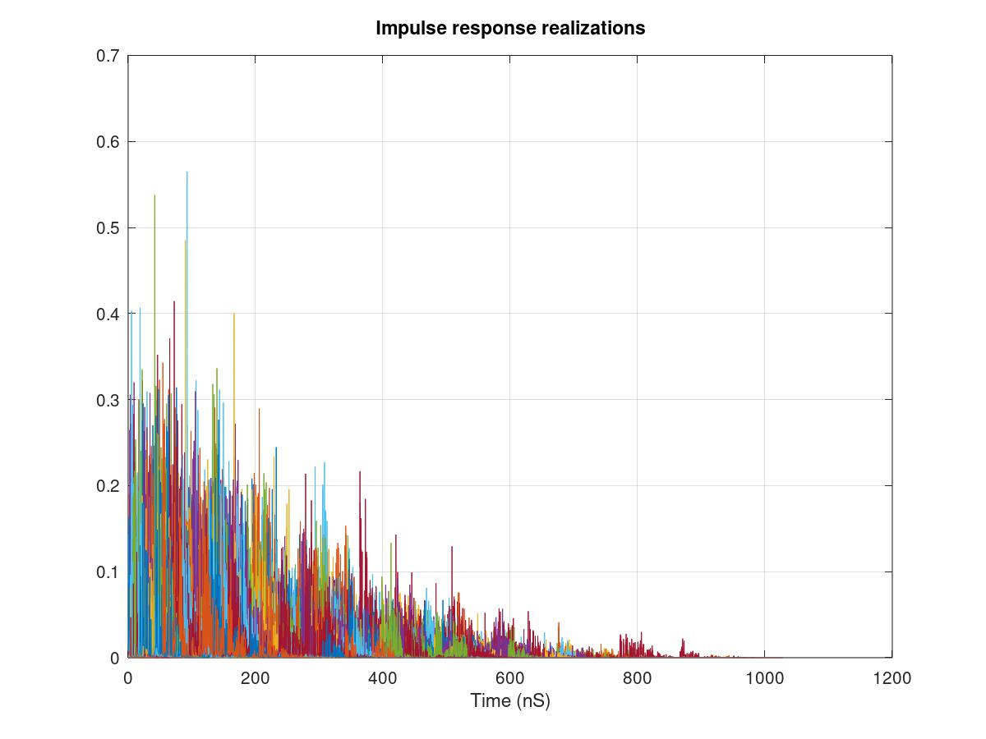
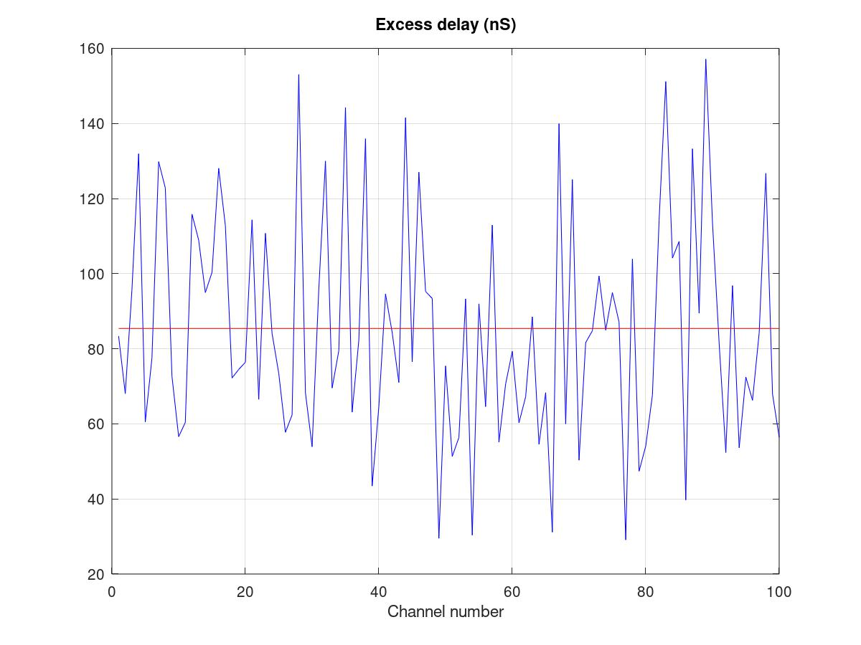
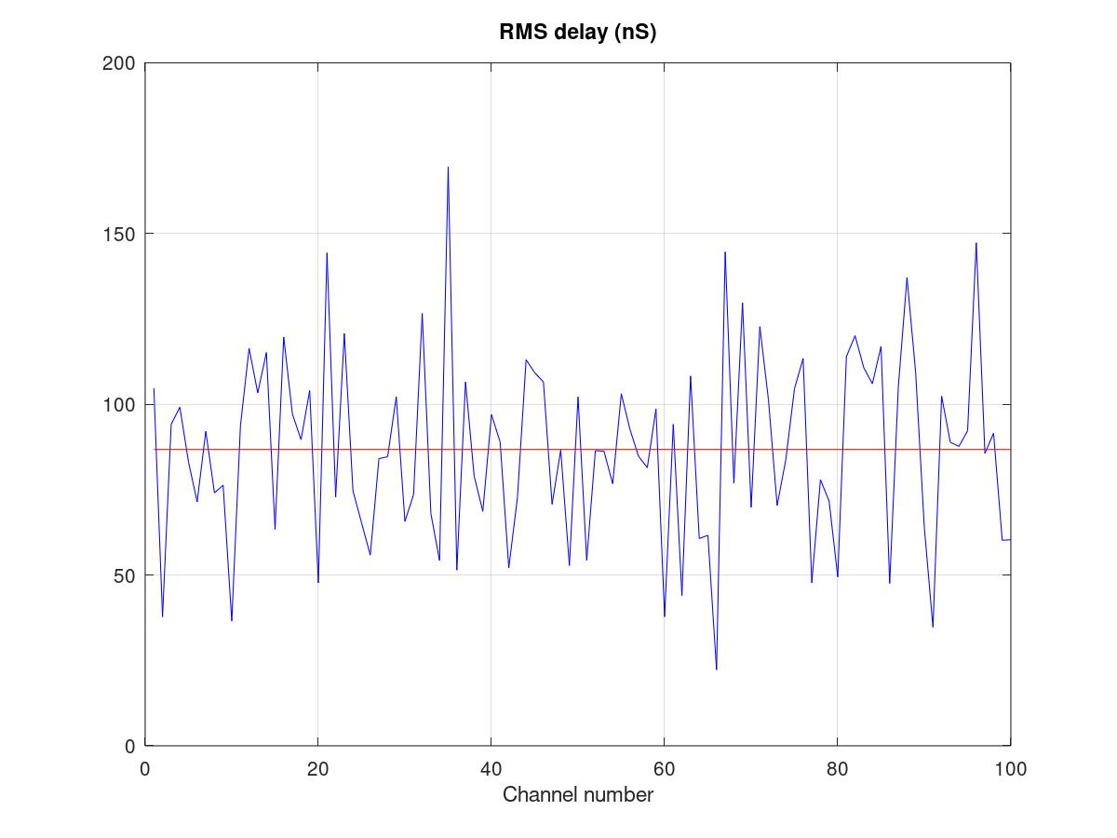
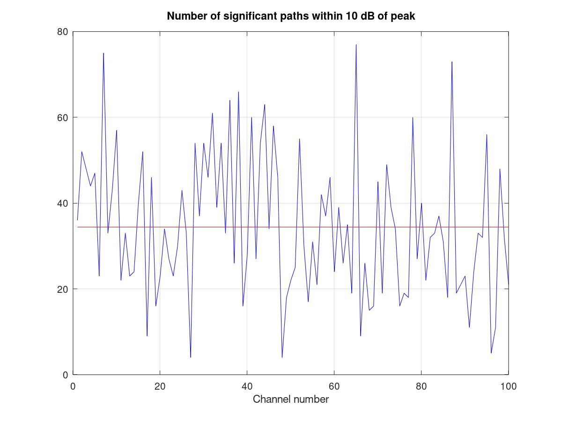
Simulation results (1/2)
Impulse response realizations
Excess delay (ns)
RMS delay (ns)
Number of significant oaths within 10dB of peak

Slide 13
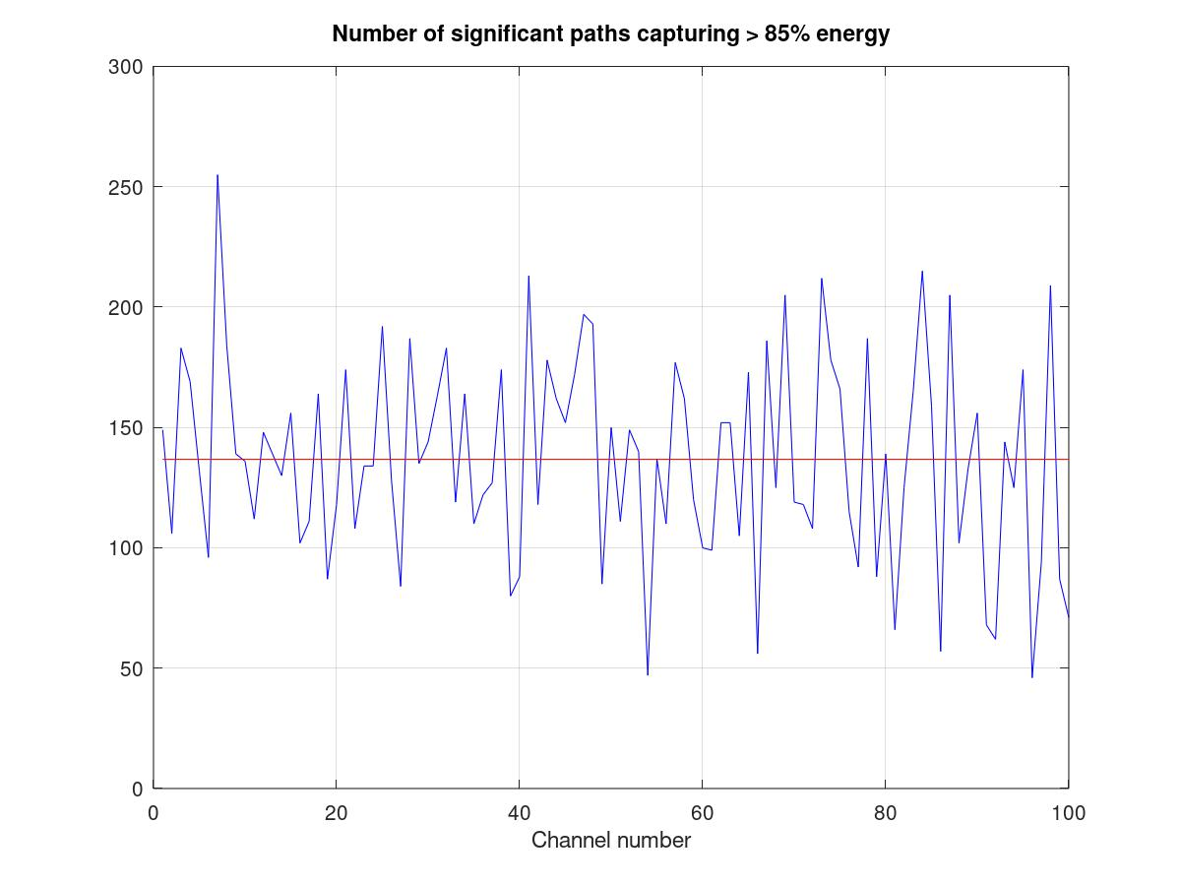
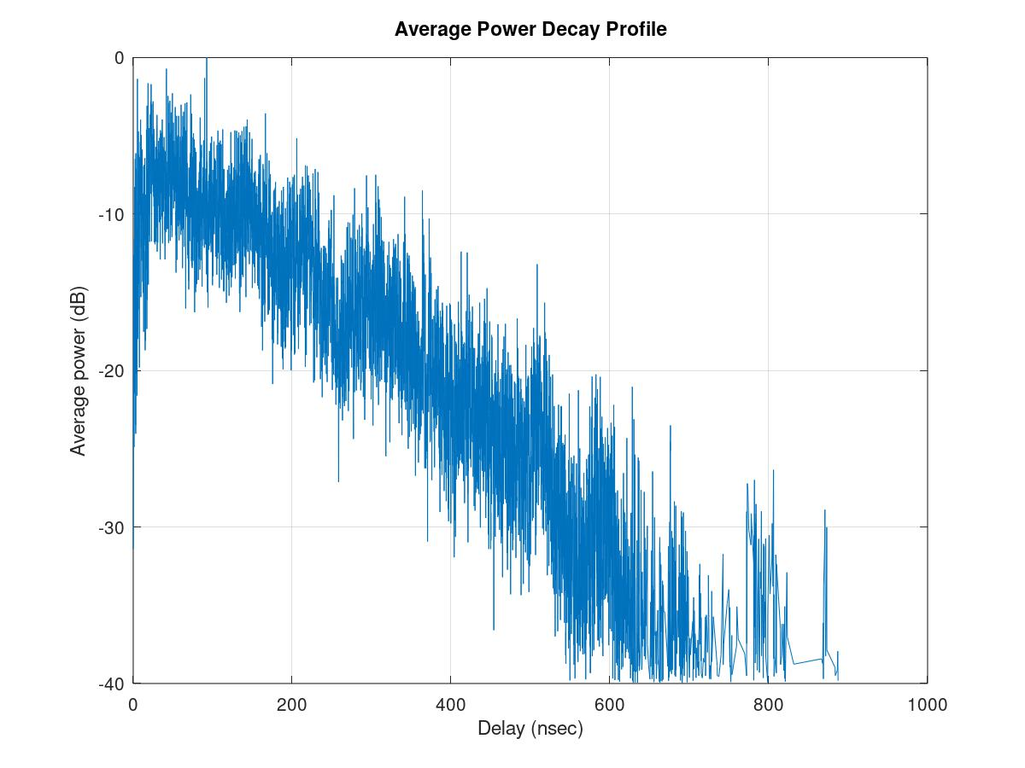
Simulation results (2/2)
Number of significant paths capturing > 85% energy
Average power decay profile

Slide 14
Environmental model
EMI from vehicle system
Colored noise
EV Switching noise
Ignition noise
etc…
Standard antenna
Standard antenna
Channel model
Propagation Model （based on S-V Model）
RF
ANT
+
ANT
RF
Distance dependent function
Interference from the other Wireless systems
Interference from the other BAN
Interference from the other UWB (not BAN)
Distance dependent function
We propose to define environmental models including antenna effect. Parameter measurements will be performed by using standard antennas which will be defined separately.

Slide 15
Symmetric scenario
In channel model (without EMC/EMI and Interference issues), two direction of propagation should be considered as equal:
Channel reciprocity.
Coordinator
Node
Coordinator
Node
Channel models of “Coordinator to node” and “Node to coordinator” without noise source should be the same.
Asymmetric scenario
Noise and/or interference source
In case of environmental model including EMC/EMI . colored noise and interference issues, two direction between source and sink is not same meaning.
Coordinator
Node
Environmental model of two different direction should be defined separately.
Coordinator
Node
Environmental models of “Coordinator to node” and “Node to coordinator” should be different.

Slide 16
Use cases
Failure and/or deterioration detection of vehicle components.
- Nodes are in engine compartment / coordinator is in engine compartment
Sensing for safety driving support / Collision avoidance
- Nodes are on outside surface of vehicle / coordinator is in engine compartment
Entertainment for passengers
- Nodes are in cabin / coordinator is in cabin.
Key-less entry system - Node is around user outside of vehicle / coordinator is in engine compartment
Communication between user on pedestrian and vehicle
- Node is around user outside of vehicle / coordinator is on outside surface of vehicle (vehicle moves at walking speed (<5km/h))
Vehicle controlling / Wireless herness
- Coordinator and nodes are in between cabin and chassis of vehicle.
Driver’s health problem detection
- Coordinator in engine compartment / nodes are on human (driver) body.
Driver’s and passenger’s healthcare application
- Nodes and coordinator are on human body.

Slide 17
Use cases
 | Use case | Coordinator | Node | Symmetric channel | EMI / EMC consideration necessity | note
1 | Failure and/or deterioration detection of vehicle components | Engine compartment | Engine compartment |  | Yes
2 | Sensing for safety driving support / Collision avoidance | outside surface of vehicle | Engine compartment | No | Yes
3 | Entertainment for passengers | Cabin | Cabin
4 | Key-less entry system | around user outside of vehicle | Engine compartment | No | Yes
5 | Communication between user on pedestrian and vehicle | outside surface of vehicle | around user outside of vehicle | No | Yes | <5km/h
6 | Vehicle controlling / Wireless herness | between cabin and chassis of vehicle | between cabin and chassis of vehicle | No | Yes
7 | Driver’s health problem detection | Engine compartment | On human body | No | Yes
8 | Driver’s and passenger’s healthcare application | on human body | on human body

Slide 18
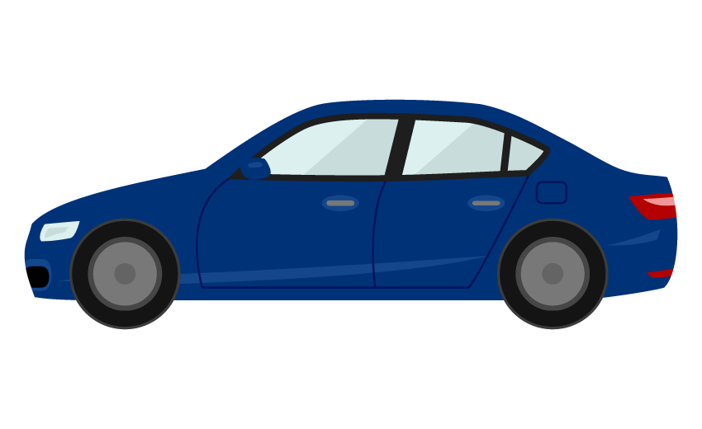
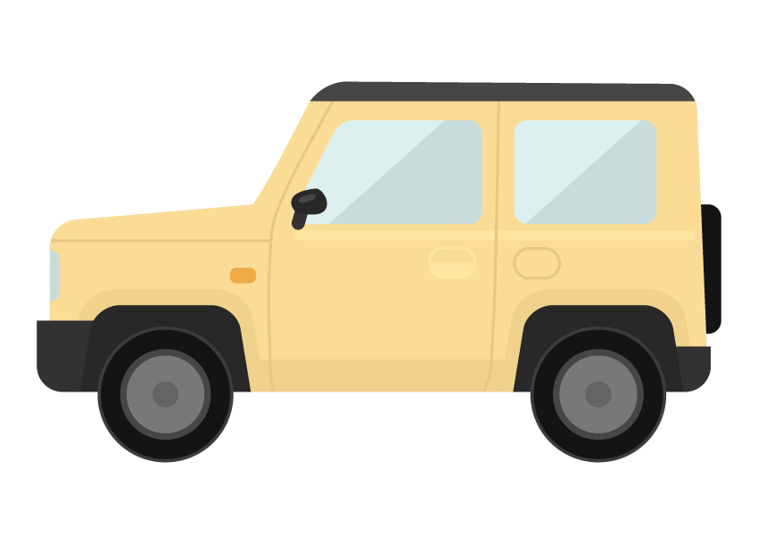
Use cases
 | Use case | Sedan/RV / SUV with combustion internal engine | Sedan/RV / SUV EV | us | Cargo / pickup | Special purpose
1 | Failure and/or deterioration detection of vehicle components | Case 1.1 | Case 1.2 | Case 1.3 |  | Case 1.5
2 | Sensing for safety driving support / Collision avoidance | Case 2.1 | Case 2.2 | Case 2.3 |  | Case 2.5
3 | Entertainment for passengers | Case 3.1 |  | Case 3.3 | Same as 3.1 | ---
4 | Key-less entry system | Case 4.1 | Case 4.2 | Case 4.3 |  | ---
5 | Communication between user on pedestrian and vehicle | Case 5.1 |  | Case 5.3 |  | ---
6 | Vehicle controlling / Wireless herness | Case 6.1 |  | Case 6.3 |  | Case 6.5
7 | Driver’s health problem detection | Case 7.1 |  | Case 7.3 |  | Case 7.5
8 | Driver’s and passenger’s healthcare application | IEEE 802.15.6 – 2012 Channel models can be applied

Slide 19
Use cases
Coordinator to node : C-N
Node to coordinator : N-C
For asymmetric environments
 | Use case | Sedan/RV / SUV with combustion internal engine | Sedan/RV / SUV EV | Bus | Cargo / pickup | Special purpose
1 | Failure and/or deterioration detection of vehicle components | Case 1.1 | Case 1.2 | Case 1.3 |  | Case 1.5
2 | Sensing for safety driving support / Collision avoidance | Case 2.1 C-N | Case 2.2 C-N | Case 2.3 C-N |  | Case 2.5 C-N
 |  | Case 2.1 N-C | Case 2.2 N-C | Case 2.3 N-C |  | Case 2.5 N-C
3 | Entertainment for passengers | Case 3.1 |  | Case 3.3 | Same as 3.1 | ---
4 | Key-less entry system | Case 4.1 C-N | Case 4.2 C-N | Case 4.3 C-N |  | ---
 |  | Case 4.1 N-C | Case 4.2 N-C | Case 4.3 N-C |  | ---
5 | Communication between user on pedestrian and vehicle | Case 5.1 C-N |  | Case 5.3 C-N |  | ---
 |  | Case 5.1 N-C |  | Case 5.3 N-C |  | ---
6 | Vehicle controlling / Wireless herness | Case 6.1 C-N |  | Case 6.3 C-N |  | Case 6.5 C-N
 |  | Case 6.1 N-C |  | Case 6.3 N-C |  | Case 6.5 N-C
7 | Driver’s health problem detection | Case 7.1 C-N |  | Case 7.3 C-N |  | Case 7.5 C-N
 |  | Case 7.1 N-C |  | Case 7.3 N-C |  | Case 7.5 N-C
8 | Driver’s and passenger’s healthcare application | IEEE 802.15.6 – 2012 Channel models can be applied

Slide 20
Scenario 1
Geometrical configuration
Engine compartment to Engine compartment
Coordinator and node
Noise source
Use case 1
Failure and/or deterioration detection of vehicle components.
Nodes are in Engine compartment / coordinator is in Engine compartment
Symmetric environmental model
 | Use case | Sedan/RV / SUV with engine | Sedan/RV / SUV without engine | Bus | Cargo / pickup | Special purpose
1 | Failure and/or deterioration detection of vehicle components | Case 1.1 | Case 1.2 | Case 1.3 |  | Case 1.5

Slide 21
Scenario 2
Geometrical configuration
Nodes on outside surface of vehicle / coordinator is in Engine compartment
Coordinator and node
Noise source
Use case 2
Sensing for safety driving support / Collision avoidance
Nodes are on outside surface of vehicle / coordinator is in Engine compartment
Asymmetric environment. Two direction model should be defined separatory.
 | Use case | Sedan/RV / SUV with engine | Sedan/RV / SUV without engine | Bus | Cargo / pickup | Special purpose
2 | Sensing for safety driving support / Collision avoidance | Case 2.1 C-N | Case 2.2 C-N | Case 2.3 C-N |  | Case 2.5 C-N
 |  | Case 2.1 N-C | Case 2.2 N-C | Case 2.3 N-C |  | Case 2.5 N-C

Slide 22
Scenario 3
Geometrical configuration
Nodes and coordinator are in cabin room
Coordinator and node
Noise source
Use case 3
Entertainment for passengers
Nodes are in cabin room / coordinator is in cabin room.
Symmetric environmental model
EMI from engine and electric system are negligible. => channel model
 | Use case | Sedan/RV / SUV with engine | Sedan/RV / SUV without engine | Bus | Cargo / pickup | Special purpose
3 | Entertainment for passengers | Case 3.1 |  | Case 3.3 | Same as 3.1 | ---

Slide 23
Scenario 3 for BUS
Geometrical configuration
Nodes and coordinator are in cabin room
Coordinator and nodes
Noise source
coordinator
Use case 3
Entertainment for passengers
Nodes are in cabin room / coordinator is in cabin room.
Symmetric environmental model
EMI from engine and electric system are negligible. => channel model
 | Use case | Sedan/RV / SUV with engine | Sedan/RV / SUV without engine | Bus | Cargo / pickup | Special purpose
3 | Entertainment for passengers | Case 3.1 |  | Case 3.3 | Same as 3.1 | ---

Slide 24
Scenario 4
Geometrical configuration
Engine compartment / body surface (outside)
Coordinator and node
Noise source
Use case 4
Key-less entry system
Node is around user outside of vehicle / coordinator is in Engine compartment
Asymmetric environment. Two direction model should be defined separatory.
 | Use case | Sedan/RV / SUV with engine | Sedan/RV / SUV without engine | Bus | Cargo / pickup | Special purpose
4 | Key-less entry system | Case 4.1 C-N | Case 4.2 C-N | Case 4.3 C-N |  | ---
 |  | Case 4.1 N-C | Case 4.2 N-C | Case 4.3 N-C |  | ---

Slide 25
Scenario 5
Geometrical configuration
Outside surface of vehicle / coordinator is in Engine compartment
Coordinator and node
Noise source
Moving at walking speed (<5km/h)
Use case 5
Communication between user on pedestrian and vehicle
Node is around user outside of vehicle / coordinator is on outside surface of vehicle (vehicle moves in walking speed (<5km/h))
Asymmetric environmental model
 | Use case | Sedan/RV / SUV with engine | Sedan/RV / SUV without engine | Bus | Cargo / pickup | Special purpose
5 | Communication between user on pedestrian and vehicle | Case 5.1 C-N |  | Case 5.3 C-N |  | ---
 |  | Case 5.1 N-C |  | Case 5.3 N-C |  | ---

Slide 26
Scenario 6
Geometrical configuration
Coordinator and nodes are in between cabin and chassis of vehicle
Coordinator and node
Noise source
Use case 2
Vehicle controlling / Wireless herness
Coordinator and nodes are in between cabin and chassis of vehicle.
Asymmetric environmental model
 | Use case | Sedan/RV / SUV with engine | Sedan/RV / SUV without engine | Bus | Cargo / pickup | Special purpose
6 | Vehicle controlling / Wireless herness | Case 6.1 C-N |  | Case 6.3 C-N |  | Case 6.5 C-N
 |  | Case 6.1 N-C |  | Case 6.3 N-C |  | Case 6.5 N-C

Slide 27
Scenario 7
Geometrical configuration
Coordinator in in Engine compartment / nodes are on human (driver) body
Coordinator and node
Noise source
Use case 7
Driver’s health problem detection
Coordinator in in Engine compartment / nodes are on human (driver) body.
Symmetric environmental model
 | Use case | Sedan/RV / SUV with engine | Sedan/RV / SUV without engine | Bus | Cargo / pickup | Special purpose
7 | Driver’s health problem detection | Case 7.1 |  | Case 7.3 |  | Case 7.5

Slide 28
Scenario 8
Geometrical configuration
Body surface to body surface for single person
This scenario should be analyzed based on current IEEE802.15.6 channel model (HBAN)
Use case 8
Driver’s and passenger’s healthcare application
Nodes and coordinator are on human body.
Symmetric environmental model
 | Use case | Sedan/RV / SUV with engine | Sedan/RV / SUV without engine | Bus | Cargo / pickup | Special purpose
8 | Driver’s and passenger’s healthcare application | IEEE 802.15.6 – 2012 Channel models can be applied

Slide 29
Other scenarios
Geometrical configuration
Engine compartment to cabin room
Coordinator and node
Noise source
cabin room to body surface
Coordinator and node
Noise source

Slide 30
Other scenarios
Geometrical configuration
body surface to body surface (in cabin)
Coordinator and node
Noise source
Vehicle body surface to vehicle body surface
Coordinator and node
Noise source
LOS
NLOS

Slide 31
Other scenarios
Geometrical configuration
cabin room to body surface (outside)
Coordinator and node
Noise source

Slide 32
Scenarios out of scope
Body surface to body surface for single person
This scenario should be analyzed based on current IEEE802.15.6 channel model (HBAN)
Vehicle to vehicle
V2V application is out of scope of this amendment.

Slide 33
Use cases
 | Use case | Sedan/RV / SUV with combustion internal engine | Sedan/RV / SUV EV | Bus | Cargo / pickup | Special purpose
1 | Failure and/or deterioration detection of vehicle components | Case 1.1 | Case 1.2 | Case 1.3 |  | Case 1.5
2 | Sensing for safety driving support / Collision avoidance | Case 2.1 C-N | Case 2.2 C-N | Case 2.3 C-N |  | Case 2.5 C-N
 |  | Case 2.1 N-C | Case 2.2 N-C | Case 2.3 N-C |  | Case 2.5 N-C
3 | Entertainment for passengers | Case 3.1 |  | Case 3.3 | Same as 3.1 | ---
4 | Key-less entry system | Case 4.1 C-N | Case 4.2 C-N | Case 4.3 C-N |  | ---
 |  | Case 4.1 N-C | Case 4.2 N-C | Case 4.3 N-C |  | ---
5 | Communication between user on pedestrian and vehicle | Case 5.1 C-N |  | Case 5.3 C-N |  | ---
 |  | Case 5.1 N-C |  | Case 5.3 N-C |  | ---
6 | Vehicle controlling / Wireless herness | Case 6.1 C-N |  | Case 6.3 C-N |  | Case 6.5 C-N
 |  | Case 6.1 N-C |  | Case 6.3 N-C |  | Case 6.5 N-C
7 | Driver’s health problem detection | Case 7.1 C-N |  | Case 7.3 C-N |  | Case 7.5 C-N
 |  | Case 7.1 N-C |  | Case 7.3 N-C |  | Case 7.5 N-C
8 | Driver’s and passenger’s healthcare application | IEEE 802.15.6 – 2012 Channel models can be applied

Slide 34
Channel and environmental model proposal (1/2)
Scenario | model | description
1 | 1.1 | Coordinator and nodes are in Engine compartment. Consider EMC/EMI from vehicle components. (with engine)
 | 1.2 | Coordinator and nodes are in Engine compartment. Consider EMC/EMI from vehicle components. (without engine)
2 | 2.1 C-N | Engine compartment to outside surface of vehicle environment. Consider EMC/EMI from vehicle components. (with engine)
 | 2.1 N-C | Outside surface of vehicle to Engine compartment environment. Consider EMC/EMI from vehicle components. (with engine)
 | 2.2 C-N | Engine compartment to outside surface of vehicle environment. Consider EMC/EMI from vehicle components. (w/o engine)
 | 2.2 N-C | Outside surface of vehicle to Engine compartment environment. Consider EMC/EMI from vehicle components. (w/o engine)
3 | 3.1 | Coordinator and nodes are in cabin room. Model for sedan, SUV or RV vehicle.
 | 3.3 | Coordinator and nodes are in cabin room. Model for BUS.

Slide 35
Channel and environmental model proposal (2/2)
Scenario | model | description
4 | 4.1 C-N | Around user outside of vehicle to Engine compartment. Consider EMC/EMI from vehicle components. (with engine)
 | 4.1 N-C | Engine compartment to around user outside of vehicle. Consider EMC/EMI from vehicle components. (with engine)
 | 4.2 C-N | Around user outside of vehicle to Engine compartment. Consider EMC/EMI from vehicle components. (w/o engine)
 | 4.2 N-C | Engine compartment to around user outside of vehicle. Consider EMC/EMI from vehicle components. (w/o engine)
5 | 5.1 C-N | Outside surface of vehicle to around user outside of vehicle. (vehicle moves in walking speed (<5km/h))
 | 5.1 N-C | Around user outside of vehicle to outside surface of vehicle. (vehicle moves in walking speed (<5km/h))
6 | 6.1 C-N | Engine compartment to distributed devices in chassis. Consider EMC/EMI from vehicle components
 | 6.1 N-C | Distributed devices in chassis to Engine compartment. Consider EMC/EMI from vehicle components
7 | 7.3 | Human (driver) body to Engine compartment. Consider EMC/EMI from vehicle components

Slide 36
Summary
Propose to re-use IEEE 802.15.6a channel model methodology as modified Saleh-Valenzuela model.
Specific parameter sets should be defined based on measurements.
IEEE 802.15.6 (2021)Channel model will be continued to be adopted to HBAN.
In some case, environmental model needs to be defined by two separate models corresponding to two direction.
We shall suggest to define 8 scenarios and 17 models including models for passenger vehicle (sedan, SUV and RV), bus, cargo (VAN, pickup) and special purpose vehicles with and without engine including effect of EMC/EMI issues.
In order to simplify, we need to choose some mandatory models as dominant cases based on discussion and consensus.

