Slide 1
Project: IEEE P802.15 Working Group for Wireless Personal Area Networks (WPANs)
Submission Title: [TG4aa JRE November Plenary2021 Virtual meeting Opening report]
Date Submitted: [08th November,2021]
Source: [Takashi Kuramochi] Company [LAPIS TECHNOLOGY]
Address [2-4-8 Shinyokohama,Kouhoku-ku,Yokohama 222-8575 Japan]
Voice:[+81-45-476-9295], FAX: [], E-Mail:[kuramochi722@lapis-tech.com]
Re: [] Abstract: [This document contains opening information and meeting agenda for the TG4aa JRE November PlenaryTeleconference,2021] Purpose: [information]
Notice: This document has been prepared to assist the IEEE P802.15. It is offered as a basis for discussion and is not binding on the contributing individual(s) or organization(s). The material in this document is subject to change in form and content after further study. The contributor(s) reserve(s) the right to add, amend or withdraw material contained herein.
Release: The contributor acknowledges and accepts that this contribution becomes the property of IEEE and may be made publicly available by P802.15.

Slide 2
IEEE 802.15 TG4aa JRE November Plenary Virtual Meeting Opening report on November 9th/15th,2021

Slide 3
Administrative Items
Required notices
Affiliation FAQ - http://standards.ieee.org/faqs/affiliationFAQ.html
Anti-Trust FAQ - http://standards.ieee.org/resources/antitrust-guidelines.pdf
Ethics - http://www.ieee.org/portal/cms_docs/about/CoE_poster.pdf
Chair/Vice-Chair/Secretary/Technical Editor
Chair :Takashi Kuramochi(LAPIS)
Vice-Chair : Hiroshi Harada(Kyoto University)
Vice-Chair: Kunal Shah(ITRON)
Secretary : Kiyoshi Fukui(OKI)
Technical Editor : Kiyoshi Fukui(OKI)

Slide 4
Participants have a duty to inform the IEEE
Participants shall inform the IEEE (or cause the IEEE to be informed) of the identity of each holder of any potential Essential Patent Claims of which they are personally aware if the claims are owned or controlled by the participant or the entity the participant is from, employed by, or otherwise represents
Participants should inform the IEEE (or cause the IEEE to be informed) of the identity of any other holders of potential Essential Patent Claims
Early identification of holders of potential Essential Patent Claims is encouraged

Slide 5
Ways to inform IEEE
Cause an LOA to be submitted to the IEEE-SA (patcom@ieee.org); or
Provide the chair of this group with the identity of the holder(s) of any and all such claims as soon as possible; or
Speak up now and respond to this Call for Potentially Essential Patents
If anyone in this meeting is personally aware of the holder of any patent claims that are potentially essential to implementation of the proposed standard(s) under consideration by this group and that are not already the subject of an Accepted Letter of Assurance, please respond at this time by providing relevant information to the WG Chair

Slide 6
Other guidelines for IEEE WG meetings
All IEEE-SA standards meetings shall be conducted in compliance with all applicable laws, including antitrust and competition laws.
Don’t discuss the interpretation, validity, or essentiality of patents/patent claims.
Don’t discuss specific license rates, terms, or conditions.
Relative costs of different technical approaches that include relative costs of patent licensing terms may be discussed in standards development meetings.
Technical considerations remain the primary focus
Don’t discuss or engage in the fixing of product prices, allocation of customers, or division of sales markets.
Don’t discuss the status or substance of ongoing or threatened litigation.
Don’t be silent if inappropriate topics are discussed … do formally object.
---------------------------------------------------------------
For more details, see IEEE-SA Standards Board Operations Manual, clause 5.3.10 and Antitrust and Competition Policy: What You Need to Know at http://standards.ieee.org/develop/policies/antitrust.pdf

Slide 7
Patent-related information
The patent policy and the procedures used to execute that policy are documented in the:
IEEE-SA Standards Board Bylaws
https://standards.ieee.org/about/policies/bylaws/sect6-7.html#6
IEEE-SA Standards Board Operations Manual
https://standards.ieee.org/about/policies/bylaws/sect6-7.html#6.3
Material about the patent policy is available at
http://standards.ieee.org/about/sasb/patcom/materials.html
If you have questions, contact the IEEE-SA Standards Board Patent Committee Administrator at patcom@ieee.org

Slide 8
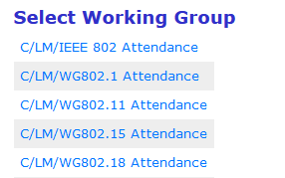
Attendance
Visit “https://imat.ieee.org” and click “802 Plenary Session” and click “C/LM/WG802.15 Attendance” shown below.
Register
Indicate attendance
Please click yellow bar on the attendance sheet.
the collar bar will be changed to green.
Important Note: Attendance will be counted session based. Each session gives you 6% of attendance.
In order to get voting right, you need to get at least 12 sessions.

Slide 9
TG4aa JRE sessions in November Plenary
 | Monday 8th November | Tuesday 9th November | Wednesday 10th November | Thursday 11th November | Friday 12th November
AM1 |  | Opening
AM2
PM1
PM2
EV1 |  | TG4aa-JRE
 | Monday 15th November | Tuesday 16th 8th November | Wednesday 17th November | Thursday 18th November | Friday 19th November
AM1 |  |  | Closing
AM2
PM1
PM2
EV1 | TG4aa-JRE (Cancelled)

Slide 10
Proposed agenda for TG4aa meetings
Target: TG Motion for Revcom Submission
Session1:
SA Ballot results
Next Steps(Revcom Submission)
Session2:
AOB

Slide 11
Agenda items for the weeks
15th Monday EV1(17:00-19:00)
Cancelled
9th Tuesday EV1(17:00-19:00)
OPEN/Patent Policy
Attendance
Approval of the Agenda
Approval of the last meeting minutes
SA ballot results
Next steps
TG Motions for Revcom Submission
Plan for January Interim(# of sessions)
Any other business
Attendance recap
Adjourn TG4aa JRE
Approval of the Agenda
Moved: Hiroshi Harada(Kyoto University)
Second: Phil Beecher(Wi-SUN Alliance)
There is no discussion or objections.
Agenda is approved unanimous consent.

Slide 12
Approval of the last meeting minutes [September Interim] July 16/20th : 15-21-0517-00-04aa
Approval of the Agenda
Moved: Hiroshi Harada(Kyoto University)
Second: Phil Beecher(Wi-SUN Alliance)
There is no discussion or objections.
Last meeting minutes is approved unanimous consent.

Slide 13
SA ballot results
Ballot ID | Ballot Close Date | Title | Ballot Type | Pool | Return | %Return | Abstain | %Abstain | Approve | Disapprove | %Approve | Comments
Initial | 14-September-2021 | IEEE Standards Association Ballot for IEEE P802.15.4aa/D08 | SA Initial Ballot | 71 | 55 | 77 | 1 | 1 | 53 | 1 | 98 | 5
Recirculation | 4- October- 2021 | IEEE Standards Association Ballot for IEEE P802.15.4aa/D09 | SA Recirculation1 Ballot | 71 | 61 | 85 | 1 | 1 | 60 | 0 | 100 | 4
2nd Recirculation | 28 October-2021 | IEEE Standards Association Ballot for IEEE P802.15.4aa/D10 | SA 2nd Recirculation Ballot | 71 | 62 | 87 | 1 | 1 | 61 | 0 | 100 | 0
SA Ballot for P802.15.4aa/D10 was quorate , and passed.

Slide 14
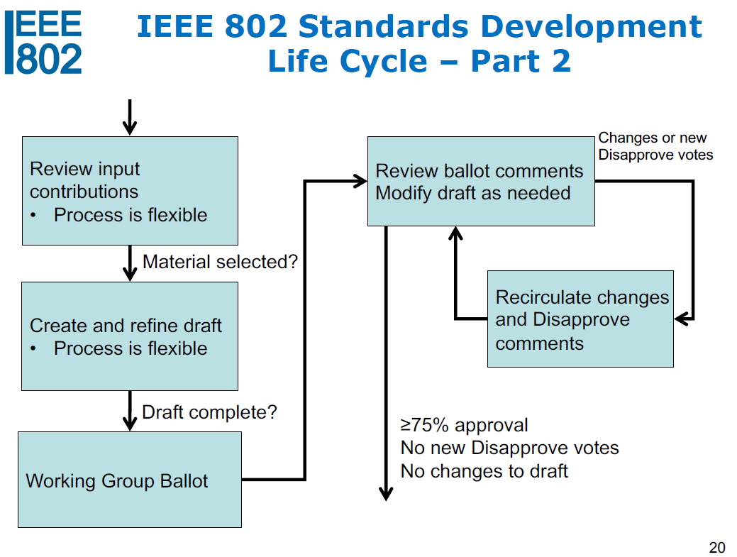
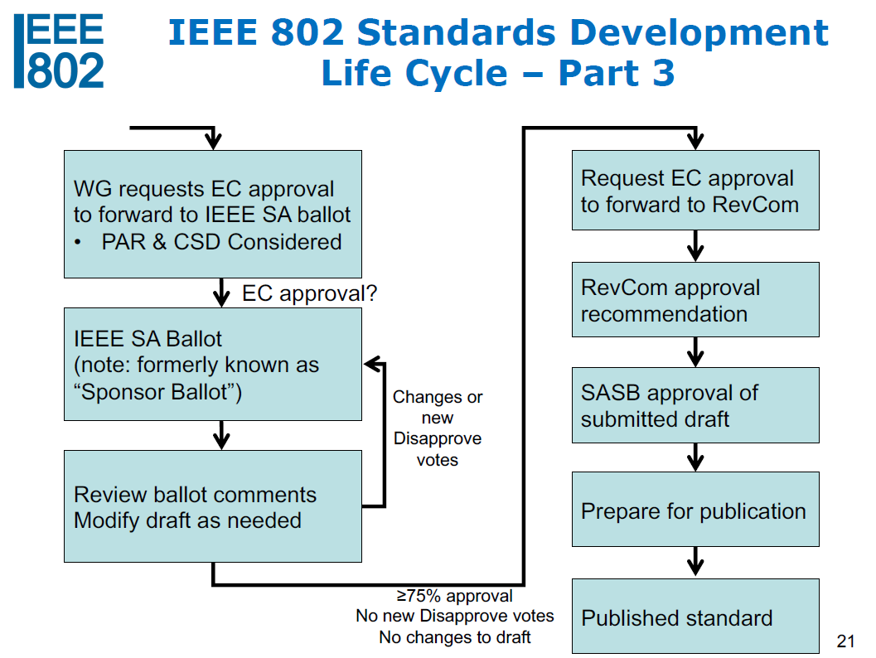
Next steps
We are here!

Slide 15
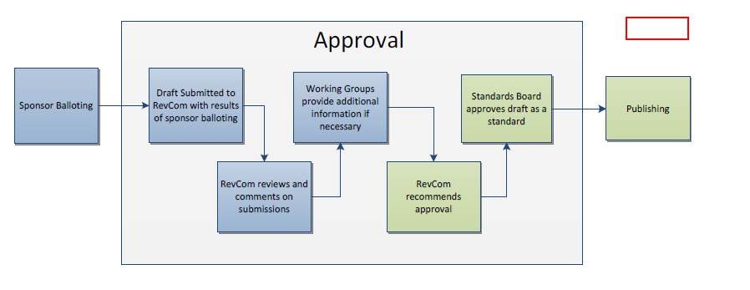
Submission for Revcom

Slide 16
TG Motion
TG Motion for Revcom Submission(15-21-0552-01-04aa)

Slide 17
TG15.4aa Timeline
 | Open | Close | Status
First SA Ballot | 15th August,2021 | 14th September,2021 | Done
Second SA Ballot | 1st October,2021 | 15th October,2021 | Done
Third SA Ballot | 19th October,2021 | 28th October,2021 | Done
WG ballot to EC for Revcom Submission | 17th November,2021
EC to RevCom | 19th November,2021
RevCom Submission | 16 Dec 2021 RevCom Submission Deadline
RevCom to SB | January,2022

Slide 18
Plan for January Interim
Topics: There are no topics to be discussed so far.
One slot will be planned.
 | Monday ^{th} January | Tuesday ^{th} January | Wednesday ^{th} January | Thursday ^{th} January | Friday ^{th} January
AM1 |  | Opening
AM2
PM1
PM2
EV1 |  | TG4aa-JRE

Slide 19
Discuss next step

Slide 20
Any other business?

Slide 21
Attendance recap

Slide 22
Adjourn TG4aa
Moved :Don Sturek(ITRON)
Second : Phil Beecher(Wi-SUN Alliance)
There is no discussion or objections. Adjourn is approved unanimous consent.

