Slide 1
Project: IEEE P802.15 Working Group for Wireless Specialty Networks (WSN)
Submission Title: TG14 Opening Report, Meeting Slides, Closing Report – Nov. 2021 Mtg
Date Submitted: November 11, 2021
Source: Clint Powell (Meta)
Contact: SAA
E-Mail: cpowell@ieee.org
Voice: +1 480 586-8457
Re: Task Group 14: UWB-AHN (p.k.a. NS-UWB)
Abstract: Meeting Slides
Purpose: Working Slide Deck for November Plenary Mtg
Notice: This document has been prepared to assist the IEEE 802.15. It is offered as a basis for discussion and is not binding on the contributing individual(s) or organization(s). The material in this document is subject to change in form and content after further study. The contributor(s) reserve(s) the right to add, amend or withdraw material contained herein.
Release: The contributor acknowledges and accepts that this contribution becomes the property of IEEE and may be made publicly available by 802.15.
Notes:
Jul 12, 2010
Page 1

Slide 2
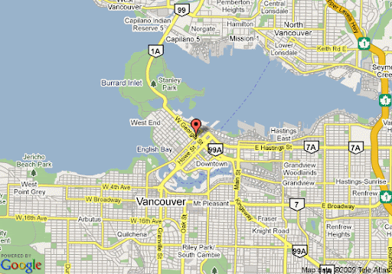
134th IEEE 802.15 WSN MTG.
Held Virtually via Webex
Nov. 9th – 17th, 2021

Slide 3
Registration for 802 LMSC Plenaries and 802 Wireless Interims
This 802.15 meeting is part of an IEEE 802 LMSC Plenary or IEEE 802 Wireless Interim session
You must pay the registration fee in order to attend
If you have not already done so, you can register here or follow the registration link here http://802world.org/plenary/
If you do not intend to register for this session you must leave this meeting and, if you have logged attendance on IMAT, email the appropriate WG chair or vice chairs to have your attendance cancelled

Slide 4
Deadbeat Consequences
(Deadbeat: in default of paying registration fee for a prior mtg.)
No participation credit will be granted for said session.
Any participation credit acquired before said session toward membership in any IEEE 802 LMSC group is revoked.
Membership in any IEEE 802 LMSC group is terminated.
No participation credit will be granted for attendance at any subsequent IEEE 802 LMSC session until the individual has complied with the registration requirements for all previously attended IEEE 802 LMSC sessions by the start of said subsequent session.

Slide 5
Task Group Rules
Discussion: Everyone present is welcome
Straw polls: Everyone present may vote
Formal motions: WG voters
  To make, second and vote
Patent policy for PAR activities applies
All the usual rules of conduct
Please identify yourself on first contact with name and affiliation

Slide 6
IEEE-SA Patent, Copyright, and Participation Policies
See: https://grouper.ieee.org/groups/802/sapolicies.shtml
IEEE-SA Patent Slides for Pre-PAR Meetings:
https://development.standards.ieee.org/myproject/Public/mytools/mob/preparslides.pdf
IEEE-SA Participation Slides for Pre-PAR Meetings:
https://standards.ieee.org/content/dam/ieee-standards/standards/web/documents/other/Participant-Behavior-Individual-Method.pdf
Copyright:
https://standards.ieee.org/content/dam/ieee-standards/standards/web/documents/other/ieee-sa-copyright-policy-2019.pdf

Slide 7
IEEE 802 Ground Rules
NO product pitches
NO corporate pitches
NO prices
NO restrictive notices:
    e.g. confidential notices in email
Presentations must be openly available
Most important:
Please respect all participants

Slide 8
Goals - Agenda by Day
Thurs. 11/11 PM2
  Open, P&P, TG14 this week
  Approve Sept. Mins.
    https://mentor.ieee.org/802.15/documents?is_dcn=500&is_year=2021
  Approve Agenda
  Status Update
  Next Steps
  Any other Business

Slide 9
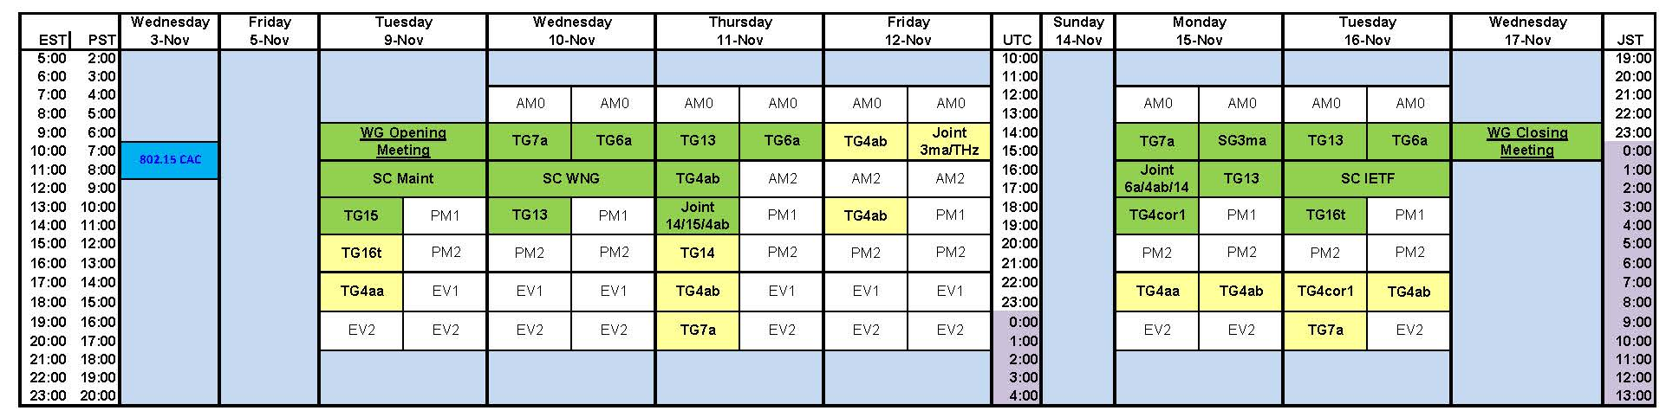
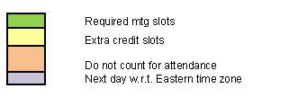
TG14 Meeting Slots
Nov. 9th – 17th, 2021

Slide 10
CSD and PAR
CSD
  15-21-0278-xx-0014-draft-csd-for-ns-uwb
    https://mentor.ieee.org/802.15/documents?is_dcn=278&is_year=2021
PAR
15-21-0274-xx-0014-ns-uwb-par-working-draft
  https://mentor.ieee.org/802.15/documents?is_dcn=274&is_year=2021

Slide 11
802.15 TG15 PAR
SCOPE
This standard specifies the physical layer (PHY) and media access control sublayer (MAC) for impulse radio ultra wideband (UWB) wireless ad hoc connectivity with fixed, portable, and moving devices with limited energy consumption requirements, and supports real time precision ranging capability that is accurate to within a few centimeters. PHYs are defined for devices operating in a variety of regulatory domains.
NEED
… Recently it has become clear that the impulse radio ultra wideband functionality and features have become increasingly complex to support inside the framework of IEEE Std 802.15.4. The end-users (industry) will benefit by including (via. referencing) the impulse radio ultra wideband functionality into a simple focused specification, enabling improved multi-vendor interoperability and further technology adoption. Furthermore, the new standard (802.15.14) will improve the accessibility and comprehension of the standard and more easily enable further amendments and enhancements.

Slide 12
Next Steps
Continue work as Study Group
  Coordinate with SG15, SG4ab
  Identify Content for 802.15.14
    Using example template developed by .15 to identify relevant portions of 802.15.4 to include in the TG14 draft
Issue a call for TG14 officers
Outreach to CCC, FiRa, UWBA, omlox, CSA, and ETSI UWB - once EC approves TG
Work via Interim telecons and virtual interim/plenary meetings

Slide 13
Jan. Interim Mtg. Goals
2nd official meeting as a TG
Continue with TG activities
5 slots needed
  ≈ 1 administrivia
  ≈ 2 to work on content dev.
  + 1 joint session with .4ab/.15
  + 1 joint session with .4ab/.6a

Slide 14
Weekly Calls
Bi-weekly calls (placeholder):
  Starting Wed. 1st, Dec. @ 7am Pacific
    (TG4ab will also use the same day/time, bi-weekly, but offset by a week from TG14)

Slide 15
Backup

Slide 16


