Slide 1
Project: IEEE P802.15 Working Group for Wireless Specialty Networks (WSN)
Submission Title: DL-TDOA positioning TDMA scheme
Date Submitted: 19th October 2021
Source: Jean-Marie André (ST microelectronics), Sven Zeisberg (Zigpos)
Contact: ST microelectronics, 19 boulevard de la mer Caspienne, 73372 Le Bourget du Lac, France
E-Mail: jean-marie.andre {at} st.com, sven.zeisberg {at} zigpos.com
Re: Call for contributions to IEEE 802.15 TG4ab
Abstract: Evolution of 802.15.4(z) to enable efficient industrial positioning systems
Purpose: Discussion of how to improve 802.15.4(z) to serve industrial positioning systems
Notice: This document has been prepared to assist the IEEE P802.15. It is offered as a basis for discussion and is not binding on the contributing individual(s) or organization(s). The material in this document is subject to change in form and content after further study. The contributor(s) reserve(s) the right to add, amend or withdraw material contained herein.
Release: The contributor acknowledges and accepts that this contribution becomes the property of IEEE and may be made publicly available by P802.15.

Slide 2
PAR Objective | Proposed Solution (how addressed)
Safeguards so that the high throughput data use cases will not cause significant disruption to low duty-cycle ranging use cases
Interference mitigation techniques to support higher density and higher traffic use cases
Other coexistence improvement
Backward compatibility with enhanced ranging capable devices (ERDEVs) | The proposed scheme is backward compatible with ERDEVs.
Improved link budget and/or reduced air-time
Additional channels and operating frequencies
Improvements to accuracy / precision / reliability and interoperability for high-integrity ranging | The proposed scheme is enabling increased reliability for industrial environments.
Reduced complexity and power consumption
Hybrid operation with narrowband signaling to assist UWB
Enhanced native discovery and connection setup mechanisms
Sensing capabilities to support presence detection and environment mapping
Low-power low-latency streaming
Higher data-rate streaming allowing at least 50 Mbit/s of throughput
Support for peer-to-peer, peer-to-multi-peer, and station-to-infrastructure protocols | The proposed scheme supports infrastructure based positioning systems.
Infrastructure synchronization mechanisms | The proposed scheme supports adding low energy consumption anchor nodes in DL-TDoA.

Slide 3
To motivate compatible enhancements of 802.15.4(z) a scalable TDMA based access scheme description for industrial positioning systems is provided for discussion, which is:
enabling DL-TDOA as well as UL-TDOA to co-exist in a given area,
enhancing positioning reliability by avoiding ranging collisions,
allowing full featured anchor nodes and battery powered anchor nodes
deploying block based communication and ranging based “creative deployment” of legacy 802.15.4(z) toolbox

Slide 4
Interest & Challenges of DL-TDoA
DL-TDoA can be viewed as GPS substitute allowing smart devices to compute their location, with substantial improvement over GPS:
Works indoors and wherever a network of “satellites” (anchors) is deployed
High precision
High refresh rate
Unlimited number / density of smart devices, as they don’t transmit
Yet, DL-TDoA comes with some challenges:
Scalability: the synchronization mechanism must be suited to address any constellation of satellites
UL-TDoA compatibility: leverage a synchronous infrastructure to also locate tags
Cost of deployment: more than the cost of a satellite itself, the cost of wiring it is a serious impairment

Slide 5
We are proposing a slight adaptation of the round structure as defined in 4z

Slide 6
2 options are taken:
Don’t use the measurement report phase in order to improve recurrence
Extend the ranging control phase to allow multiple controllers to co-exist

Slide 7
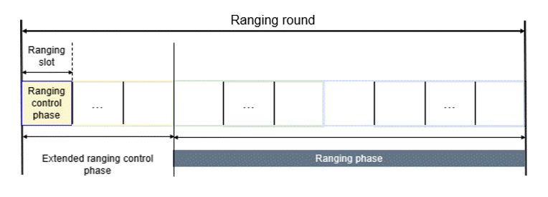
This is minimizing the evolution compared to 4z: from a local standpoint, the structure is in line with 4z.

Slide 8
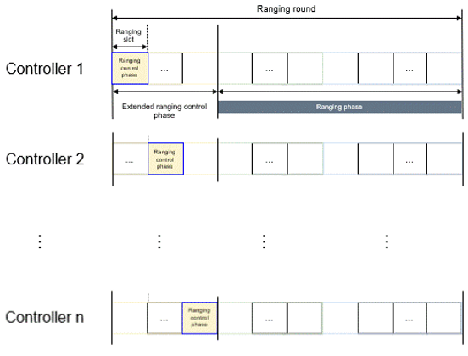
From a system standpoint, this allows to have multiple controllers synchronized
This ensure a scalable synchronization, enabling DL-TDoA across a wide space
There is no concept of clusters, as everybody is on the same clock

Slide 9
As in 802.15.4z, the Ranging Phase is split in 2 parts:
Initiation
Response
The Initiation part of the ranging phase is dedicated to downlink messages. It is used exclusively by fixed anchors, aka satellites. It is sufficient to enable DL-TDoA.
The Response part is left for mobile devices aka tags, to transmit uplink. A number of location possibilities are thus enabled: UL-TDoA, TWR, RToF, etc.

Slide 10
In this approach, anchors are designating the fixed parts of the location system. We call them satellites and we make the difference between 2 types:
Full Blown Satellites are regular anchors, they are connected to the mains and can receive a much as needed.
Battery Powered Satellites are not connected to the mains. They are easy to install and very useful to densify a place where accurate DL-TDoA is needed.
For such devices, the reception time must be minimized, in order to save power and maximize lifetime.
To achieve this mix, roles are split based on power consumption profiles:
Battery Powered Satellites are only involved in the Initiation Phase, they transmit during the first slots of the Initiation Phase.
Full blown satellites are active in the Control Phase, as well as in the last slots of the initiation phase.

Slide 11
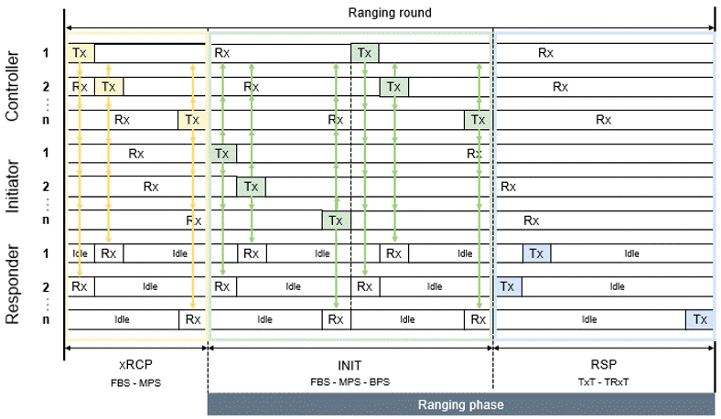
Full Blown Satellites: RCP + Init
Uplink
Battery Powered Satellites: Init only

Slide 12
Battery Powered Satellites do not set their receiver at every round
=> Init messages may drift
Full Blown Satellites monitor the init messages of their neighbours and transmit a list of time corrections to be applied
Uplink

Slide 13
Background behind this proposal
Sven & Jean-Marie are part of omlox, where they defined an open standard to enable UWB tracking in industrial context
omlox v1 was implemented several years ago and offered both TWR and DL-TDoA capabilities. It was deployed in various industrial compounds in Europe & US
We found that in harsh environments, a higher density of anchors was needed. That is where the concept of Battery Powered Satellite was crafted.
This concept and the rest of this presentation are part of the definition of omlox v2, whose release is due by the end of this year.
This disclosure was authorized by the board of omlox

Slide 14
Thank you for your kind attention.
Are there any questions?

