Slide 1
Project: IEEE P802.15 Working Group for Wireless Personal Area Networks (WPANs)
Submission Title: [TG4aa JRE CRG(SA Recirculation Ballot) meeting Opening report]
Date Submitted: [7th October,2021]
Source: [Takashi Kuramochi] Company [LAPIS TECHNOLOGY]
Address [2-4-8 Shinyokohama,Kouhoku-ku,Yokohama 222-8575 Japan]
Voice:[+81-45-476-9295], FAX: [], E-Mail:[kuramochi722@lapis-tech.com]
Re: [] Abstract: [This document contains opening information and meeting agenda for the TG4aa JRE CRG(SA Recirculation Ballot) Teleconference 7th October,2021] Purpose: [information]
Notice: This document has been prepared to assist the IEEE P802.15. It is offered as a basis for discussion and is not binding on the contributing individual(s) or organization(s). The material in this document is subject to change in form and content after further study. The contributor(s) reserve(s) the right to add, amend or withdraw material contained herein.
Release: The contributor acknowledges and accepts that this contribution becomes the property of IEEE and may be made publicly available by P802.15.

Slide 2
IEEE 802.15 TG4aa JRE CRG(SA Recirculation Ballot) Opening report on EDT October 7th,2021

Slide 3
Administrative Items
Required notices
Affiliation FAQ - http://standards.ieee.org/faqs/affiliationFAQ.html
Anti-Trust FAQ - http://standards.ieee.org/resources/antitrust-guidelines.pdf
Ethics - http://www.ieee.org/portal/cms_docs/about/CoE_poster.pdf
Chair/Vice-Chair/Secretary/Technical Editor
Chair :Takashi Kuramochi(LAPIS)
Vice-Chair : Hiroshi Harada(Kyoto University)
Vice-Chair: Kunal Shah(ITRON)
Secretary : Kiyoshi Fukui(OKI)
Technical Editor : Kiyoshi Fukui(OKI)
CRG Membership: Takashi Kuramochi(Chair), Hiroshi Harada, Kunal Shah, Henk De Ruijter, and Kiyoshi Fukui

Slide 4
Participants have a duty to inform the IEEE
Participants shall inform the IEEE (or cause the IEEE to be informed) of the identity of each holder of any potential Essential Patent Claims of which they are personally aware if the claims are owned or controlled by the participant or the entity the participant is from, employed by, or otherwise represents
Participants should inform the IEEE (or cause the IEEE to be informed) of the identity of any other holders of potential Essential Patent Claims
Early identification of holders of potential Essential Patent Claims is encouraged

Slide 5
Ways to inform IEEE
Cause an LOA to be submitted to the IEEE-SA (patcom@ieee.org); or
Provide the chair of this group with the identity of the holder(s) of any and all such claims as soon as possible; or
Speak up now and respond to this Call for Potentially Essential Patents
If anyone in this meeting is personally aware of the holder of any patent claims that are potentially essential to implementation of the proposed standard(s) under consideration by this group and that are not already the subject of an Accepted Letter of Assurance, please respond at this time by providing relevant information to the WG Chair

Slide 6
Other guidelines for IEEE WG meetings
All IEEE-SA standards meetings shall be conducted in compliance with all applicable laws, including antitrust and competition laws.
Don’t discuss the interpretation, validity, or essentiality of patents/patent claims.
Don’t discuss specific license rates, terms, or conditions.
Relative costs of different technical approaches that include relative costs of patent licensing terms may be discussed in standards development meetings.
Technical considerations remain the primary focus
Don’t discuss or engage in the fixing of product prices, allocation of customers, or division of sales markets.
Don’t discuss the status or substance of ongoing or threatened litigation.
Don’t be silent if inappropriate topics are discussed … do formally object.
---------------------------------------------------------------
For more details, see IEEE-SA Standards Board Operations Manual, clause 5.3.10 and Antitrust and Competition Policy: What You Need to Know at http://standards.ieee.org/develop/policies/antitrust.pdf

Slide 7
Patent-related information
The patent policy and the procedures used to execute that policy are documented in the:
IEEE-SA Standards Board Bylaws
https://standards.ieee.org/about/policies/bylaws/sect6-7.html#6
IEEE-SA Standards Board Operations Manual
https://standards.ieee.org/about/policies/bylaws/sect6-7.html#6.3
Material about the patent policy is available at
http://standards.ieee.org/about/sasb/patcom/materials.html
If you have questions, contact the IEEE-SA Standards Board Patent Committee Administrator at patcom@ieee.org

Slide 8
Attendance
Name | Affiliation

Slide 9
Proposed agenda for TG4aa CRG meeting
Target: Review and resolve all the comments for P802.15.4aa/D09
Contents | Who | Period | Accumulated time
OPEN/Patent Policy | Kuramochi | 5 | 5
Attendance | Kuramochi | 5 | 10
Agenda | Kuramochi | 5 | 15
SA Recirc1 Ballot Results | Kuramochi | 5 | 20
Resolve comments | Kuramochi | 10 | 30
CRG Motion | Kuramochi | 10 | 40
Next steps | Kuramochi | 5 | 45
Next meeting information | Kuramochi | 5 | 50
Adjourn | Kuramochi | 5 | 55
Approval of the Agenda
Moved: Hiroshi Harada(Kyoto University)
Second: Kunal Shah(ITRON)
There is no discussion or objections.
Agenda is approved unanimous consent.

Slide 10
SA ballot results
Ballot ID | Ballot Close Date | Title | Ballot Type | Pool | Return | %Return | Abstain | %Abstain | Approve | Disapprove | %Approve | Comments
Initial | 14- September- 2021 | IEEE Standards Association Ballot for IEEE P802.15.4aa/D08 | SA Initial Ballot | 71 | 55 | 77 | 1 | 1 | 53 | 1 | 98 | 5
Recirc1 | 4- October- 2021 | IEEE Standards Association Ballot for IEEE P802.15.4aa/D09 | SA Recirculation1 Ballot | 71 | 61 | 85 | 1 | 1 | 60 | 0 | 100 | 4
Recirculation SA Ballot for P802.15.4aa/D09 was quorate , and passed.

Slide 11
Review and resolve SA Recirculation Ballot comments for P802.15.4aa/D09
Approve Consolidated comment resolutions specified on15-21-0528-01-04aa.
Moved: Kunal Shah (ITRON)
Seconded: Hiroshi Harada(Kyoto University)
Approved by unanimous consent

Slide 12
CRG Motion for Recirculation SA Ballot
Motion:TG4aa CRG has reviewed and approves the CSD [15-20-0319-00-04aa], and the CA document [15-21-0083-08-04aa]; and approves forwarding draft P802.15.4aa_D10 as edited in accordance with the instructions in document 15-21-0528-01-04aa to Standards Association Recirculation ballot.
Moved: Kunal Shah (ITRON)
Seconded: Hiroshi Harada(Kyoto University)
Approved by unanimous consent

Slide 13
Next CRG cancelled
CRG meeting next week EDT14th October will be cancelled
 | Monday 11th October | Tuesday 12th October | Wednesday 13th October | Thursday 14th October | Friday 15th October
AM1 |  |  |  |  | TG4aa-CRG (JST07:00)
AM2
PM1
PM2
EV1 |  |  |  | TG4aa-CRG (EDT18:00)

Slide 14
Next Steps
 | Open | Close | Status
First SA Ballot | 15th August,2021 | 14th September,2021 | Done
Second SA Ballot | 24th September,2021 | 4th October,2021 | Done
Third SA Ballot | 11th October,2021 | 21th October,2021 | Ready
EC to RevCom | January,2022
RevCom to SASB
1.Response To Individual Ballot Comments of Standards Association ballot via myProject.
2.Initiate Recirculation ballot via myProject

Slide 15
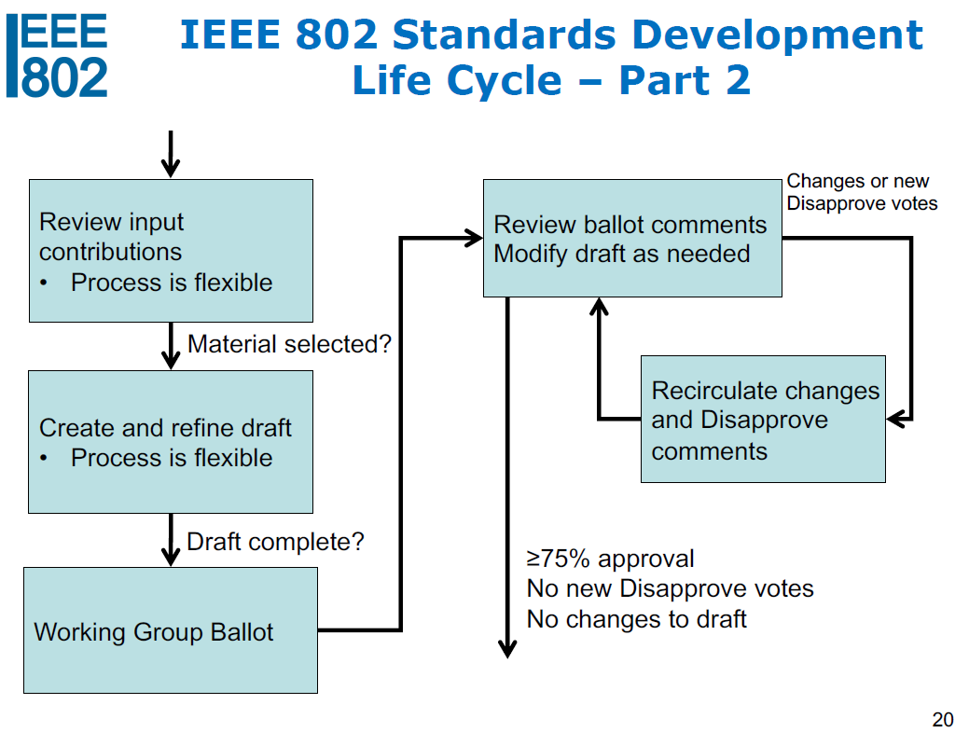
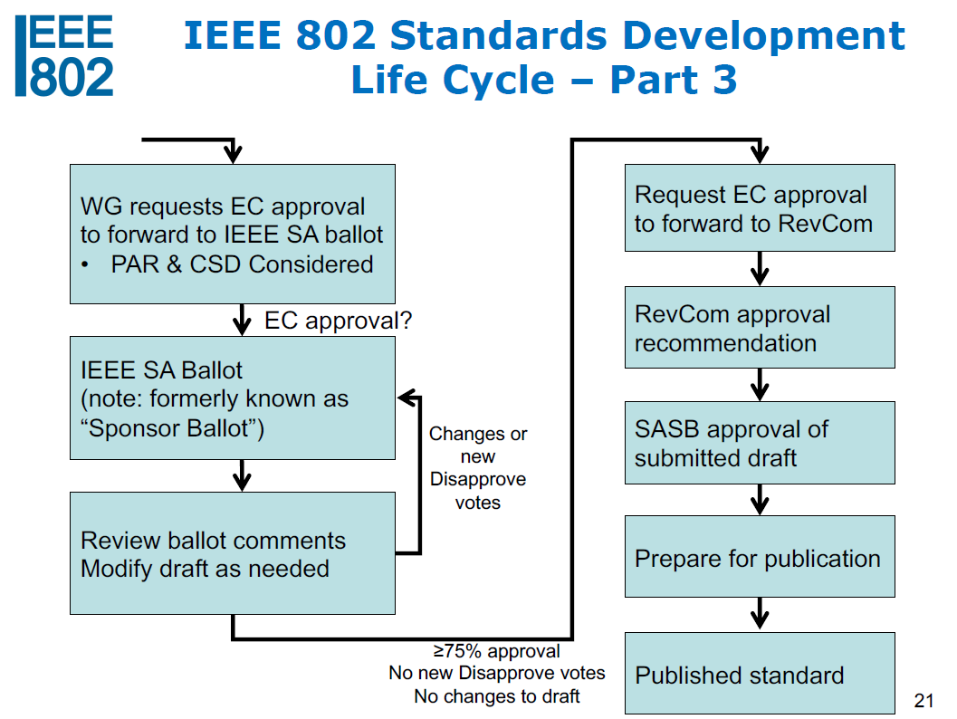
Current Status of TG4aa
We are here!
1.SA Initial Ballot :Closed
2.Comment resolutions :Done.
3. Amendment of the draft :Done
4. Recirculation1 SA Ballot: Closed
5. Recirculation2 SA Ballot: Ready

Slide 16
Plan for November Plenary
Topics
Review & resolve comments on SA ballot.
Slots
2 slots are planned on EST EV1.
 | Monday 8th Nov | Tuesday 9th Nov | Wednesday 10th Nov | Thursday 11th Nov | Friday 12th Nov
AM1
AM2 |  | Opening
PM1
PM2
EV1 |  | TG4aa-JRE
 | Monday 15th Nov | Tuesday 16th Nov | Wednesday 17nd Nov | Thursday 18rd Nov | Friday 19th Nov
AM1
AM2 |  |  | Closing
PM1
PM2
EV1 | TG4aa-JRE

Slide 17
Attendance recap

Slide 18
Adjourn

