Slide 1
Project: IEEE P802.15 Working Group for Wireless Specialty Networks (WSN)
Submission Title: SG 15.4ab Agenda and Meeting Slides
Date Submitted: October 05, 2021
Source: Benjamin A. Rolfe (Blind Creek Associates)
Contact:
Voice: +1 408 395 7207, E-Mail: ben.rolfe @ ieee.org
Re: Study Group 4ab: UWB Next Generation
Abstract: Teleconference (WebEx) Agenda and Meeting Slides
Purpose: Support the continued illusion of organization and promote progress
Notice: This document has been prepared to assist the IEEE P802.15. It is offered as a basis for discussion and is not binding on the contributing individual(s) or organization(s). The material in this document is subject to change in form and content after further study. The contributor(s) reserve(s) the right to add, amend or withdraw material contained herein.
Release: The contributor acknowledges and accepts that this contribution becomes the property of IEEE and may be made publicly available by P802.15.
Notes:
Jul 12, 2010
Page 1

Slide 2

Task Group 15.4ab
Next Generation UWB Amendment
Teleconference / Virtual Meeting
October 05, 2021

Slide 3
Approval of PAR
From the IEEE SA Standards Board (SASB) DRAFT Meeting Minutes 23-24 September 2021:
  3.2.3 Consent Agenda, NesCom Recommendations, New PARs, IEEE Computer Society/LAN/MAN Standards Committee
  P802.15.4ab
  Standard for Low-Rate Wireless Network Amendment: Enhanced Ultra Wide-
  Band (UWB) Physical Layers (PHYs) and Associated Medium Access and
  Control (MAC) Sublayer Enhancements
  Recommendation: Approve new PAR until December 2025

Slide 4
802.15 Study Group Meeting
Pre-PAR Activity Rules
Study Group voting: everyone present can vote
Identify yourself and affiliation on first contact
Reminder: Individual Participation
No Longer Study Group
Task Group Rules Apply

Slide 5
Task Group Rules
Straw Polls: Everyone present are voters
Formal motions: WG voters
  To make, second and vote
Patent policy for PAR activities applies

Slide 6
IEEE-SA Patent, Copyright, and Participation Policies
See: https://grouper.ieee.org/groups/802/sapolicies.shtml
IEEE-SA Patent Slides for Standards Development Meetings (.pdf)
https://development.standards.ieee.org/myproject/Public/mytools/mob/slideset.pdf
IEEE-SA Standards Board Patent Committee (PatCom) home page
https://standards.ieee.org/content/ieee-standards/en/about/sasb/patcom/index.html
IEEE-SA Participation Policy meeting slide set - individual method (.pdf)
https://standards.ieee.org/content/dam/ieee-standards/standards/web/documents/other/Participant-Behavior-Individual-Method.pdf
Copyright:
https://standards.ieee.org/content/dam/ieee-standards/stand
https://standards.ieee.org/faqs/copyrights/index.htmlards/web/documents/other/ieee-sa-copyright-policy-2019.pdf
https://standards.ieee.org/ipr/copyright-materials.html

Slide 7
IEEE 802 Ground Rules
Respect … give it, get it
NO product pitches
NO corporate pitches
NO prices
NO restrictive notices – (no confidentially notices in email)
Presentations must be openly available

Slide 8
Proposed Agenda
Opening and meeting preamble
Recap
Status updates
  TGD
  TFD
Technical discussions
Any other Business

Slide 9
Recap

Slide 10
5.2.b Scope of the project (As submitted to NesCom):
This amendment enhances the Ultra Wideband (UWB) physical layers (PHYs) medium access control (MAC), and associated ranging techniques while retaining backward compatibility with enhanced ranging capable devices (ERDEVs).
Areas of enhancement include:
additional coding, preamble and modulation schemes to support improved link budget and/or reduced air-time relative to IEEE Std 802.15.4 UWB;
additional channels and operating frequencies; interference mitigation techniques to support greater device density and higher traffic use cases relative to the IEEE Std 802.15.4 UWB;
improvements to accuracy, precision and reliability and interoperability for high-integrity ranging;
schemes to reduce complexity and power consumption;
definitions for tightly coupled hybrid operation with narrowband signaling to assist UWB;
enhanced native discovery and connection setup mechanisms;
sensing capabilities to support presence detection and environment mapping;
and mechanisms supporting low-power low-latency streaming as well as high data-rate streaming allowing at least 50 Mbit/s of throughput.

Slide 11
Review and Status
September Closing Report:
  https://mentor.ieee.org/802.15/dcn/21/15-21-0518-01-04ab-15-4ab-september-interim-closing-report.pptx
  Reviewed TGD
  Started draft TFD
  Heard contributions
  Call for more discussion and contributions
TGD Status
TFD Status
TG Organization

Slide 12

Technical Contributions

Slide 13

Next Steps

Slide 14
Teleconference Schedule Discussion
Proposal:
Frequency: Bi-weekly
Phase: Tuesday
Time: 10:00 ET (07:00 PT)
Offset: First call October 5th
Duration: 1 hour.
Week | Time (ET)
Now: | [Sept Interim]
October 5 | 10:00 ET
October 19 | 10:00 ET
November 2 | 10:00 ET
November 9: | Nov Plenary
We are Here
NEXT

Slide 15
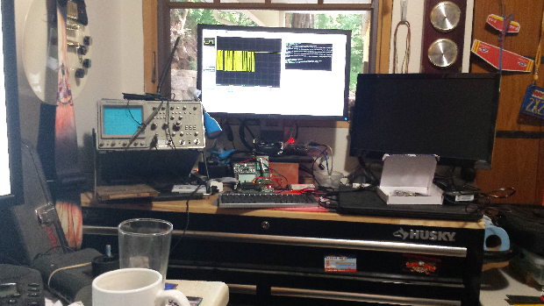
Other Business

Slide 16
Adjourned
Thanks

