Slide 1
Project: IEEE P802.15 Working Group for Wireless Personal Area Networks (WPANs)
Submission Title: [TG4aa JRE September Virtual Interim 2021 Closing report]
Date Submitted: [22th September, 2021]
Source: [Takashi Kuramochi] Company [LAPIS TECHNOLOGY]
Address [2-4-8 Shinyokohama,Kouhoku-ku,Yokohama 222-8575 Japan]
Voice:[+81-45-476-9295], FAX: [], E-Mail:[kuramochi722@lapis-tech.com]
Re: []
Abstract: [This document contains TG4aa JRE closing report from Virtual September Interim sessions,2021]
Purpose: [information]
Notice: This document has been prepared to assist the IEEE P802.15. It is offered as a basis for discussion and is not binding on the contributing individual(s) or organization(s). The material in this document is subject to change in form and content after further study. The contributor(s) reserve(s) the right to add, amend or withdraw material contained herein.
Release: The contributor acknowledges and accepts that this contribution becomes the property of IEEE and may be made publicly available by P802.15.

Slide 2
IEEE 802.15 TG4aa JRE
Virtual September Interim
Closing report on
September 22th ,2021

Slide 3
About TG4aa
TG 4aa – Japanese Rate Enhancement (JRE) amendment
Objective: data rate extensions for the SUN FSK modulation and channel parameters focusing on the Japanese frequency band
  Chair :Takashi Kuramochi(LAPIS)
  Vice-Chair : Hiroshi Harada(Kyoto University)
  Vice-Chair : Kunal Shah(ITRON)
  Secretary : Kiyoshi Fukui(OKI)
  Technical Editor : Kiyoshi Fukui(OKI)

Slide 4
TG4aa JRE sessions in September Interim
 | Monday 13th September | Tuesday 14th September | Wednesday 15th September | Thursday 16th September | Friday 17th September
AM1 |  | Opening
AM2
PM1
PM2
EV1 |  |  |  | TG4aa-JRE
 | Monday 20th September | Tuesday 21th September | Wednesday 22th September | Thursday 23th September | Friday 24th September
AM1 |  |  | Closing
AM2
PM1
PM2
EV1 | TG4aa-JRE

Slide 5
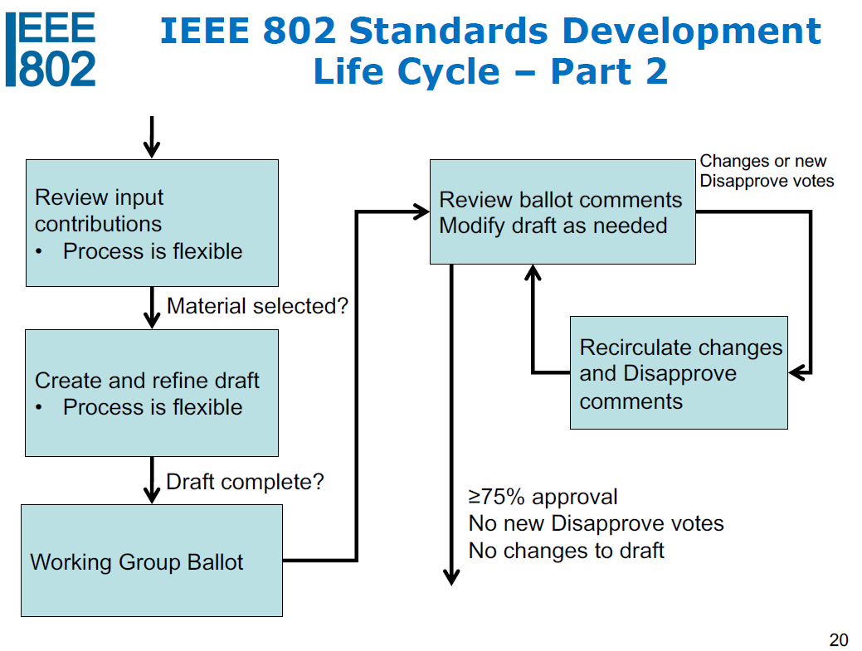
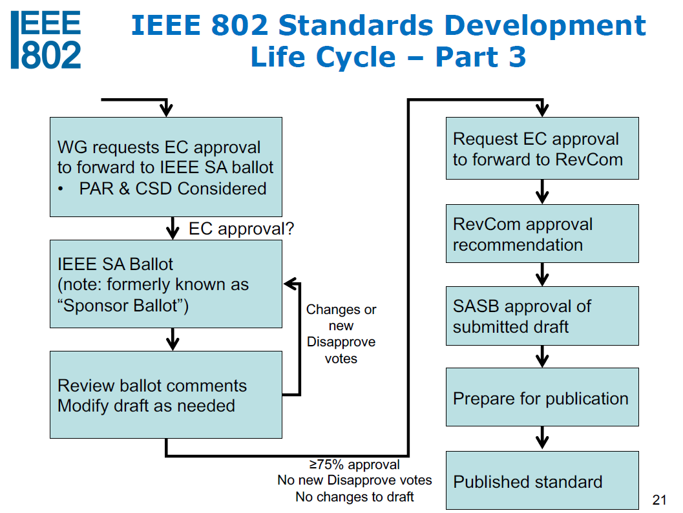

Current Status of TG4aa
We are here!
1.SA Initial Ballot :Closed
2.Comment resolutions :Done.
3. Amendment of the draft :Done
4. Recirculation SA Ballot: Ready

Slide 6
Agenda for TG4aa meetings
Target: TG Motion for SA Recirculation ballot and CRG formation
Session1:
Review SA Ballot results
Resolve comments for SA ballot of 802.15.4aa d08.
Session2:
Review updated draft (802.15.4aa d09)
TG motion for SA recirculation ballot and CRG formation
Next Steps

Slide 7
Accomplishments:
Review SA ballot results
Resolve comments for SA ballot of 802.15.4aa d08
(DOC:15-21-0495-01-04aa)
Review updated draft (802.15.4aa/D09)
Three TG motions were moved.
Planned November Plenary(# of Sessions)
Minutes posted(15-21-0517-00-04aa)

Slide 8
Review SA Initial ballot results
Ballot ID | Ballot Close Date | Title | Ballot Type | Pool | Return | %Return | Abstain | %Abstain | Approve | Disapprove | %Approve | Comments
Initial | 14-September-2021 | IEEE Standards Association Ballot for IEEE P802.15.4aa/D08 | SA Initial Ballot | 71 | 55 | 77 | 1 | 1 | 53 | 1 | 98 | 5
Initial SA Ballot for P802.15.4aa/D08 was quorate , and passed.

Slide 9
TG Motions
Three TG motions were moved.
-Motion 1: Approve the comment resolutions in the spreadsheet that is
posted to Mentor(DOC:15-21-0495-01-04aa).
→ This Motion doesn’t go WG Motion
-Motion 2: Approve the draft for recirculation
→ This Motion goes WG Motion
-Motion 3: Approve the CRG formation
→ This Motion goes WG Motion

Slide 10
TG Motion 1: Approve the comment resolutions in the spreadsheet that is posted to Mentor
(Task Group only)
Motion: Task Group TG4aa approves the comment resolutions in the spreadsheet that is posted to Mentor[15-21-0495-01-04aa] as the Response To Individual Ballot Comments of Standards Association ballot.
Moved:Phil Beecher(Wi-SUN Alliance)
Seconded: Don Sturek(ITRON)
There is no discussion or objections.
The motion is approved unanimous consent

Slide 11
TG Motion 2: Approve the draft for recirculation
Motion:Task Group TG4aa requests 802.15WG to review and approve the CSD [15-20-0319-00-04aa], and the CA document [15-21-0083-08-04aa]; and requests unconditional approval from the EC to submit P802.15.4aa_D9 to Standards Association Recirculation ballot.
Moved:Don Sturek(ITRON)
Seconded: Kunal Shah(ITRON)
There is no discussion or objections.
The motion is approved unanimous consent

Slide 12
WG Motion SA Ballot recirculation
802.15 has reviewed and approves the CSD [15-20-0319-00-04aa], and the CA document [15-21-0083-08-04aa]; and approves forwarding draft P802.15.4aa_D9 to Standards Association Recirculation ballot.
Moved by: Takashi Kuramochi
Seconded by: Rick Alfvin
There is no discussion or objections.
The motion is approved unanimous consent

Slide 13
TG Motion3:Approve the CRG formation
Task Group TG4aa requests 802.15WG to approve the formation of a Comment Resolution Group (CRG) for the Standards Association Recirculation balloting of the P802.15.4aa_D9 with the following membership: Takashi Kuramochi(Chair), Hiroshi Harada, Kunal Shah, Henk De Ruijter, and Kiyoshi Fukui. The 802.15.4aa CRG is authorized to approve comment resolutions, edit the draft according to the comment resolutions, and to approve the start of recirculation ballots of the revised draft on behalf of the 802.15 WG. Comment resolution on recirculation ballots between sessions will be conducted via reflector email and via teleconferences announced to the reflector as per the LMSC 802 WG P&P.
Moved:Phil Beecher(Wi-SUN Alliance)
Seconded: Don Sturek(ITRON)
There is no discussion or objections.
The motion is approved unanimous consent

Slide 14
WG Motion to form TG4aa CRG:
Move that 802.15 WG approve the formation of a Comment Resolution Group (CRG) for the Standards Association Recirculation balloting of the P802.15.4aa_D9 with the following membership: Takashi Kuramochi(Chair), Hiroshi Harada, Kunal Shah, Henk De Ruijter, and Kiyoshi Fukui. The 802.15.4aa CRG is authorized to approve comment resolutions, edit the draft according to the comment resolutions, and to approve the start of recirculation ballots of the revised draft on behalf of the 802.15 WG. Comment resolution on recirculation ballots between sessions will be conducted via reflector email and via teleconferences announced to the reflector as per the LMSC 802 WG P&P.
Moved by: Takashi Kuramochi
Second by:Richard Alfvin
There is no discussion or objections.
The motion is approved unanimous consent

Slide 15
Plan for November Plenary
Topics
Review & resolve comments on SA ballot.
Slots
2 slots are planned on EST EV1.
 | Monday 8th Nov | Tuesday 9th Nov | Wednesday 10th Nov | Thursday 11th Nov | Friday 12th Nov
AM1
AM2 |  | Opening
PM1
PM2
EV1 |  | TG4aa-JRE
 | Monday 15th Nov | Tuesday 16th Nov | Wednesday 17nd Nov | Thursday 18rd Nov | Friday 19th Nov
AM1
AM2 |  |  | Closing
PM1
PM2
EV1 | TG4aa-JRE

Slide 16
Next Steps
 | Open | Close | Status
First SA Ballot | 15th August,2021 | 14th September,2021 | Done
Second SA Ballot | 1st October,2021 | 15th October,2021
Third SA Ballot | 28th October,2021 | 13th November,2021
EC to RevCom | January,2022
RevCom to SASB
1.Response To Individual Ballot Comments of Standards Association ballot via myProject.
2.Initiate Recirculation ballot via myProject
CRG meeting will be planned on
EDT 17:00-18:00 Thursday 7th October 2021
EDT 17:00-18:00 Thursday 14th October 2021

Slide 17
Contacts
Takashi Kuramochi, LAPIS TECHNOLOGY
kuramochi722@lapis-tech.com

