Slide 1
Project: IEEE P802.15 Working Group for Wireless Personal Area Networks (WPANs)
Submission Title: New MIMO Channel Estimation Sequences for the PM-PHY
Date Submitted: 21.09.2021
Source: Jonathan Schostak, Lennert Bober, Volker Jungnickel Fraunhofer HHI
Address: Einsteinufer 37, 10587 Berlin, Germany
Voice: +49 30 31002-302, FAX: / E-Mail: kai.lennert.bober@hhi.fraunhofer.de
Re: -
Abstract: This document presents a proposal for a new type of sequence to be used as MIMO Pilot Symbols for the PM-PHY.
Purpose: Improve performance of MIMO techniques with the PM-PHY in P802.15.13
Notice: This document has been prepared to assist the IEEE P802.15. It is offered as a basis for discussion and is not binding on the contributing individual(s) or organization(s). The material in this document is subject to change in form and content after further study. The contributor(s) reserve(s) the right to add, amend or withdraw material contained herein.
Release: The contributor acknowledges and accepts that this contribution becomes the property of IEEE and may be made publicly available by P802.15.

Slide 2
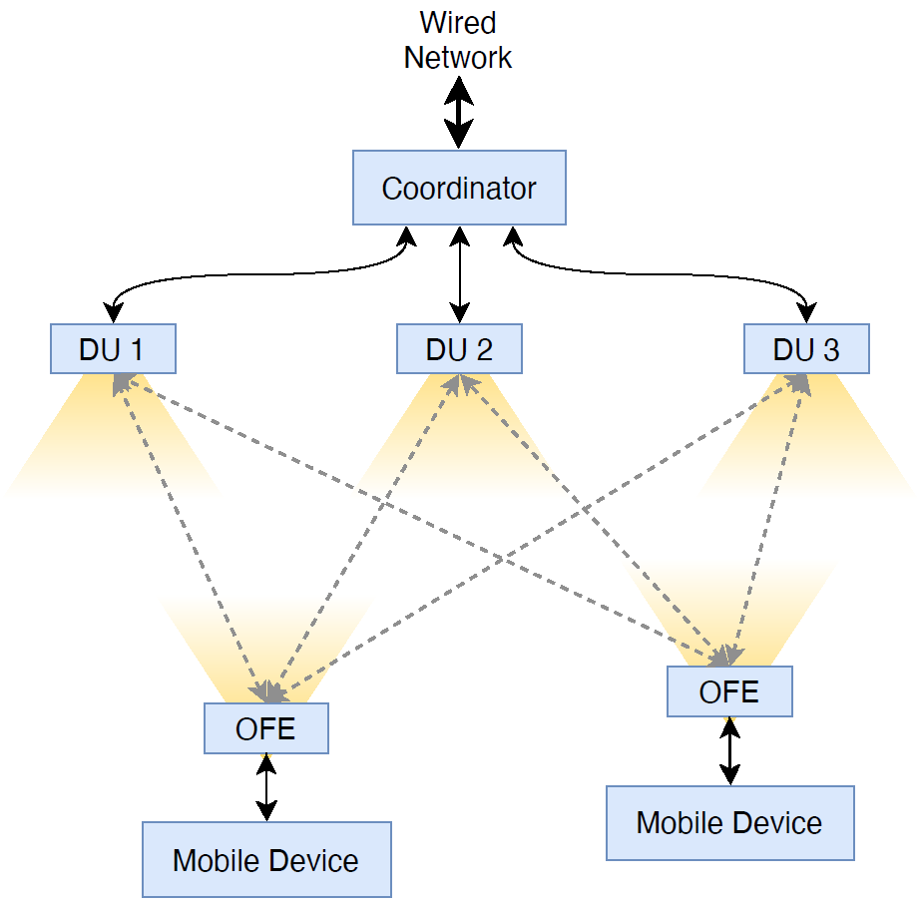
Background: MIMO/MISO in the PM-PHY
Parallel transmission of multiple PPDUs
Concurrent transmission of MIMO pilot sequences
Used to get a MIMO channel estimation for
MIMO transmission
Fine-synchronization of the transmitters
Sequences currently defined in Clause 9.2.4.2
Potential to improve performance / efficiency

Slide 3
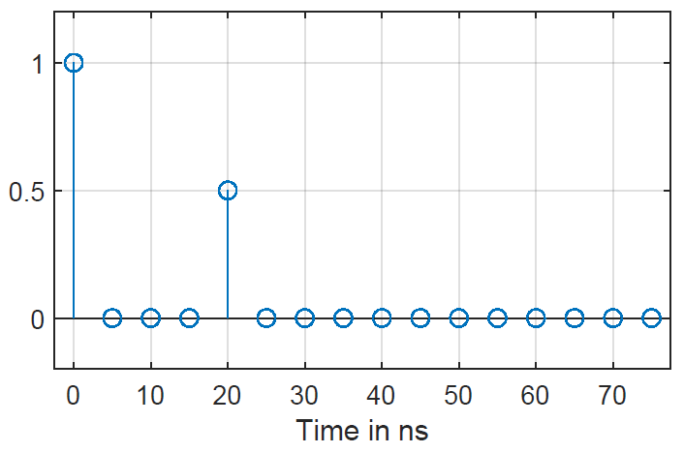
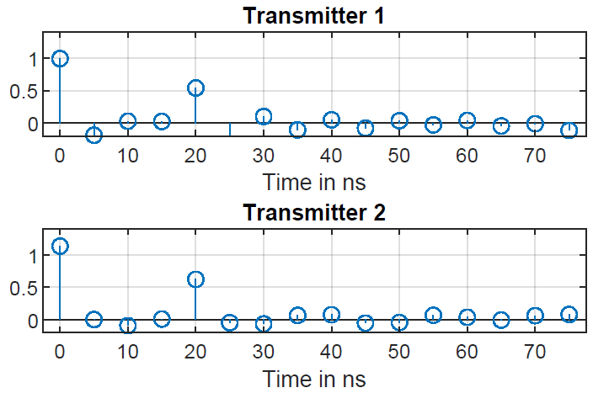
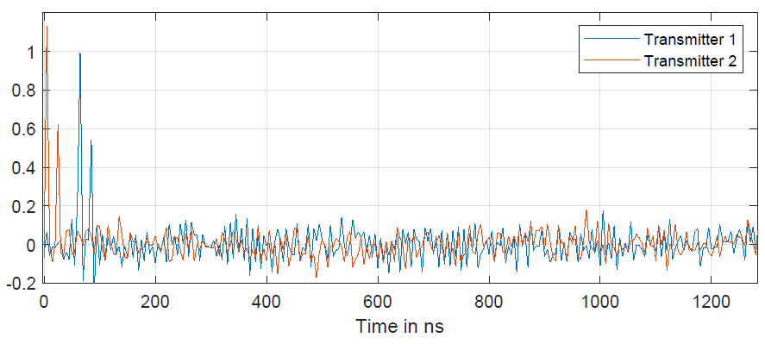
Channel Estimation Example
Original channel impulse response
Relevant cut-out
Estimated channel impulse response

Slide 4
Sequence Requirements
Basics
Alphabet:
PM-PHY uses PAM-2 (OOK) → only +1 and -1 allowed
Balance:
OFEs are AC-coupled
Sequences must be balanced to prevent baseline wandering
Implementability:
Generatable sequences are preferred (e.g. using LFSRs)

Slide 5
Sequence Requirements
Length & Set Size
Shorter sequences: lower resistance to interference & noise
Longer sequences: more overhead, no benefit
PM-PHY uses a cyclic prefix (CP)
It makes sense to utilize the CP block sizes
N = 64, 128, 256, 512, 1024
Set size = number of different available sequences
Bigger set size → more concurrent estimations
Minimum set size of 8 → up to 56 transmitters

Slide 6
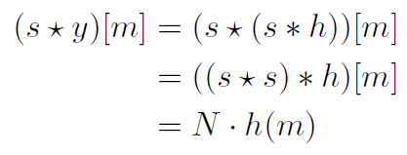
Sequence Requirements
Orthogonality and Correlation Properties
Concurrently transmitted sequences interfere…
…with each other (cross correlation, CCF)
…with themselves (autocorrelation, ACF)
Perfect ACF and CCF → perfect impulse response recovery through correlation
=> Sequences should have low ACF and CCF values
=> If possible, they should be orthogonal (CCF[0]=0)

Slide 7
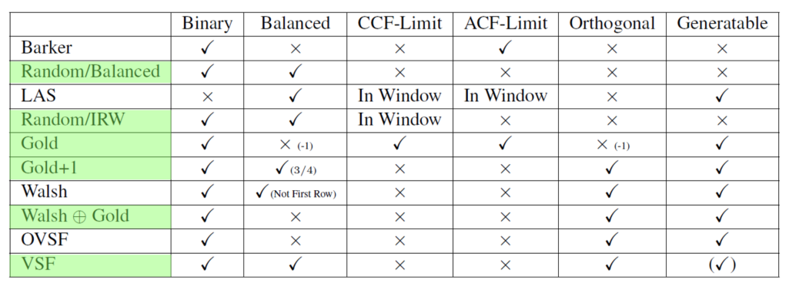
Sequence Candidates
Summary

Slide 8
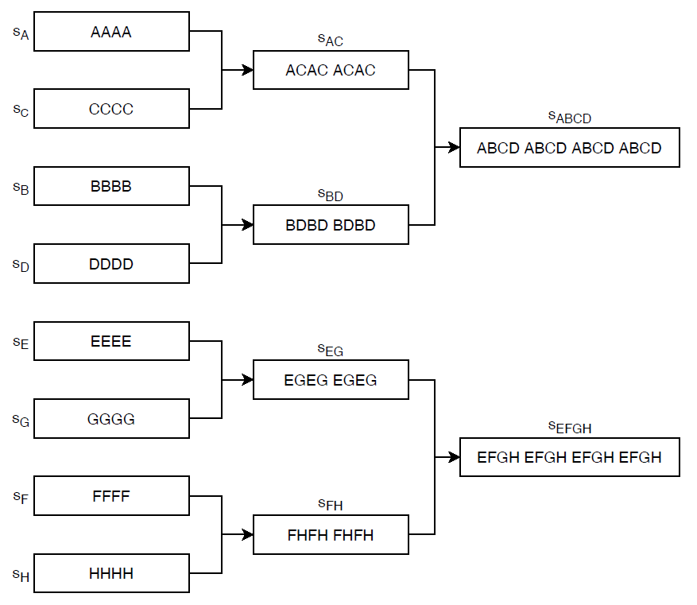
Sequence Candidates
Variable Sampling Factor (VSF) Sequences
Inspired by OVSF-Sequences [1]
Use expanded Gold sequences for the shortest stage
Combine the sequences to make the longer counterparts using presented scheme
Special:
Lower sample rate can be used at receiver
Orthogonality is maintained between "stages"
[1] “3GPP TS 25.213, v16.0.0, Spreading and modulation (FDD),” Tech. Rep., 2020.

Slide 9
Sequence Candidates
Variable Sampling Factor Sequences
Orthogonality: 𝑎(𝑛)∙𝑏(𝑛) = Σ𝑎_{𝑖}∙𝑏_{𝑖} = 0
Required orthogonalities: s_{A} and s_{E}, s_{C} and s_{G}, s_{B} and s_{F}, as well as s_{D} and s_{H}
Then also orthogonal:
s_{AC} and s_{EG} as well as s_{BD} and s_{FH}
s_{ABCD} and s_{EFGH}
With ideal subsampling in synchronous transmission, orthogonality is maintained
Principle can be adapted to lengths and set sizes required for the PM-PHY

Slide 10
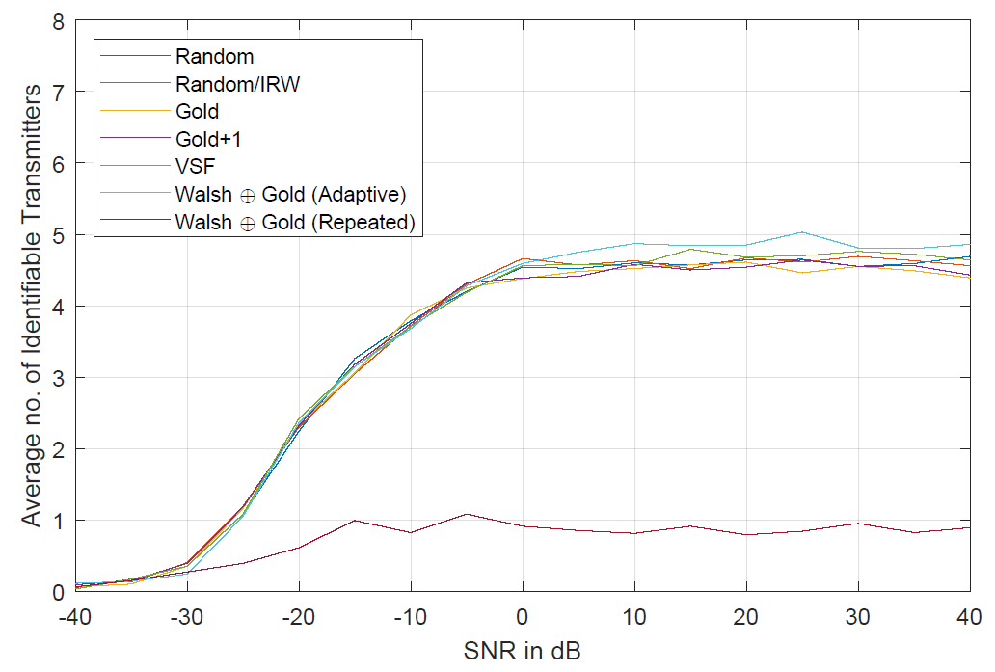
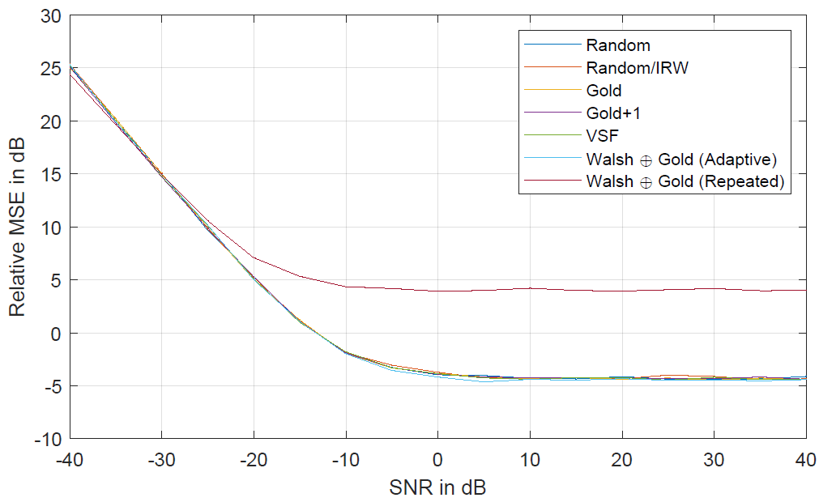
Results
Asynchronous Scenario
Virtually no differences between the non-repetitive sequences
(Repeated) sequence currently in the standard draft does not perform well

Slide 11
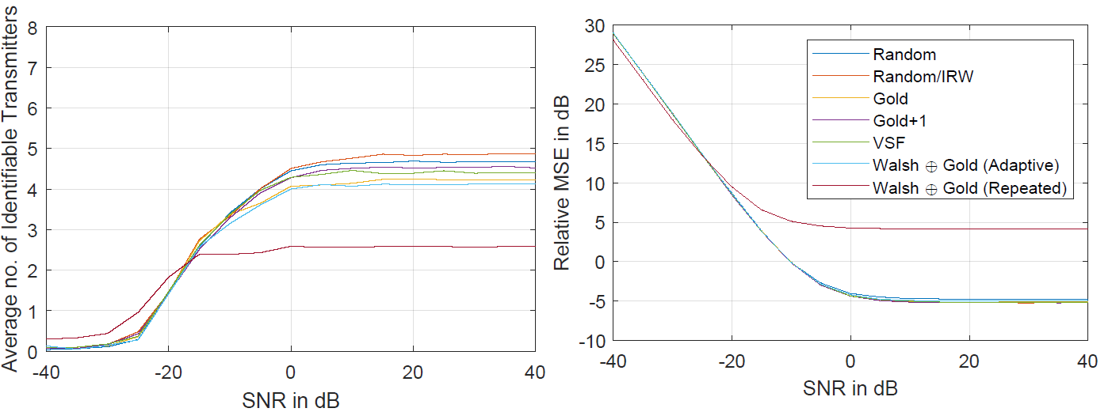
Results
Synchronous Scenario
Small differences now visible
However, seems to be highly scenario-dependent

Slide 12
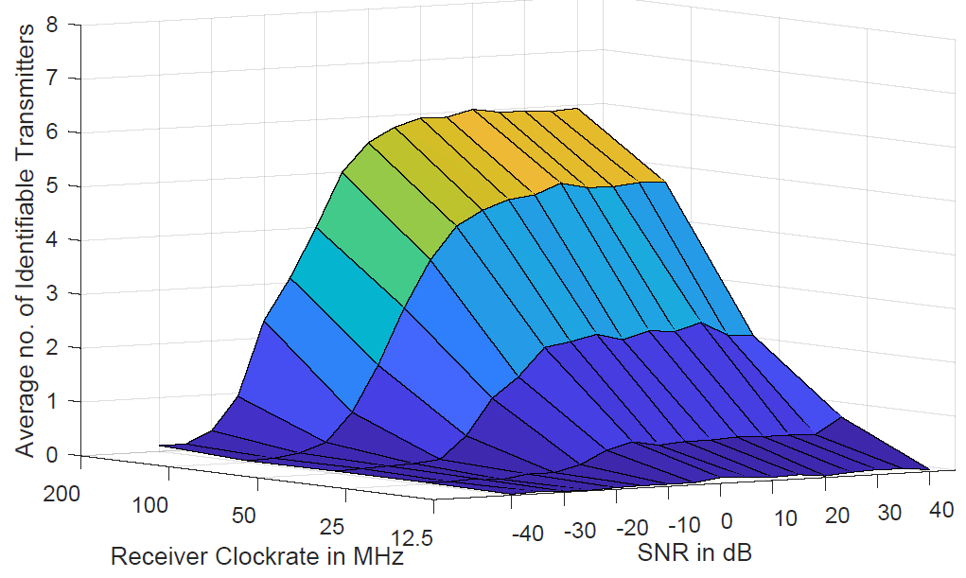
Results
VSF Evaluation & Performance
Sequences transmitted at 200 MHz in all simulations

Slide 13
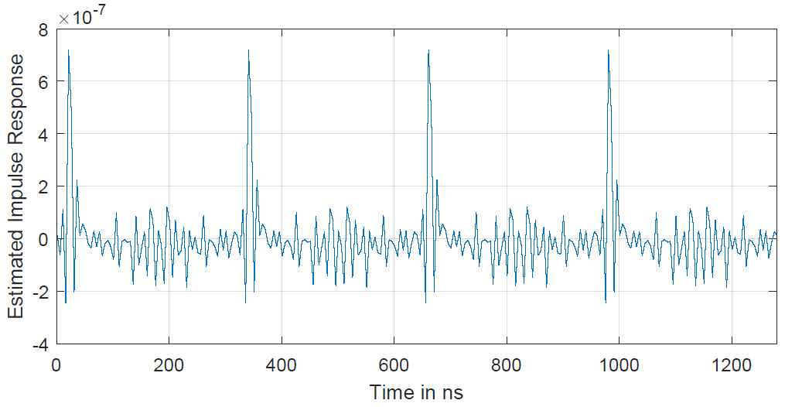
Discussion
Why do repeated sequences perform worse?
The base sequence to be repeated is shorter than the CP
This leads to a repetition of the impulse response
Which peak is the „correct“ one? => channel delay cannot be determined.

Slide 14
Conclusions
Sequence correlation properties are not as relevant at the examined lengths as anticipated.
The VSF-sequences have an additional feature (variable clock rate at the receiver)
→Therefore recommended for IEEE P802.15.13 PM-PHY
See working text in doc. 15-21/0447r0

Slide 15
Appendix

Slide 16
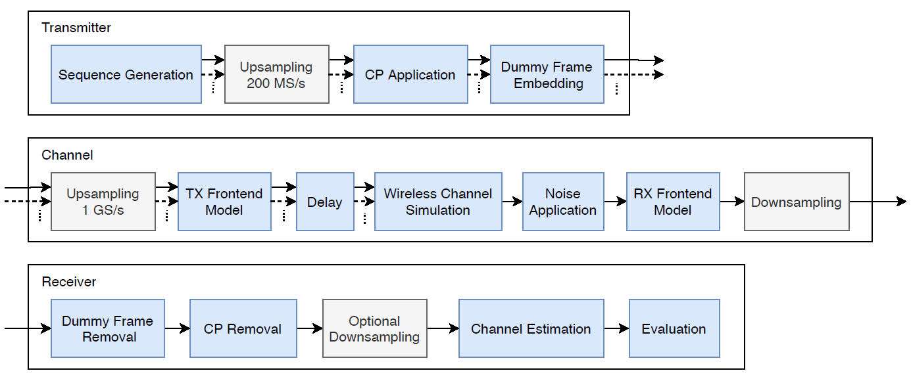
Evaluation Framework
Simulation Pipeline

Slide 17
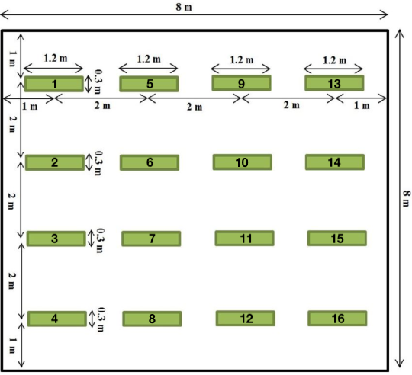
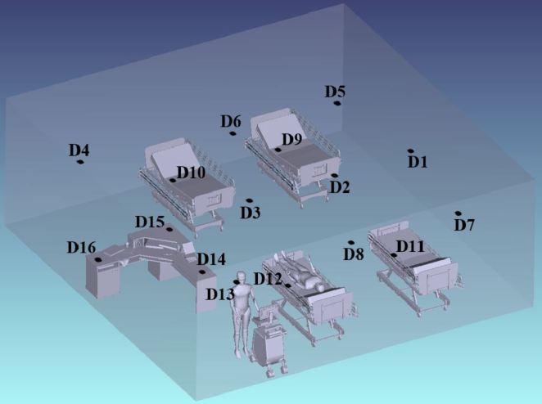
Evaluation Framework
Optical Channel Simulation
Model from 802.11bb standardization [2]
D15 was mainly used as a test point
[2] M. Uysal, F. Miramirkhani, and T. Baykas, “IEEE 802.11bb Reference Channel Models
for Indoor Environments,” Tech. Rep., 2018. [Online]. Available:
http://csndsp2018.com/Viewproject

Slide 18
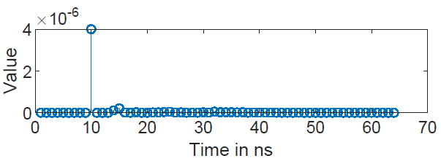
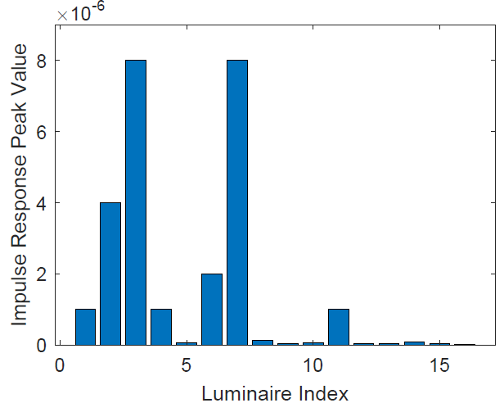
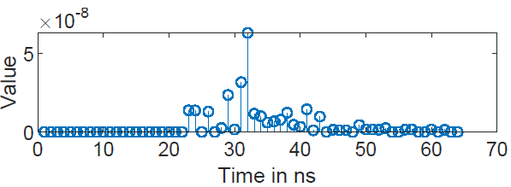
Evaluation Framework
Optical Channel Simulation
Impulse response of luminaire #2
Peak Values of all Channel Impulse Responses to D15
Impulse response of luminaire #5

Slide 19
Evaluation Metrics
Number of identifiable transmitters
Important to test the delay measurement accuracy
Transmitter is counted as identified when
Relative mean squared error (RMSE)
Relation of overall error energy to overall impulse response energy
: Delay Estimation Error
: PAM-2 Symbol Duration

