Slide 1
Project: IEEE P802.15 Working Group for Wireless Personal Area Networks (WPANs)
Submission Title: Advanced Coding for Data Communications in 802.15.4ab
Source: Carlos Aldana (Meta), Jack Zou (Meta), Carlos Bocanegra (Meta)
Address : [1 Hacker Way, Menlo Park, CA 94025]
E-Mail: [caldana (at) meta.com, jackzou (at) meta.com, cbocanegra (at) meta.com]
Re: Study Group 4ab: UWB Next Generation
Abstract: [Advanced coding for 802.15.4ab]
Purpose:
Notice: This document has been prepared to assist the IEEE P802.15. It is offered as a basis for discussion and is not binding on the contributing individual(s) or organization(s). The material in this document is subject to change in form and content after further study. The contributor(s) reserve(s) the right to add, amend or withdraw material contained herein.
Release: The contributor acknowledges and accepts that this contribution becomes the property of IEEE and may be made publicly available by P802.15.
Notes:
Jul 12, 2010
Page 1

Slide 2
Technical Guidance [1]
PAR Objective | Proposed Solution (how addressed)
Safeguards so that the high throughput data use cases will not cause significant disruption to low duty-cycle ranging use cases.
Interference mitigation techniques to support higher density and higher traffic use cases
Other coexistence improvement
Backward compatibility with enhanced ranging capable devices (ERDEVs).
Improved link budget and/or reduced air-time | advanced codes provide improved link budgets
Additional channels and operating frequencies
Improvements to accuracy / precision / reliability and interoperability for high-integrity ranging;
Reduce complexity and power consumption;
Hybrid operation with narrowband signaling to assist UWB;
Enhanced native discovery and connection setup mechanisms;
Sensing capabilities to support presence detection and environment mapping;
Low-power low-latency streaming
higher data-rate streaming allowing at least 50 Mbit/s of throughput. | advanced codes will help enable this use case
Support for peer-to-peer, peer-to-multi-peer, and station-to-infrastructure protocols;
Infrastructure synchronization mechanisms.

Slide 3
Previous Strawpoll
Are you in favor of having an optional non-BCC coding scheme (e.g. LDPC, Turbo) introduced in 802.15.4ab?
  21 Y
  0 N
  3 Abstain

Slide 4
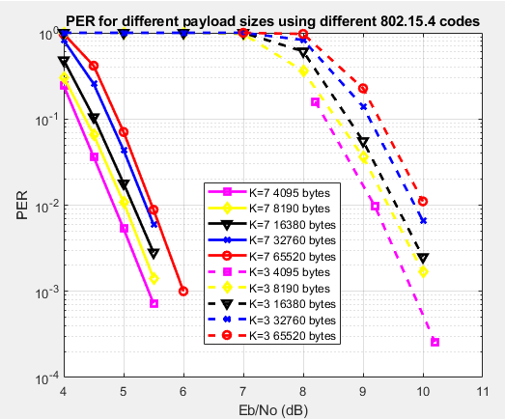
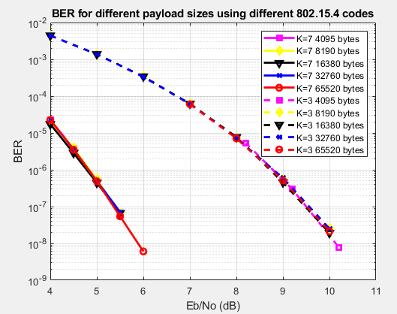
Background
Current codes defined in 802.15.4 and 802.15.4z are based on BCC
Below is BCC K=3 and K=7 performance in AWGN channel
Shannon placed an upper bound on code rate for a given BW and SNR, or equivalently a minimum SNR for a given code rate and BW.
Shannon limit for rate ½ code using BPSK or QPSK (1 bit/dim) is SNR=Eb/No=0dB.
For 1% PER, 3e-7 BER, the 802.15.4 code with K=3 is 9.2dB away from Shannon!

Slide 5
“Near” Shannon Capacity Codes
LDPC (Gallagher 1963) [2]
shown to reach within 0.0045dB from the Shannon limit [3]
amenable to parallelization (better latency)
Turbo (Berrou 1993) [4]
Polar (Arikan 2008) [5]
based on idea of channel polarization

Slide 6
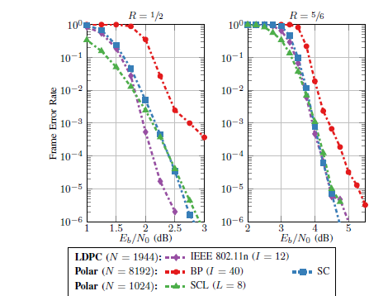
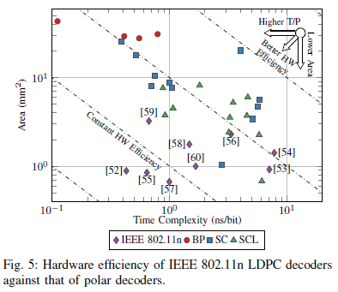
IEEE 802.11n vs Polar codes
[6] HW efficiency defined as area per decoded bit
90nm CMOS using standard Dennard scaling laws
  Area scales as s² and operating frequency scales as 1/s, where s is the technology feature size
Note: BP = belief propagation
SC = successive cancellation
SCL = successive cancellation list
Note: BP = belief propagation
SC = successive cancellation
SCL = successive cancellation list
Polar Decoders are not as HW efficient as LDPC decoders

Slide 7
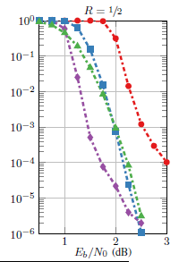
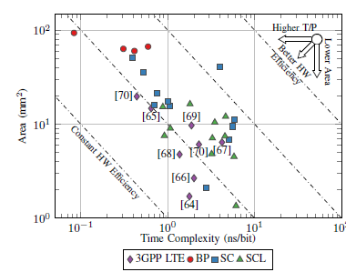

Polar vs 3GPP Turbo Results
Error floor associated with 3GPP LTE Turbo codes
  due to some combination of block size and coding rate, rate matching module leads to bad interactions between puncturing and interleaving in the turbo encoder structure . With low Hamming weights, small amounts of channel noise can induce the decoder to make completely wrong decisions, resulting in very high block error rates [7]
  Becomes worse at higher code rates [8]
Y-axis : FER

Slide 8
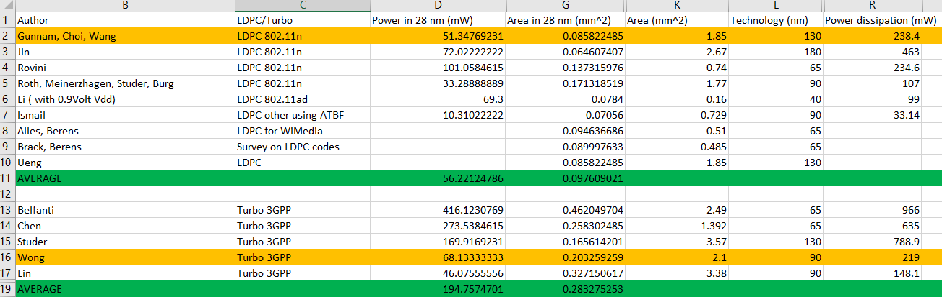
Survey of LDPC vs Turbo Decoders
Assume power scales as s, where s is the technology feature size
ATBF = adaptive threshold bit flipping
Improvements in process technology will only reduce these area and power numbers

Slide 9
802.11n LDPC vs 3GPP Turbo
 | 802.11n LDPC Gunnam, Choi (2dB from cap) | 3GPP Turbo Wong, Lee, Chang (1.5 dB from cap)
Area (28nm) [mm²] | .09 | 0.2
Power (28nm) [mW] | 51 | 68
K,N, rate | 972,1944, 1/2 | 6144, 18432, 1/3
Eb/No operating point (1e-4 PER) | 2dB | 0.9 dB
SNR (dB) operating point | 2dB | -0.86 dB

Slide 10
Simulation Scenario
AWGN channel
Floating point sims
Soft decisions
LDPC (rate ½) uses layer belief propagation with offset min-sum approximations with variable number of iterations
Turbo (3GPP, rate 1/3) uses max-log-MAP with 8 iterations
Polar (3GPP,UL, rate 1/2) uses L=8 list length, n_{max} = 10 (n_{max} is upper bound on mother code length)

Slide 11
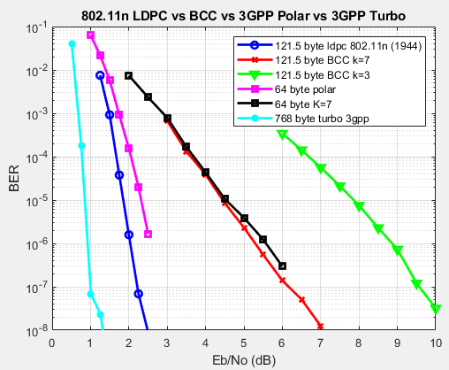
Performance for different codes
Error floor concern for turbo codes, even with floating point simulations
Inferior BER performance for Polar codes vs LDPC

Slide 12
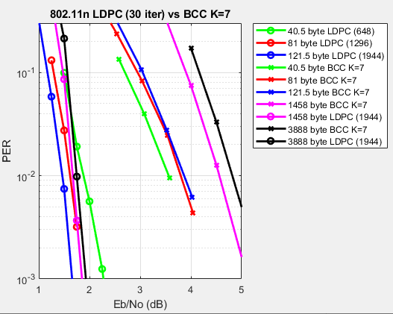
Baseline IEEE 802.11n LDPC vs BCC in AWGN
Payload (bytes) | LDPC gain (dB)
40.5 | 1.68
81 | 2.18
121.5 | 2.4
1458 | 2.89
3888 | 3.07
LDPC gains increase as payload size increases

Slide 13
LDPC on short codewords
It is now found there are gains to be had from LDPC even on short data blocks.
In fact, the shorter the block length, the larger the gain.
3 802.11n block lengths are considered
648, 1296, 1944

Slide 14
LDPC 648 on short payload
K <= 324
Step 1: Encoder finds parity bits by appending zeros to K information bits
Step 2: Ignore 324-K zeros at TX and send K information bits along with 324 parity bits.
Note: Coding rate becomes K/(K+324)
K information Bits
324-K zeros
324 parity bits
K information Bits
324 parity bits

Slide 15
LDPC 1296 on short payload
K <= 648
Step 1: Encoder finds parity bits by appending zeros to K information bits
Step 2: Ignore 648-K zeros at TX and send K information bits along with 648 parity bits.
Note: Coding rate becomes K/(K+648)
K information Bits
648-K zeros
648 parity bits
K information Bits
648 parity bits

Slide 16
LDPC 1944 on short payload
K <= 972
Step 1: Encoder finds parity bits by appending zeros to K information bits
Step 2: Ignore 972-K zeros at TX and send K information bits along with 972 parity bits.
Note: Coding rate becomes K/(K+972)
K information Bits
972-K zeros
972 parity bits
K information Bits
972 parity bits

Slide 17
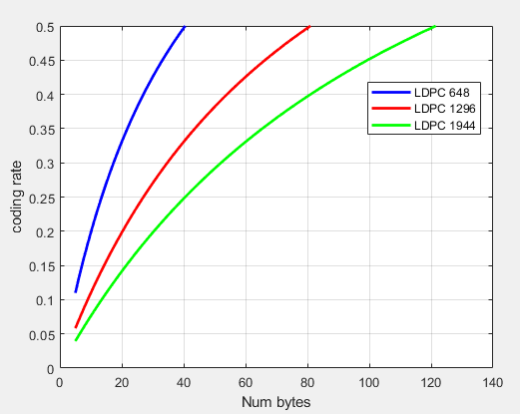
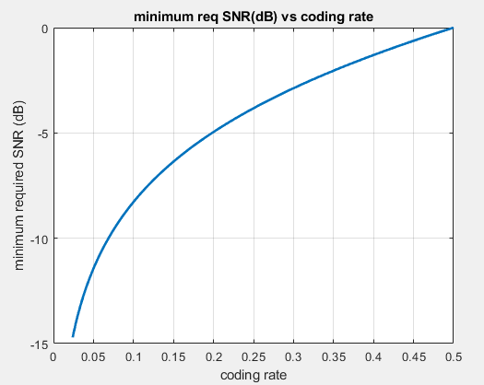
Coding Rate vs Num bytes
For rate ½ code, Shannon bound is at 0 dB. For PAM constellations, SNR(dB)>=10log₁₀ (2^{2r} -1), where r is the code rate.
For rate 1/6 code, Shannon bound is at -5.85 dB. A 5.85 dB improvement is achievable by lowering the code rate below 1/6. This may be possible using the current rate ½ LDPC codes for short payloads.

Slide 18
LDPC decoder
The LDPC decoder is trying to determine whether H*c^{T} = 0
The parity bits were acquired assuming that “zeros” in the data were transmitted.
The N/2-K “zeros” that were ignored at the TX are not ignored at the RX.
  By setting the LLRs of the “zeros” to a high value, the certainty of the “zeros” is shared across multiple equations.

Slide 19
Simulation Assumptions
Payload at the PHY level is under consideration
30 LDPC iterations
Offset min-sum approx. for LDPC
Nsync = 64 preamble symbols using length 91 code
NSFD = 8 symbols
Sync + SFD duration is 52.5us
For BCC, PHR (26 bits) sent at same symbol rate as data
For LDPC, PHR (26 bits) sent at symbol rate < data

Slide 20
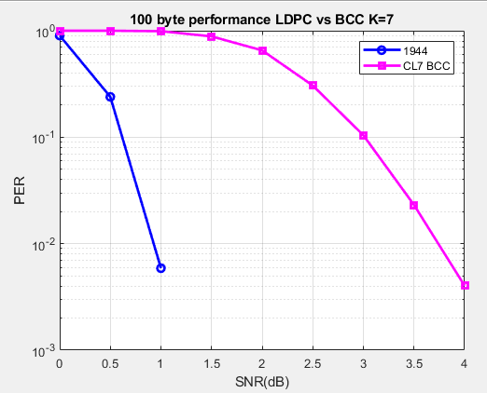
100 bytes
Packet Duration (us) /Gating gain penalty/Net Gain
2 PHR reps | CL7 BCC (us) | 1944 LDPC (us) | Gating gain penalty (dB) | Net gain (dB)
7.8 Mbps | 159.9 | 174.3 | 0.4 | 2.4
31.2 Mbps | 79.4 | 82.9 | 0.3 | 2.5
62.4 Mbps | 65.9 | 67.7 | 0.2 | 2.6
124.8 Mbps | 59.2 | 60.1 | 0.1 | 2.7
Without gating gain considerations, LDPC 1944 code gains 2.8 dB over BCC

Slide 21
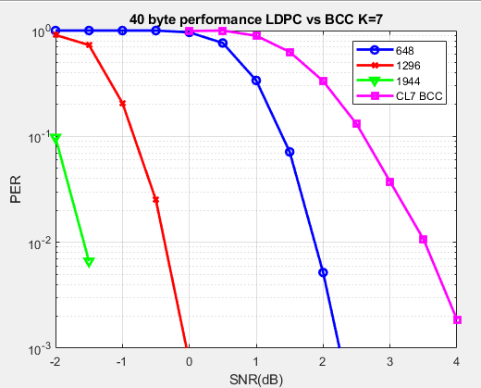
40 bytes
Packet Duration (us) /Gating gain penalty/Net Gain
3 PHR reps | CL7 BCC (us) | 1944 LDPC (us) | Gating gain penalty (dB) | Net gain (dB)
7.8 Mbps | 98.4 | 147.6 | 1.9 | 3.2
31.2 Mbps | 64.0 | 76.3 | 1.3 | 3.8
62.4 Mbps | 58.2 | 64.4 | 0.8 | 4.3
124.8 Mbps | 55.4 | 58.4 | 0.5 | 4.6
Without gating gain considerations, LDPC 1944 code gains 5.1 dB over BCC

Slide 22
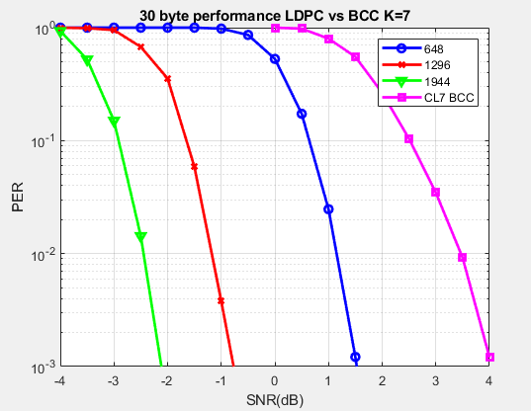
30 bytes
Packet Duration (us) /Gating gain penalty/Net Gain
3 PHR reps | CL7 BCC (us) | 1944 LDPC (us) | Gating gain penalty (dB) | Net gain (dB)
7.8 Mbps | 88.1 | 142.5 | 2.2 | 3.7
31.2 Mbps | 61.4 | 75 | 1.5 | 4.4
62.4 Mbps | 57.0 | 63.8 | 0.9 | 5.0
124.8 Mbps | 54.7 | 58.1 | 0.5 | 5.4
Without gating gain considerations, LDPC 1944 code gains 5.9 dB over BCC

Slide 23
How about PHR performance?

Slide 24
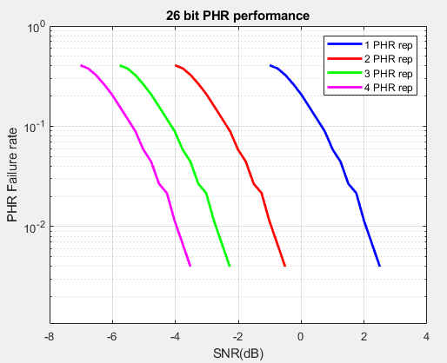
26 bit PHR performance
Num PHR reps | SNR (dB) 1% failure rate
1 | 2.06
2 | -0.95
3 | -2.7
4 | -3.96

Slide 25
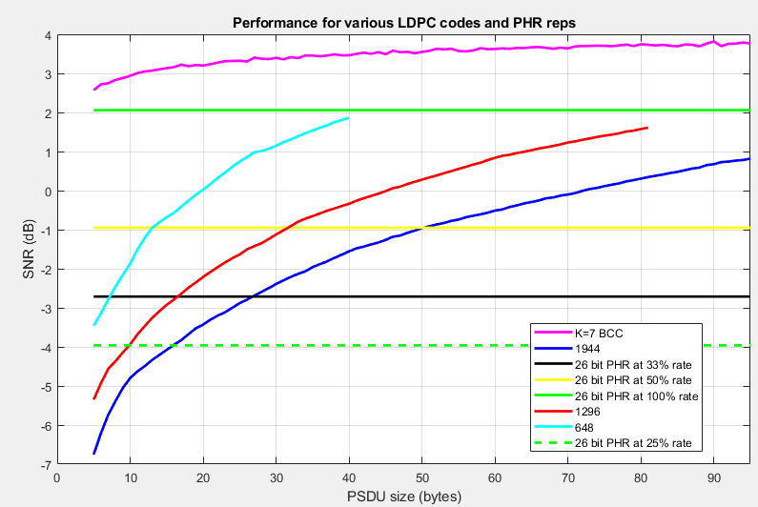
Independent PHR + LDPC results
Theoretical minimum payload length (bytes) so that PHR is not limiting
PHR rate | 648 | 1296 | 1944
0.5 (Num PHR reps =2) | 13 | 32 | 51
0.33 (Num PHR reps =3) | 8 | 17 | 27
0.25 (Num PHR reps =4) | 5 | 10 | 16
Note that actual minimum payload lengths are greater than the values listed in this table

Slide 26
Joint PHR + LDPC Results

Slide 27
Simulation Assumptions
AWGN channel
Assume perfect SYNC and SFD detection as well as channel estimation
For 7.8 Mbps,
Nsync = 64 preamble symbols using length 91 code
NSFD = 8 symbols
For 1.95 Mbps
Nsync = 128 preamble symbols using length 91 code
NSFD = 32 symbols
Sync + SFD duration is 52.5us
26 bit PHR from Meta
SNR (Symbol)+ Gating gain is included
SNR (symbol) = SNR – 10*log10(#chips/symbol)
= SNR – SNR_adj
Data rate (Mb/s) | #chips /symbol | SNR_adj (dB)
1.95 | 256 | 24.1
7.8 | 64 | 18.1
31.2 | 16 | 12
62.4 | 8 | 9
124.8 | 4 | 6

Slide 28
What does performance look like for 7.8 Mbps when PHR reps =2,3, or 4?

Slide 29
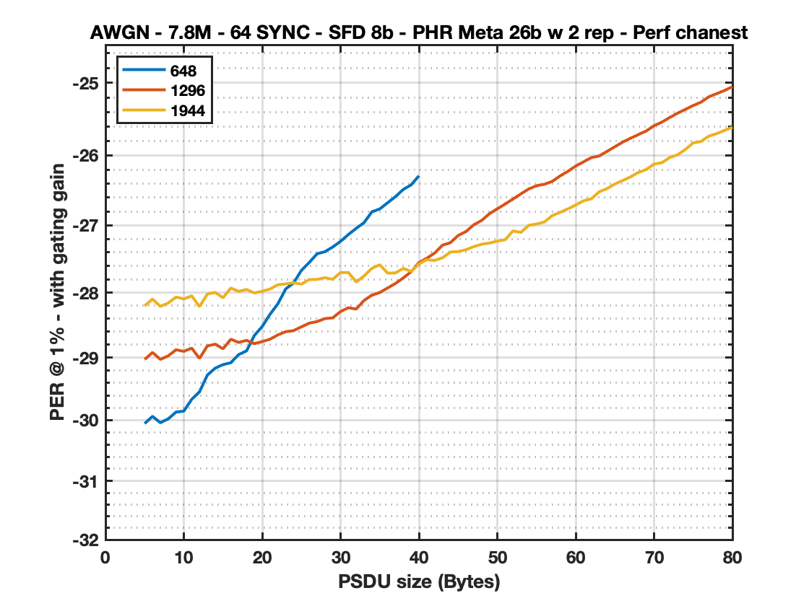
648 vs 1296 vs 1944 - 2 reps - genie ON (SYNC,SFD)
PSDU | 648 | 1296 | 1944
5 | -30.0543 | -29.0321 | -28.2054
6 | -29.9372 | -28.921 | -28.098
7 | -30.04 | -29.0298 | -28.2103
8 | -29.9801 | -28.9756 | -28.1597
9 | -29.8689 | -28.8802 | -28.0685
10 | -29.853 | -28.9038 | -28.0964
11 | -29.6645 | -28.8538 | -28.0497
12 | -29.5436 | -29.0148 | -28.2144
13 | -29.2771 | -28.8193 | -28.023
14 | -29.1679 | -28.7922 | -27.9987
15 | -29.1124 | -28.8643 | -28.0783
16 | -29.0817 | -28.7157 | -27.9317
17 | -28.9539 | -28.7651 | -27.9825
18 | -28.8971 | -28.7334 | -27.9539
19 | -28.6569 | -28.7834 | -28.0067
20 | -28.519 | -28.7525 | -27.9806
21 | -28.3298 | -28.7151 | -27.9463
22 | -28.1704 | -28.6482 | -27.8825
23 | -27.9459 | -28.5989 | -27.8701
24 | -27.8556 | -28.5828 | -27.8514
25 | -27.6674 | -28.524 | -27.8737
26 | -27.5495 | -28.4672 | -27.804
27 | -27.4198 | -28.4425 | -27.8028
28 | -27.3886 | -28.3974 | -27.7763
29 | -27.3199 | -28.3857 | -27.7999
30 | -27.2356 | -28.2891 | -27.6989
PSDU | 648 | 1296 | 1944
31 | -27.1352 | -28.2306 | -27.6979
32 | -27.0452 | -28.2506 | -27.8417
33 | -26.9616 | -28.1192 | -27.7499
34 | -26.8044 | -28.0393 | -27.6361
35 | -26.7632 | -27.9998 | -27.5822
36 | -26.6746 | -27.9312 | -27.7075
37 | -26.5858 | -27.863 | -27.7048
38 | -26.4828 | -27.78 | -27.6372
39 | -26.4176 | -27.6876 | -27.6834
40 | -26.2886 | -27.5503 | -27.5711
41 |  | -27.4864 | -27.5077
42 |  | -27.4095 | -27.5187
43 |  | -27.2921 | -27.4796
44 |  | -27.2563 | -27.3939
45 |  | -27.1511 | -27.3867
46 |  | -27.0926 | -27.36
47 |  | -26.9932 | -27.3141
48 |  | -26.9304 | -27.2779
49 |  | -26.8315 | -27.261
50 |  | -26.7613 | -27.2326
51 |  | -26.6922 | -27.2127
52 |  | -26.6199 | -27.0821
53 |  | -26.5468 | -27.1052
54 |  | -26.4767 | -27.0022
55 |  | -26.4299 | -26.982
56 |  | -26.4087 | -26.9531
PSDU | 648 | 1296 | 1944
57 |  | -26.3681 | -26.8604
58 |  | -26.2905 | -26.8135
59 |  | -26.2258 | -26.7629
60 |  | -26.1503 | -26.7065
61 |  | -26.0902 | -26.6456
62 |  | -26.0303 | -26.6162
63 |  | -26.0079 | -26.5167
64 |  | -25.9436 | -26.4706
65 |  | -25.878 | -26.4045
66 |  | -25.8137 | -26.3546
67 |  | -25.7603 | -26.3036
68 |  | -25.7082 | -26.2395
69 |  | -25.6588 | -26.1992
70 |  | -25.5866 | -26.1214
71 |  | -25.5361 | -26.1025
72 |  | -25.4731 | -26.0296
73 |  | -25.4138 | -25.9922
74 |  | -25.3619 | -25.916
75 |  | -25.3082 | -25.8245
76 |  | -25.2618 | -25.8048
77 |  | -25.1888 | -25.7292
78 |  | -25.146 | -25.6957
79 |  | -25.1036 | -25.6502
80 |  | -25.0526 | -25.6076
Through sims, we have found that the best combination is:
648 CBS when PSDU <= 18 Bytes
1296 CBS when PSDU in [19,39] Bytes
1944 CBS when PSDU >= 40 Bytes

Slide 30
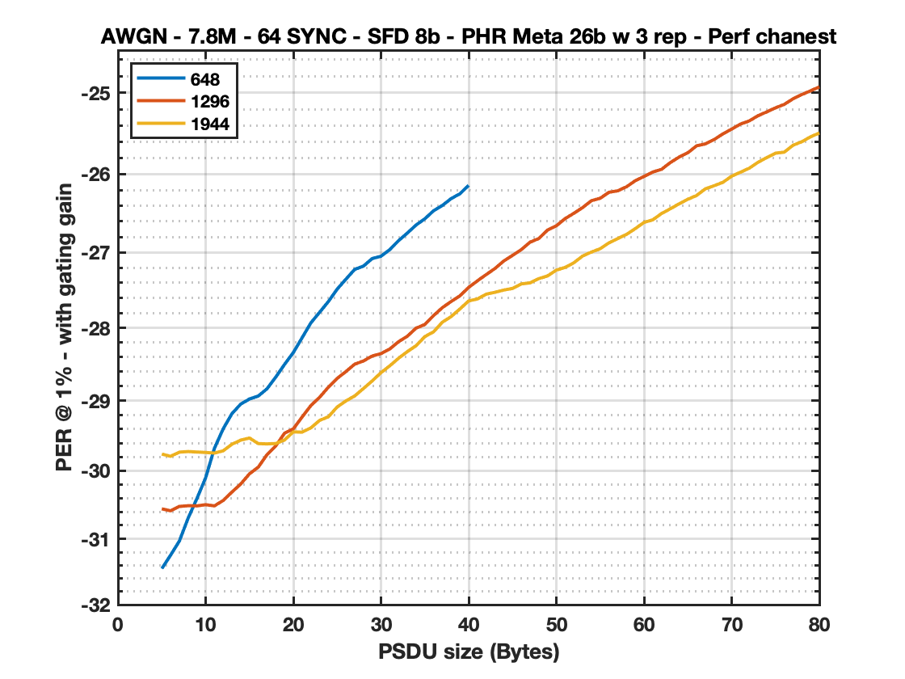
648 vs 1296 vs 1944 - 3 reps - genie ON (SYNC,SFD)
PSDU | 648 | 1296 | 1944
5 | -31.449 | -30.5552 | -29.7582
6 | -31.246 | -30.5841 | -29.7911
7 | -31.0341 | -30.52 | -29.7308
8 | -30.6937 | -30.5087 | -29.7222
9 | -30.4053 | -30.5118 | -29.7294
10 | -30.1006 | -30.4943 | -29.7353
11 | -29.6762 | -30.5113 | -29.744
12 | -29.3983 | -30.4323 | -29.7119
13 | -29.1839 | -30.3089 | -29.6176
14 | -29.0496 | -30.1916 | -29.5591
15 | -28.9788 | -30.0435 | -29.5292
16 | -28.9368 | -29.9474 | -29.6086
17 | -28.8364 | -29.7672 | -29.6128
18 | -28.674 | -29.6405 | -29.6077
19 | -28.4989 | -29.4609 | -29.5566
20 | -28.3369 | -29.3992 | -29.4419
21 | -28.1353 | -29.2316 | -29.4458
22 | -27.9347 | -29.071 | -29.3853
23 | -27.7912 | -28.9542 | -29.2792
24 | -27.6479 | -28.8139 | -29.2282
25 | -27.4833 | -28.6921 | -29.0908
26 | -27.3514 | -28.5975 | -29.0054
27 | -27.2226 | -28.4956 | -28.9358
28 | -27.1794 | -28.4519 | -28.8324
29 | -27.0801 | -28.3834 | -28.7267
30 | -27.0505 | -28.3514 | -28.6126
PSDU | 648 | 1296 | 1944
31 | -26.9647 | -28.288 | -28.5186
32 | -26.8481 | -28.1891 | -28.4152
33 | -26.7499 | -28.1151 | -28.3243
34 | -26.6463 | -28.0048 | -28.2435
35 | -26.5664 | -27.9557 | -28.1196
36 | -26.4633 | -27.8353 | -28.0544
37 | -26.3959 | -27.7292 | -27.9246
38 | -26.3087 | -27.6477 | -27.8494
39 | -26.2476 | -27.5722 | -27.7472
40 | -26.1409 | -27.4594 | -27.6399
41 |  | -27.3728 | -27.6133
42 |  | -27.2908 | -27.5497
43 |  | -27.2106 | -27.5248
44 |  | -27.1127 | -27.4952
45 |  | -27.0394 | -27.474
46 |  | -26.965 | -27.414
47 |  | -26.8675 | -27.3999
48 |  | -26.82 | -27.3442
49 |  | -26.7109 | -27.3083
50 |  | -26.6567 | -27.232
51 |  | -26.5638 | -27.1968
52 |  | -26.4957 | -27.1357
53 |  | -26.4225 | -27.0471
54 |  | -26.3352 | -26.9958
55 |  | -26.3047 | -26.9528
56 |  | -26.2289 | -26.8762
PSDU | 648 | 1296 | 1944
57 |  | -26.21 | -26.8204
58 |  | -26.1594 | -26.7674
59 |  | -26.083 | -26.6929
60 |  | -26.0288 | -26.6123
61 |  | -25.9738 | -26.5797
62 |  | -25.94 | -26.4986
63 |  | -25.8557 | -26.4386
64 |  | -25.7873 | -26.3749
65 |  | -25.7335 | -26.3168
66 |  | -25.6472 | -26.2692
67 |  | -25.6236 | -26.1852
68 |  | -25.57 | -26.1456
69 |  | -25.5 | -26.1027
70 |  | -25.4417 | -26.0256
71 |  | -25.3796 | -25.9761
72 |  | -25.3417 | -25.9264
73 |  | -25.2777 | -25.8522
74 |  | -25.2312 | -25.7941
75 |  | -25.1817 | -25.7383
76 |  | -25.1394 | -25.726
77 |  | -25.0725 | -25.6404
78 |  | -25.021 | -25.5967
79 |  | -24.9758 | -25.536
80 |  | -24.9285 | -25.4892
Through sims, we have found that the best combination is:
648 CBS when PSDU <= 8 Bytes
1296 CBS when PSDU in [9,18] Bytes
1944 CBS when PSDU >= 19 Bytes

Slide 31
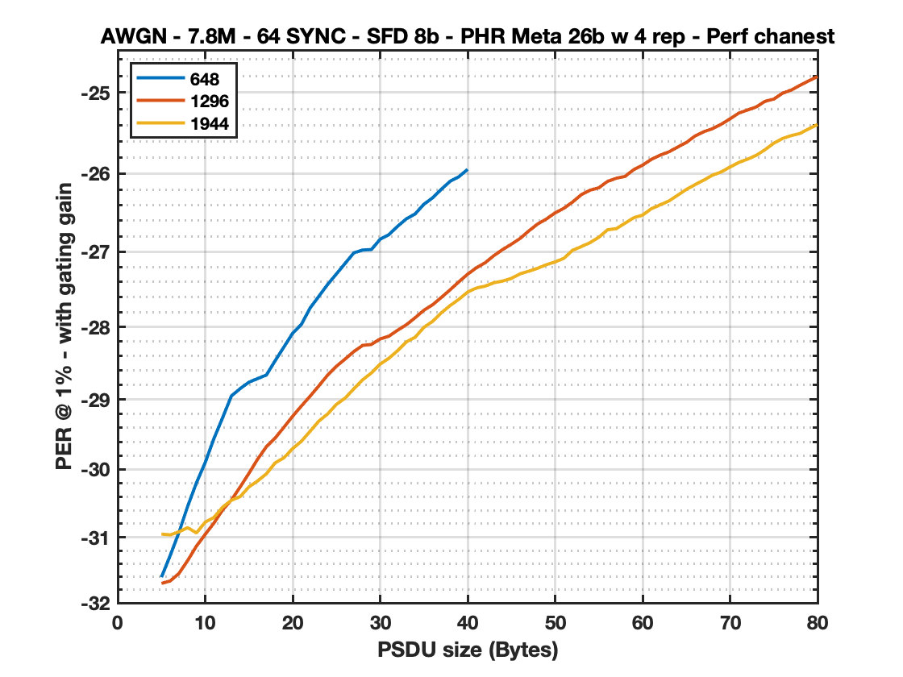
648 vs 1296 vs 1944 - 4 reps - genie ON (SYNC,SFD)
PSDU | 648 | 1296 | 1944
5 | -31.6055 | -31.7006 | -30.9526
6 | -31.2757 | -31.663 | -30.9649
7 | -30.9287 | -31.5485 | -30.9194
8 | -30.5392 | -31.351 | -30.8571
9 | -30.1952 | -31.1336 | -30.9361
10 | -29.9007 | -30.9577 | -30.7754
11 | -29.5547 | -30.7881 | -30.7047
12 | -29.2563 | -30.5917 | -30.5515
13 | -28.9512 | -30.4469 | -30.4507
14 | -28.8501 | -30.2549 | -30.3976
15 | -28.7602 | -30.0564 | -30.2545
16 | -28.7099 | -29.8499 | -30.1667
17 | -28.6597 | -29.6715 | -30.063
18 | -28.463 | -29.5477 | -29.9043
19 | -28.2749 | -29.394 | -29.8314
20 | -28.0864 | -29.2377 | -29.6989
21 | -27.9667 | -29.0932 | -29.5934
22 | -27.7452 | -28.9548 | -29.4506
23 | -27.5889 | -28.8101 | -29.3057
24 | -27.4319 | -28.6615 | -29.2057
25 | -27.2929 | -28.5399 | -29.0703
26 | -27.1533 | -28.4396 | -28.9822
27 | -27.0155 | -28.3367 | -28.8515
28 | -26.9791 | -28.2526 | -28.7277
29 | -26.9732 | -28.24 | -28.6316
30 | -26.8386 | -28.1644 | -28.5097
PSDU | 648 | 1296 | 1944
31 | -26.7791 | -28.1276 | -28.4292
32 | -26.6704 | -28.046 | -28.3247
33 | -26.575 | -27.9716 | -28.2047
34 | -26.5121 | -27.8772 | -28.142
35 | -26.3878 | -27.7764 | -28.0073
36 | -26.3063 | -27.7026 | -27.9255
37 | -26.197 | -27.6043 | -27.8103
38 | -26.0969 | -27.5033 | -27.7135
39 | -26.0387 | -27.397 | -27.6299
40 | -25.9463 | -27.2959 | -27.5336
41 |  | -27.2123 | -27.4792
42 |  | -27.1457 | -27.4546
43 |  | -27.0525 | -27.4094
44 |  | -26.9727 | -27.3873
45 |  | -26.9034 | -27.352
46 |  | -26.8282 | -27.2913
47 |  | -26.7302 | -27.256
48 |  | -26.6419 | -27.2176
49 |  | -26.5773 | -27.1713
50 |  | -26.4983 | -27.1343
51 |  | -26.44 | -27.0878
52 |  | -26.3595 | -26.9821
53 |  | -26.2661 | -26.9342
54 |  | -26.2091 | -26.882
55 |  | -26.1784 | -26.8129
56 |  | -26.0976 | -26.7162
PSDU | 648 | 1296 | 1944
57 |  | -26.058 | -26.7013
58 |  | -26.0346 | -26.6307
59 |  | -25.9487 | -26.5605
60 |  | -25.8941 | -26.5271
61 |  | -25.8213 | -26.446
62 |  | -25.7685 | -26.3958
63 |  | -25.7284 | -26.3472
64 |  | -25.6688 | -26.2741
65 |  | -25.6119 | -26.1999
66 |  | -25.5305 | -26.1391
67 |  | -25.478 | -26.082
68 |  | -25.4408 | -26.0189
69 |  | -25.3859 | -25.979
70 |  | -25.3201 | -25.9166
71 |  | -25.2496 | -25.8596
72 |  | -25.212 | -25.819
73 |  | -25.1746 | -25.7709
74 |  | -25.106 | -25.7007
75 |  | -25.0793 | -25.6203
76 |  | -25.0082 | -25.5616
77 |  | -24.9691 | -25.5262
78 |  | -24.9133 | -25.4996
79 |  | -24.8579 | -25.4428
80 |  | -24.8081 | -25.3902
Through sims, we have found that the best combination is:
1296 CBS when PSDU <= 12 Bytes
1944 CBS when PSDU > 12 Bytes

Slide 32
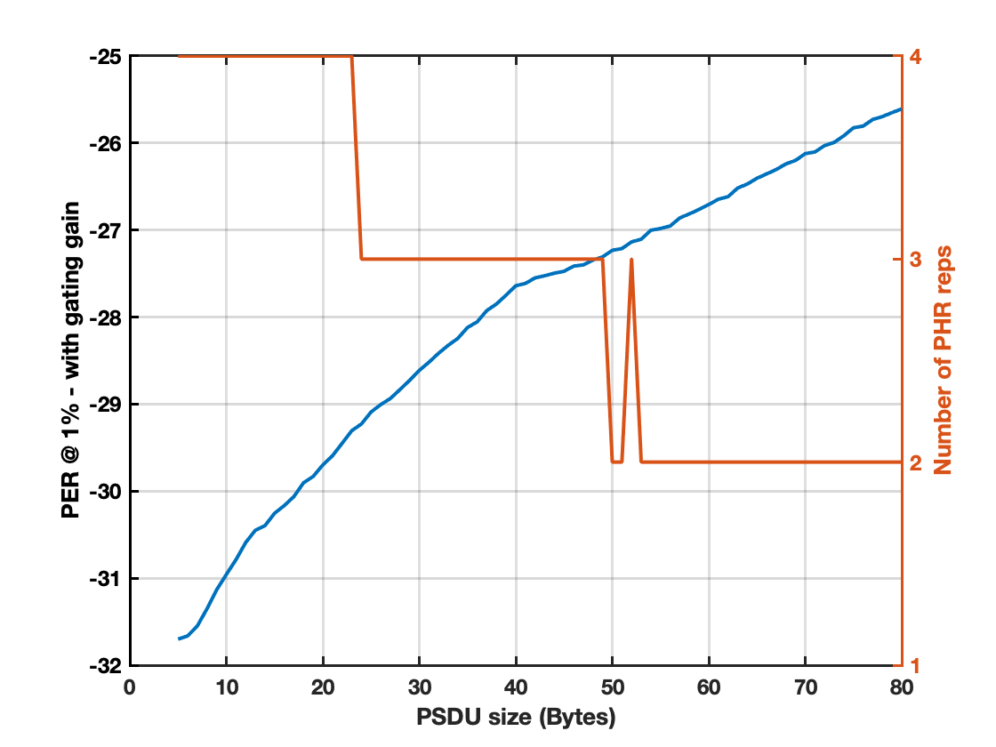
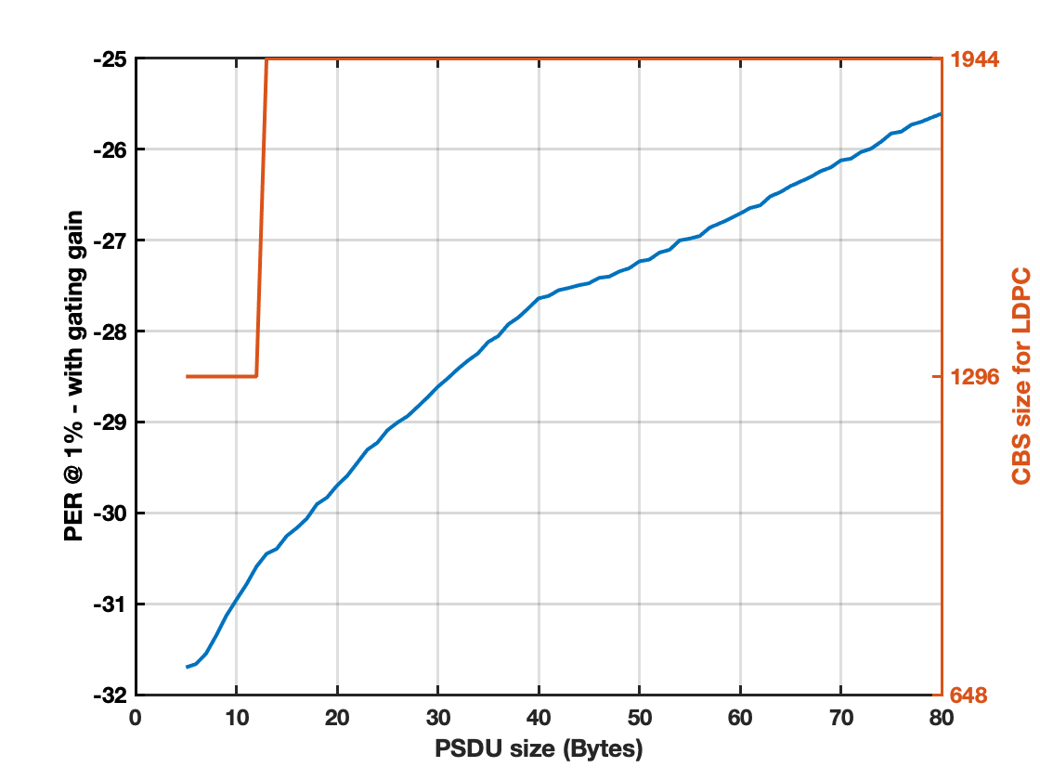
Global comparison for 7.8Mbps - genie ON (SYNC,SFD)
PSDU | REPS | CBS | SNR @ 1%
5 | 4 | 1296 | -31.7006
6 | 4 | 1296 | -31.663
7 | 4 | 1296 | -31.5485
8 | 4 | 1296 | -31.351
9 | 4 | 1296 | -31.1336
10 | 4 | 1296 | -30.9577
11 | 4 | 1296 | -30.7881
12 | 4 | 1296 | -30.5917
13 | 4 | 1944 | -30.4507
14 | 4 | 1944 | -30.3976
15 | 4 | 1944 | -30.2545
16 | 4 | 1944 | -30.1667
17 | 4 | 1944 | -30.063
18 | 4 | 1944 | -29.9043
19 | 4 | 1944 | -29.8314
20 | 4 | 1944 | -29.6989
21 | 4 | 1944 | -29.5934
22 | 4 | 1944 | -29.4506
23 | 4 | 1944 | -29.3057
24 | 3 | 1944 | -29.2282
25 | 3 | 1944 | -29.0908
26 | 3 | 1944 | -29.0054
27 | 3 | 1944 | -28.9358
28 | 3 | 1944 | -28.8324
29 | 3 | 1944 | -28.7267
30 | 3 | 1944 | -28.6126
PSDU | REPS | CBS | SNR @ 1%
31 | 3 | 1944 | -28.5186
32 | 3 | 1944 | -28.4152
33 | 3 | 1944 | -28.3243
34 | 3 | 1944 | -28.2435
35 | 3 | 1944 | -28.1196
36 | 3 | 1944 | -28.0544
37 | 3 | 1944 | -27.9246
38 | 3 | 1944 | -27.8494
39 | 3 | 1944 | -27.7472
40 | 3 | 1944 | -27.6399
41 | 3 | 1944 | -27.6133
42 | 3 | 1944 | -27.5497
43 | 3 | 1944 | -27.5248
44 | 3 | 1944 | -27.4952
45 | 3 | 1944 | -27.474
46 | 3 | 1944 | -27.414
47 | 3 | 1944 | -27.3999
48 | 3 | 1944 | -27.3442
49 | 3 | 1944 | -27.3083
50 | 2 | 1944 | -27.2326
51 | 2 | 1944 | -27.2127
52 | 3 | 1944 | -27.1357
53 | 2 | 1944 | -27.1052
54 | 2 | 1944 | -27.0022
55 | 2 | 1944 | -26.982
56 | 2 | 1944 | -26.9531
PSDU | REPS | CBS | SNR @ 1%
57 | 2 | 1944 | -26.8604
58 | 2 | 1944 | -26.8135
59 | 2 | 1944 | -26.7629
60 | 2 | 1944 | -26.7065
61 | 2 | 1944 | -26.6456
62 | 2 | 1944 | -26.6162
63 | 2 | 1944 | -26.5167
64 | 2 | 1944 | -26.4706
65 | 2 | 1944 | -26.4045
66 | 2 | 1944 | -26.3546
67 | 2 | 1944 | -26.3036
68 | 2 | 1944 | -26.2395
69 | 2 | 1944 | -26.1992
70 | 2 | 1944 | -26.1214
71 | 2 | 1944 | -26.1025
72 | 2 | 1944 | -26.0296
73 | 2 | 1944 | -25.9922
74 | 2 | 1944 | -25.916
75 | 2 | 1944 | -25.8245
76 | 2 | 1944 | -25.8048
77 | 2 | 1944 | -25.7292
78 | 2 | 1944 | -25.6957
79 | 2 | 1944 | -25.6502
80 | 2 | 1944 | -25.6076
57 | 2 | 1944 | -26.8604
Allowing for variable number of PHR repetitions, the results suggest that we should use LDPC 1296 for 12 bytes or less and 1944 for 13 bytes or more.
Notes:
If LDPC hardcoded to 4 reps, how much do we lose for pkts >= 24B?
CRC analysis - how short can it get? Analyze 6, 7, and 8 bit CRC.
Tradeoff between packet length, loss in gating gain, loss in 1% PER <-> false alarm
7.8Mbps, AWGN, Genie ON (SYNC, SFD), PSDU 40 Bytes.
Work on replicating results using Qorvos new PHR.

Slide 33
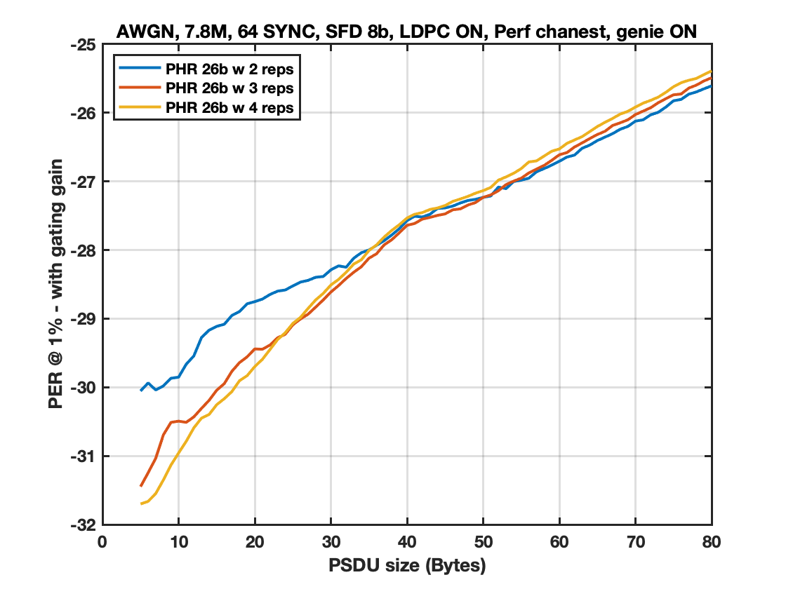
Global comparison for 7.8Mbps - genie ON (SYNC,SFD)
The plot above shows ~1dB performance benefit of using either 3 or 4 PHR reps for smaller PSDU sizes while incurring minimal loss for the larger PSDU sizes.

Slide 34
What does performance look like for 1.95 Mbps when PHR reps =2?

Slide 35
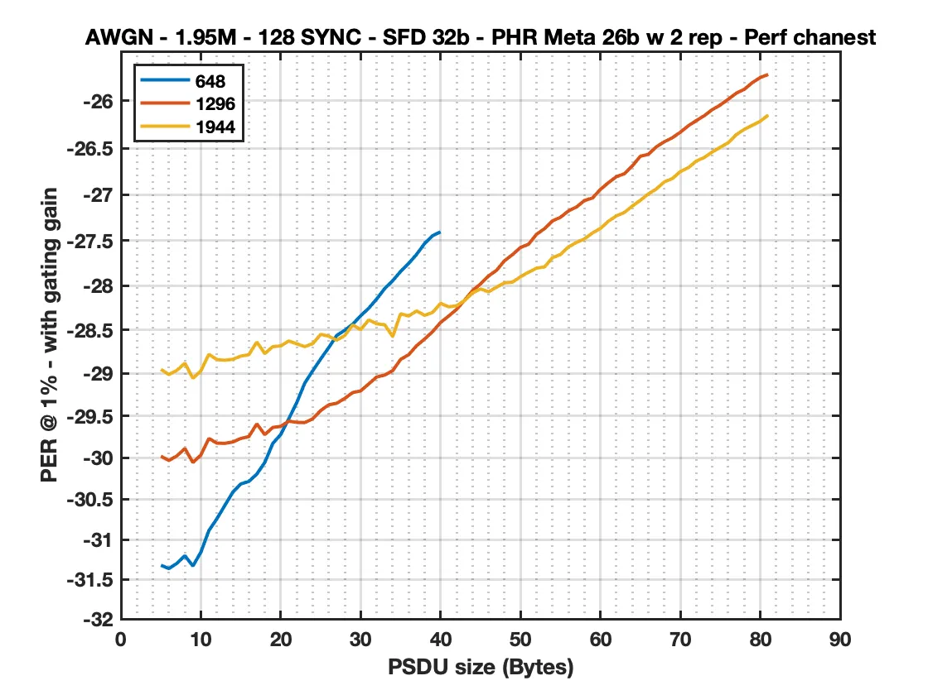
648 vs 1296 vs 1944 - 2 reps - genie ON (SYNC,SFD)
PSDU | 648 | 1296 | 1944
5 | -31.3199 | -29.9808 | -28.9555
6 | -31.3613 | -30.0328 | -29.0164
7 | -31.2956 | -29.9765 | -28.9662
8 | -31.2003 | -29.8886 | -28.8844
9 | -31.3299 | -30.0569 | -29.0599
10 | -31.1562 | -29.9667 | -28.9734
11 | -30.8881 | -29.7687 | -28.7816
12 | -30.7426 | -29.8243 | -28.8427
13 | -30.5777 | -29.8269 | -28.8503
14 | -30.4156 | -29.8102 | -28.839
15 | -30.316 | -29.7685 | -28.8026
16 | -30.2857 | -29.7469 | -28.7863
17 | -30.1965 | -29.5952 | -28.6404
18 | -30.0553 | -29.7229 | -28.7727
19 | -29.8277 | -29.6373 | -28.6931
20 | -29.7208 | -29.6248 | -28.6848
21 | -29.5337 | -29.5625 | -28.6281
22 | -29.3439 | -29.5775 | -28.661
23 | -29.1158 | -29.5798 | -28.6932
24 | -28.9721 | -29.5344 | -28.6586
25 | -28.8343 | -29.4367 | -28.5522
26 | -28.7049 | -29.3702 | -28.5736
27 | -28.5645 | -29.3515 | -28.6194
28 | -28.5067 | -29.2946 | -28.5665
29 | -28.4366 | -29.2262 | -28.4447
30 | -28.3406 | -29.2065 | -28.4981
PSDU | 648 | 1296 | 1944
31 | -28.2555 | -29.1253 | -28.3884
32 | -28.1513 | -29.0449 | -28.4314
33 | -28.0344 | -29.0216 | -28.4432
34 | -27.946 | -28.9715 | -28.5772
35 | -27.8417 | -28.8402 | -28.3177
36 | -27.7533 | -28.7864 | -28.3438
37 | -27.652 | -28.6822 | -28.286
38 | -27.5319 | -28.606 | -28.3366
39 | -27.4455 | -28.5216 | -28.3027
40 | -27.4046 | -28.4165 | -28.2005
41 |  | -28.3447 | -28.2392
42 |  | -28.2681 | -28.2282
43 |  | -28.1638 | -28.1679
44 |  | -28.057 | -28.0822
45 |  | -27.9808 | -28.0378
46 |  | -27.8925 | -28.0697
47 |  | -27.829 | -28.0184
48 |  | -27.7224 | -27.9689
49 |  | -27.6546 | -27.961
50 |  | -27.5756 | -27.9006
51 |  | -27.5407 | -27.8506
52 |  | -27.4309 | -27.8046
53 |  | -27.3692 | -27.7923
54 |  | -27.2842 | -27.6891
55 |  | -27.2443 | -27.6535
56 |  | -27.1751 | -27.5685
PSDU | 648 | 1296 | 1944
57 |  | -27.133 | -27.5214
58 |  | -27.0616 | -27.4806
59 |  | -27.0352 | -27.4159
60 |  | -26.9416 | -27.3668
61 |  | -26.869 | -27.2873
62 |  | -26.8043 | -27.2295
63 |  | -26.7734 | -27.1916
64 |  | -26.6883 | -27.1216
65 |  | -26.5858 | -27.0594
66 |  | -26.5657 | -26.9905
67 |  | -26.4855 | -26.9371
68 |  | -26.4321 | -26.8599
69 |  | -26.3898 | -26.8253
70 |  | -26.3312 | -26.7494
71 |  | -26.2636 | -26.7085
72 |  | -26.2092 | -26.6375
73 |  | -26.1571 | -26.5992
74 |  | -26.0937 | -26.5404
75 |  | -26.0457 | -26.4906
76 |  | -25.9852 | -26.4425
77 |  | -25.9232 | -26.3565
78 |  | -25.8832 | -26.3019
79 |  | -25.8143 | -26.2588
80 |  | -25.7605 | -26.2156
81 |  | -25.7293 | -26.1509
Through sims, we have found that the best combination is:
648 CBS when PSDU <= 20 Bytes
1296 CBS when PSDU in [21,42] Bytes
1944 CBS when PSDU >= 43 Bytes

Slide 36
Conclusions
LDPC was successfully introduced in 802.11n [12] and 5G NR as well as other standard bodies (e.g., 802.15.3c, 802.11ad/ay, 802.16e, 802.3an, and DVB-S2) and is a mature technology that should be considered in IEEE 802.15.4ab
LDPC provides substantial coding gains for both long and short payloads
  For short payloads, LDPC gains improve with higher data rates
LDPC decoder could have both small area and low power in <=28nm CMOS
For 7.8 Mbps and above, 3 or 4 PHR repetitions should be used and LDPC 1296 should be used for 12 bytes or less and LDPC 1944 for 13 bytes or more.
For 1.95 Mbps with 2 PHR repetitions, LDPC 648 should be used for 20 bytes or less, 1296 for payloads between 21 and 42 bytes, and 1944 for payloads greater than or equal to 43 bytes.

Slide 37
References
[1] 15-21-297-01 15.4.ab Technical Guidance Doc
[2] R.G. Gallagher, “Low-Density Parity-Check Codes”. Cambridge, MA : MIT Press, 1963.
[3] Chung, et al, “On the design of low-density parity-check codes within 0.0045dB of the Shannon limit”, IEEE Commun. Letters, vol. 5, no.2, pp.58-60, February 2001.
[4] Berrou, et al, “Near Shannon Limit Error – Correcting coding and decoding : Turbo Codes”, Proceedings of ICC ’93 – IEEE International Conference on Communications
[5] Arikan, “A performance comparison of polar codes and Reed-Muller codes”, IEEE Communications Letters, 2008, vol. 12, issue 6.
[6] Balatsoukas-Stimming, Giard, Burg, “Comparison of Polar Decoders with Existing Low-Density Parity-Check and Turbo Decoders”, 2017 IEEE WCNC
[7] J.-F. Cheng, A. Nimbalker, Y. Blankenship, B. Classon, and T. Blankenship, “Analysis of circular buffer rate matching for LTE turbo code,” in Proc. IEEE 68th Vehicular Technology Conference (VTC 2008-Fall), Calgary, Canada, Sept. 2008.
[8] 3GPP R1-164359
[9] Chen, Dholakia, Eleftheriou, Fossorier, Hu, “Reduced-complexity decoding of LDPC codes”, IEEE Trans. On Communications, vol 53, pp. 1288-1299, Aug 2005.
[10] Hui, Sandberg, Blankenship, Andersson, Grosjean, “Channel Coding in 5G New Radio: A Tutorial Overview and Performance Comparison with 4G LTE”, in IEEE Vehicular Technology Magazine, vol. 13, Issue #4.
[11] 3GPP R1-1610600
[12] IEEE 802.11 Wireless LANs WWiSE Proposal: High Throughput Extension to the 802.11 Standard, IEEE 11-04-0886-06-000n, 2005

Slide 38
Appendix

Slide 39
Early Stopping criterion for LDPC
Kienle, Wehn “Low complexity stopping criterion for LDPC code decoders”,VTC ’05
Li, You, “Early stopping for LDPC decoding: convergence of mean magnitude (CMM)” 2006
Cui, Chen “An efficient early stopping scheme for LDPC decoding”, 2007
Shin, et al., “A Stopping Criterion for LDPC”, VTC ’07
Chen, et al., “A Channel-Adaptive Early Termination Strategy for LDPC Decoders”, 2009

