Slide 1
Project: IEEE P802.15 Working Group for Wireless Personal Area Networks (WPANs)
Submission Title: Advanced Coding for Data Communications in 802.15.4ab
Source: Carlos Aldana (Facebook)
Address : [1 Hacker Way, Menlo Park, CA 94025]
E-Mail: [caldana (at) fb.com]
Re: Study Group 4ab: UWB Next Generation
Abstract: [Advanced coding for 802.15.4ab]
Purpose:
Notice: This document has been prepared to assist the IEEE P802.15. It is offered as a basis for discussion and is not binding on the contributing individual(s) or organization(s). The material in this document is subject to change in form and content after further study. The contributor(s) reserve(s) the right to add, amend or withdraw material contained herein.
Release: The contributor acknowledges and accepts that this contribution becomes the property of IEEE and may be made publicly available by P802.15.
Notes:
Jul 12, 2010
Page 1

Slide 2
Technical Guidance [1]
PAR Objective | Proposed Solution (how addressed)
Safeguards so that the high throughput data use cases will not cause significant disruption to low duty-cycle ranging use cases.
Interference mitigation techniques to support higher density and higher traffic use cases
Other coexistence improvement
Backward compatibility with enhanced ranging capable devices (ERDEVs).
Improved link budget and/or reduced air-time | advanced codes provide improved link budgets
Additional channels and operating frequencies
Improvements to accuracy / precision / reliability and interoperability for high-integrity ranging;
Reduce complexity and power consumption;
Hybrid operation with narrowband signaling to assist UWB;
Enhanced native discovery and connection setup mechanisms;
Sensing capabilities to support presence detection and environment mapping;
Low-power low-latency streaming
higher data-rate streaming allowing at least 50 Mbit/s of throughput. | advanced codes will help enable this use case
Support for peer-to-peer, peer-to-multi-peer, and station-to-infrastructure protocols;
Infrastructure synchronization mechanisms.

Slide 3
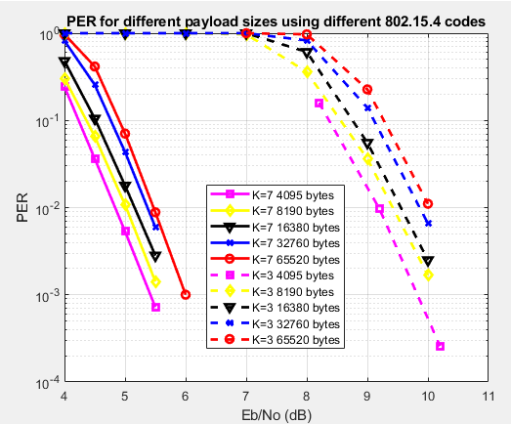
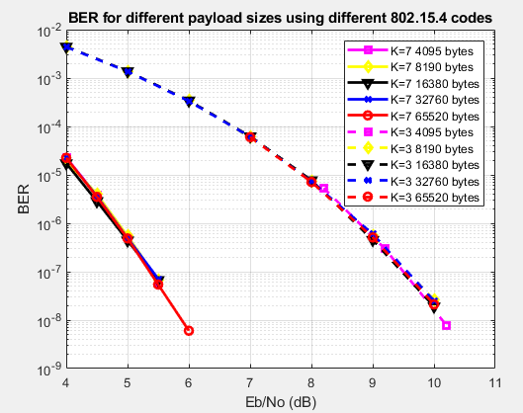
Background
Current codes defined in 802.15.4 and 802.15.4z are based on BCC
Below is BCC K=3 and K=7 performance in AWGN channel
Shannon placed an upper bound on code rate for a given BW and SNR, or equivalently a minimum SNR for a given code rate and BW.
Shannon limit for rate ½ code using BPSK or QPSK (1 bit/dim) is SNR=Eb/No=0dB.
For 1% PER, 3e-7 BER, the 802.15.4 code with K=3 is 9.2dB away from Shannon!

Slide 4
“Near” Shannon Capacity Codes
LDPC (Gallagher 1963) [2]
shown to reach within 0.0045dB from the Shannon limit [3]
amenable to parallelization (better latency)
Turbo (Berrou 1993) [4]
Polar (Arikan 2008) [5]
based on idea of channel polarization

Slide 5
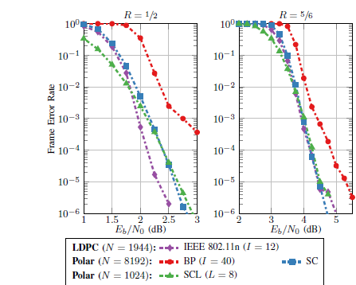
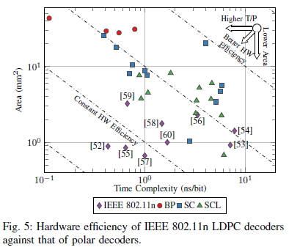
IEEE 802.11n vs Polar codes
[6] 90nm CMOS using standard Dennard scaling laws
Area scales as s² and operating frequency scales as 1/s, where s is the technology feature size
Note: BP = belief propagation
SC = successive cancellation
SCL = successive cancellation list
Note: BP = belief propagation
SC = successive cancellation
SCL = successive cancellation list
Polar Decoders are not as efficient as LDPC decoders

Slide 6
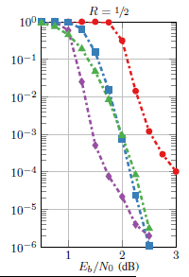
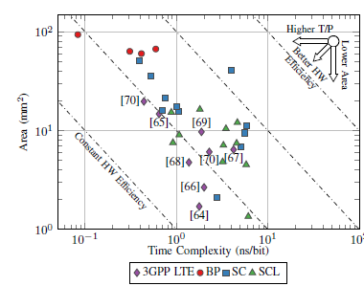
Polar vs 3GPP Turbo Results
Error floor associated with 3GPP LTE Turbo codes
due to some combination of block size and coding rate, rate matching module leads to bad interactions between puncturing and interleaving in the turbo encoder structure . With low Hamming weights, small amounts of channel noise can induce the decoder to make completely wrong decisions, resulting in very high block error rates [7]
Becomes worse at higher code rates [8]
Y-axis : FER

Slide 7
Simulation Scenario
AWGN channel
Floating point sims
Soft decisions
LDPC uses layer belief propagation with offset min-sum approximations with variable number of iterations

Slide 8
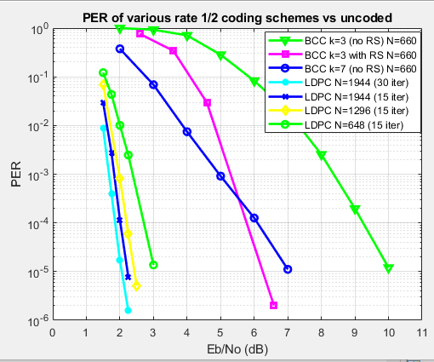
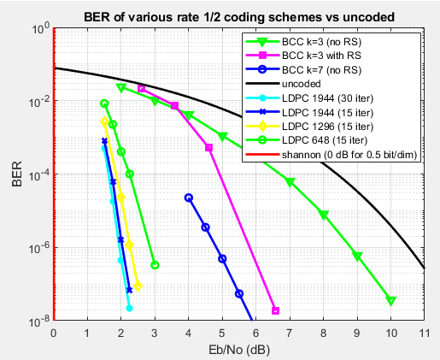
IEEE 802.11n LDPC vs BCC in AWGN
PER results match closely those of [6]
LDPC codes perform better for longer block lengths.
Reed-Solomon results have been adjusted by 10*log10(63/55)d

Slide 9
IEEE 802.11n LDPC vs BCC in AWGN
1944 block length LDPC code provides 3.2 dB /7 dB gain over K=7 / K=3 at 0.1% PER
648 block length LDPC codes provides 2.55 dB /6.05 dB gain over K=7 / K=3 at 0.1% PER

Slide 10
LDPC 648 on short payload
K <= 324
Step 1: Encoder finds parity bits by appending zeros to K information bits
Step 2: Ignore 324-K zeros and send K information bits along with 324 parity bits.
Note: Coding rate is now K/(K+324)
K information Bits
324-K zeros
324 parity bits
K information Bits
324 parity bits

Slide 11
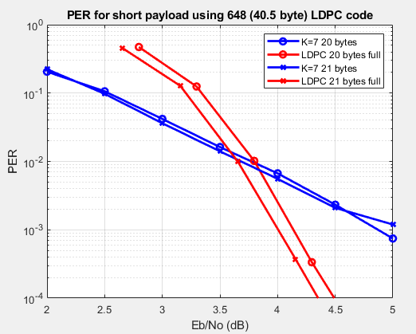
Performance on short payloads
Energy per bit penalty of (K+324)/(2K)
SNR = Eb/No * rho, where rho is effective # bits per 2D
For short payload LDPC, rho = 2*K/(K+324)
For K=7 BCC with r=1/2, rho = 1
Payload size | Eb/No penalty
20 bytes | 1.8 dB
21 bytes | 1.66 dB
https://grouper.ieee.org/groups/802/15/calendar.html
Payload sizes of 21 bytes or greater benefit from LDPC when compared with K=7 BCC

Slide 12
Gains Expected from LDPC
K=3 packet length | PER | BER | LDPC gain (dB)
4095 bytes | 1% | 3e-7 at 9.2 dB | 7.2
4095 bytes | .1% | 3e-8 at 9.9 dB | 7.7
K=7 packet length | PER | BER | LDPC gain (dB)
4095 bytes | 1% | 1e-6 at 4.8 dB | 2.9
4095 bytes | 0.1% | 1e-7 at 5.4 dB | 3.3
Larger gains expected from LDPC for larger payload sizes

Slide 13
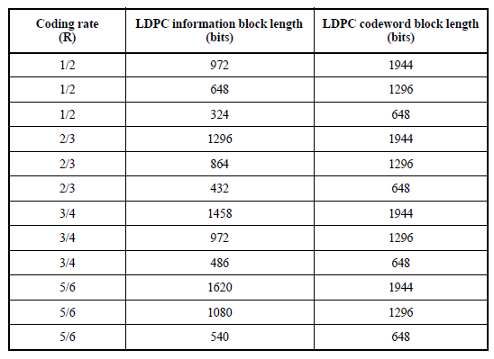
LDPC in IEEE 802.11n
Decoder supports all code lengths 648, 1296, and 1944
It also supports code rates ½, 2/3, ¾, and 5/6
12 PCMs (Parity Check Matrices) defined

Slide 14
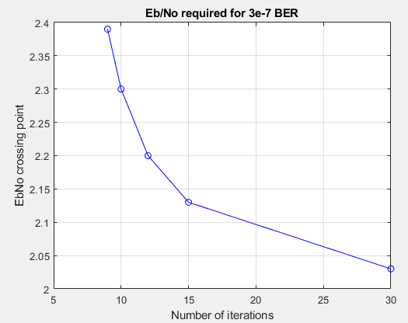
802.11n LDPC Performance vs Iterations
15 iterations seems like a good compromise

Slide 15
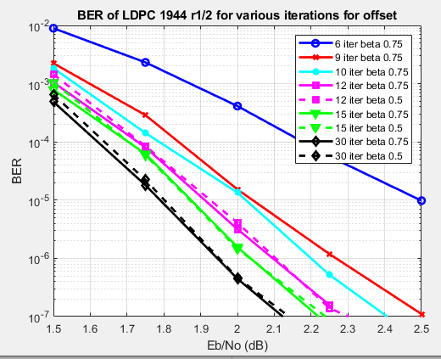
Offset min-sum approx. for 802.11n LDPC
Chen showed that the offset min-sum decoding algorithm with 5 bit uniform quantization could achieve same BER as that of floating point SP and BCJR with less than 0.1 dB penalty [9]
Beta values of 0.5 and 0.75 are good choices

Slide 16
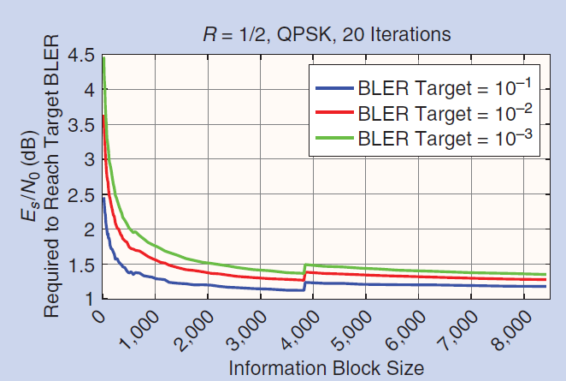
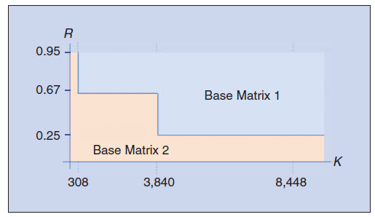
LDPC in 5G NR [10]
Allows for HARQ operation using incremental redundancy
2 block sizes : 8448 and 3840, 51 PCMs for each base matrix
Full results can be found in [11]
Parameter | Base Matrix 1 | Base Matrix 2
Min code rate | 1/3 | 1/5
Max information block size | 8448 | 3840

Slide 17
Conclusions
LDPC was successfully introduced in 802.11n [12] and 5G NR as well as other standard bodies (e.g., 802.15.3c, 802.11ad/ay, 802.16e, 802.3an, and DVB-S2) and is a mature technology that should be considered in IEEE 802.15.4ab
LDPC provides substantial coding gains for long payloads and SNR gains for short payloads (e.g. 21 bytes)
Implementation considerations
LDPC decoder has area < 1mm² in 90nm CMOS
LDPC with 15 iterations seems like a good compromise
If using offset-min-sum approximation, beta values of 0.5 and 0.75 are good choices

Slide 18
Strawpoll
Are you in favor of having an optional LDPC coding scheme introduced in 802.15.4ab?
Y
N
Abstain

Slide 19
References
[1] 15-21-297-01 15.4.ab Technical Guidance Doc
[2] R.G. Gallagher, “Low-Density Parity-Check Codes”. Cambridge, MA : MIT Press, 1963.
[3] Chung, et al, “On the design of low-density parity-check codes within 0.0045dB of the Shannon limit”, IEEE Commun. Letters, vol. 5, no.2, pp.58-60, February 2001.
[4] Berrou, et al, “Near Shannon Limit Error – Correcting coding and decoding : Turbo Codes”, Proceedings of ICC ’93 – IEEE International Conference on Communications
[5] Arikan, “A performance comparison of polar codes and Reed-Muller codes”, IEEE Communications Letters, 2008, vol. 12, issue 6.
[6] Balatsoukas-Stimming, Giard, Burg, “Comparison of Polar Decoders with Existing Low-Density Parity-Check and Turbo Decoders”, 2017 IEEE WCNC
[7] J.-F. Cheng, A. Nimbalker, Y. Blankenship, B. Classon, and T. Blankenship, “Analysis of circular buffer rate matching for LTE turbo code,” in Proc. IEEE 68th Vehicular Technology Conference (VTC 2008-Fall), Calgary, Canada, Sept. 2008.
[8] 3GPP R1-164359
[9] Chen, Dholakia, Eleftheriou, Fossorier, Hu, “Reduced-complexity decoding of LDPC codes”, IEEE Trans. On Communications, vol 53, pp. 1288-1299, Aug 2005.
[10] Hui, Sandberg, Blankenship, Andersson, Grosjean, “Channel Coding in 5G New Radio: A Tutorial Overview and Performance Comparison with 4G LTE”, in IEEE Vehicular Technology Magazine, vol. 13, Issue #4.
[11] 3GPP R1-1610600
[12] IEEE 802.11 Wireless LANs WWiSE Proposal: High Throughput Extension to the 802.11 Standard, IEEE 11-04-0886-06-000n, 2005

Slide 20
Appendix

Slide 21
LDPC on short payload (truncate parity)
K <= 324
Step 1: Encoder finds parity bits by appending zeros to K information bits
Step 2: Ignore 324-K zeros and send K information bits along with first K parity bits.
Note: Coding rate maintained at 1/2
K information Bits
324-K zeros
324 parity bits
K information Bits
K parity bits

Slide 22
Short Payloads

