Slide 1
Project: IEEE P802.15 Working Group for Wireless Personal Area Networks (WPANs)
Submission Title: [UWB sensing methods and KPIs in 802.15]
Date Submitted: []
Source: [Xiaohui Peng, David Xun Yang, Ziyang Guo, Stephen McCann] Company [Huawei Technologies]
Re: [Input to the Working Group]
Abstract: [Presentation, UWB in 802.15, sensing]
Purpose: []
Notice: This document has been prepared to assist the IEEE P802.15. It is offered as a basis for discussion and is not binding on the contributing individual(s) or organization(s). The material in this document is subject to change in form and content after further study. The contributor(s) reserve(s) the right to add, amend or withdraw material contained herein.
Release: The contributor acknowledges and accepts that this contribution becomes the property of IEEE and may be made publicly available by P802.15.

Slide 2
PAR Objective | Proposed Solution (how addressed)
Safeguards so that the high throughput data use cases will not cause significant disruption to low duty-cycle ranging use cases
Interference mitigation techniques to support higher density and higher traffic use cases
Other coexistence improvement
Backward compatibility with enhanced ranging capable devices (ERDEVs)
Improved link budget and/or reduced air-time
Additional channels and operating frequencies
Improvements to accuracy / precision / reliability and interoperability for high-integrity ranging
Reduced complexity and power consumption
Hybrid operation with narrowband signaling to assist UWB
Enhanced native discovery and connection setup mechanisms
Sensing capabilities to support presence detection and environment mapping | RSS method, Doppler method, ranging method, DOA method, joint method, reflection method, real antenna array method, virtual antenna array method
Low-power low-latency streaming
Higher data-rate streaming allowing at least 50 Mbit/s of throughput
Support for peer-to-peer, peer-to-multi-peer, and station-to-infrastructure protocols
Infrastructure synchronization mechanisms

Slide 3
Presence detection using UWB

Slide 4
Presence detection
Presence detection detects the position change of an object with respect to time or its reference point, which is typically described by displacement, direction, velocity or acceleration.
The purpose of presence detection using an UWB device or UWB network is to
  Identify the presence of a target
  Determine the number of targets
  Identify the type of target
  Monitor the vital sign
  Recognize the gesture
  Detect a moving target
  Measure the range of device-free targets
in a given environment [2].
Presence detection can be applied to many scenarios including [2]
  Smart home, e.g., light and air condition control
  Security, e.g., intrusion detection in pre-defined areas
  Health care, e.g., fall detection of the elderly and children
  Game control, e.g., gesture control for VR game

Slide 5
Presence detection – RSS method
RSS variation: The presence of an object (e.g., human and robot) will lead to RSS (Received Signal Strength) variations, especially when the LOS (line of sight) path is blocked by a moving target.
Operation mode
  Using a pair of links, only the presence of a target can be detected
  Using a UWB network, both the presence and the activity area can be detected
RSS information can be extracted from CIRs (channel impulse response)
Human presence blocks the LOS path between node2 and node3

Slide 6
Presence detection – KPIs of RSS method
  (Note: The material below builds upon the definitions presented in [1].)
  Receiver Sensitivity: The minimum power level at which the receiving node is able to detect the transmitted signal.
  E.g., -70dBm is a requirement that the received signal strength should be larger than -70dBm.
  Range Coverage: The maximum allowable distance from a sensing device to the target within which the SNR is above a pre-defined threshold.
  E.g., <5m@13dB indicates that the maximum allowable distance from a sensing device to the target with a 13dB SNR threshold is 5 meters.
  Field of View (FOV): The coverage area of a sensing device in terms of angle.
  E.g., ±50˚ is a requirement that the coverage area of a sensing device is ±50˚.
  Probability of Detection: The ratio of the number of correct predictions to the number of all aimed samples in terms of gestures/activities/motions.
  E.g., >95% is a requirement that the percentage of correct detections is greater than 95%.

Slide 7
Presence detection – Doppler method
Doppler information: UWB sensors can be used to measure the Doppler effect caused by a moving target.
Doppler effect is mainly determined by
  The operation frequency
  The target speed relative to the sensor
  The RCS (Radar Cross Section) of the measured target
Operation mode
  Mono-static mode: this mode contains only one sensor, and can only detect the radial speed of a target
  Multi-static mode: this mode contains multiple spatially diverse sensors, and can detect the absolute velocity of a target
Mono-static mode
Multi-static mode

Slide 8
Presence detection – KPIs of Doppler method
  (Note: The material below builds upon the definitions presented in [1].)
  Velocity Resolution: The minimum radial velocity difference required for a sensing device to distinguish between two targets moving in the same range.
  E.g., 0.1m/s indicates that two targets are distinguishable if their velocity difference is greater than 0.1m/s.
  Velocity Accuracy: The difference between the estimated velocity and the actual velocity of a target.
  E.g., 0.2m/s is a requirement that the difference between the estimated velocity and the actual velocity is less than 0.2m/s.
  Range Coverage: The maximum allowable distance from a sensing device to the target within which the SNR is above a pre-defined threshold.
  E.g., < 5m@13dB indicates that the maximum allowable distance from a sensing device to the target with a 13dB SNR threshold is 5 meters.
  Field of View (FOV): The coverage area of a sensing device in terms of angle.
  E.g., ±50˚ is a requirement that the coverage area of a sensing device is ±50˚.
  Probability of Detection: The ratio of the number of correct predictions to the number of all aimed samples in terms of gestures/activities/motions.
  E.g., >95% is a requirement that the percentage of correct detections is greater than 95%.

Slide 9
Presence detection – Ranging method
Range information: UWB sensors can be used to measure the propagation distance of the signal reflected by a target.
Ranging performance is mainly determined by
  The bandwidth (≥500MHz)
  The SNR (Signal to Noise Ratio)
  The RCS (Radar Cross Section) of the measured target
Operation mode
  Mono-static mode: this mode contains only one sensor, and can be used to measure the two-way propagation delay from the sensor to the target
  Multi-static mode: this mode contains multiple spatially diverse sensors, and can be used to measure the location of the target
Mono-static mode
Multi-static mode

Slide 10
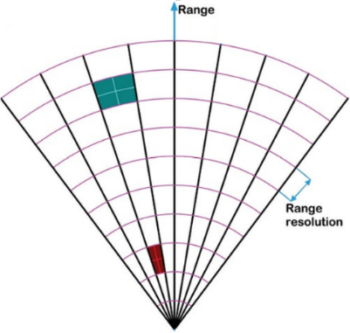
Presence detection – KPIs of ranging method
  (Note: The material below builds upon the definitions presented in [1].)
  Range Resolution: The minimum range difference required for a sensing device to distinguish between two targets in the same direction.
  E.g., 50cm indicates that two targets are distinguishable if their range difference is greater than 50cm.
  Range Accuracy: The difference between
  the estimated range and the actual range
  of a target.
  E.g., 10cm is a requirement that the difference
  between the estimated range and the actual range
  is less than 10cm.
  Range Coverage: The maximum allowable distance from a sensing device to the target within which the SNR is above a pre-defined threshold.
  E.g., < 5m@13dB indicates that the maximum allowable distance from a sensing device to the target with a 13dB SNR threshold is 5 meters.
  Field of View (FOV): The coverage area of a sensing device in terms of angle.
  E.g., ±50˚ is a requirement that the coverage area of a sensing device is ±50˚.
  Probability of Detection: The ratio of the number of correct predictions to the number of all aimed samples in terms of gestures/activities/motions.
  E.g., >95% is a requirement that the percentage of correct detections is greater than 95%.

Slide 11
Presence detection – DOA method
Angle information: An UWB sensor with multiple antennas can be used to measure the DOA (direction of arrival) of a target.
DOA performance is mainly determined by
  The antenna array aperture
  The operation frequency
  The SNR (Signal to Noise Ratio)
  The RCS (Radar Cross Section) of the measured target
Operation mode
  Mono-static mode: this mode contains only one sensor with multiple antennas
  Multi-static mode: this mode contains multiple spatially diverse sensors and each sensor has multiple antennas
Mono-static mode
Multi-static mode

Slide 12

Presence detection – KPIs of DOA method
  (Note: The material below builds upon the definitions presented in [1].)
  Angular Resolution (Horizontal / Vertical): The minimum angle difference required for a sensing device to distinguish between two targets in the same range.
  E.g., 10˚ indicates that two targets are distinguishable if their angle difference is greater than 10˚.
  Angular Accuracy (Horizontal / Vertical): The difference between the estimated angle and the actual angle of an object.
  E.g., 1˚ is a requirement that the difference between the estimated angle and the actual angle of an object is less than 1˚.
  Range Coverage: The maximum allowable distance from a sensing device to the target within which the SNR is above a pre-defined threshold.
  E.g., < 5m@13dB indicates that the maximum allowable distance from a sensing device to the target with a 13dB SNR threshold is 5 meters.
  Field of View (FOV): The coverage area of a sensing device in terms of angle.
  E.g., ±50˚ is a requirement that the coverage area of a sensing device is ±50˚.
  Probability of Detection: The ratio of the number of correct
  predictions to the number of all aimed samples in terms of
  gesture/activities/motions.
  E.g., >95% is a requirement that the percentage of correct detections
  is greater than 95%.
Angular resolution

Slide 13
Presence detection – joint method
Doppler+Range
  Target radial velocity
  SNR (Signal to Noise Ratio)
  Operation frequency and bandwidth (≥500MHz)
  RCS (Radar Cross Section) of the measured target
Doppler+Angle
  Target radial velocity
  Operation frequency
  SNR (Signal to Noise Ratio)
  Antenna array aperture
  RCS (Radar Cross Section) of the measured target
Angle+Range
  Antenna array aperture
  Bandwidth (≥500MHz)
  SNR (Signal to Noise Ratio)
  RCS (Radar Cross Section) of the measured target
Angle+Range+Doppler
  Antenna array aperture
  Operation frequency and Bandwidth (≥500MHz)
  SNR (Signal to Noise Ratio)
  Target radial velocity
  RCS (Radar Cross Section) of the measured target

Slide 14
Presence detection – summary of KPIs
The proposed KPIs can be grouped into 4 different categories
Method | Coverage |  | Resolution |  |  | Accuracy |  |  | Other performance
 | Range (m) | FOV (˚) | Range (m) | Angle (˚) | Velocity (m/s) | Range (m) | Angle (˚) | Velocity (m/s) | Probability of detection (%) | Receiver sensitivity (dBm)
RSS method | √ | √ | NA | NA | NA | NA | NA | NA | √ | √
Doppler method | √ | √ | NA | NA | √ | NA | NA | √ | √ | NA
Ranging method | √ | √ | √ | NA | NA | √ | NA | NA | √ | NA
DOA method | √ | √ | NA | √ | NA | NA | √ | NA | √ | NA
Joint method | √ | √ | √ | √ | √ | √ | √ | √ | √ | NA

Slide 15
Environment mapping using UWB

Slide 16
Environment mapping
The purpose of environment mapping using a UWB device or UWB network is to
  Identify the environment (e.g., determine whether the environment is a living room, a meeting room or another environment)
  Determine the rough structure of the environment
  Reconstruct a two-dimensional map of the environment
  Reconstruct a three-dimensional map of the environment
Environment mapping can be applied to many scenarios including
  Smart home, e.g., indoor robot navigation
  Security, e.g., environment structure identification for fire rescue
  Game control, e.g., digital map construction for virtual reality games

Slide 17
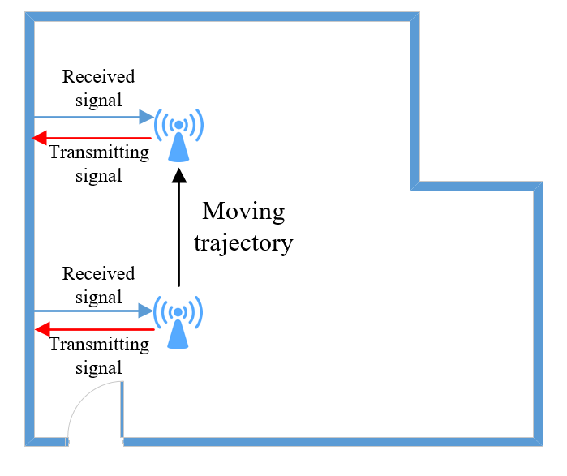
Environment mapping– Reflection method
The principles behind environment mapping using a reflection method are as follows:
  First, a UWB sensor is mounted on a platform that can move along at least two orthogonal directions of the building
  Second, determine the locations of all the walls. A UWB sensor radiates a signal and receives the signal reflected by the wall to infer the position of the scatter point
  Third, determine the start and end points of all the walls
  Last, determine how the different walls are connected
Mapping performance is mainly determined by
  The bandwidth
  The SNR (Signal to Noise Ratio)
  The dynamic range, which is defined as the ratio between the maximum and the minimum intensity of the image.
The imaging accuracy is limited by the accuracy of UWB sensor position

Slide 18
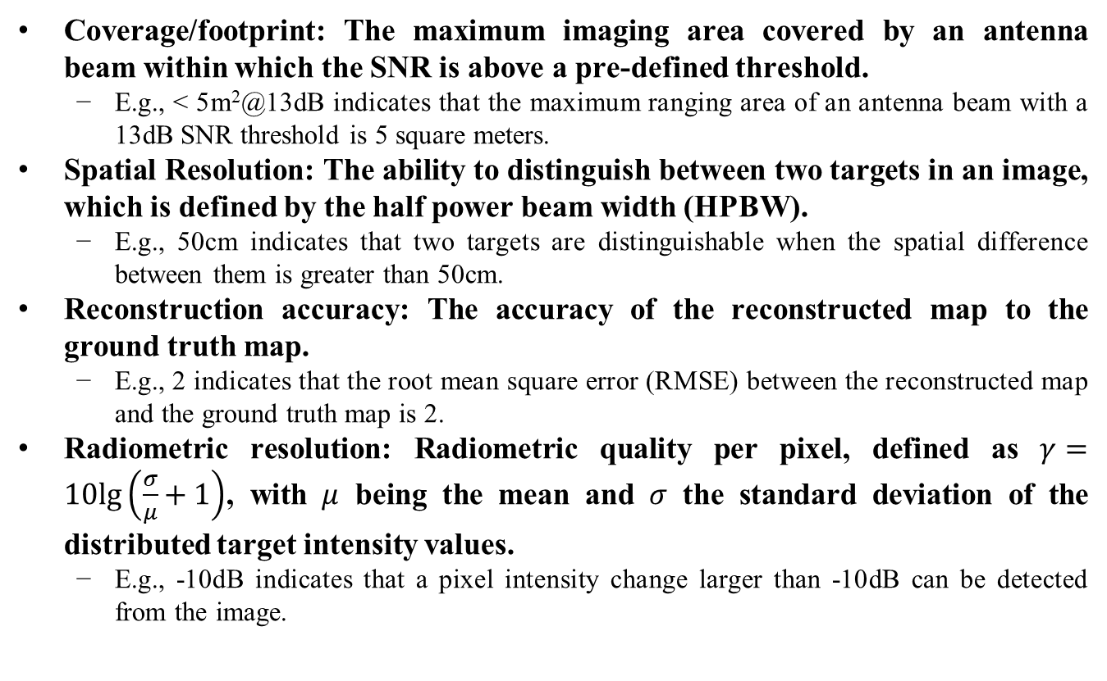
Environment mapping– KPIs of reflection method
  Coverage/footprint: The maximum imaging area covered by an antenna beam within which the SNR is above a pre-defined threshold.
  E.g., < 5m²@13dB indicates that the maximum ranging area of an antenna beam with a 13dB SNR threshold is 5 square meters.
  Spatial Resolution: The ability to distinguish between two targets in an image, which is defined by the half power beam width (HPBW).
  E.g., 50cm indicates that two targets are distinguishable when the spatial difference between them is greater than 50cm.
  Reconstruction accuracy: The accuracy of the reconstructed map to the ground truth map.
  E.g., 2 indicates that the root mean square error (RMSE) between the reconstructed map and the ground truth map is 2.
  Radiometric resolution: Radiometric quality per pixel, defined as $γ=10lg\left(\frac{σ}{μ}+1\right)$, with $μ$ being the mean and $σ$ the standard deviation of the distributed target intensity values.
  E.g., -10dB indicates that a pixel intensity change larger than -10dB can be detected from the image.

Slide 19
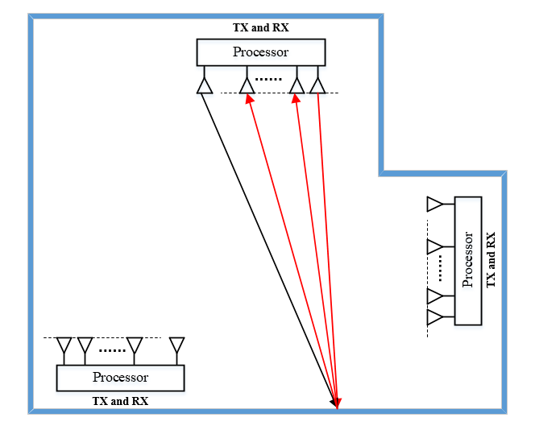
Environment mapping– Real antenna array method
The principles behind environment mapping using a real antenna array are as follows:
  First, some UWB nodes with antenna arrays are deployed in the environment
  Second, determine the locations of all the walls. A UWB sensor radiates a signal and receives the signal reflected by the wall using multiple antennas to infer the range and the angle of the scatter point
  Third, determine the start and end points of all the walls
  Last, determine how different walls are connected
Mapping performance is mainly determined by
  The bandwidth
  The SNR (Signal to Noise Ratio)
  The dynamic range, which is defined as the ratio between the maximum and the minimum intensity of the image.
  The antenna array aperture
  The operation frequency

Slide 20
Environment mapping– KPIs of real antenna array method 1/2
  Coverage/footprint: The maximum imaging area covered by a real antenna beam within which the SNR is above a pre-defined threshold.
  E.g., < 5m²@13dB indicates that the maximum imaging area of a real antenna beam with a 13dB SNR threshold is 5 square meters.
Spatial Resolution: The ability to distinguish between two targets in an image, which is defined by half power beam width (HPBW).
  E.g., 50cm indicates that two targets are distinguishable when the spatial difference between them is greater than 50cm.
  Integrated side lobe ratio (ISLR) : The ratio of the total power in all of the side lobes to the power in the main lobe.
  E.g., -13dB indicates that the ratio of the total power in all of the side lobes to the power in the main lobe of a point target is -13dB.
  Peak side lobe ratio (PSLR): The ratio of the peak intensity of the most prominent side lobe to the peak intensity of the main lobe.
  E.g., -13dB indicates that the ratio of the peak intensity of the most prominent side lobe to the peak intensity of the main lobe of a point target is -13dB.

Slide 21
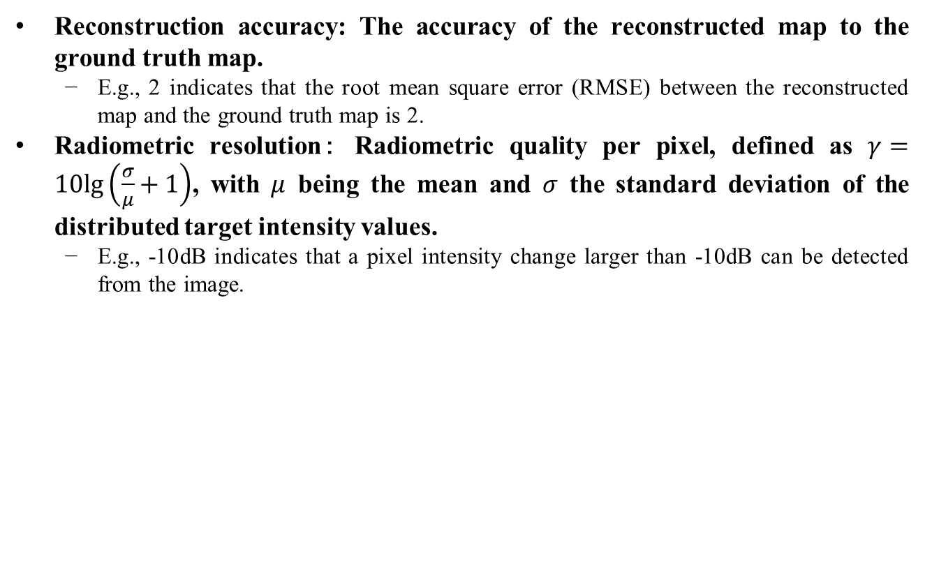
Environment mapping– KPIs of real antenna array method 2/2
  Reconstruction accuracy: The accuracy of the reconstructed map to the ground truth map.
  E.g., 2 indicates that the root mean square error (RMSE) between the reconstructed map and the ground truth map is 2.
  Radiometric resolution： Radiometric quality per pixel, defined as $γ=10lg\left(\frac{σ}{μ}+1\right)$, with $μ$ being the mean and $σ$ the standard deviation of the distributed target intensity values.
  E.g., -10dB indicates that a pixel intensity change larger than -10dB can be detected from the image.

Slide 22
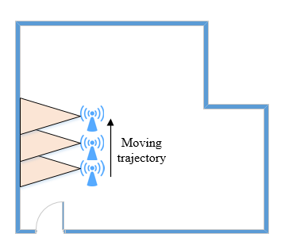
Environment mapping– Virtual antenna array method
The principles behind environment mapping using an virtual antenna array are as follows:
  First, a UWB sensor is mounted on a moving platform working as a SAR (synthetic aperture radar), which uses the motion of the radar antenna over a target region to provide finer spatial resolution than a conventional stationary real aperture radar
  Second, determine the locations of all the walls. A UWB sensor radiates a signal and receives the signal reflected by the wall with a moving antenna to infer the position of the scatter point
  Third, determine the start and end points of all the walls
  Last, determine how different walls are connected
Mapping performance is mainly determined by
  The bandwidth
  The SNR (Signal to Noise Ratio)
  The dynamic range, which is defined as the ratio between the maximum and the minimum intensity of the image.
  The virtual antenna aperture
  The operation frequency
  It requires accurate sensor position and motion compensation

Slide 23
Environment mapping– KPIs of Virtual antenna array method 1/2
  Coverage/footprint: The maximum imaging area covered by a virtual antenna beam within which the SNR is above a pre-defined threshold.
  E.g., < 5m²@13dB indicates that the maximum imaging area of a virtual antenna beam with a 13dB SNR threshold is 5 square meters.
Spatial Resolution: The ability to distinguish between two targets in an image, which is defined by half power beam width (HPBW).
  E.g., 50cm indicates that two targets are distinguishable when the spatial difference between them is greater than 50cm.
  Integrated side lobe ratio (ISLR) : The ratio of the total power in all of the side lobes to the power in the main lobe.
  E.g., -13dB indicates that the ratio of the total power in all of the side lobes to the power in the main lobe of a point target is -13dB.
  Peak side lobe ratio (PSLR): The ratio of the peak intensity of the most prominent side lobe to the peak intensity of the main lobe.
  E.g., -13dB indicates that the ratio of the peak intensity of the most prominent side lobe to the peak intensity of the main lobe of a point target is -13dB.

Slide 24
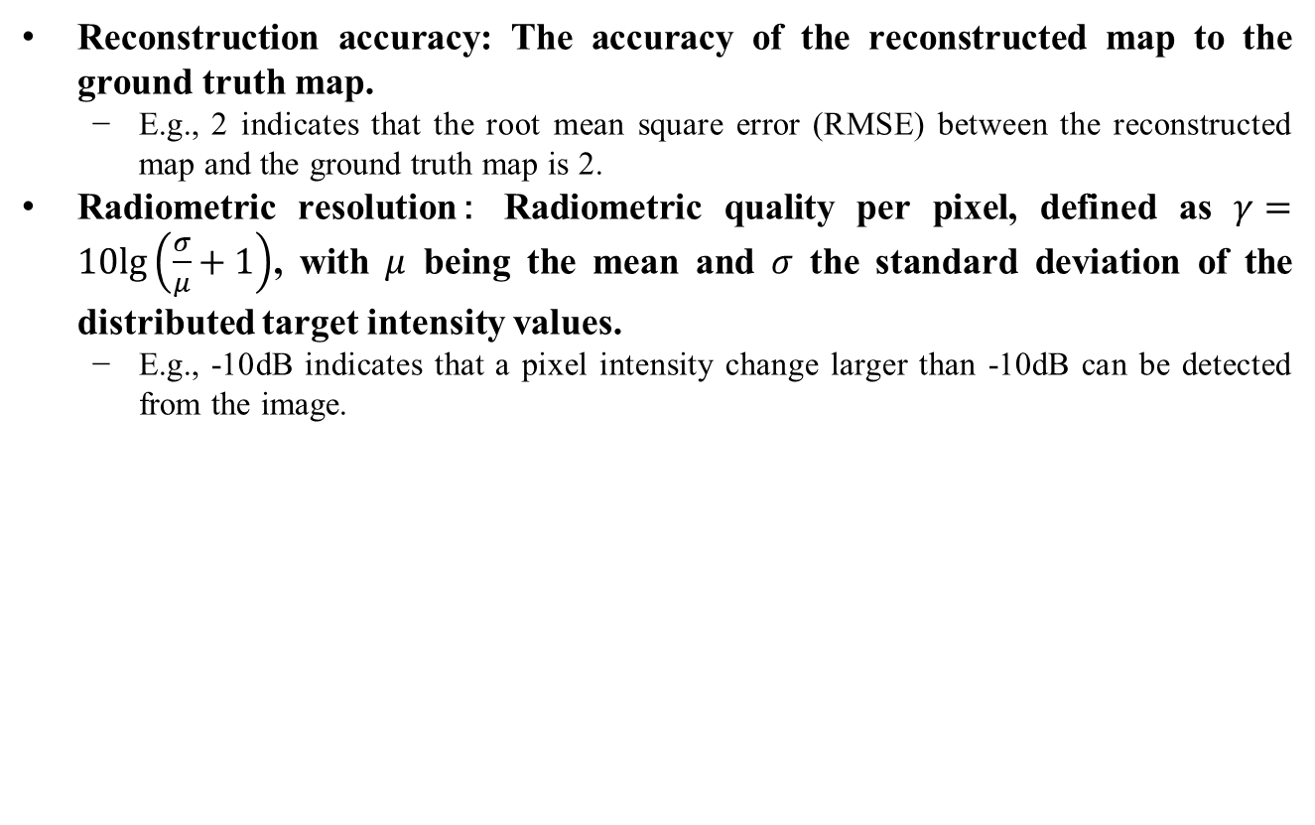
Environment mapping– KPIs of Virtual antenna array method 2/2
  Reconstruction accuracy: The accuracy of the reconstructed map to the ground truth map.
  E.g., 2 indicates that the root mean square error (RMSE) between the reconstructed map and the ground truth map is 2.
  Radiometric resolution： Radiometric quality per pixel, defined as $γ=10lg\left(\frac{σ}{μ}+1\right)$, with $μ$ being the mean and $σ$ the standard deviation of the distributed target intensity values.
  E.g., -10dB indicates that a pixel intensity change larger than -10dB can be detected from the image.

Slide 25
Environment mapping– KPI Summary
Method | Coverage | Resolution |  | Reconstruction accuracy | Other performance
 |  | Spatial resolution (m) | Radiometric resolution (˚) |  | ISLR | PSLR
Reflection method | √ | √ | √ | √ | NA | NA
Real antenna array method | √ | √ | √ | √ | √ | √
Virtual antenna array method | √ | √ | √ | √ | √ | √

Slide 26
References
Usage model terminology for WLAN Sensing, IEEE 802.11-20/0905r2.
Presence and proximity detection using WLAN Sensing, IEEE 802.11-19/1772r0.

