Slide 1
Project: IEEE P802.15 Working Group for Wireless Personal Area Networks (WPANs)
Submission Title: [Narrowband / UWB Coupling MAC]
Date Submitted: [17 September, 2021]
Source: [Mingyu Lee, Taeyoung Ha, Karthik Srinivasa Goplan, Aniruddh Rao Kabbinale, Ankur Bansal, Clint Chaplin, James Schuessler] Company [Samsung Electronics]
Address: [34, Seongchon-gil, Seocho-gu, Seoul, Korea]
E-Mail: [mg0218.lee@samsung.com]
Abstract: [Discussion of how NB and UWB signaling can cooperate to discover UWB device and establish a UWB connection with collision avoidance]
Purpose: [ ]
Notice: This document has been prepared to assist the IEEE P802.15. It is offered as a basis for discussion and is not binding on the authoring individual(s) or organization(s). The material in this document is subject to change in form and content after further study. The authors(s) reserve(s) the right to add, amend or withdraw material contained herein.
Release: The contributor acknowledges and accepts that this contribution becomes the property of IEEE and may be made publicly available by P802.15.
Mingyu Lee et al. (Samsung Electronics)

Slide 2
PAR Objective | Proposed Solution (how addressed)
Safeguards so that the high throughput data use cases will not cause significant disruption to low duty-cycle ranging use cases
Interference mitigation techniques to support higher density and higher traffic use cases
Other coexistence improvement
Backward compatibility with enhanced ranging capable devices (ERDEVs)
Improved link budget and/or reduced air-time
Additional channels and operating frequencies
Improvements to accuracy / precision / reliability and interoperability for high-integrity ranging
Reduced complexity and power consumption | Off-loading of functionality to lower-complexity/power NB PHY helps reduce complexity of “heavier” UWB sub-system and power consumption of UWB system
Hybrid operation with narrowband signaling to assist UWB | Exploit tightly coupled concurrent operation of NB to help UWB
Enhanced native discovery and connection setup mechanisms | Provide native discovery procedures and collision avoidance scheme based on the energy detection
Sensing capabilities to support presence detection and environment mapping
Low-power low-latency streaming
Higher data-rate streaming allowing at least 50 Mbit/s of throughput
Support for peer-to-peer, peer-to-multi-peer, and station-to-infrastructure protocols
Infrastructure synchronization mechanisms
Mingyu Lee et al. (Samsung Electronics)

Slide 3
Contents
Motivation
Assumptions
NB Channel Type 1 : Mirroring Channel
NB Channel Type 2: Discovery Channel
Collision Avoidance
Conclusions
Mingyu Lee et al. (Samsung Electronics)

Slide 4
Motivation
Currently, discovery of UWB devices without help of out-of-band (OOB) is not easy to be used, because some UWB parameters should be shared in advance between the devices before discovering each other via UWB
Furthermore, discovery using UWB consumes more energy than narrow band (NB)
In order to avoid collision, energy detection based schemes are cost/energy effective but it may not be the proper scheme for UWB because the spectral density of UWB is low
According to above, to discover UWB device and to avoid collision through energy detection, a MAC using NB coupled with UWB can be considered
Mingyu Lee et al. (Samsung Electronics)

Slide 5
Assumptions
The concept of NB & UWB coupling MAC in this contribution is based on the assumption that a new NB technology for UWB will be introduced
- The energy consumption of NB is much lower than that of UWB
- Data rate is enough to support the operations in this contribution
A device utilizes two antenna for NB and UWB, respectively.
NB clock and UWB clock are tightly synchronized
Mingyu Lee et al. (Samsung Electronics)

Slide 6
Mirroring Channel
This type of channel can be defined for each UWB channel (e.g., CH5, CH9)
The type of channel reflects the behavior of corresponding UWB channel
In this channel, advertisement packet can be sent by NB/UWB device which occupies UWB channel at the specific period as controller
Advertisement packet is used to announce that the specific period of UWB channel is being used
By listening this channel and receiving the advertisement packet, other devices can recognize whether the corresponding UWB channel is occupied or not
Controller in UWB shall listen the mirroring channels to find the available channel and time before establishing the connection
Mingyu Lee et al. (Samsung Electronics)

Slide 7
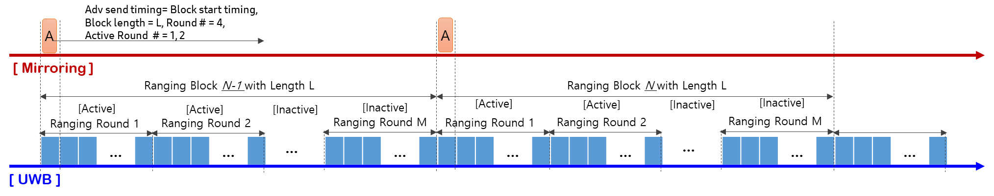
Example Operation with Mirroring Channel
Notations
A : Advertisement
Controller transmits an advertisement packet at every active ranging block/round in mirroring channel
This packet is used for notifying the occupation status of the corresponding UWB channel to other devices
This packet includes the information about the usage of the corresponding UWB channel
  Start time of ranging rounds, Length of Ranging Block, Number of Ranging Rounds, Index of Active Round, etc.
This packet may provide the information about the PHY parameters (e.g., BPRF/HRPF)
Controller scans the mirroring channels before establishing UWB connection to find the available period and avoid collisions
If the controller finds an idle period, it can send an advertisement packet for reserving the period in the corresponding UWB channel
Mingyu Lee et al. (Samsung Electronics)

Slide 8
Discovery Channel
Controller/Controlee (in UWB channel) can send discovery beacon in this channel
Discovery beacon can be treated same as the packets for device discovery in other wireless communication technologies (e.g. advertising packet in BLE)
Controller and controlee can exchange some messages for connection setup in this channel
To complete the connection setup procedure, controller shall find the available period in a UWB channel by listening mirroring channels
Mingyu Lee et al. (Samsung Electronics)

Slide 9
Example Operation with Discovery Channel
Notations
D : Discovery Beacon
CR : Connection Request
CC : Connection Confirmation
A : Advertisement
RAN : Ranging Access Network
NB/UWB device can transmit discovery beacon in this channel to find other devices
When a NB/UWB device receives the discovery beacon, it can send connection request to the device which transmits the discovery beacon for establishing UWB connection
The NB/UWB device which will be the controller in UWB communications scans the mirroring channels to find the available period in a UWB channel
After reserving the UWB channel by sending advertisement packet in the corresponding mirroring channel, the NB/UWB device (i.e. controller) start the connection setup process
Mingyu Lee et al. (Samsung Electronics)

Slide 10
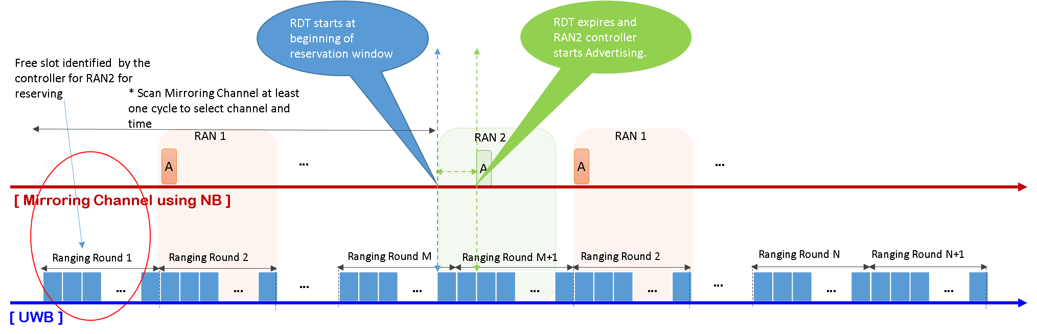
Collision Avoidance in Mirroring channel
Notations
A : Advertisement
RAN : Ranging Access Network
Collision Avoidance in Mirroring channel is necessary during reserving of open slots
  There are chances of two controllers choosing same time slot to be reserved.
We define a random delay timer - Reservation Delay Timer (RDT) to expire before the controllers starts advertising for reserving free slots
  RDT starts at the beginning of reservation window
  RDT can have a maximum value of difference between reservation window size and time duration of advertisement packet. This ensures the advertisement is transmitted completely within the reservation window that the controller wishes to reserve.
Mingyu Lee et al. (Samsung Electronics)

Slide 11
CA in Mirroring channel continued…
Notations
A : Advertisement
RAN : Ranging Access Network
Collision Avoidance in Mirroring channel is necessary during reserving of open slots
  There are chances of two controllers choosing same time slot to be reserved.
At any point during running of RDT, if channel is found busy, reservation is aborted in this cycle and attempted in a newly chosen slot in next cycle
From next cycle, post reservation, controller sends the advertisement at beginning of reservation window
Mingyu Lee et al. (Samsung Electronics)

Slide 12
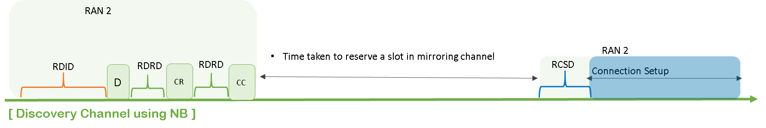
CA in Discovery Channel
Notations
RDID : Ranging Discovery Initial Delay
RDRD: Ranging Discovery Response Delay
RCSD: Ranging Connection Setup Delay
Collisions in discovery channel may happen between
  Discovery messages of two or more RANs
  Discovery message with connection request, connection response messages of two or more RANs
  Discovery, connection request and confirmation messages and connection setup messages
To address collision in discovery channel, we define a few timers and a back off strategy
We base our CA scheme on well established collision avoidance techniques in other wireless technologies
Mingyu Lee et al. (Samsung Electronics)

Slide 13
CA in Discovery Channel continued…
Notations
RDID : Ranging Discovery Initial Delay
RDRD: Ranging Discovery Response Delay
RCSD: Ranging Connection Setup Delay
Among Discovery, Connection Request and Connection Confirmation messages, we define 2 delay timers to address collision
  Ranging Discovery Initial Delay (RDID), Ranging Discovery Response Delay (RDRD)
  RDID > RDRD; Connection request and connection response has higher priority than a new discovery beacon.
For connection setup message, we define a delay timer to address collision
  Ranging Connection Setup Delay (RCSD)
  The 1st connection setup message has to wait for RCSD period of idle channel before transmitting. Next set of messages within connection setup need not wait and can respond as soon as the channel is found to be idle.
  Connection setup is given higher priority than Discovery. So RDID > RCSD > RDRD
For any of the messages and at any point of time, if the channel is found to be busy, follow a random binary exponential back off strategy.
Mingyu Lee et al. (Samsung Electronics)

Slide 14
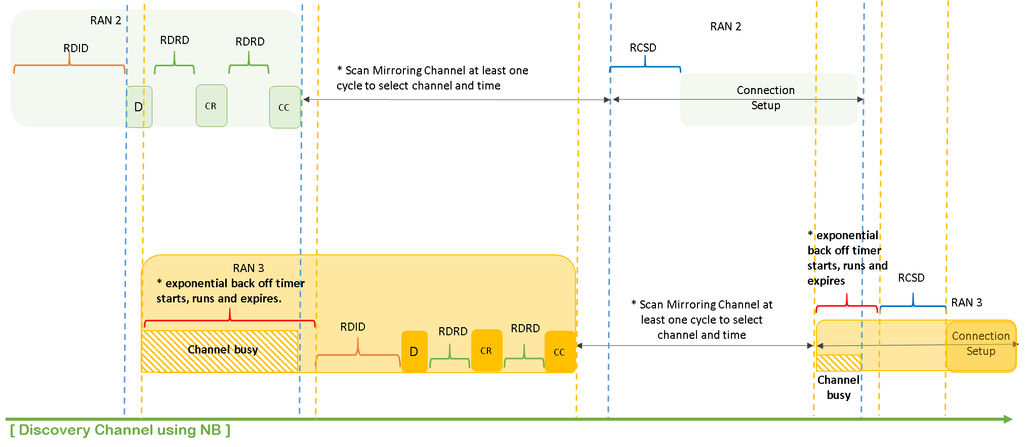
Example CA scenario in Discovery Channel
Notations
RDID : Ranging Discovery Initial Delay
RDRD: Ranging Discovery Response Delay
RCSD: Ranging Connection Setup Delay
Mingyu Lee et al. (Samsung Electronics)

Slide 15
Conclusions
By coupling NB with UWB, clear channel assessment (CCA) for UWB channels and native discovery/connection is possible
NB mirroring channel is introduced for CCA
NB discovery channel is introduced for native discovery/connection
CA method in the newly introduced NB channels is provided
NB-assisted UWB may reduce the power consumption of device and avoid collision between UWB communications
Mingyu Lee et al. (Samsung Electronics)

