Slide 1
Project: IEEE P802.15 Working Group for Wireless Personal Area Networks (WPANs)
Submission Title: [Higher bit rate for the HRP UWB PHY]
Date Submitted: [17th Sep 2021]
Source: [Chenchen Liu] Company [Huawei]
Address [Huawei base, Shenzhen, CHINA]
E-Mail:[liuchenchen1@huawei.com]
Re: [Proposed enhancements to the HRP UWB PHY]
Abstract: [Talk about ways to support a higher data rate with the HRP UWB PHY ]
Purpose: []
Notice: This document has been prepared to assist the IEEE P802.15. It is offered as a basis for discussion and is not binding on the contributing individual(s) or organization(s). The material in this document is subject to change in form and content after further study. The contributor(s) reserve(s) the right to add, amend or withdraw material contained herein.
Release: The contributor acknowledges and accepts that this contribution becomes the property of IEEE and may be made publicly available by P802.15.

Slide 2
Backgroud
It has been agreed to increase the data rate to at least of 50Mbits/s in the PAR:
PAR Objective | Proposed Solution (how addressed)
Safeguards so that the high throughput data use cases will not cause significant disruption to low duty-cycle ranging use cases
Interference mitigation techniques to support higher density and higher traffic use cases
Other coexistence improvement
Backward compatibility with enhanced ranging capable devices (ERDEVs)
Improved link budget and/or reduced air-time
Additional channels and operating frequencies
Improvements to accuracy / precision / reliability and interoperability for high-integrity ranging
Reduced complexity and power consumption
Hybrid operation with narrowband signaling to assist UWB
Enhanced native discovery and connection setup mechanisms
Sensing capabilities to support presence detection and environment mapping
Low-power low-latency streaming
Higher data-rate streaming allowing at least 50 Mbit/s of throughput
Support for peer-to-peer, peer-to-multi-peer, and station-to-infrastructure protocols
Infrastructure synchronization mechanisms

Slide 3
Ways to achieve higher rates :
Option 1：Increasing the symbol rate
Option 2： Higher modulation level
Option 3： Code Puncturing
Option 4： Multiple streams
Option 5： Complex base band
…

Slide 4
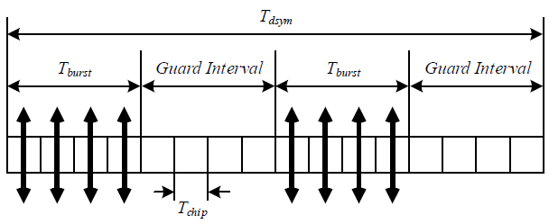




Option 1： Increasing symbol rate
27/31 Mbps
$$g_{0}$$
$$g_{1}$$
Note: $g_{0}$ and $g_{1}$ are the coded bits; higher data rates can be achieved by further reducing the number of impulse for each coded bits
54/62 Mbps
$$g_{0}$$
$$g_{1}$$

Slide 5


Option 2： Higher modulation level
Make use of the polarity of each pulse to carry more coded bits
$$g_{0}$$
$$g_{1}$$
$$g_{2}$$
$$g_{3}$$

Slide 6
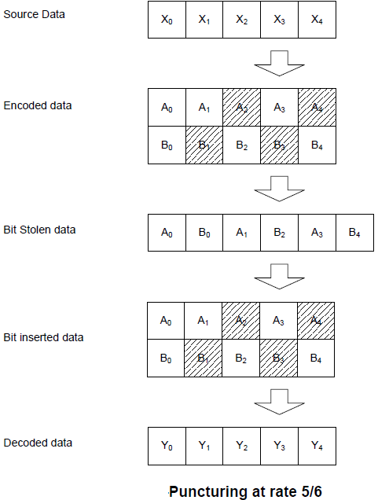

Option 3： Code Puncturing
For 802.15.4z, puncturing can be applied to the K=7 convolutional encoder to achieve a higher data rate. E.g., 1/2 to 5/6, 31M $→$ 51.67M

Slide 7
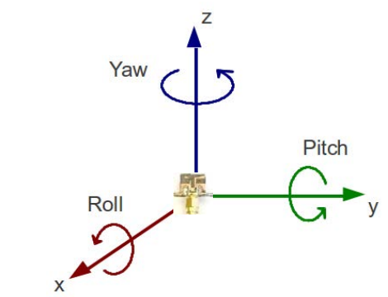
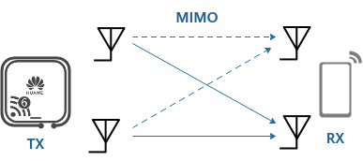
Option 4： Multiple streams
Some UWB products are already equipped with MIMO to do AoA estimation for localization.

Slide 8
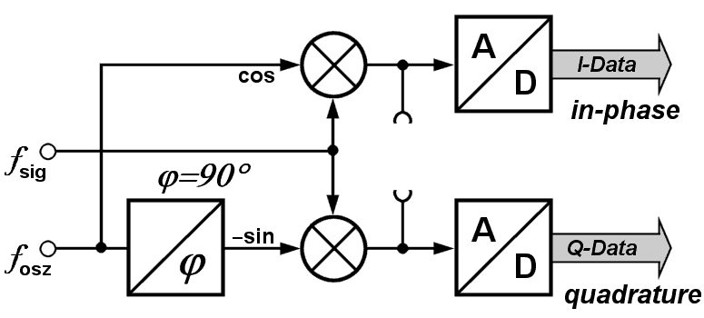
Option 5： Complex base band
Make full use of In-phase and quadrature components

Slide 9
Summary
Any combination of the ways talked can be used together to further improve the data rate
Option1 and Option3 are easy to implement， but may decrease the robustness of system
Option2 can preserve the data symbol structure with increased demodulation complexity
Option4 and Option5 are more challenge to implement，which may need some modification of the system architecture

Slide 10
THE END

