Slide 1
Project: P802.15 Working Group for Wireless Specialty Networks
Submission Title: Report of joint session 15.4ab, 15.14, 15.15 and 802.1 webinar
Date Submitted: September 16th, 2021
Source: Marco Hernandez¹, Ryuji Kohno^{1,2}, Takumi Kobayashi^{1,2}, Minsoo Kim¹
Company: ¹Yokosuka Research Park International Alliance Institute (YRP-IAI), Japan; ²Yokohama National University (YNU), Japan
Address: ¹YRP 1, 3-4 Hikarino-oka, Yokosuka, 239-0847, Japan; ²79-5 Tokiwadai, Hodogaya-ku, Yokohama, 240-8501 Japan
Voice: ²+81 90-5408-0611, Fax: ²+81-45-383-5528 E-Mail:[Marco.Hernandez@ieee.org; kohno@ynu.ac.jp; kohno@yrp-iai.jp]]
Abstract:
Purpose: Material for discussion in P802.15.6a.
Notice: This document has been prepared to assist P802.15.6a. It is offered as a basis for discussion and is not binding on the contributing individual(s) or organization(s). The material in this document is subject to change in form and content after further study. The contributor(s) reserve(s) the right to add, amend or withdraw material contained herein.
Release: The contributor acknowledges and accepts that this contribution becomes the property of IEEE and may be made publicly available by P802.15.6a.

Slide 2
15.4ab, 15.14, 15.15
Review & discussion for call for TG chair
  According to OM: chair appointed by the WG chair and affirmed by the TG & other officers.
Call for participation to external SDOs (standard development organization)
SG15 development update
  Discussion on how to best separate the different NB PHYs
Maintenance of 15.4 and convergence to 15.14 and 15.15

Slide 3
802.1 webinar
Overview of 802.1 WG

Slide 6
IEEE Std 802.1AC specifies the MAC Service provided by all IEEE 802 LANs
IEEE Std 802.1Q specifies interworking among IEEE 802 LANs by bridging at the MAC sublayer
Interworking can be heterogeneous (across different 802 technologies).

Slide 7
802.1Q interworking
Description of bridge architecture, topologies (RSTP,..), network virtualization, link aggegation

Slide 8
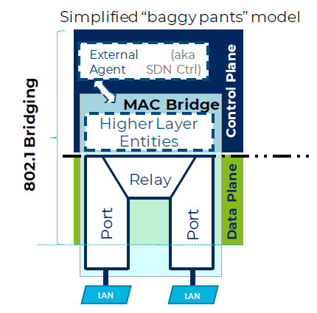
Control protocols are implemented as
Higher Layer Entities
The data plane is comprised of
—A MAC Relay and
—At least two ports

Slide 9
802.1 TIME-SENSITIVE NETWORKING

Slide 10
TSN profiles narrow down the interworking service / traffic
Details in Std and TGs

